Slide 1
What’s the Poop?
Kevin Conrad, DVM, CCRP

Slide 2
Introduction
In 2013: 1 article about Microbiome Restoration
Today, there are over 3,000 articles written each year.

Slide 3
Agenda
Topic 1: It all started 2013
Topic 2: Research from previous Guide Dog school
Topic 3: Fecal Transplant technique
Topic 4: The Future of Microbiome Restoration

Slide 4
Topic 1: How we started
1. 2013 Guide Dog School with severe diarrhea problem
Stress, diet, giardia
200+ dogs, metronidazole monthly
2. One article about fecal transplants for Crohn’s disease
3. Camaro the Schnauzer
24 chronic cases, 19 normal in 24 hours
3 more after second dose, 89%

Slide 5
Topic 2: Microbiome Research
FIELD TRIAL
SELECTION
Donors: stool quality, history, fecal exam, B vit. TLI, Diarrhea panels, bloodwork, T4,urine
Score of “3” or better within 72 hours of therapy was successful
Breeders had D+ panels quantified and litters tracked for diarrhea.
In house cultures to identify “best” bacteria
101 dogs, 65 adults, 36 puppies in 6 litters
Fecal scores of 5+, treated after 24 hours
10 adults improved on own
23 adults medical, 4 repeated three times before FT.
32 adults FT 7 repeated 2nd dose
Puppies divided 1ml, 2ml, 5 ml transplants

Slide 6
Microbiome Research: Results
Medical therapy dogs: 23
5 had giardia tx. Tinidazole 44 mg/kg/day x 6 days, 1 dog continued, Tx. FT and was normal 1 day
13 dogs metronidazole 25 mg/kg bid po x7 days, 8 dogs needed second dose and still D+. Tx. FT normal in 2 days
3 dogs treated with Tylan 1/8th teaspoon bid 14 days, no improvement, Tx. with FT, normal 1 day
2 dogs coccidia responded to Ponazuril 44 mg/kg one dose
Fecal transplant dogs: 32
27 dogs normal in 3 days, no other therapy
4 dogs normal after second dose 1 week later
1 dog did not respond but treated with Tylan and changed diet to hypoallergenic diet before normal.
Fecal Transplant successful as a primary (86%) or secondary adjunct Tx 94.5% (52/55 cases)
Medical therapy successful 43% as a primary

Slide 7
Microbiome Research: Results
Puppies are more difficult:
2 litters 1 ml FT, 1 successful, 1 failed, repeated with oral for 4 days, 3/6 pups recurred diarrhea 3 weeks later
2 litters 2 ml FT, Tylan corrected in 48 hours
2 litters 5 ml FT, both successful within 24 hours
Donor stools had high levels of Enterobacter, Diarrhea population cultured mixed population All changed to high levels of Enterobacter 1 month post FT.
Breeder Correlation:
Breeders positive for Clostridium gene toxin A produced litters with diarrhea. Breeders negative Clostridium had consistently litters without diarrhea
1 Breeder that was positive Clostridium was given FT @25 days pregnancy and retested @ 58 days to be negative had normal litter without diarrhea throughout their development

Slide 8
Conclusions
Fecal Transplants are effective, efficient, and inexpensive. Saved $60,000 in antibiotics per year, staff time dealing with treatments and diarrhea
FT can be used for acute or chronic diarrhea, alone or as an adjunct to other treatments.
Breeders with high levels of Enterobacter spp. produce puppies that are more resistant to diarrhea. Is this Inherited or Epigenetics?
Giving FT during pregnancy alters the microbiome of the bitch AND the litter. Timing has still not been determined
Puppies respond best to 5 ml+ rectally for puppies over 8 weeks
Once treated dogs develop a new version of “normal”.

Slide 9
Topic 3: Fecal Transplant Technique: Donor Stool Prep
Select donors with consistently firm feces
Do Not need to be related; nor eat same diet
Perform a fecal analysis and diarrhea panel, donor is free of pathogenic parasites, bacteria, or viruses
Cultures not required
Soak feces 1part feces: 9 parts sterile 0.9% saline.
Mash and sift to remove any solid material (ie. handheld colander) repeat 3x to refine the liquefied material.
10 ml of this filtered material in a sterile syringe.
Any remaining fecal material from the donor can be frozen until future use. When ready just thaw the sample and prepare as in step 1-6.

Slide 10
Topic 3: Fecal Transplant technique: Patient application
1. #28 Red Rubber feeding tube. Cut the flanged end to fit your syringe
2. Use sterile lubricant for the tip of the feeding tube
3. Pass the tube rectally in patient as far as it will advance. Easier if chilled
4. Deposit entire donor sample at one time
5. For best results… kink the tube while removing the syringe from the feeding tube, fill syringe with air, reattach to end of catheter, push air to empty the remaining contents before removing it from the rectum (This prevents fecal material from evacuating the patient when you remove the tube)

Slide 11
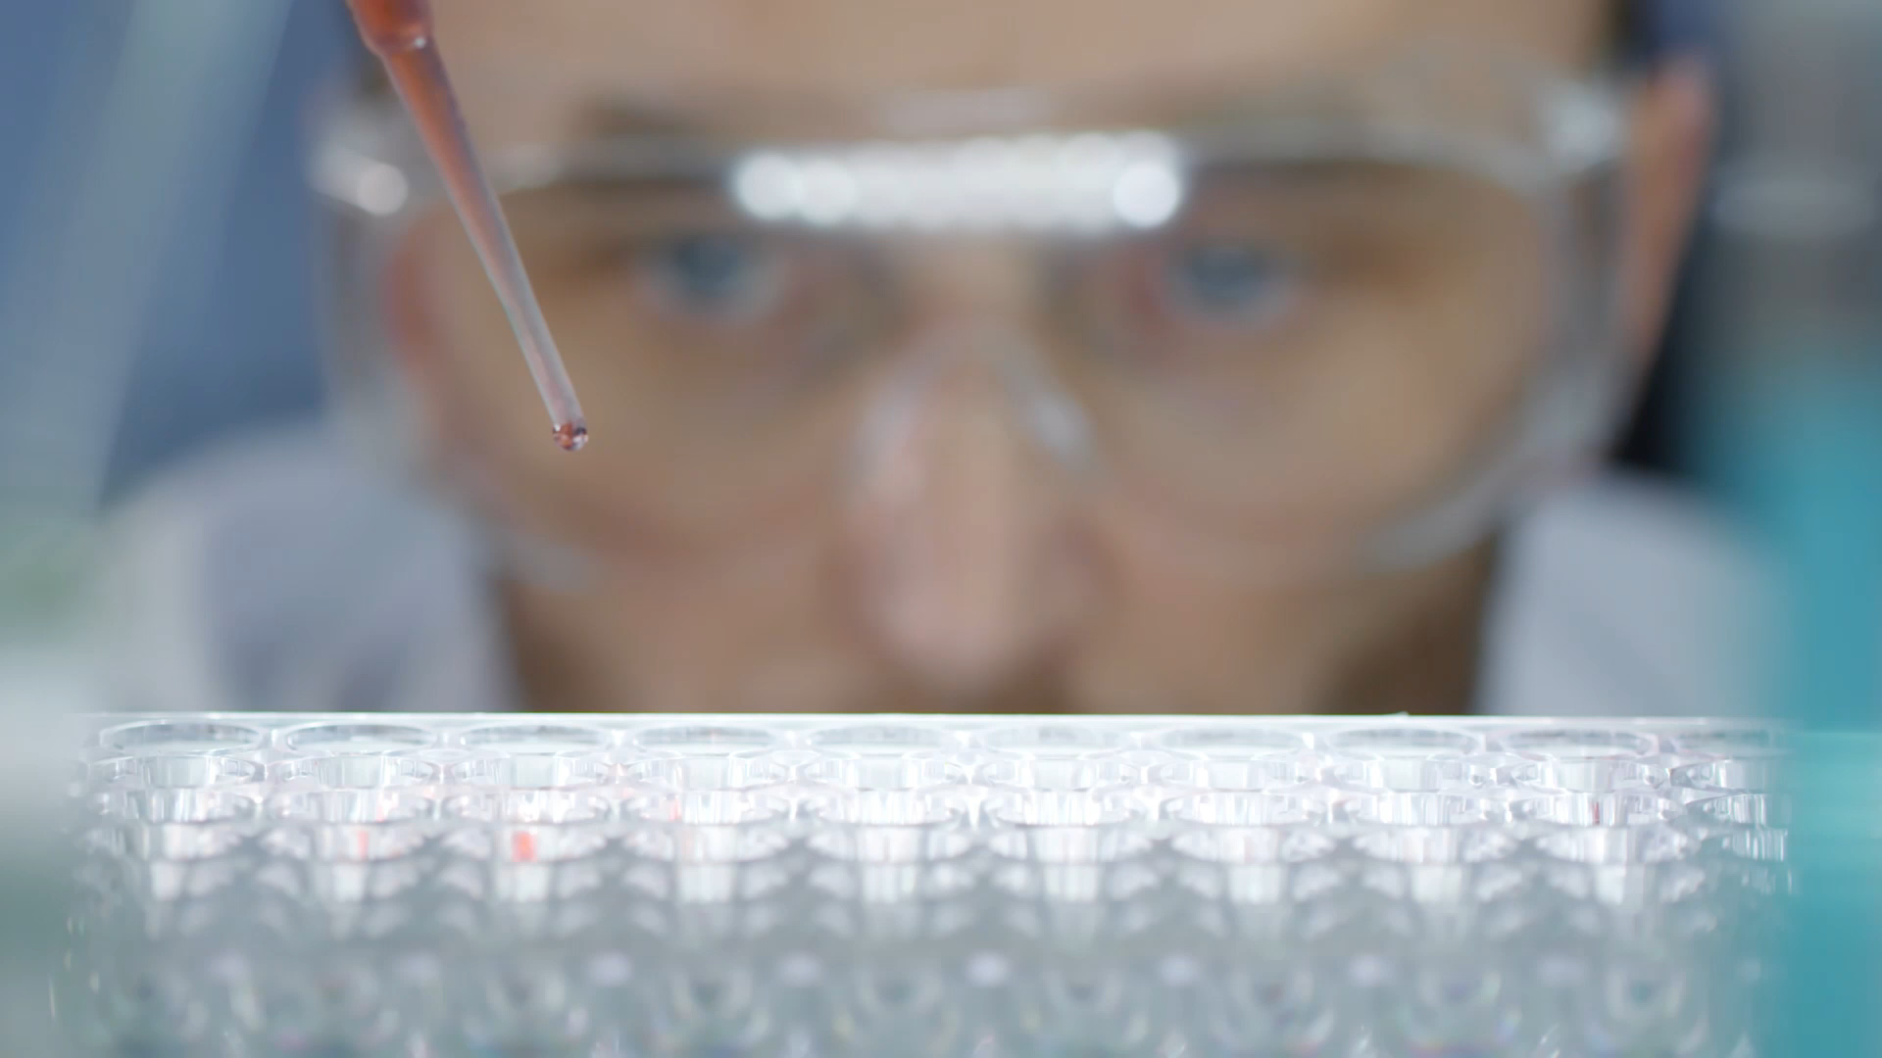
Topic 4: The Future of Microbiome Restoration
Current Research in Humans and Animals

Slide 12
Can PTSD be Diagnosed by Saliva?
Clinical Research in Isreal is finding common bacteria in Saliva for PTSD Veterans. They are looking at using bacteria as biomarkers.
Is it possible to alter the Microbiome as an adjunct treatment for PTSD?
The study was also supported by IDF's Medical Corps Department of Health and Well-Being and Dr. Ariel Ben Yehuda, former chief of the above Department and currently, a Department Manager in the Mental Health Medical Center in Shalvata, Clallit Health Services. The study also involved collaboration with the Charité University Medicine in Berlin and its microbiology experts Dr. Markus M. Heimesaat and Professor Stefan Bereswill, as well as with the University of Hong Kong, which is studying the effects of air pollution, Professors Victor Li and Jacqueline Lam.

Slide 13
Unhealthy Gut Helps Breast Cancer Spread, Research Reveals
Unhealthy bacteria caused by long term antibiotic use, poor diets, Obesity, etc.
Think about the ability to prevent long term antibiotic use, or Obesity, or cancer in our dogs…
It starts with Breeding and Fecal Transplants before they are born…something we cannot accomplish with humans
Reprograms immune cells, with a direct link to mast cells in breast tissue, leading to Breast Cancer.
They are now using this to prevent metastatic disease in At-Risk patients
The work was supported by Susan G. Komen, grant CCR17483602; the National Institutes of Health’s National Cancer Institute, grant R01CA253285; and the American Cancer Society, grant IRG 81-001-26. Additional support came from UVA Cancer Center, the BBSRC Institute Strategic Programme Gut Microbes and Health, and Cancer Research UK.
.

Slide 14
Fecal Transplants Reverse Hallmarks of Aging in the Gut, Eyes, and Brain
This is a study in rats where they took young rat gut bacteria and put it in old rats and old rat bacteria and put it in the young rats.
Putting young rat bacteria in old rats improved the lining and slowed the changes of aging in the brain and eyes
Putting old rat bacteria in the young rats speeded up the process of aging in the gut, eyes, and brain.
This suggests living with an unhealthy gut may be speeding up the aging process in humans. They are looking for a link with the microbiome and Amyloidosis, Parkinson’s, Alzheimer’s, etc.
They found that gut microbes lose integrity with age allowing the gut lining to get thinner and toxins to cross the gut barrier, triggering the immune system.
The bacteria in older microbiomes lose the ability to metabolize lipids and vitamins leading to increased inflammatory cells of the brain and eyes.

Slide 15
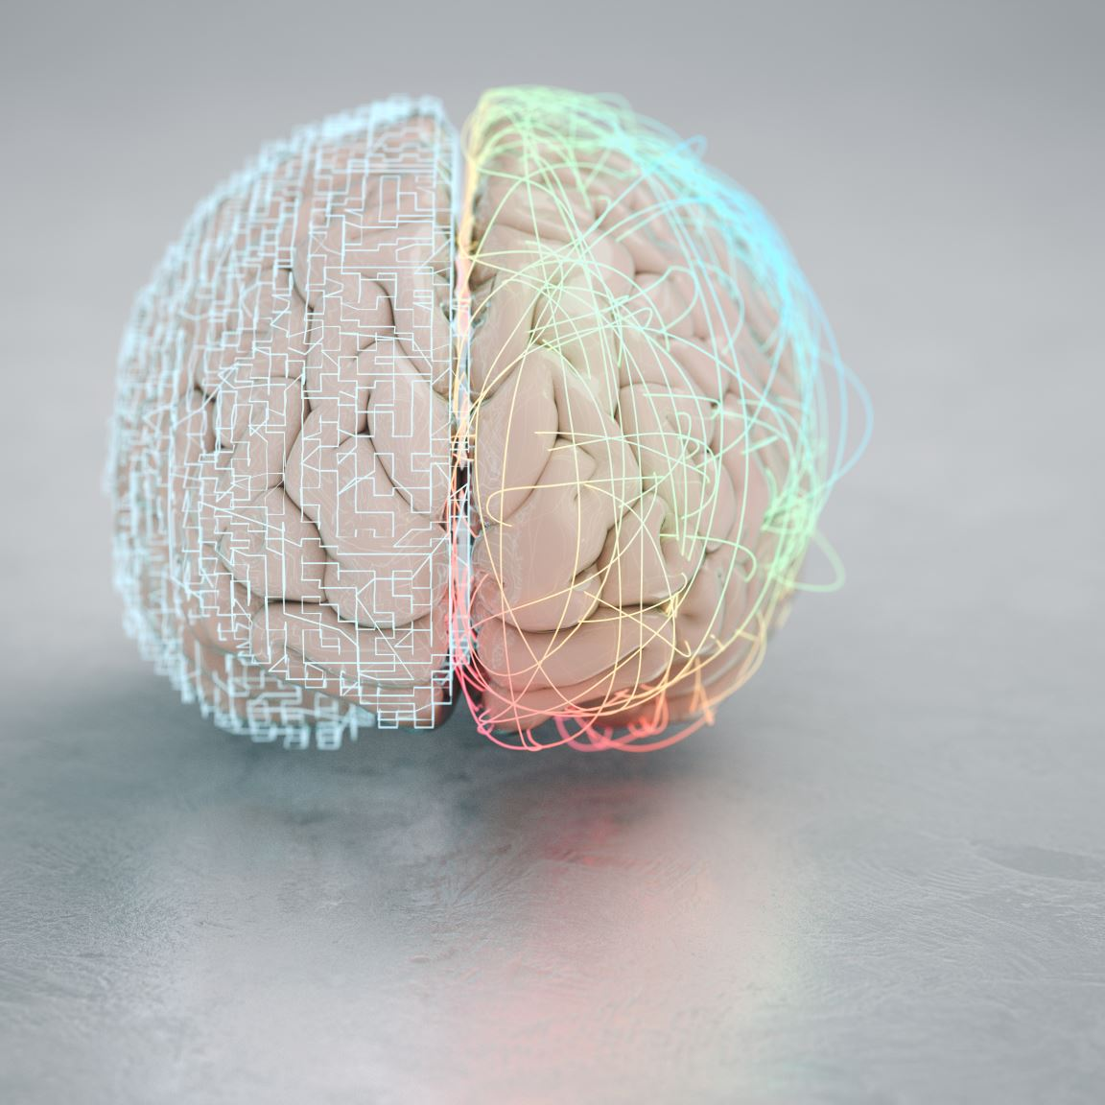
The Brain-Gut Connection
Direct relationship between stress levels and Cortisol release and gut activity.
How many get “Butterflies” or worse when feeling anxiety?
New research is using the microbiome to treat anxiety in dogs. Think about all the dogs in Training that have diarrhea from Stress. What if we could alter the microbiome to control diarrhea AND lower Training stress!
This has been shown to be effective for dog aggression as well.

Slide 16
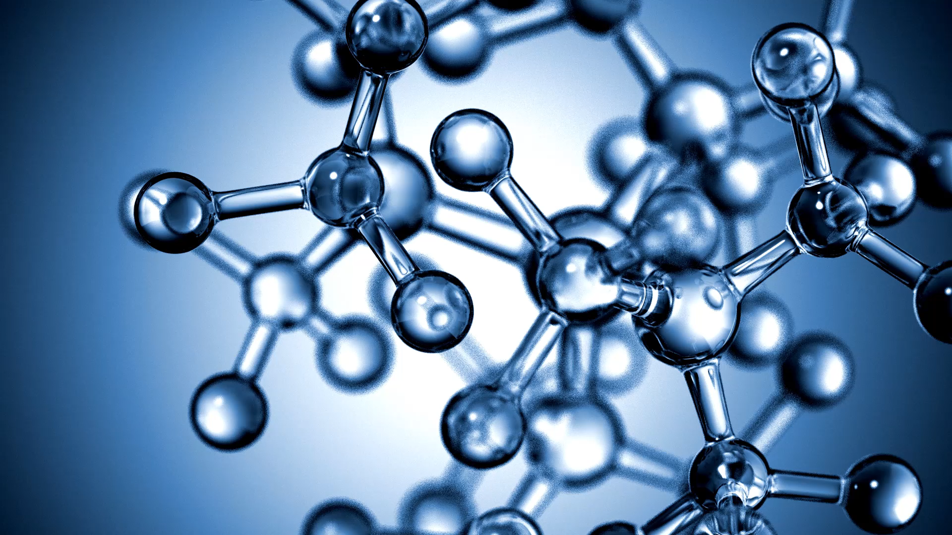
The Gut Immune System Connection
Chronic Skin conditions, Ear infections, and Urinary tract infections are being managed by altering the microbiome.
Is our DNA being altered by the bacteria in our gut?
Or is it just anti-inflammatory and lowered Cortisol that makes the body change?

Slide 17
Thank You
Kevin Conrad, DVM, CCRP
Kconrad11960@gmail.com
DoctorCvet.com

