Slide 1
How to use estimated breeding values (EBVs) successfully
Madeline Zimmermann, M.S.
2023 Breeders Workshop

Slide 2
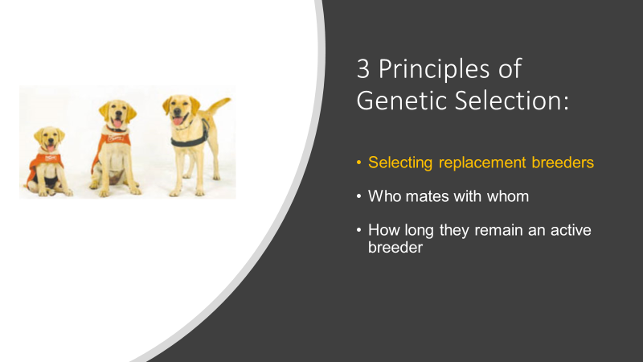
Must Have
Data on all or most dogs bred
Consistency and accurately measured

Slide 3
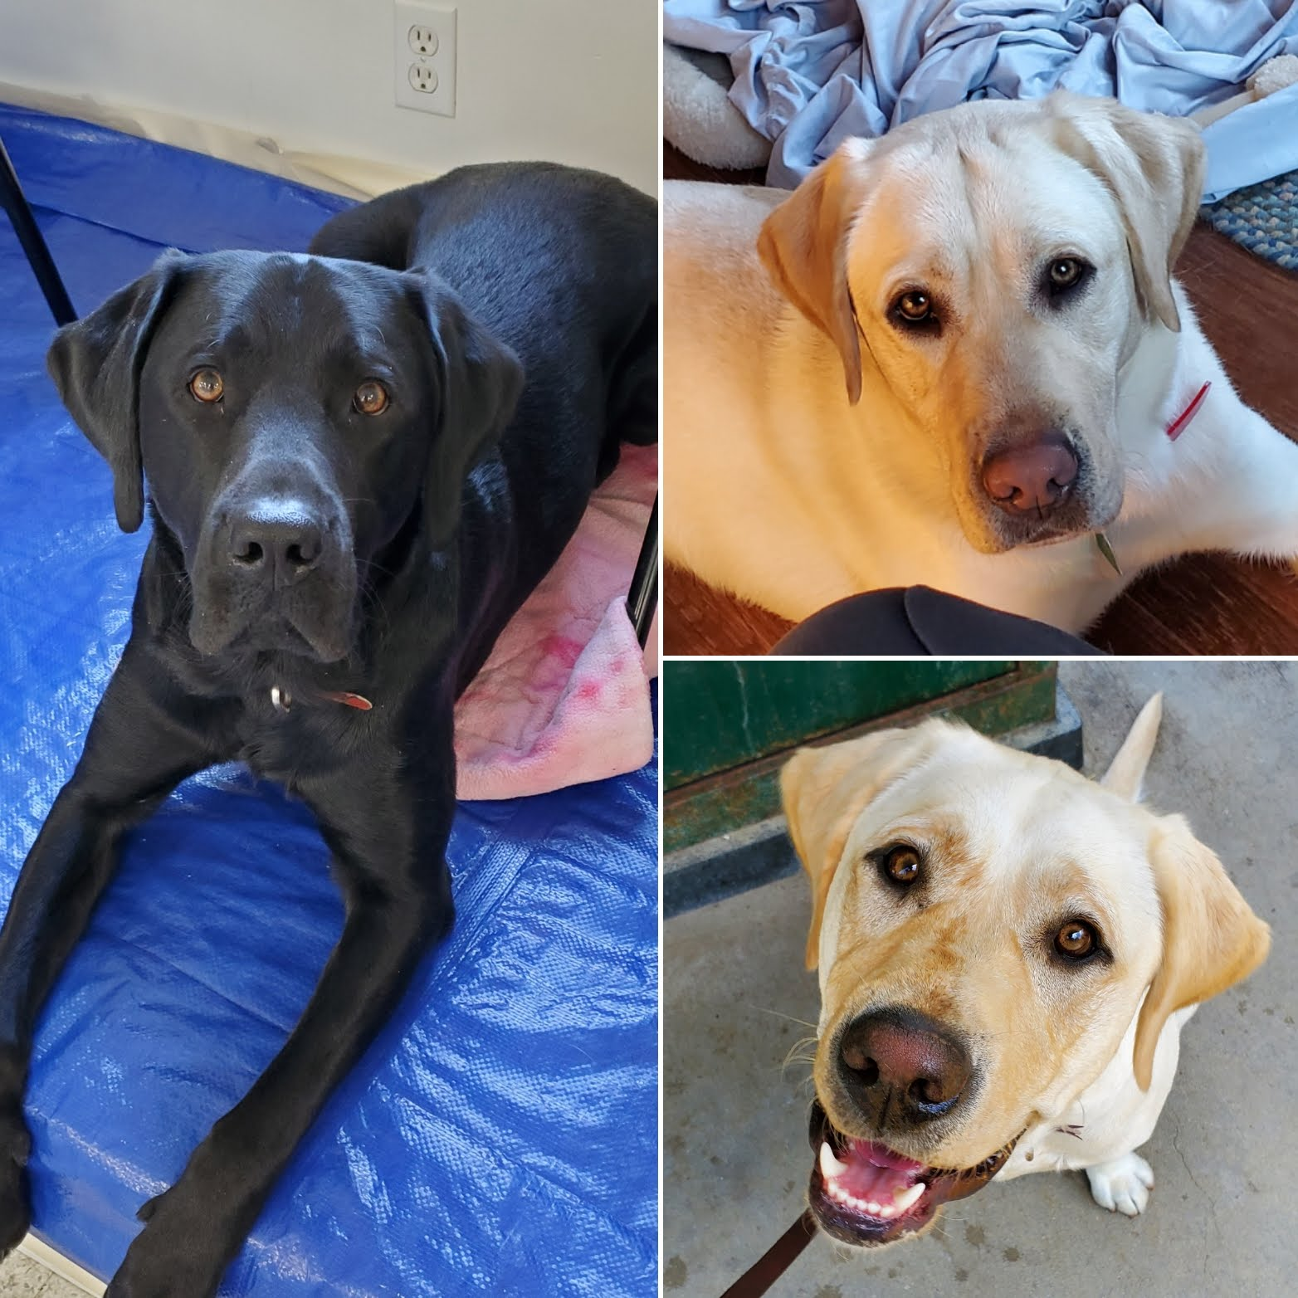
Selecting replacement breeders
A now-retired stud and two of his puppies screened as potential replacement breeders.

Slide 4
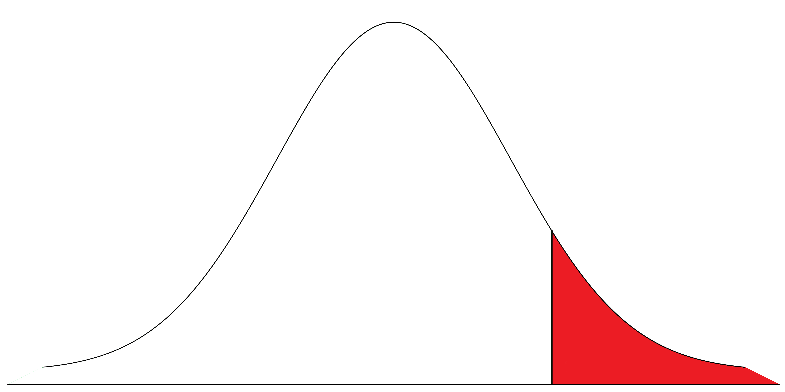
Select genetically superior candidates for breeders.
Screen 3x as many as you need, best indexes available from a variety of pedigrees.
If this is the distribution of index values for dogs available...
... then should ideally become breeders.
these
Average index of breeder candidates
Average index of selected breeders
(Average expected index of their progeny)
Notes:
Variety of pedigrees don’t need to be completely unrelated, but don’t want a bunch of sibs or half sibs.

Slide 5

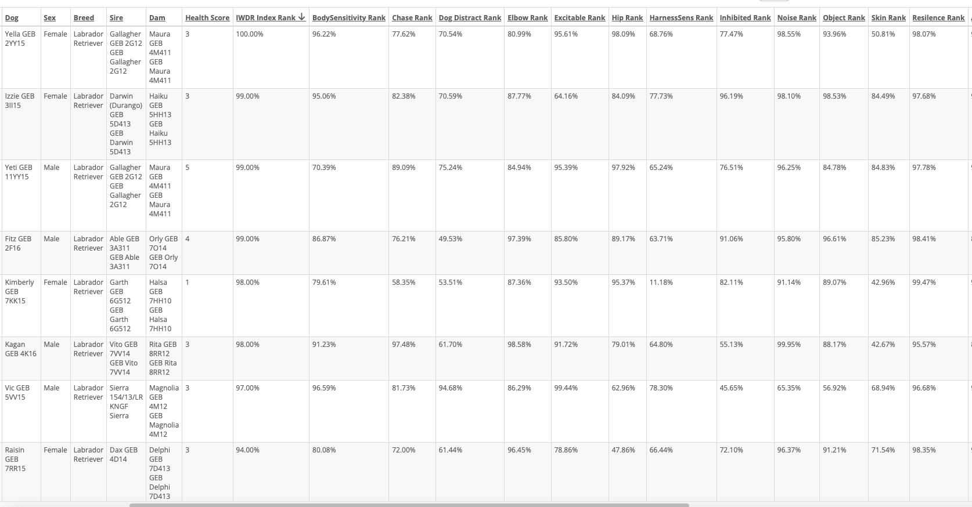
Need 2 breeders, screen 6… Candidates: IWDR > Estrus, Puppies, Breeding Colony > Candidates
S
S
Poor Health
Diversity
Notes:
These are sorted index high-low. Green boxes are dogs I’d pick - highest index.
Siblings:
For the sake of example, not paying attention to sex but there is a sib pair.
A sibling pair is usually fine but be sure you aren't saving all siblings. They will often be similarly highly ranked.
If the ones you pick don’t pan out, look to the siblings. They will often be similarly ranked.
If your best is low-ranked, that’s okay. That’s just what you have to work with. You still take the best you have and improve. Can also collaborate with orgs with better ranking dogs. (Verbal e.g.. Outside dogs do come with their own pros and cons. Best if collaborator has similar goals.)
Health - 1-2 is a problem. 3 generally OK. 4-5 no problem.
Want to know history.
Sometimes there are data problems like missing or incorrect diagnosis.
Trust internal vets - it is a team effort to screen the dogs and inform the decision maker from their area of expertise but CAN'T HAVE A COMMITTEE PICKING DOGS. One person needs to be responsible for making decisions about what’s best. Otherwise set bar too high and eliminate too many breeders. Must use the experts to get information on screening process.
They are not perfect – that’s okay. There’s no such thing as a perfect dog. Index handles some of the genetic balancing to identify overall most valuable genetically. Be sure you're not saving all low in the same area. Key is looking for best overall not perfect.

Slide 6
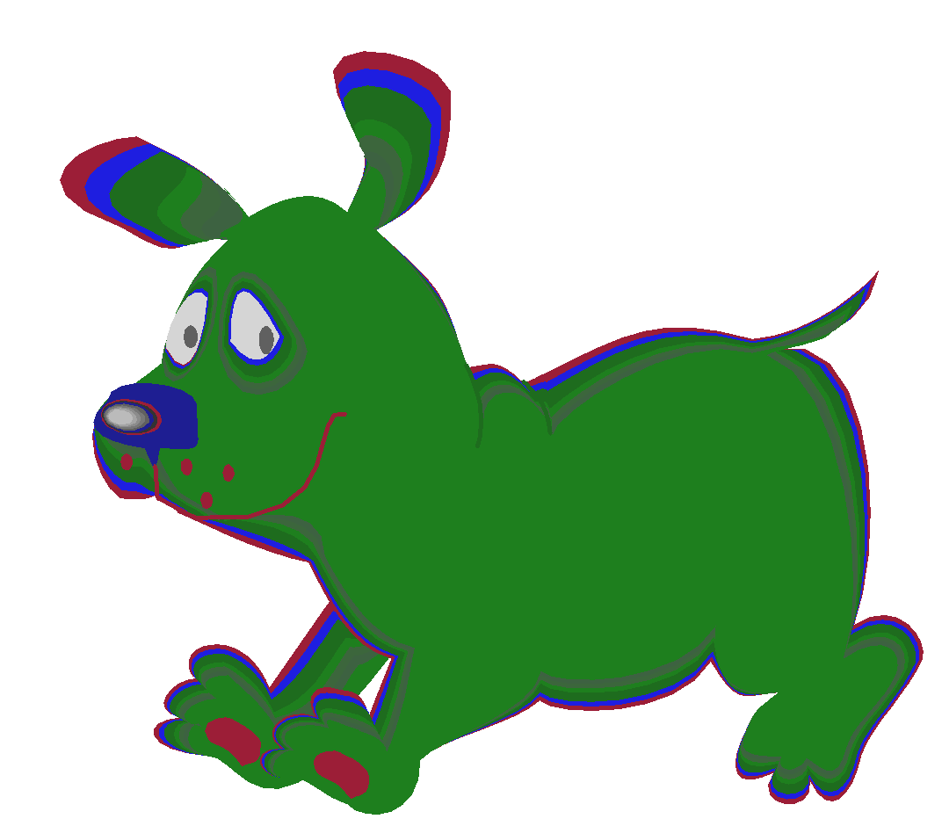
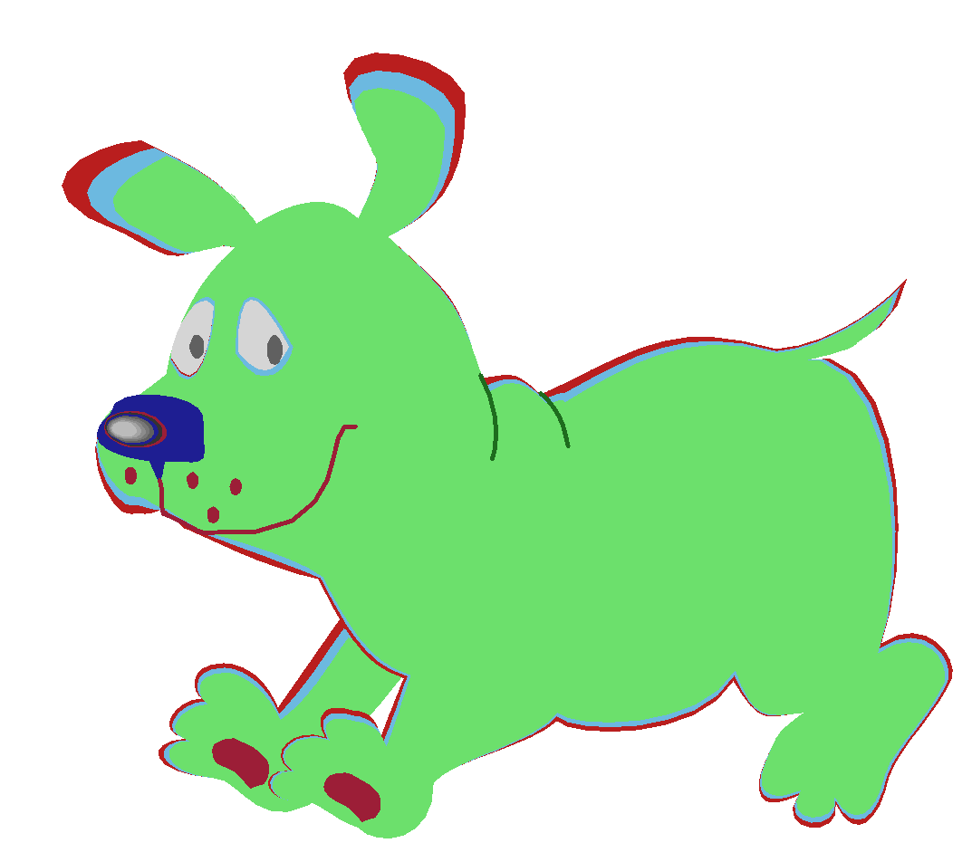


What Do I Do With the Index & EBV Ranking
Candidates
Training
Use EBVs Selection Index to identify litters mostly likely to produced best pups
Lower Index
Best Ranked Overall Index
Highest Index
Breeder
Candidates
From Variety of Families
Conduct Screening
Tests on candidates
Replacement Breeders
Notes:
Vets do their thing, training specialist looks at them. Explain what screening process looks like.
You may know line has problems. Certain things are not reflected in index and affecting relative with high heritability = big problems but everyone will have smaller problems in the pedigree. Focus on what really matters.
E.g. say you’re the only one who went to college of several siblings. Doesn’t mean family is not smart.

Slide 7
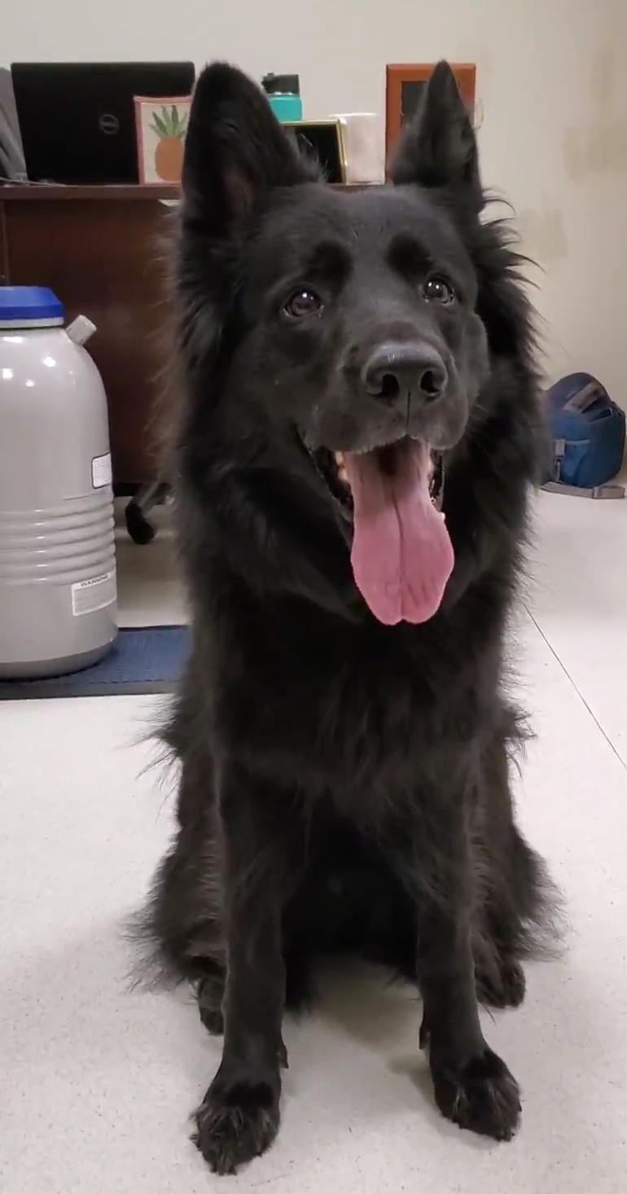
Choosing mates
A German Shepherd brood sits in front of a tank of frozen semen.

Slide 8
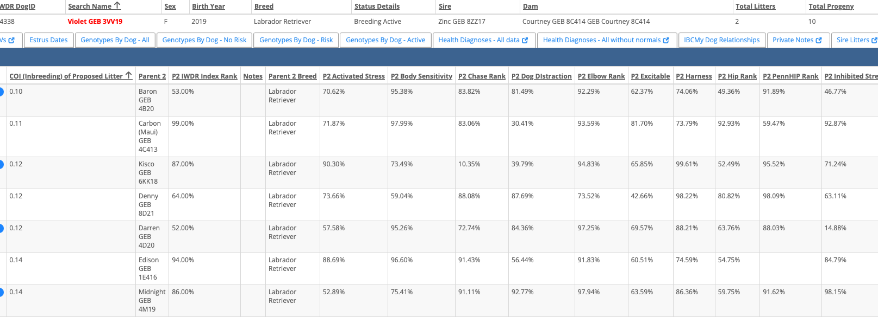

Mating Decisions (Test Matings): IWDR > Breed Stock Data & Test Matings
Medical concern
Used recently
Maxed out
Chosen stud
Lowest inbreeding
Avoid repeat matings
Stud genetically strong where brood is not so genetically strong
Avoid producing carriers where genetic tests are available
Use studs equally
Notes:
Inbrd increase no less than 2%/generation while using 3 key principles is ok.
Darren not chosen b/c Denny stronger.

Slide 9
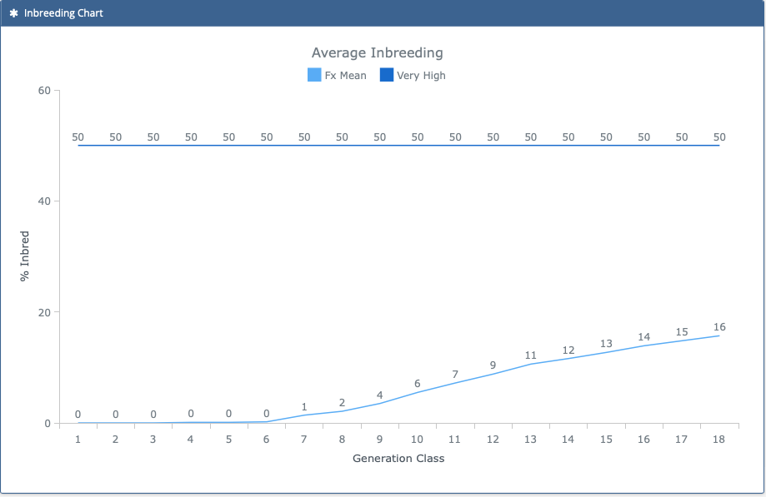
Monitoring Inbreeding: IWDR > Estrus, Puppies, Breeding Colony > Colony Reports-COI Inventory > Colony Size Age Inbreeding
Genetic selection necessarily makes dogs genetically alike for traits that matter:
Inbreeding increase of ≤2% per generation with use of 3 principles of selection
Notes:
Inbreeding with genetic selection (EBVs) ok at about 2%/generation. Inbreeding without genetic selection (EBVs) = high risk of collecting unwanted traits.
Principles of Selection: https://www.iwdr.org/master-knowledge-base/3-key-principles-of-genetic-selection/
Select genetically superior replacement breeders (EBVs & selection index)
Choose ideal mates
Limit use of any one breeder

Slide 10
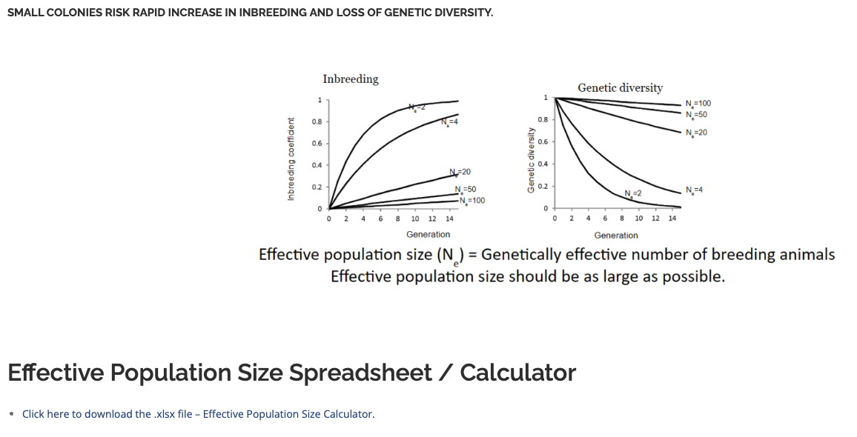
Limit each stud’s number of matings – within own colony AND among population where he is shared.
Limit depends on effective population size.
Ideally want ≥20
Considers how many breeders contribute to the last year of production, or several years if small colony
Bolstered by saving semen on studs not actively saved and/or collaborating with organizations of similar quality & goals
Downloadable chart can help you calculate effective population size.
https://www.iwdr.org/master-knowledge-base/effective-population-size/
Notes:
Pay attention because genetic diversity drops rapidly, dogs become related very fast, esp if Ne<20.
If you’re at one of the first 2 categories, e.g. Ne=2 or 4, really need to consider strongly limiting use of studs to one or two litters.
Sharing situation with other collaborators of similar quality and goals is great to boost Ne. IBC is example where there is a big population size but source of dogs is diverse group of organizations that use EBVs for selection.
Test mating feature shows how each stud can help.

Slide 11
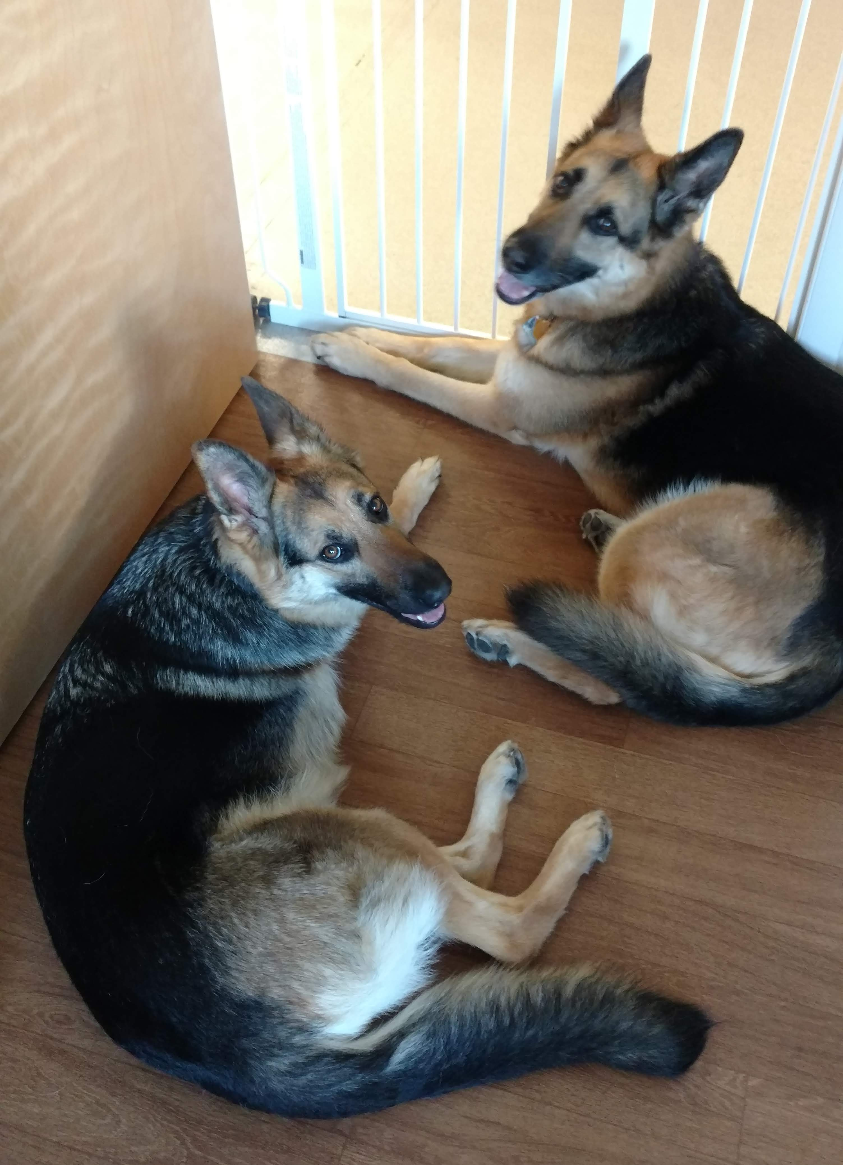
Who to retire and when?
A retired stud and his great-granddaughter, now also retired.

Slide 12
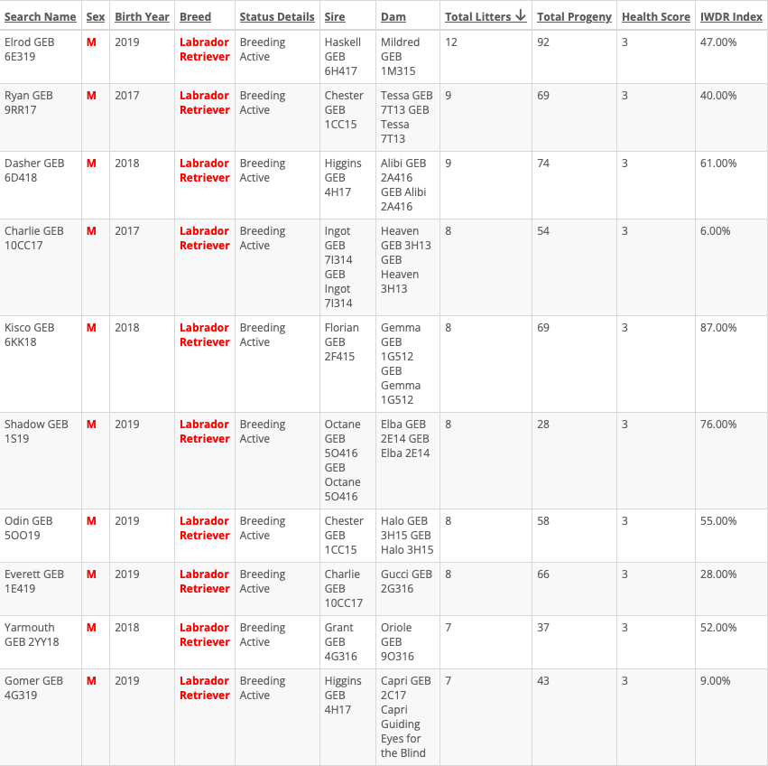
Reached limit
Limit progeny from each stud.
  Know how many you need to replace in next quarter.
  Screen 3x as many, look for males with index higher than these.
Low index
Some males are problematic due to own health, very low index, or other factors not in index: then replace with genetically better dog before reaching limit UNLESS offering something like diversity.
Produced metatarsal fistula
Better to use strong, single-use or FS mating with stud going to/in Training than continue using very poorly ranked active stud.
Also consider fertility: semen quality, conception rate. (IWDR provides via Breed Stock records)
Low index
Same concepts apply to broods.
Notes:
GEB Labrador colony limit is 10 per stud because 70-80 Labrador broods. If your colony is smaller, the limit will be smaller. Elrod used with other orgs.
Low index:
Charlie - puppies tend to be activated & demanding, also produced some neurologic issues. Have son who is stronger ranked. (Not great but better.)
Gomer - Higgins represented an outside line that was sensitive. Had to take best of what’s available which included Gomer but have other male from same stud that are more highly ranked, Gomer less helpful. More breeder progeny saved from Dasher than Gomer, looking for better ranked replacement breeder.
Shadow on hold. Produced MTF. MTF – unusual problem, haven’t seen before, had to release due to it. Appeared in multiple litters, not just sired by him. Explain incidence, dam could be risk but want to learn more about problem. Had to release the dogs. Don’t know enough about the issue but thought to be related to the immune system.

Slide 13
Summary
Identify genetically best candidates
Select highest index dogs representing a variety of families.
Screen 3x as many as needed for replacement breeders.
Team of experts performs screening, informs one decision maker.
No dog is perfect. Keep the best of what is available in the needed quantity & continue using genetic principles to guide future improvement.
2. Select genetically strong mates
Minimize inbreeding in each mating. Overall, keep inbreeding increase ≤2% per generation.
Don’t mate two carriers where genetic tests are available.
Don’t repeat same stud x brood combination.
Use studs equally.
Stud good where brood is not so good. (Make sure not all pairs are low x high EBV!)
3. Determine how long they will be active breeders
Limit progeny from any one breeder, within own colony and elsewhere. (Consider effective population size.)
Replace problematic/weak dogs with genetically stronger dogs before limit is reached unless they offer something else significant like diversity.
Consider fertility (e.g. semen quality, conception rate).
Use frozen semen and/or collaboration to bolster population size/genetic merit.

Slide 14
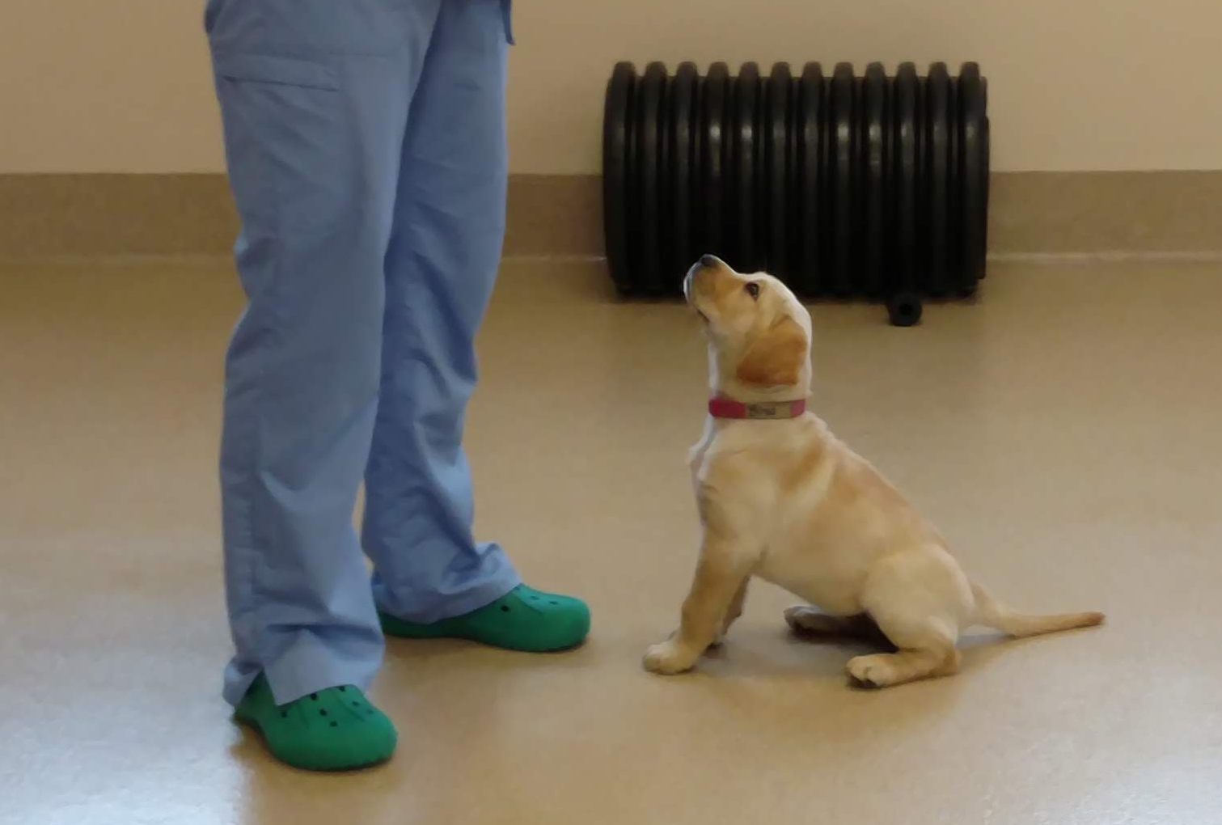
Questions?

