Slide 1
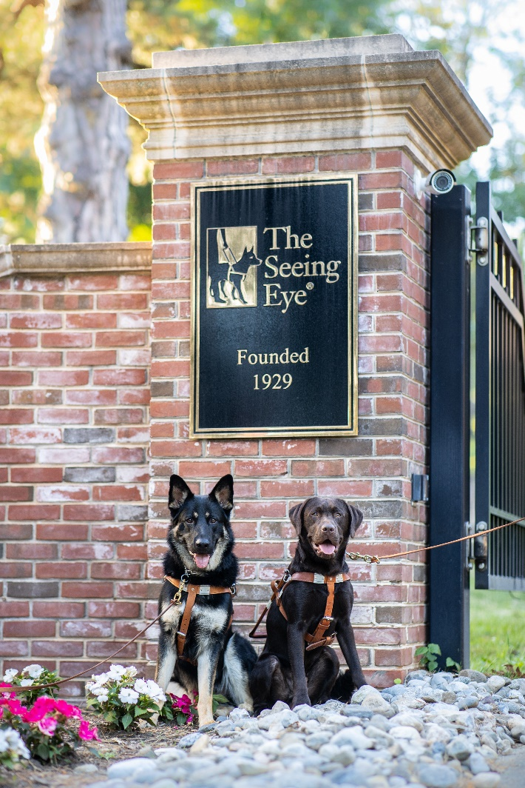
Stargardt disease in Labrador Retrievers
Dr. Katy M. Evans, The Jane H. Booker Chair in Canine Genetics

Slide 2

Notes:
A quick genetics primer for you – fellow geeks you may laugh at my pun!

Slide 3
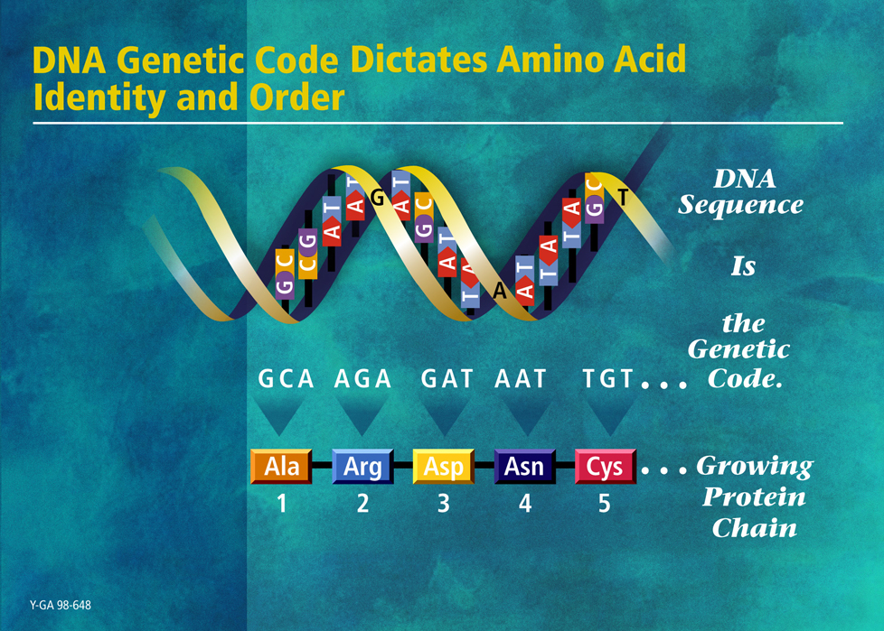
http://www.ornl.gov/hgmis
Notes:
DNA molecule a series of ‘bases’ (letters), 3 bases code for an amino acid, which fold up into a peptide/protein. Proteins are the building blocks of every structure in our bodies.

Slide 4
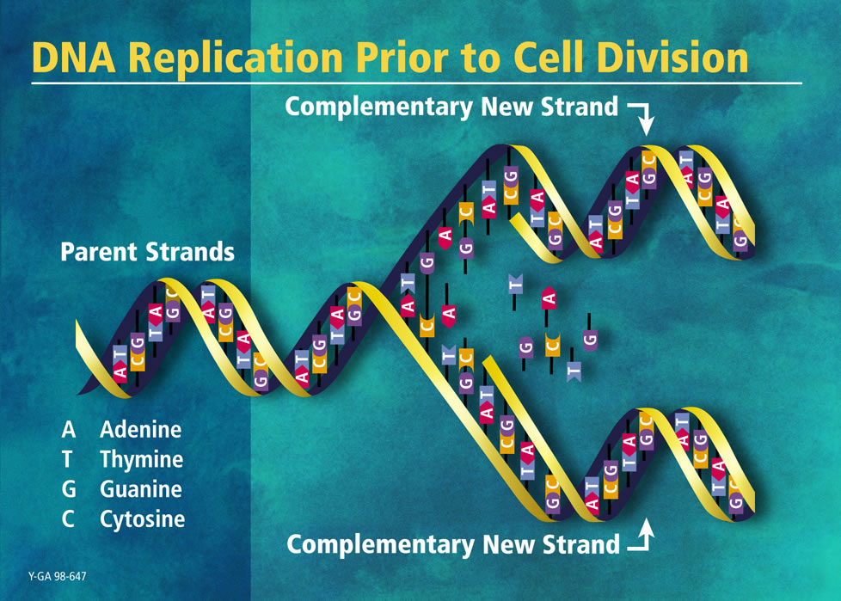
http://www.ornl.gov/hgmis
Notes:
Each time a cell divides, the DNA is unzipped and is copied. Sometimes errors occur, and these are known as mutations.

Slide 5
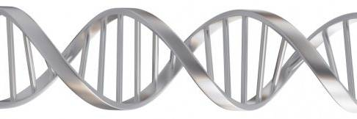
Slide from Dr. Tom Lewis
CGT-CGT-CGT-CGT-TGA
CGT-CGT-CGT-CGC-TGA
CGT-CGT-CGT-CAT-TGA
Notes:
SEQUENCE_DETERMINES_SHAPE…
Change the DNA base (happens a lot during copying) → may change sequence and so shape…
… & this is CRUCIAL because SHAPE is KEY to FUNCTION (enzymes, receptors etc).
Doesn’t work as well, or even at all.
We ALL have versions like this, but if we inherit 2, then the function protein performs is sub-optimal ➔ disease.

Slide 6
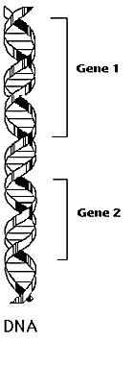
Chromosome Logical Structure
Locus – location of a gene/marker on the chromosome.
Allele – one variant form of a gene/marker at a particular locus.
Locus1
Possible Alleles: A1,A2
Locus2
Possible Alleles: B1,B2,B3

Slide 7
Genotypes Phenotypes
At each locus (except for sex chromosomes) an individual has 2 alleles. These constitute the individual’s genotype at the locus.
The expression of a genotype is termed a phenotype. For example, coat color, height, or the presence or absence of a disease.

Slide 8
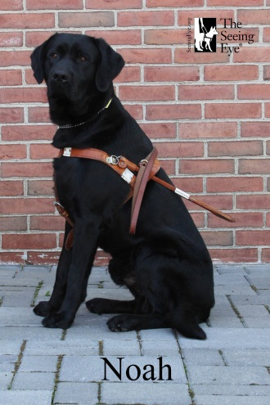
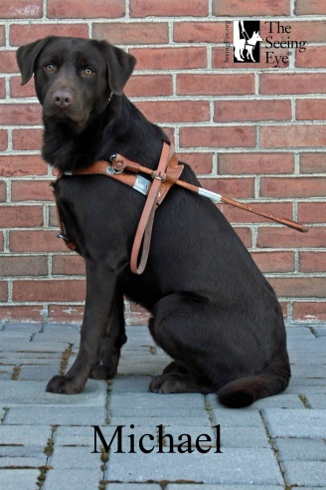
Dominant vs. Recessive
In Labradors the brown (B/b) locus controls the expression of the dark pigment eumelanin.
A dominant allele is expressed even if it is paired with a recessive allele e.g. in Labradors B = black
A recessive allele is only visible when paired with another recessive allele e.g in Labradors b = brown
When an individual has two copies of the same allele at a locus, e.g. BB or bb, they are described as homozygous
An individual with two different alleles at a locus, e.g. Bb, they are described as heterozygous
The phenotype is clearly visible, but the genotype is only visible if the individual is homozygous recessive
BB or Bb
bb

Slide 9
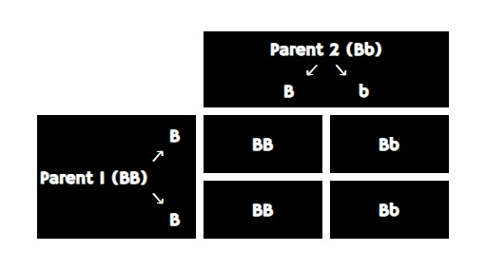
One gene = ‘simple inheritance’
Notes:
Easy to predict the phenotypes of offspring of a particular mating, using something called a ‘punnet square’. Of course, we all know that Labrador coat colour is actually controlled by more than one gene, but this was a useful visual illustration!

Slide 10

Notes:
There endeth the lesson, we’re all equipped to follow the meaty bits of my presentation.

Slide 11
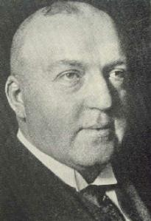
Stargardt disease
Seven patients with a recessively inherited macular dystrophy were described by Karl Bruno Stargardt at the University of Marburg, Germany, in 1909
The most prevalent inherited form of macular dystrophy
Affects approximately 1 in 10,000 people

Slide 12
Stargardt disease 2
The majority of cases are caused by recessive mutations in ABCA4 gene, first identified in 1997
Vision loss typically starts before 20 years of age
Common symptoms:
- gradual loss of central vision in both eyes
            - light sensitivity
            - needing more time to adjust between light and dark places

Slide 13
Aetiology
The ABCA4 gene normally encodes a protein that transports byproducts away from the photoreceptor (rods and cones) cells in the retina
Failure to remove the byproducts results in accumulation of lipofuscin, which is highly toxic to the retinal pigment epithelial (RPE) cells
The rods and cones rely on metabolic support of the RPE cells, so the gradual destruction of the RPE cells results in gradual loss of rods and cones
Notes:
Protein is the ATP-binding cassette transporter sub-family A, member 4. Both rods and cones are affected, but cones seem to be affected first.

Slide 14
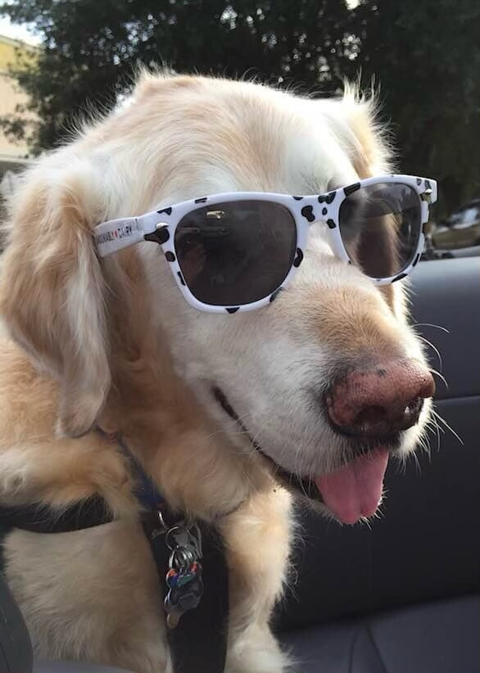
Aetiology 2
Faster rate of progression associated with:
    - increased sunlight/UV light exposure
    - climate
    - altitude
    - lifestyle
- high vitamin A intake
- potentially other, unidentified, genetic factors

Slide 15
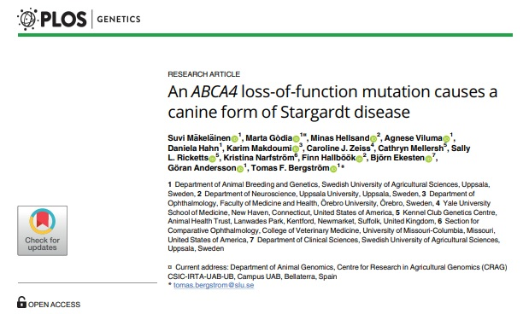
Stargardt disease in Labradors
Paper published 2019

Slide 16
Stargardt disease in Labradors 2
Vision of affected dogs described as impaired in both daylight and dim light conditions by 10-12 years of age
Some vision retained throughout their lifetime
Ophthalmoscopic signs of bilateral diffuse retinal degeneration
Reduced number of photoreceptors; cone function profoundly abnormal, rod function better preserved (ERG abnormal)

Slide 17
Stargardt disease in Labradors 3
As with the majority of human cases, caused by a recessive mutation in the ABCA4 gene (on CFA 6)
Whole genome sequencing (WGS) of a family quartet (sire, dam and two affected offspring)
WGS findings validated in 16 related and 6 unrelated Labradors
DNA test made commercially available
Notes:
We didn’t seek out the DNA test as we didn’t think we’d seen any cases, and also considered the age of onset to be after most guide dogs retire

Slide 18
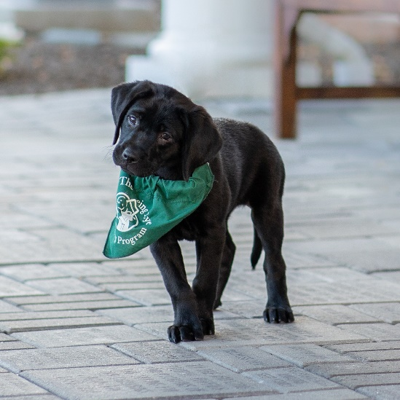
Stargardt disease investigation at The Seeing Eye
Mutation added to our DNA panel test in September 2020
At that time 5 of our 29 Labrador (or backcross) breeders were carriers
Decision made to avoid mating carriers together

Slide 19
Stargardt disease investigation at The Seeing Eye 2
Our expert veterinary ophthalmology consultant, Dr. Gus Aguirre, advised that homozygous-affected dogs should not work as guide dogs
Went back through pedigrees behind our known carriers to identify older carrier (or affected) breeders
Aim to identify status of all parents with offspring still in our program
Notes:
Either still being raised, in training or out working in the field

Slide 20
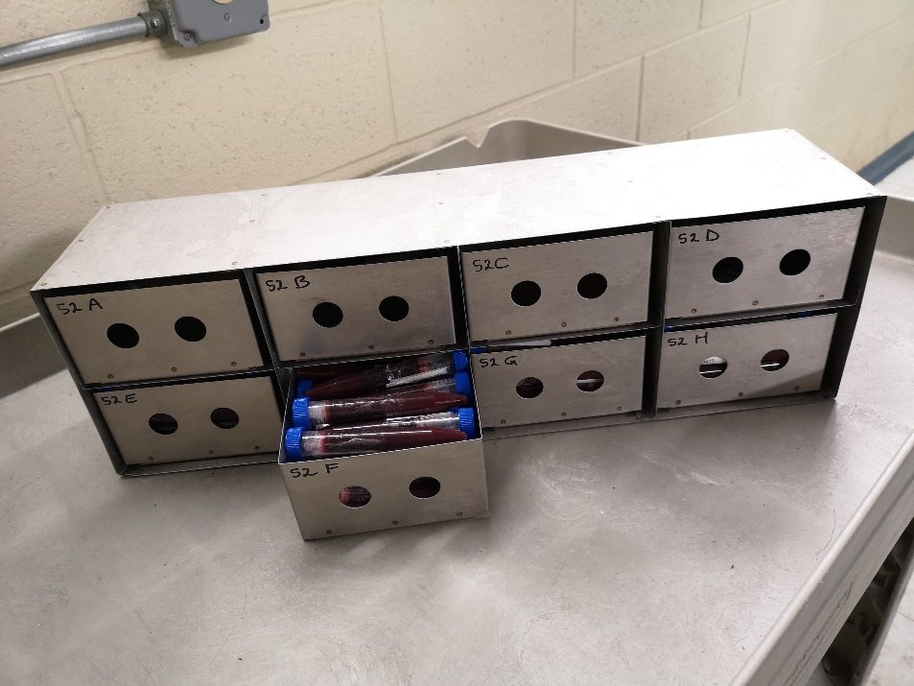
The Seeing Eye’s ‘biobank’
Since 1999, almost every dog born has had blood and/or DNA stored
Since 2016, all puppies’ dew claws are also stored (including stillborns)

Slide 21
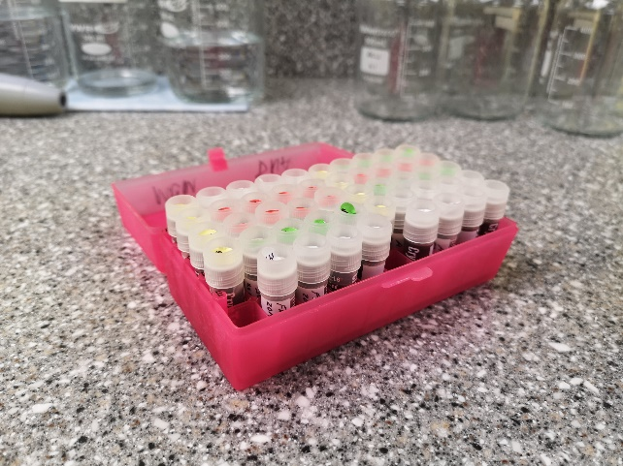
The Seeing Eye’s ‘biobank’ 2
Blood is collected into citrate anticoagulant
Three 1.5ml vials of blood are frozen (at -20°F)
The rest used for DNA extraction; extracted DNA is then also frozen, split into multiple tubes
Good success with using frozen blood or DNA for SNP genotyping and WGS
Notes:
Stop press – high quality DNA has just been extracted from our frozen dewclaws as part of a new project!

Slide 22
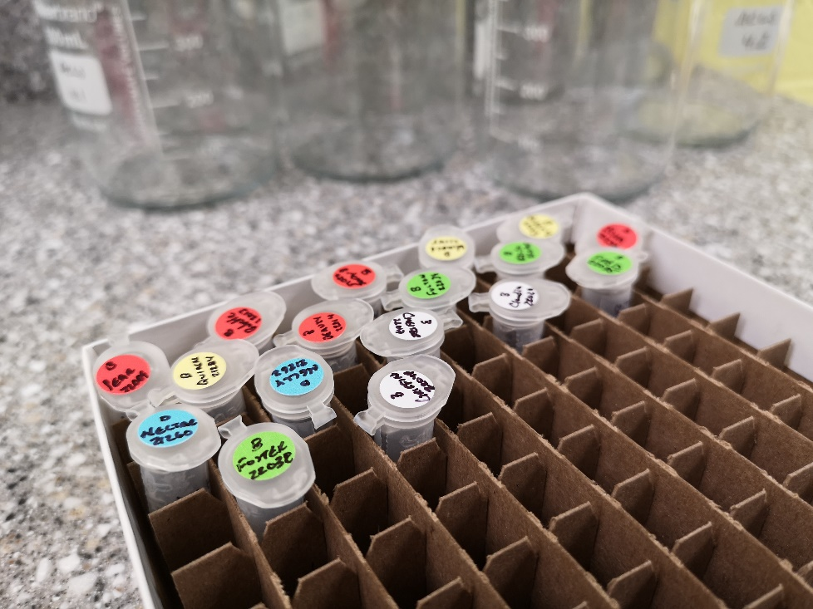
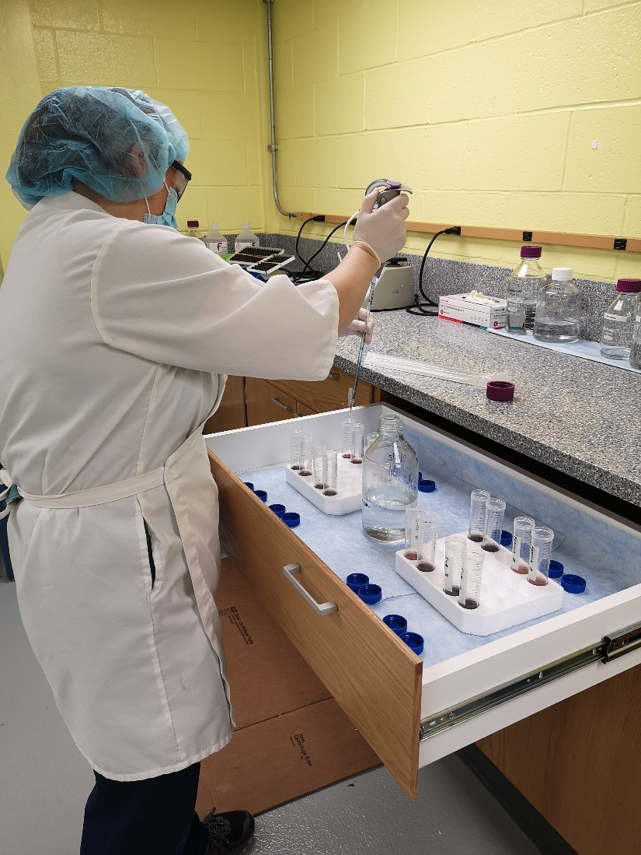
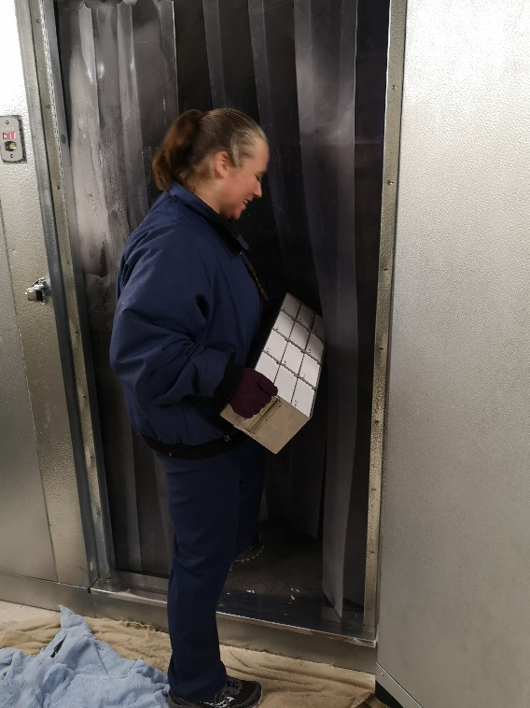

Slide 23
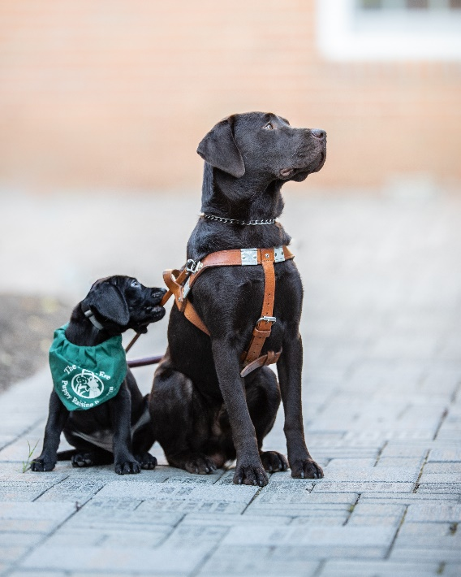
Stargardt disease investigation at The Seeing Eye 3
Used stored DNA for genotyping of all parents with offspring in our program
Where carrier (or affected) to carrier mating had occurred, used stored DNA to genotype all dogs in the litter
Notes:
Either still being raised, in training or out working in the field

Slide 24
Our situation
Last litter (of 7) from two carrier parents born February 2020 – tested when they came in for training, 5 carriers, 1 clear, 1 affected
Two dogs in training identified as affected (two carrier siblings, qualified and working)
Eight working guide dogs (including one former breeder) identified as genetically affected

Slide 25
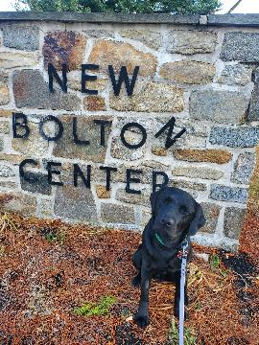
Youngest affected dog
No fundic abnormalities found on ophthalmic examination by expert at 1y9m & 2y10m
Normal ERG, showing normally functioning cones and rods, at 1y9m (repeat scheduled)

Slide 26
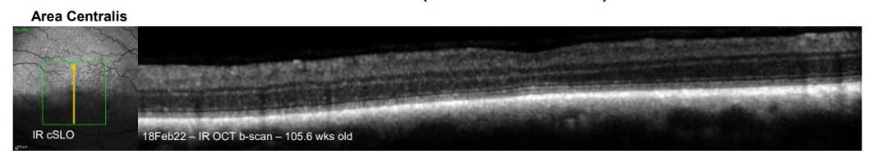
Youngest affected dog’s
OCT results (at 2y)
Generally normal fundus
Marked thinning of the retina and outer nuclear layer at the area centralis (foveal dip)
Notes:
OCT = optical coherence tomography
The area of thinning correlated with a dark area on infrared confocal scanning laser ophthalmoscopy and the area of greatest intensity on autofluorescence confocal scanning laser ophthalmoscopy.

Slide 27
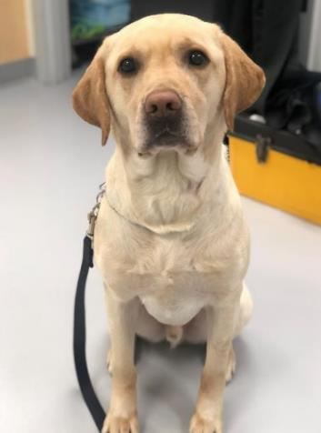
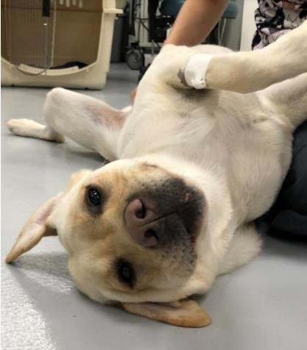
Two brothers in training

Slide 28
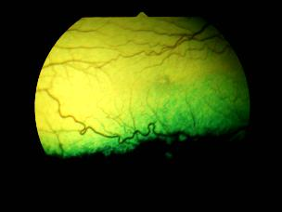
Dog 1 in training
Fundic abnormalities found on ophthalmic examination by expert at 2y4m – focal changes of reflectivity in area centralis, symmetrical both eyes
ERG at 2y3m – slight reduction in scotopic responses compared to control dogs, marked reduction in photopic responses
Notes:
Scotopic responses are those in dim light, believed to correlate mainly to rod activity
Photopic responses are those in daylight or other bright light, correlating mainly to cone activity

Slide 29
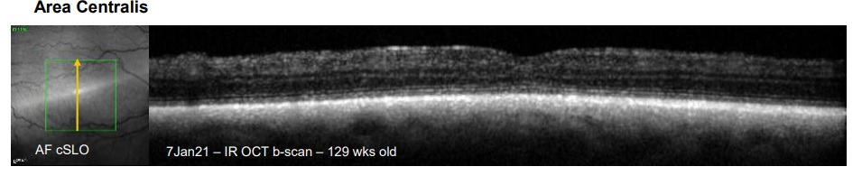
Dog 1 in training
OCT at 2y6m – marked thinning of the outer nuclear layer at the area centralis, corresponding to the area of greatest intensity on the autofluorescence confocal scanning laser ophthalmoscopy

Slide 30
Dog 2 in training
No fundic abnormalities found on ophthalmic examination by expert at 2y4m – area centralis normal in both eyes
Repeat expert fundic exam at 3y8m – still normal
ERG at 2y4m – moderate reduction in scotopic responses compared to control dogs, marked reduction in photopic responses

Slide 31
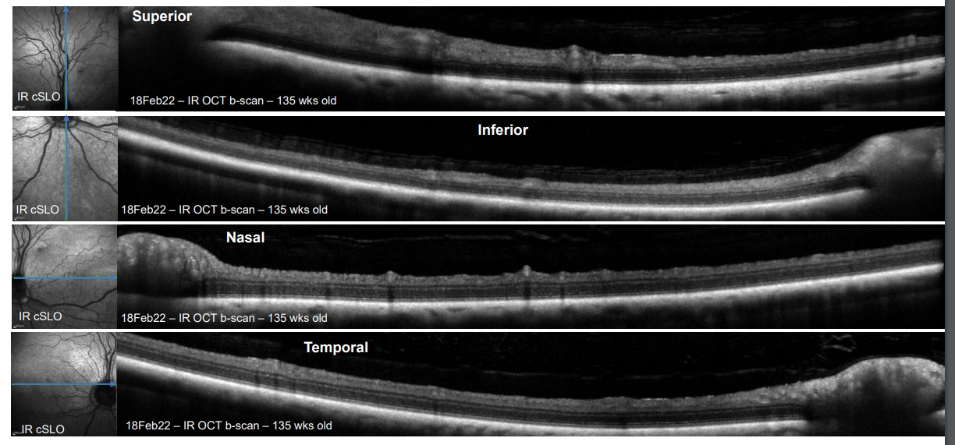
Dog 2 in training
OCT at 2y7m – a generally normal fundus with some slight thinning of the ONL at the AC (within normal limits) and an area of greatest intensity on AF cSLO

Slide 32
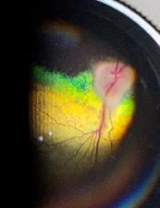
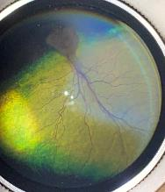
Youngest guide dog
Fundic abnormalities found on ophthalmic examination by expert at 7y4m – focal hyperreflective spot at area centralis, generalized foci with change in reflectivity
ERG at 7y4m – normal scotopic waveforms although possibly reduced in amplitude, minimal to no photopic responses bilaterally
Notes:
Also retired breeder, aged 7y4m when she came in for investigations

Slide 33
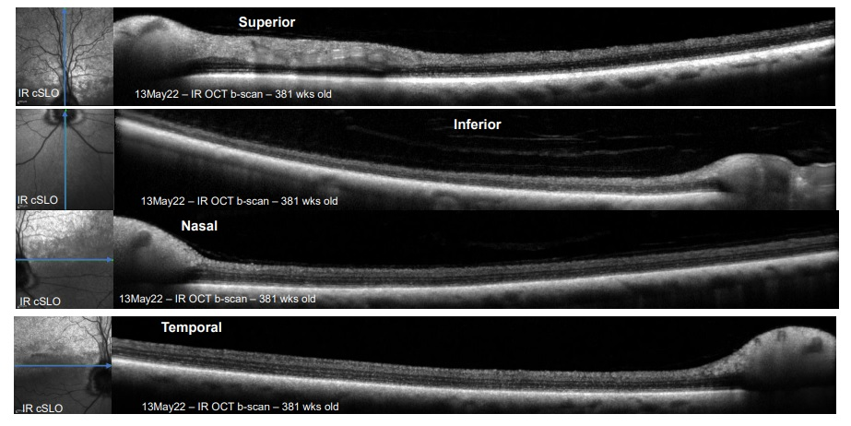
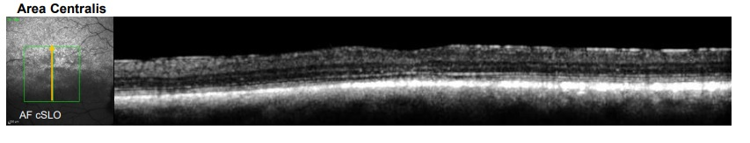
Youngest guide dog
Notes:
OCT at 7y4m – thinning of ONL in all 4 quadrants, markedly thinned ONL at AC

Slide 34
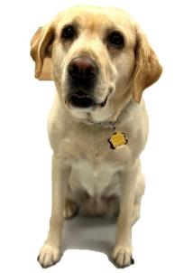
Youngest guide dog
“She did not work like a typical seasoned dog. Despite the fact that they are with a new handler (me), most seasoned dogs move out with confidence. She seemed to lack confidence and was most affected going from light into darkness. She was hesitant to approach down curbs and storm drains, yet would approach ramps. She avoided manhole covers as if they were open
holes in the sidewalk, yet walked over all
gratings as if they were not there.”
Notes:
Worked by our Director of Instruction and Training at 7y4m. Guide dog owner had not noticed any visual impairment.

Slide 35
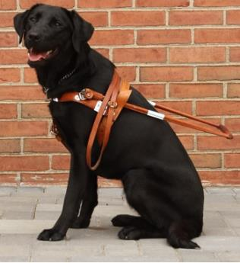
Guide dog 2
No fundic abnormalities found on ophthalmic examination by expert at 8y1m
ERG at 8y3m – very abnormal cone responses, either absent or very low amplitude at all frequencies
OCT not performed

Slide 36
Guide dog 2
“When I worked her facing into bright sunlight her pull diminished. In fact, I could not get her to accept the harness facing into the sunlight, but when I turned to harness her with our backs to the sun she accepted the harness readily. When working her in the dark she did not like working into oncoming car headlights – her pull diminished with uncertainty. When working her into a dark driveway with heavy shadow from overhead trees she was reluctant to work at all. I should note she seemed perfectly happy in daylight and cloud cover as long as the sun was not shining brightly in her eyes.”
Notes:
Worked by our Director of Instruction and Training at 8y1m. Guide dog owner noticed a growing unwillingness to cross a dark area to her toileting area, but nothing else.

Slide 37
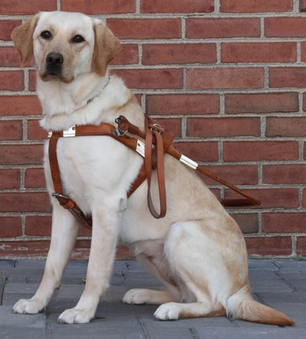
Guide dog 3
GDO could not bring the dog to campus for investigations and instead requested a visit with a veterinary ophthalmologist in her area
Report at 8y1m: ‘Owner says dog has had issues in dim light and seems most comfortable when the light is better. Owner indicates that dog is not guiding her across streets in the dark at this point. Suspect that even though fundi appear normal, dog could have some rod function issues.’
Notes:
Aged 8y1m, retina appeared normal on expert examination.

Slide 38
Guide dog 4
Fundic abnormalities found on ophthalmic examination by expert at 8y10m – focal hyperreflective spot over AC
ERG at 8y10m – normal scotopic waveforms although possibly reduced in amplitude, minimal to no photopic responses
OCT at 9y – thinning of ONL in all 4 quadrants, markedly thinned ONL at AC
Notes:
Aged 8y10m

Slide 39
Guide dog 4
“My route began with traveling from east to west with sunlight overhead, broken up by buildings on our right. She still moves out like a young, spry dog. She trotted along happily at a brisk pace with a defined pull all the way to the end of the block. When we turned north, into the shade, there was some initial diminished pace and pull for 50-100 feet. I supposed that she was adjusting to the diminished light. What was very clear was her reaction to bright spots of sun shining on the pavement. She made very strong, overt moves to guide me around those spots without breaking stride, as if they were unsafe obstacles…”
Notes:
Worked by our Director of Instruction and Training at 8y11m.

Slide 40
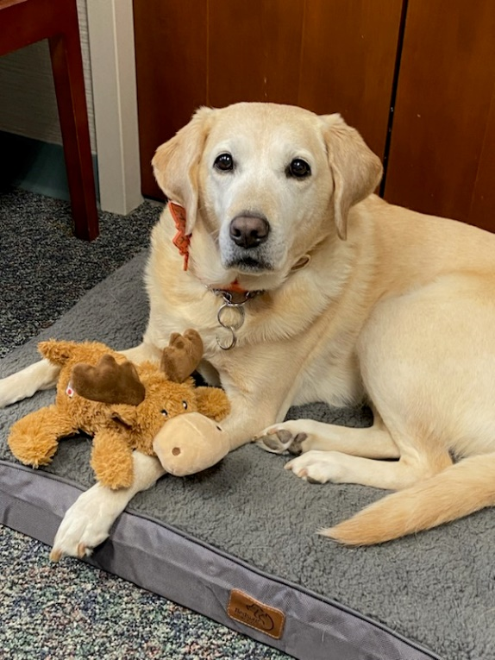
Guide dog 4
“… At the end of the shady block we wound up in bright sunlight and turned to the east. It’s interesting to me that there doesn’t seem to be as much of an adjustment walking into bright sunlight as there is walking into darkness and shadows – for this dog and the others. On the next dark, shaded block, traveling south, I once again
observed a more tentative dog until the
conditions became brighter again.”

Slide 41
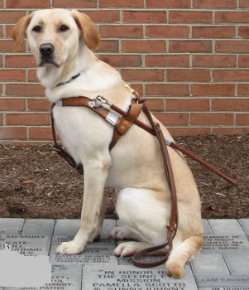
Guide dog 5
Fundic abnormalities found on ophthalmic examination by expert at 10y10m – peripheral naso-temporal tapetal multifocal mottling with hyperreflectivity, in both eyes
ERG at 10y10m – abnormal rod responses, very low amplitudes at all intensities and frequencies; cone responses absent
Notes:
No OCT

Slide 42
Guide dog 5
“She seemed vibrant in her work during normal daylight with grad and with instructor who worked her into the sun. When I worked her at night, into oncoming headlights on a dark road, her pull decreased and she seemed uncertain. Her reaction to darkness was marked. She froze in dark shadows and was uncertain”
Notes:
Worked by our Director of Instruction and Training at 10y10m. Guide dog owner had not noticed any changes.

Slide 43
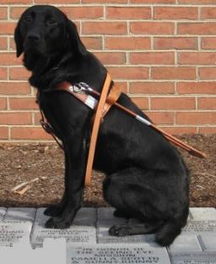
Guide dog 6
Fundic abnormalities found on ophthalmic examination by expert at 10y10m – mottling of fundus and focal areas of tapetal pigmentation bilaterally
ERG at 10y10m – normal rod, absent cone, responses
Notes:
No OCT, work notes mislaid. Dogs 7 and 8 were littermates of 5 and 6 and were unfortunately unable to come in for investigations due to the poor health of their guide dog owners. All dogs were retired on our advice.

Slide 44
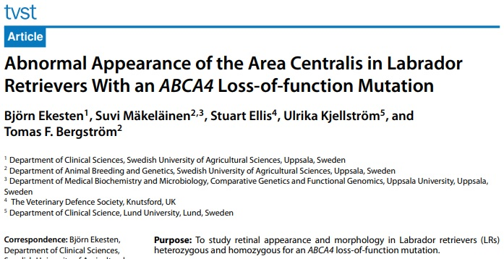
Latest research
Paper published 2022
Notes:
Three of the same authors as the first study

Slide 45
Latest research findings
Studied 6 homozygous affected, 5 heterozygous (carriers) and 5 homozygous wildtype (clear)
Clinical findings in homozygous affected dogs same as ours
Clear evidence of visual impairment in both daylight and dim light in dogs >8 years of age
Ophthalmoscopic examination and vision testing of carriers normal at all ages
Notes:
However middle-aged and older carriers did show some changes on cSLO and OCT, being intermediate between normal dogs and affected dogs, indicating some accumulation of lipofuscin in the RPE in the AC. In human carriers for ABCA4 mutations, visual acuity is normal but ERGs have been found to be abnormal.

Slide 46
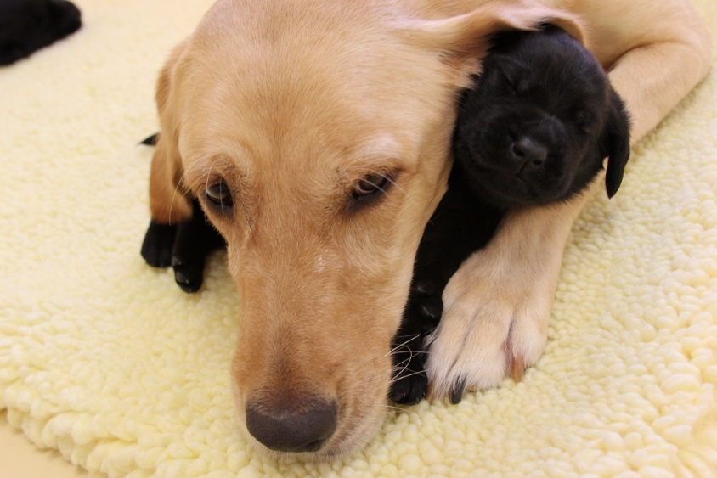
Selection strategy
Homozygous affected and carrier dogs can safely be used as breeders, so long as mates are clear
Try to reduce mutant allele frequency slowly so as not to reduce genetic diversity
Could preferentially choose clear progeny over carrier littermates

Slide 47
Summary
Fundic abnormalities found on ophthalmic examination by expert at 2y4m – but relatively non-specific
OCT abnormalities found at 2 years
ERG abnormalities detected at 2y3m
Work abnormalities detected, although not by GDO, at 7y4m (youngest dog checked)

Slide 48
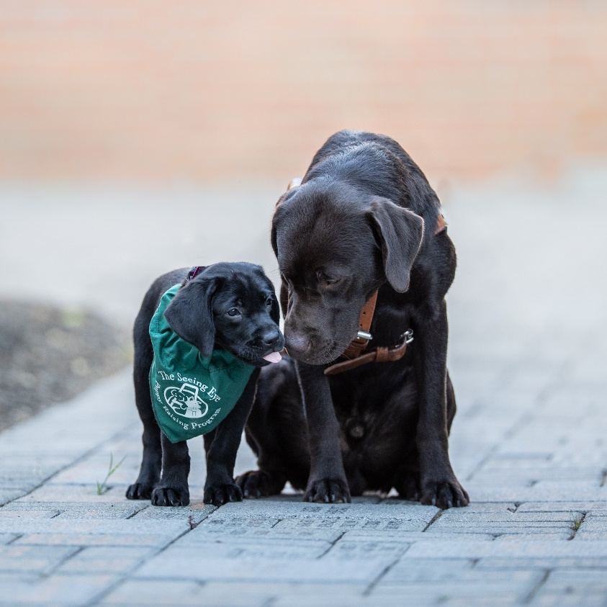
Summary
Our strong opinion is that it is unsafe to place a genetically affected (homozygous) dog as a guide
Genetically affected dogs can safely be used as breeders so long as they are only mated with clear dogs
Carriers safe for work
and breeding
Notes:
that opinion is based on both the research and our own observed work and ophthalmic findings. I will also say that organizations using Labradors (or crosses) in roles other than guide work will have to make their own judgement about how important good vision is for dogs in those roles

Slide 49

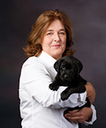
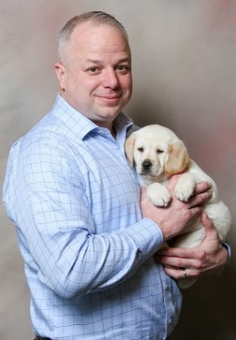
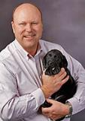
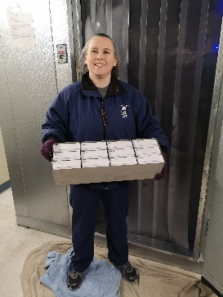


Acknowledgements
Acknowledgements
The Seeing Eye Inc.
Dr. Dolores Holle
Dr. Kyle Quigley
David Johnson
Patricia Tardive
The Seeing Eye Inc.
Dr. Gustavo Aguirre

