Slide 1
Improving health using EBVs: Elbow, Skin, and Mast Cell Tumors
Madeline Zimmermann, M.S.
2023 Breeders Workshop

Slide 2
Introduction
Goal = select new, young breeders less likely to produce affected offspring
EBVs DO NOT identify genetic cause and effect.
Traits must be measurable, have variation, and be heritable (i.e., significant portion due to genetics) to make worthwhile improvements through breeding.
Need lots of consistent and accurate data on many (ideally all) dogs.

Slide 3
Skin (Atopy)

Slide 4

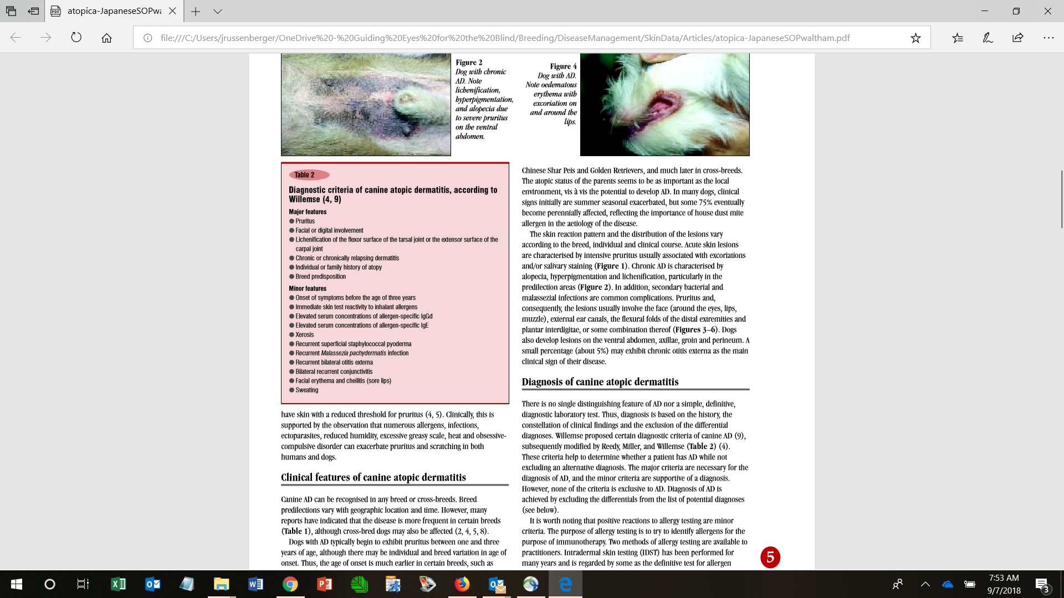
Skin: Atopy Criteria
(At Guiding Eyes- mostly digital)
Features observed in Guiding Eyes for affected dogs

Slide 5
Skin Trait = Lowest Skin Score of “Allergy Diagnoses”
Diagnosis | Score
Normal skin/ears | 5
Pododermatitis predisposing factor, not allergy | 4
Pyoderma superficial- not likely allergy caused | 4
Rash, mild | 4
skin lesions | 4
Acute moist dermatitis, predisposing factor | 3
Contact dermatitis | 3
Interdigital pyoderma | 3
Otitis externa both ears | 3
Otitis externa left ear | 3
Otitis externa right ear | 3
Salivary staining | 3
Staph folliculitis | 3
Allergic dermatitis (inhalant) | 2
Flea allergy dermatitis | 2
Follicular conjunctivitis | 2
Food allergy dermatitis verified | 2
Generalized pyoderma deep skin | 2
Metatarsal Fistula | 2
Otitis externa persistent-not fully resolved or recurs readily | 2
Pyoderma (deep) unspecified* | 2
Pyoderma superficial- allergy cause possible | 2
Acute moist dermatitis - suspect allergy caused | 1
Atopy | 1
Chronic allergies skin | 1
Interdigital dermatitis allergy caused | 1
Otitis externa chronic-3+ episodes/12 mo | 1
Diagnoses presumed related to allergies are assigned score 5 to 1
Database assigns dog lowest score as skin score
Normal skin & ears
  Has been examined age 15 mo. or later and was normal
  ≥ 3 yrs. old and no diagnoses scoring 1-4
Notes:
Red box = ones that impact most heavily (the big problems – affects client or dog wellbeing)
The IWDR Skin Score includes 46 different traits.
IWDR has diagnoses for otitis (3), persistent (2), 2nd in 12 months (2), chronic 3+ in 12 months (1).

Slide 6
Skin Data: Dogs that leave the program
Annually survey owners for health updates, ideally lifelong but at least until 5 yrs. old (average 3 yr. old age of onset + catch the older tail of presentation)
Use consistent definitions to assign diagnoses based on feedback
Options for survey collection:
  Survey Monkey or similar service
  New electronic health survey form via IWDR beginning test, expected available around August: https://www.tfaforms.com/5053016
Notes:
IWDR users can send survey from their organization. Data imported to IWDR where responses can be reviewed and accepted for import.
If an organization wants a copy of results to go to their own database, then the survey can be configured for that. In these cases, can add questions for the individual org but can’t change the IWDR questions.
If specific questions, support@iwdr.org or Molly Morelli: molly@warriorcanineconnection.org

Slide 7
Maintaining Lifelong Health Surveys
Send to all dogs produced (Released, retired, active working, breeders)
Get agreement from adopters & clients to supply information
Keep contact information as current as possible
Response rates:
  Improved with time as new owners gained experience in filling out surveys.
  Volunteer provides phone call follow-up as needed.

Slide 8
IWDR* Skin EBV Model
 | Labrador Retriever | German Shepherd | Golden Retriever
Heritability | 0.353 | 0.279 | 0.459
Trait: score of lowest-scored (most undesirable) skin diagnosis
Fixed effects: sex
Covariates: percent inbreeding
Random effects:
  Age of dog in days when diagnosis was made providing lowest score
  Dog ID
*GEB model for Labradors shown following – from which IWDR was based – is similar.

Slide 9
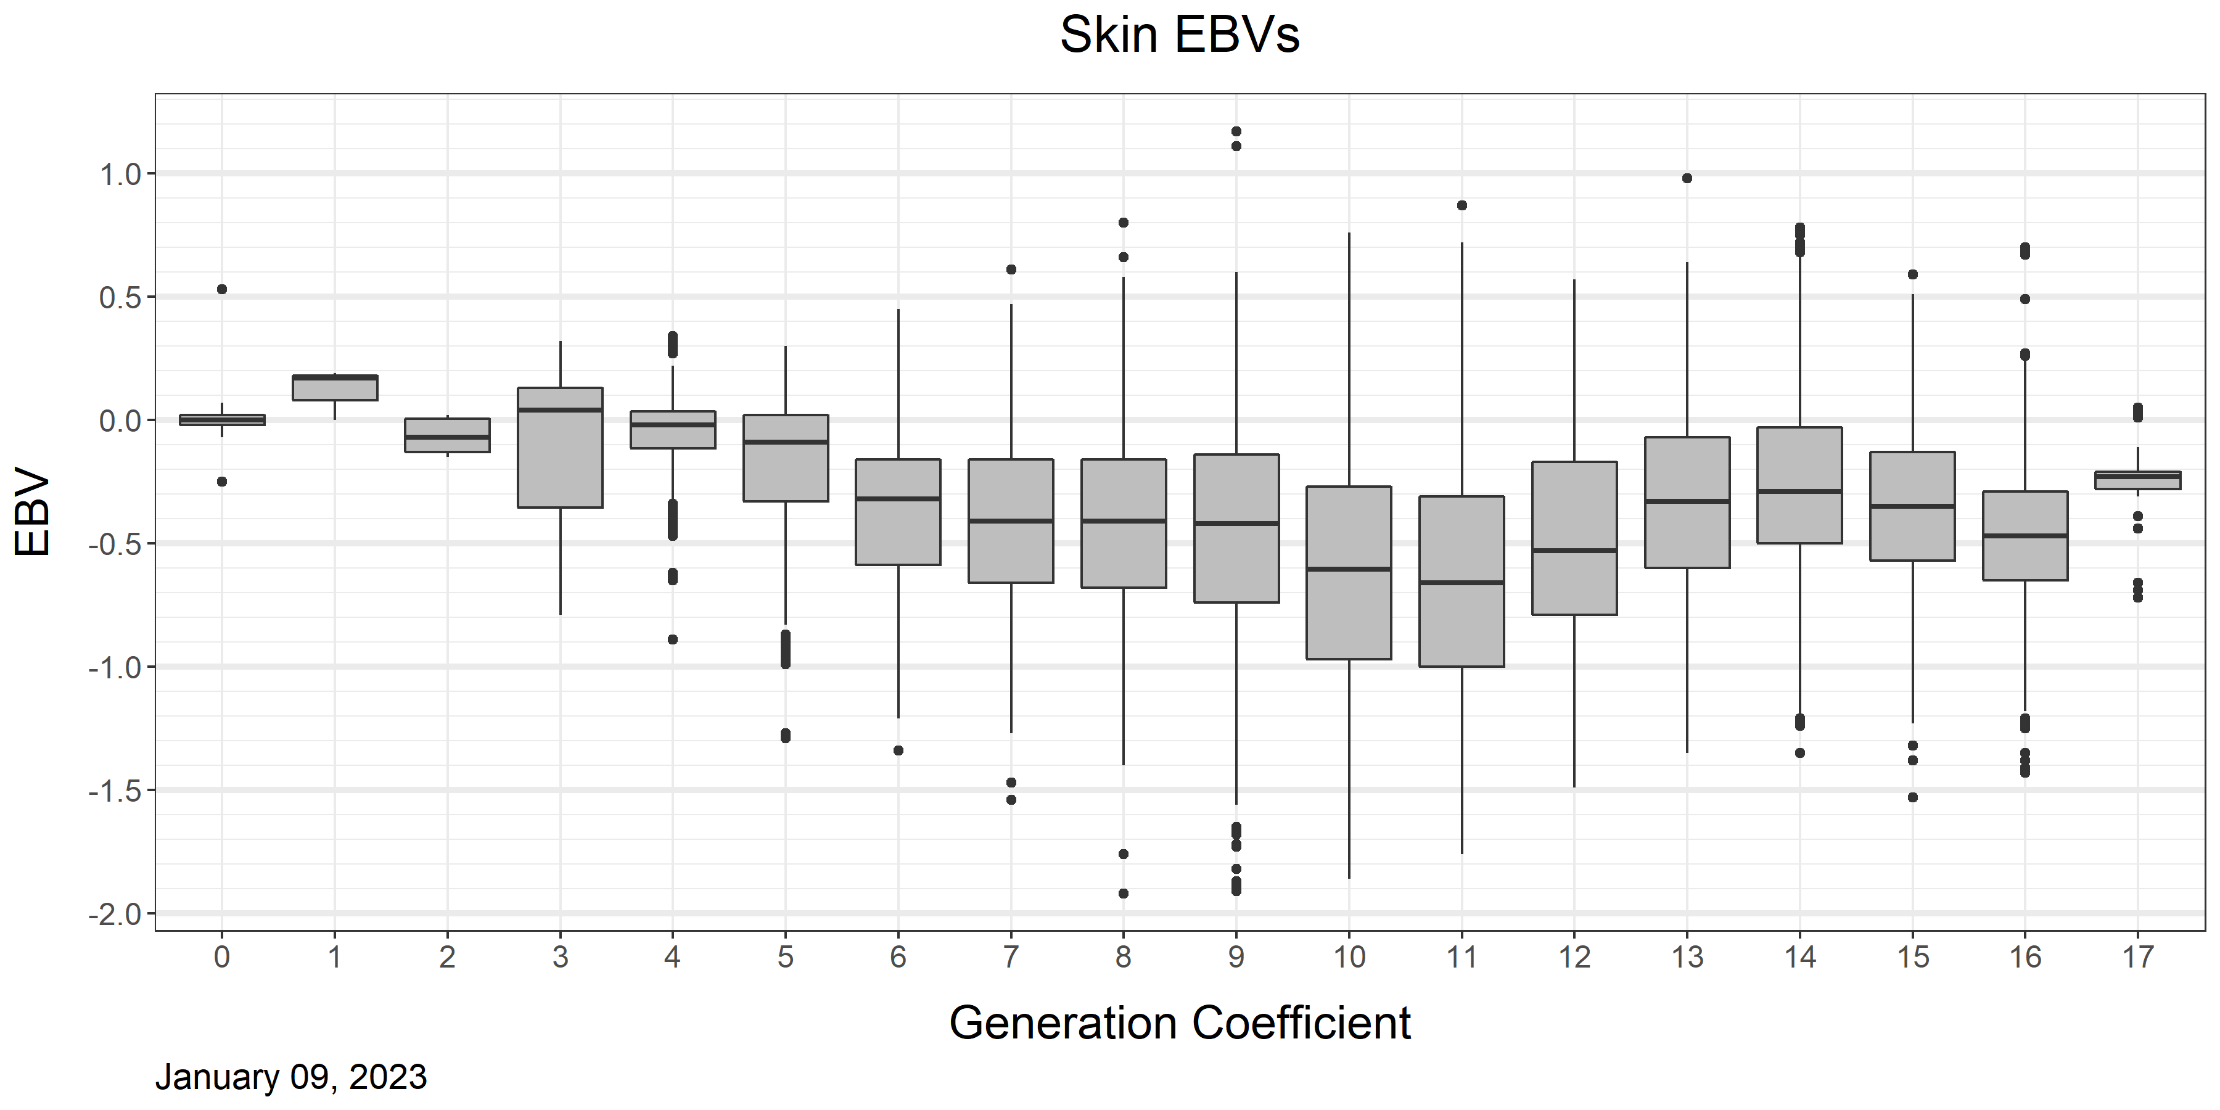
Skin Genetic Trend – GEB Data
h² = 0.395
2007: Better data
Modified diagnoses, Otitis ≥3 in 12 mo.= chronic otitis
2013: Influx of different breeders to address body sensitivity
2005: Skin & Otitis EBV first used
Influx of outside germplasm
For genetic diversity
Notes:
EBV changes before phenotype changes, esp. with low h² (typically ~3 generations).
Later onset can be tricky because you may already have selected & started breeding a dog by the time issues show up.

Slide 10
2005: EBV implemented
2012: Environmental change e.g. kennels more humid than usual?
2013: Breeding priority shifted away from skin/otitis
2017: Influx of outside studs
2019: Focus shifting back to skin/otitis
Notes:
Skin allergy/otitis are major reasons for release. Consider whole dog & whole picture: Focus on things affecting longevity & be sure they have measures. Consequence of not doing this = making improvements one trait while something else is inadvertently worsened
Skin allergy release refers to atopic-type dogs. Otitis is included in allergy EBV and generally move together (otitis being harder to get rid of) with few exceptions. Ear infections have a genetic component.
One year spike without degradation in EBV usually isn’t cause for alarm.
Outside dogs brought in for diversity or shifting priorities – gain what you want from that. Work through sorting out over time.

Slide 11
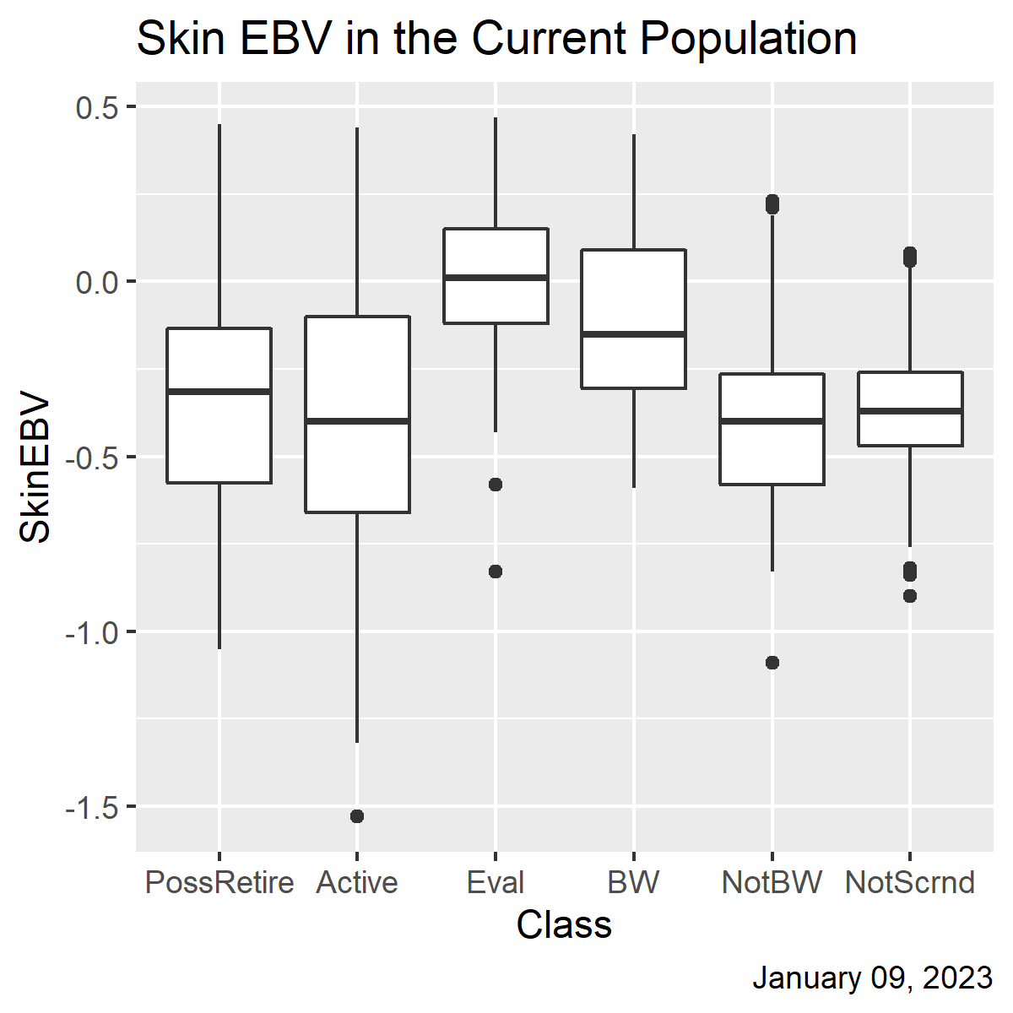
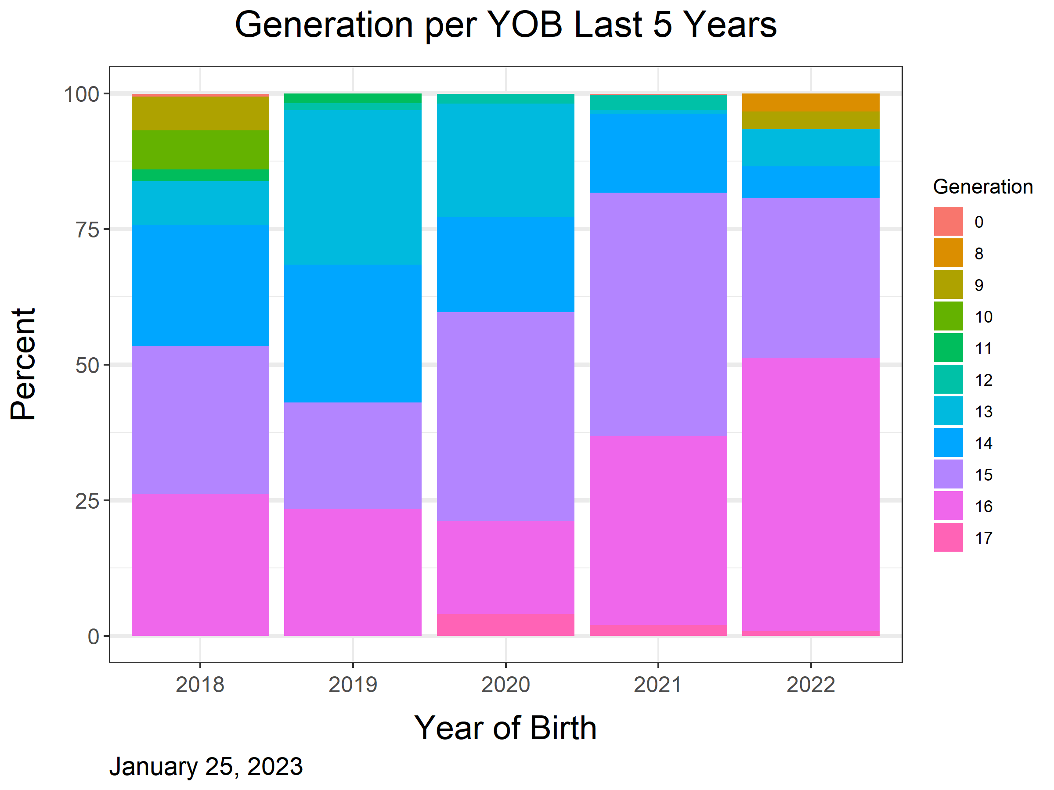
Timeline of Genetic Progress: GEB Skin Data
14
14
14
14
15
14
15
15
15
15
Progress lost when dogs leaving the colony were stronger
Lag in progress timeline: A year’s production is mixed among multiple generations, therefore progress may look slower
Progress made when new dogs kept are stronger than dogs not kept/leaving
Notes:
Newer generation is better, but still breeding dogs that could be several years behind in any given calendar year. Want to turn over generations quickly.

Slide 12
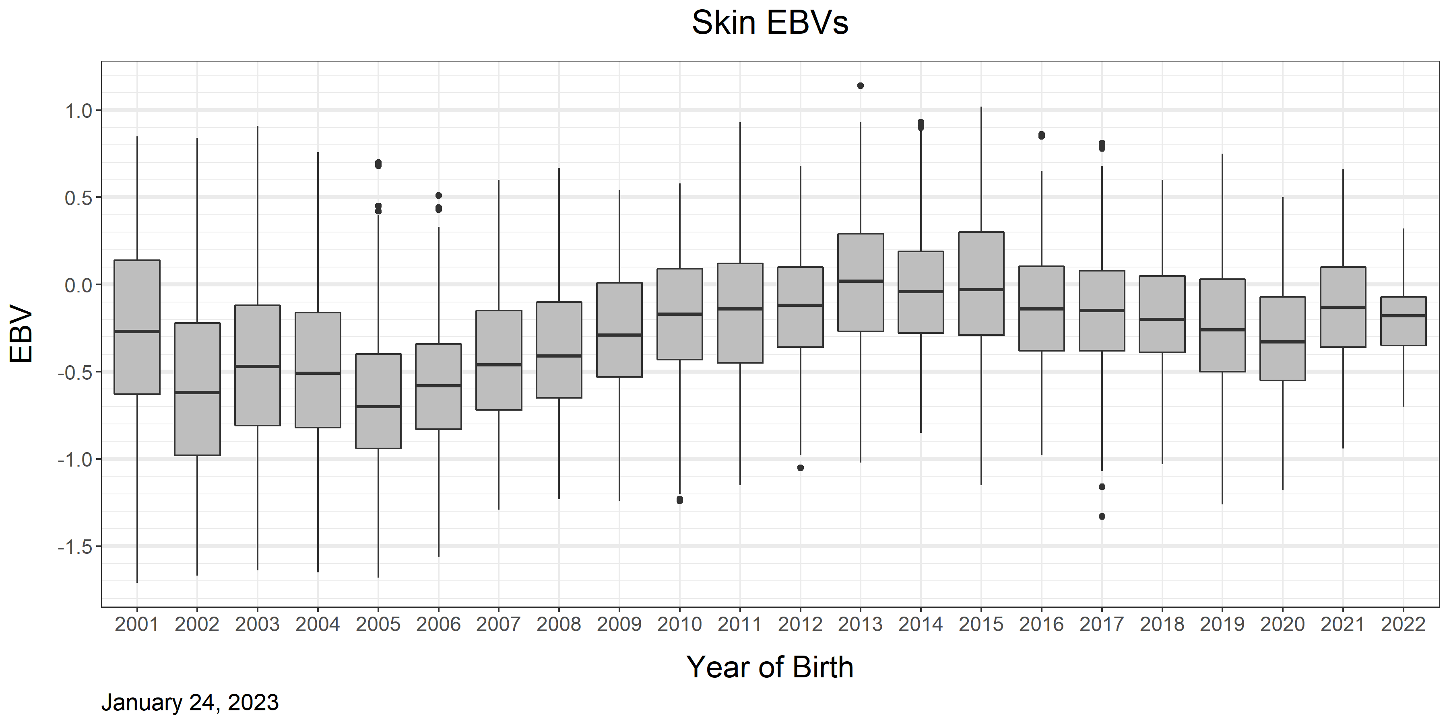
Skin Genetic Trend by Year of Birth
h² = 0.395
Notes:
Gen doesn’t say how you’re doing at a specific time so looking at YOB to see how decisions/progress are going bc any YOB has many generations

Slide 13
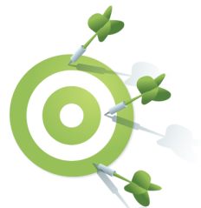

Summary: Skin
Responds well to genetic selection. Select young breeders from families with lowest incidence of skin allergy and otitis.
Requires accurate data on many relatives & can be later onset: Annual health survey of dog’s owners helps track changes with age. Continue getting data on all relatives at least until at least 5 years of age.
 | Labrador Retriever (GEB) | Labrador Retriever (IWDR) | German Shepherd (IWDR) | Golden Retriever (IWDR)
Heritability | 0.395 | 0.353 | 0.279 | 0.459
12 mo.
5 years

Slide 14
Elbow Dysplasia

Slide 15
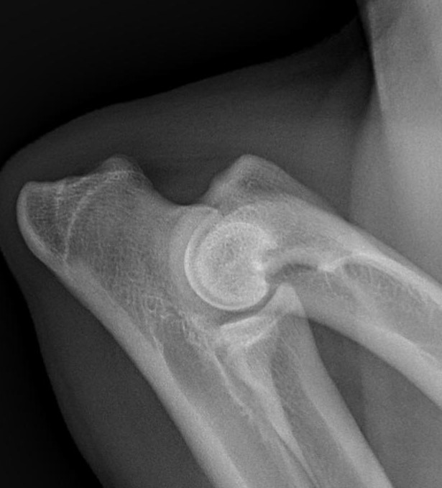
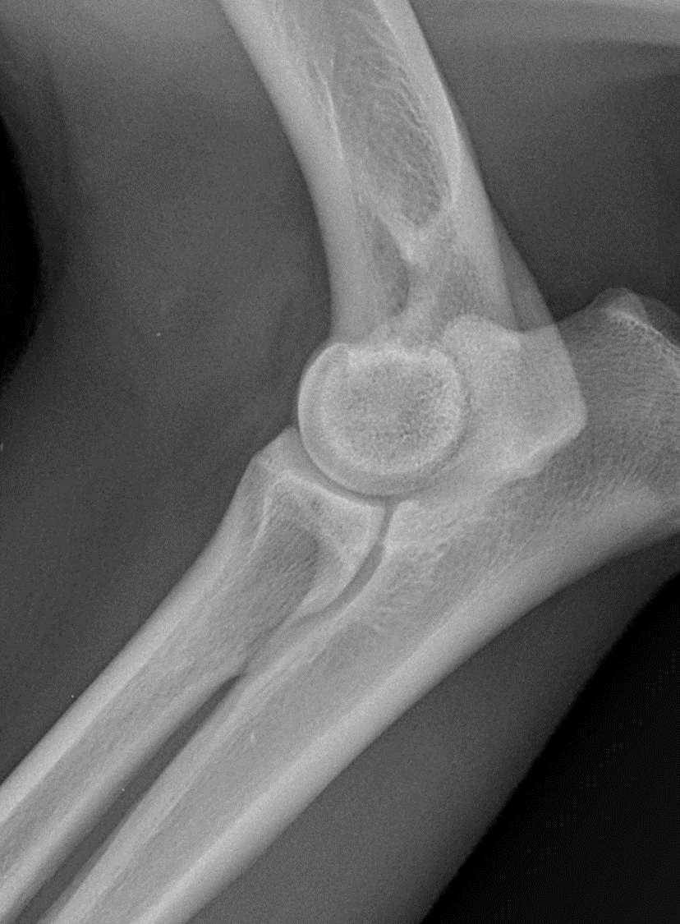
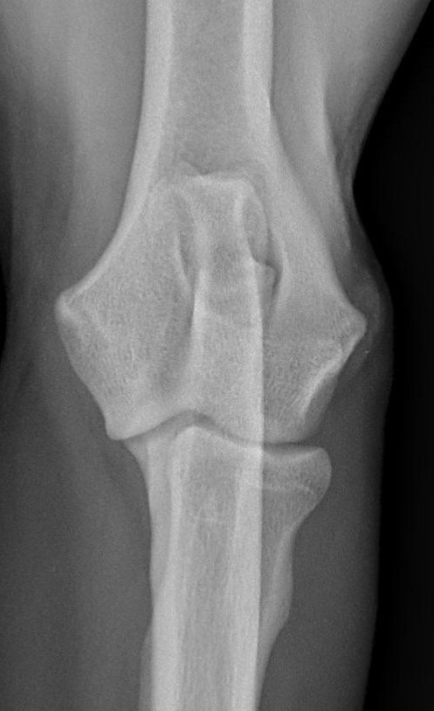
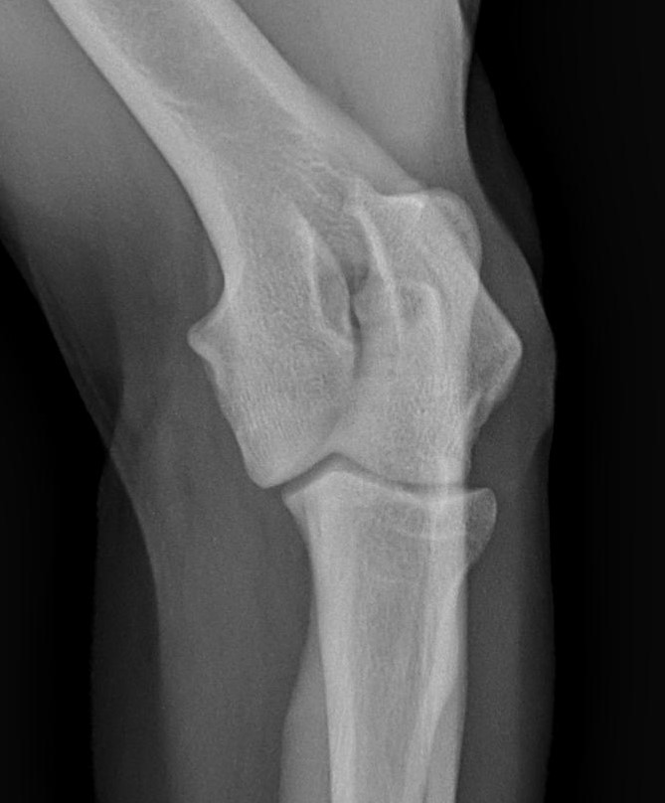
Radiograph Views For Elbow Diagnoses
Multiple conditions = need different views to correctly identify.
Elbow Diagnosis | ML Flexed | ML extended | Cranial Caudal | Cranial Caudal Oblique
Medial Coronoid (MCD) previously FCP |  | x |  | x
Ununited anconeal process (UAP) | x
Osteochondrosis (OCD) |  |  | x
Kissing lesions – look like OCD but are secondary to MCD | x | x
Incongruity |  | x
Summary from IWDR: https://www.iwdr.org/elbow-dysplasia-screening/
PowerPoint download from FCI website: http://www.fci.be/medias/SCI-ART-DYS-COU-MDU-en-1744.ppt

Slide 16
Identifying Elbow Dysplasia
(Radiographs)
ML flexed
ML extended
Cranial Caudal
Cranial Caudal
Oblique
Measure: https://www.iwdr.org/elbow-dysplasia-screening/
  4 views is best
  Read by certifying agency (FCI, OFA, BVA), not a local veterinarian
Age:
  IDEAL: 15-18 months old
  Minimum: 12 months old
  Breeders: Re-screen at 36 months (3 years) old
Which Dogs: All dogs (breeders, working candidates, released of appropriate age)
Notes:
Single flex view may miss FCP/MCD – common pathology

Slide 17
Identifying Elbow Dysplasia
(CAT Scan)
Alternative way of measuring elbow quality gaining popularity in some parts of the world
Accuracy for selection is better than radiographs.
May be able to identify MCD at younger ages than radiographs.
May be cost prohibitive and/or less available in some places.
See extra slides for references/further reading.

Slide 18
IWDR* Elbow EBV Model – same as Skin
 | Labrador Retriever | German Shepherd | Golden Retriever
Heritability | 0.312 | 0.268 | 0.204
Trait: score of lowest-scored (most undesirable) elbow diagnosis
Fixed effects: sex
Covariates: percent inbreeding
Random effects:
  Age of dog in days when evaluated for elbow quality
  Dog ID
*GEB model shown next differs.
Notes:
GEB model: mean + animal + residual

Slide 19
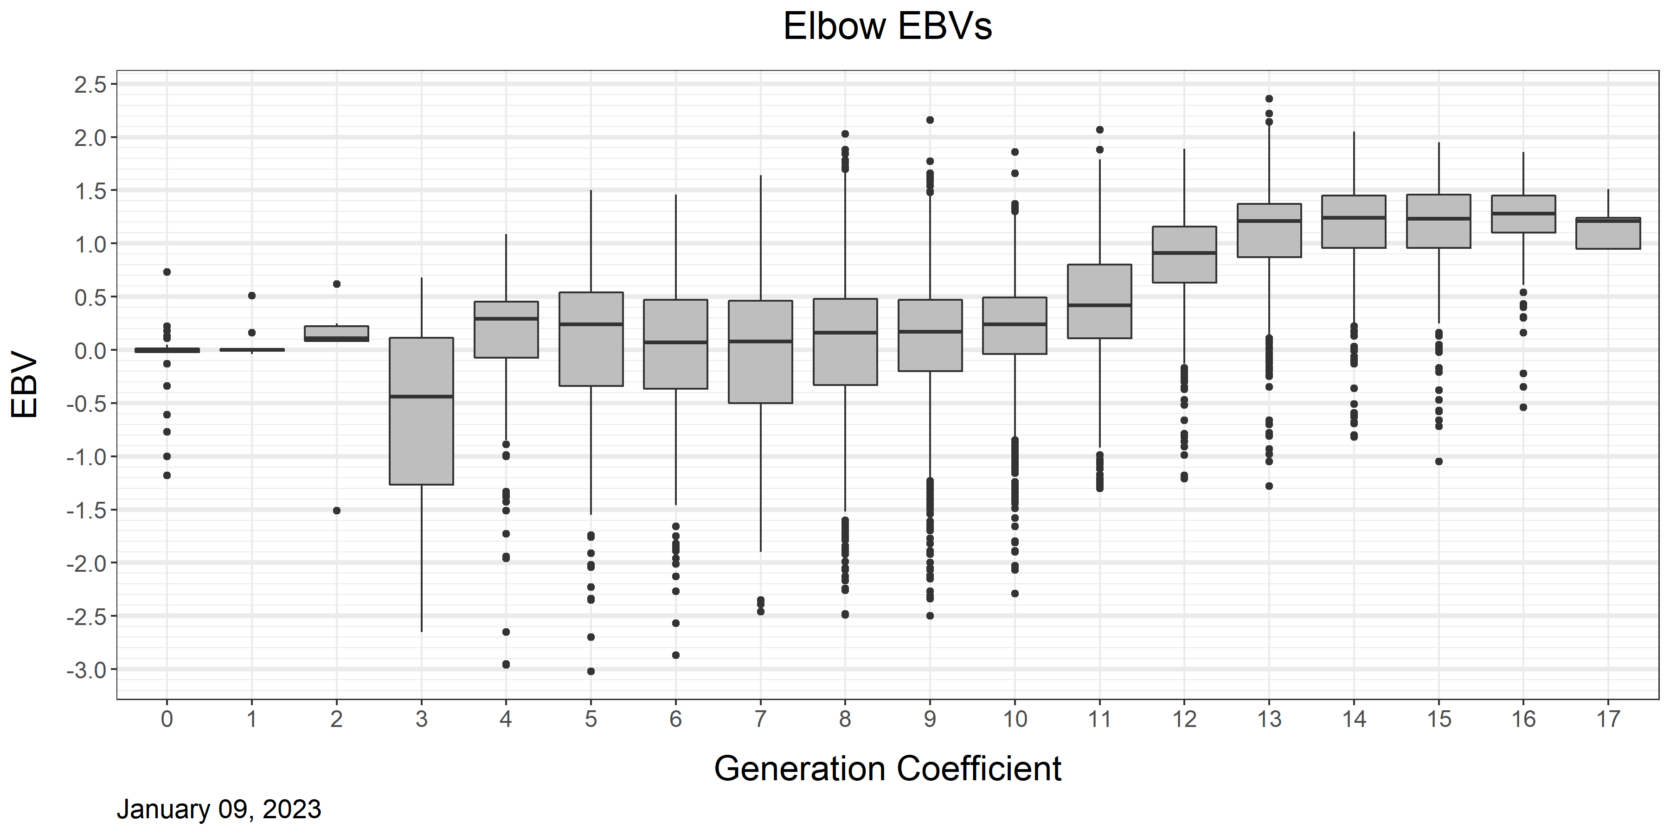
Elbow Genetic Trend by Generation
h² = 0.59
Notes:
Note recent generations stalling out, may be starting decline. See next slide.

Slide 20
*Birth years 2021 and 2022 excluded due to low number of dogs screened to-date.
Notes:
Note for a while only 1 view was done, suspect some incidences may have been missed leading to inaccurate EBVs and less-than-optimal selection. Multiple views

Slide 21
Summary: Elbow Dysplasia
Consists of several diseases seen with different radiographic views
Screen all dogs ideally at 15-18 months old but no younger than 12 months old. Recheck breeders at 36 months.
Responds to genetic selection, but several radiographic views read by certifying agency (not a local vet) or CAT scan are necessary to get accurate data for accurate selection.
 | Labrador Retriever (GEB) | Labrador Retriever (IWDR) | German Shepherd (IWDR) | Golden Retriever (IWDR)
Heritability | 0.594 | 0.353 | 0.279 | 0.459

Slide 22
Mast Cell Tumors

Slide 23
Mast Cell Tumors
Common type of malignant skin tumor.
Can be graded by biopsy/histopathologic analysis: Lower grades are less aggressive.
Average age of onset in GEB colony = 7 years old, so need to survey dog owners/handlers about health through advanced ages.
Notes:
https://www.vet.upenn.edu/docs/default-source/ryan/oncology-handouts/final-canine-mct.pdf?sfvrsn=4
https://www.acvs.org/small-animal/mast-cell-tumors

Slide 24
Mast Cell Genetic Model (GEB Labradors)
Doesn’t currently have an IWDR EBV
Heritability about 30%
Trait: Age of onset (2 parts: min and max age. Driving toward later onset – using score did not drive continued improvement.)
  Cases: min age = max age
  Controls:
    Min age is 6 or less depending on last exam
    Max age is infinity (did not get disease)
Fixed effects: Sex
Random effects: Dog ID
Notes:
survival analysis looking at age at first onset, goal is have dogs never get it but if they do get it as old as possible so minimal impact on life – requires health survey.

Slide 25
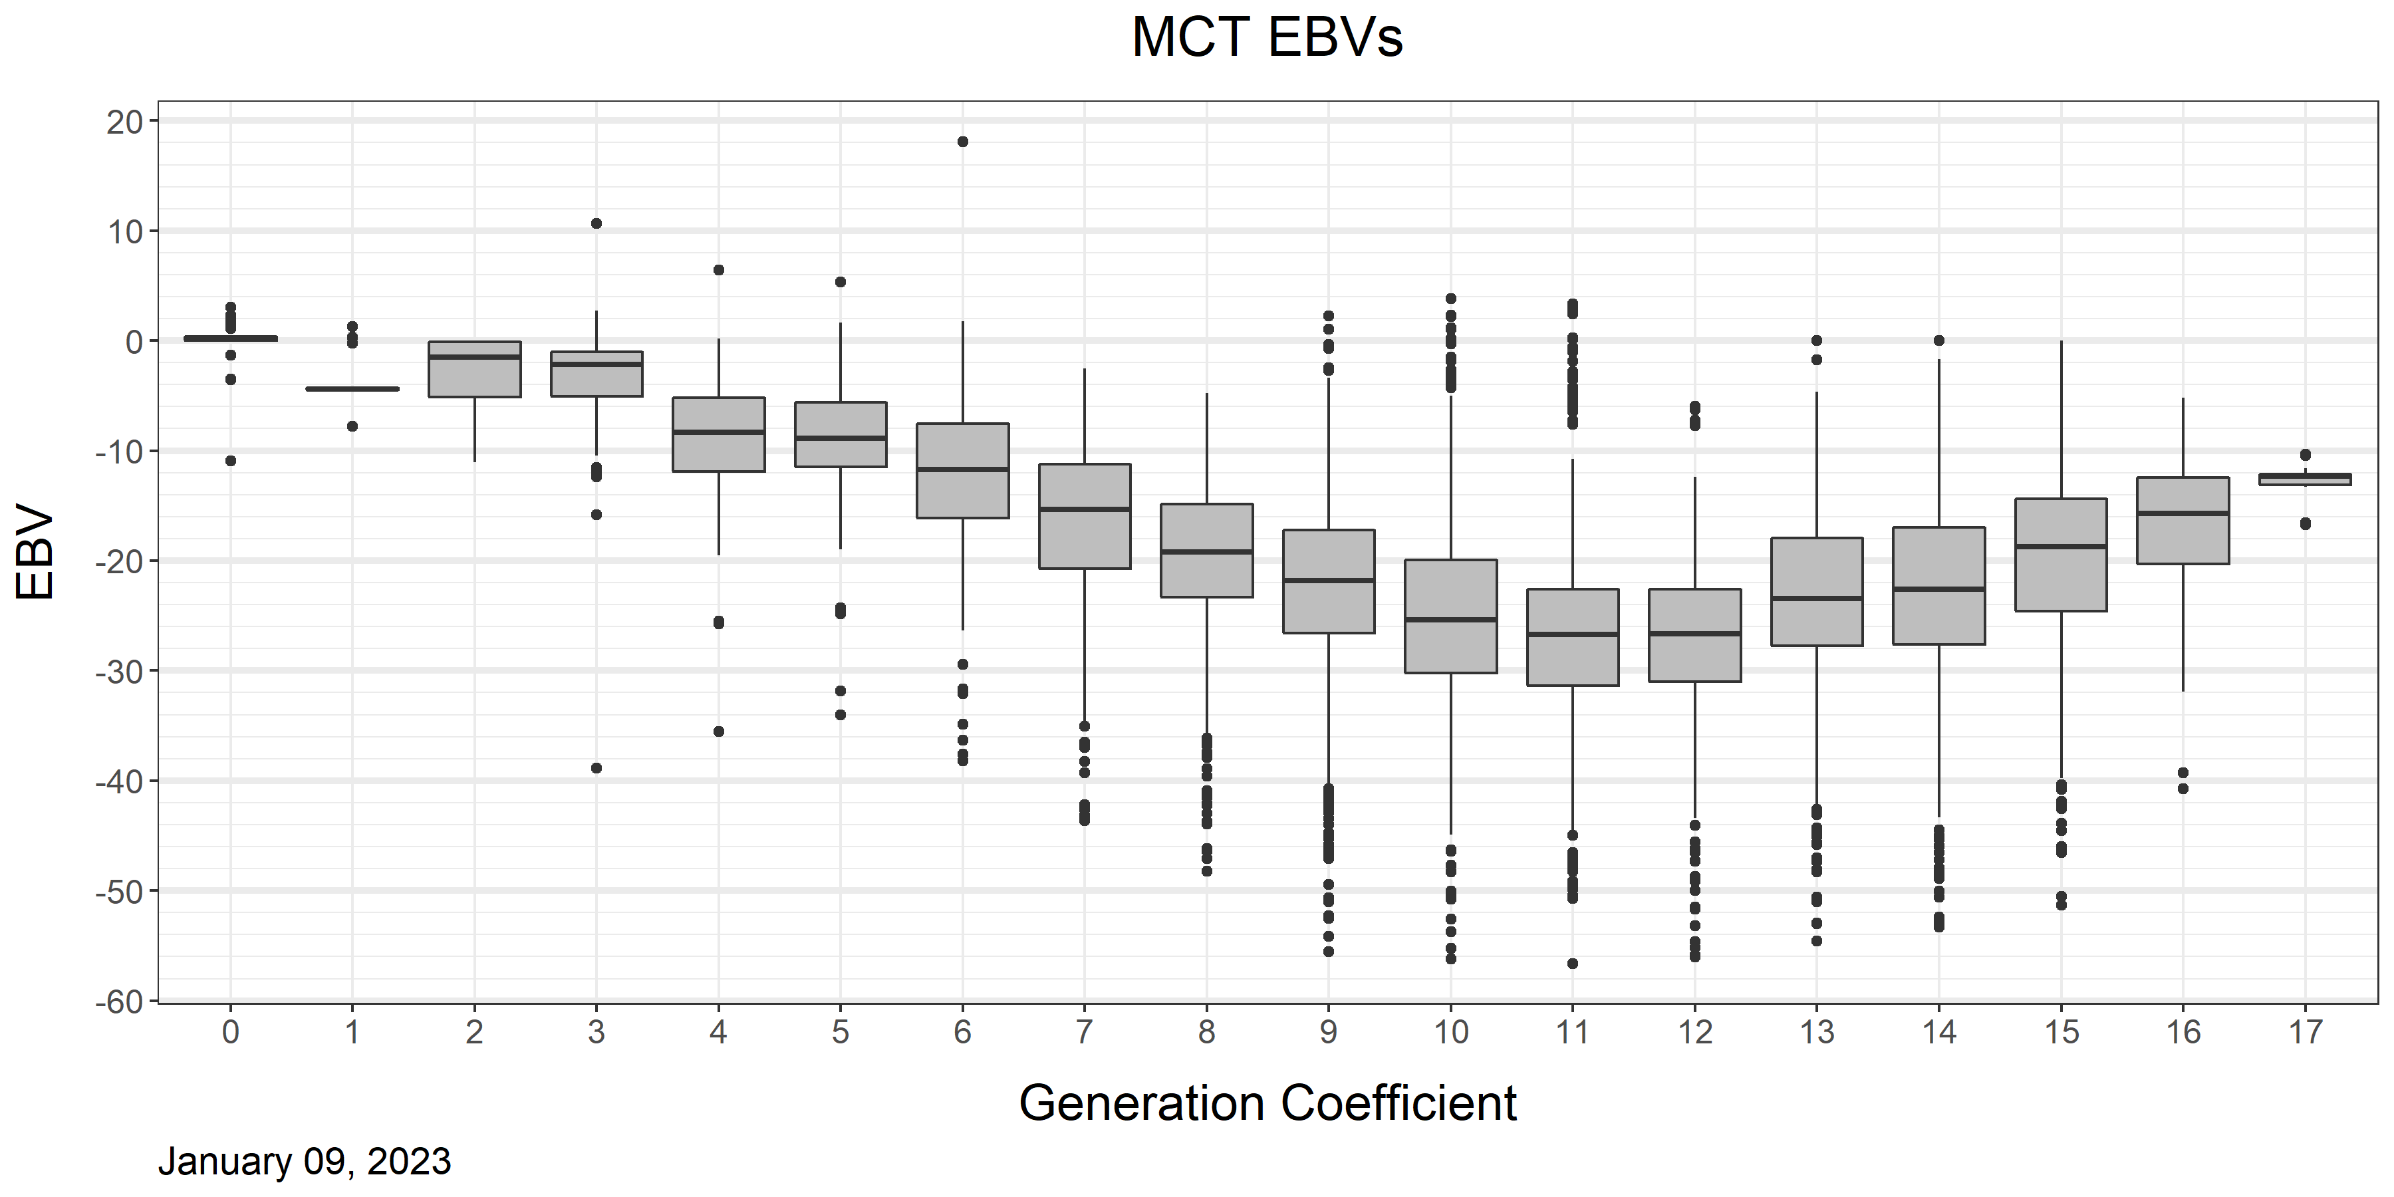
Mast Cell Genetic Trend by Generation
h² = 0.30
EBV based on grading
EBV model changed to consider age of onset as trait
Notes:
Old model ~12-14. Classification based on grades. Initial improvement but no change after that. Broad didn’t see big association between EBVs and genomic work.
Then transition to survival model. Goal is that dogs never get it but if they do, get it as old as possible so minimal impact on life..

Slide 26
Notes:
Expecting data at average age onset for 2015 & 2016 born dogs NOW.

Slide 27

EU & US cluster
The outlier group consists of the Guiding Eyes for the Blind dogs.
114 affected, 119 controls. Inflation factor 1.08.
EU&US cluster
Notes:
2016 study – populations differ, MCT can be genetically different between colonies.
Can’t assume your population has same genes causing MCT – org effect important and genomic could help in future.
EBVs will help correct even if mixing populations as long as everyone is getting data.

Slide 28
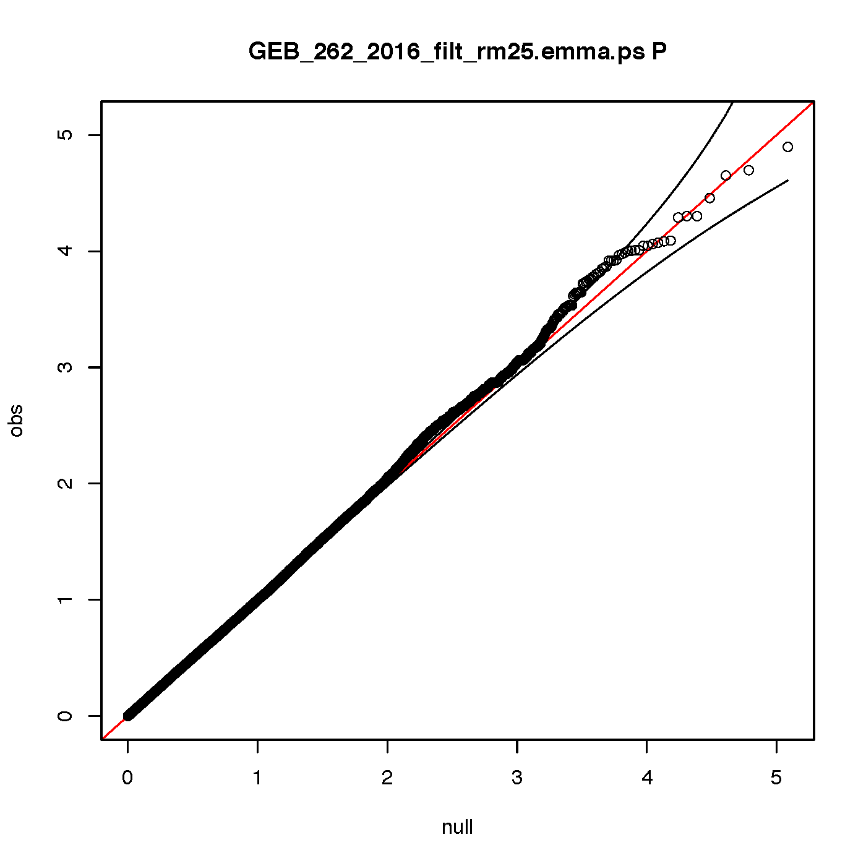
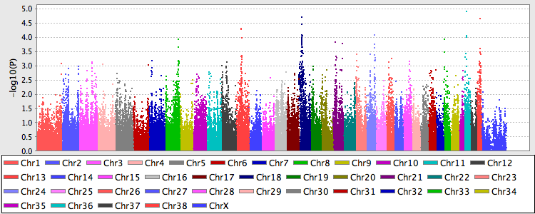
GEB GWAS analysis based on mast cell tumor cases and controls
No significant association identified
261 individuals 141 cases 120 controls (recently updated phenotypes) after removing individuals related more than 25% there are 101 cases and 64 controls. Analysis performed using the emmax software. No deviations from the expected p-values in the qq-plot are seen.
QQ plot to the left shows expected versus observed p-values, a deviation from the expected normal indicates significance. 95% confidence interval is indicated by thin black line.
Manhattan plot to the right shows dots for each SNP in the analysis. Location of each SNP is on the x-axis and on the y-axis the -10log p-value is noted.
Notes:
Low-effect genes – cancers tend to be related to immune issues which are complex with many genes
Cancer is a high area of research. HSA project getting going, have estimate of h2 in Labradors 0.28.

Slide 29
Summary: Mast Cell
Need substantial longevity data, ideally lifetime (average age of onset is 7 in GEB colony – want to capture at least through then)
Responds to selection, especially when considering age of onset (goal = never get it, but if they do, it happens at more advanced ages)
Can be genetically different between colonies/populations. EBVs can still help if populations mix providing everyone is collecting data.

Slide 30
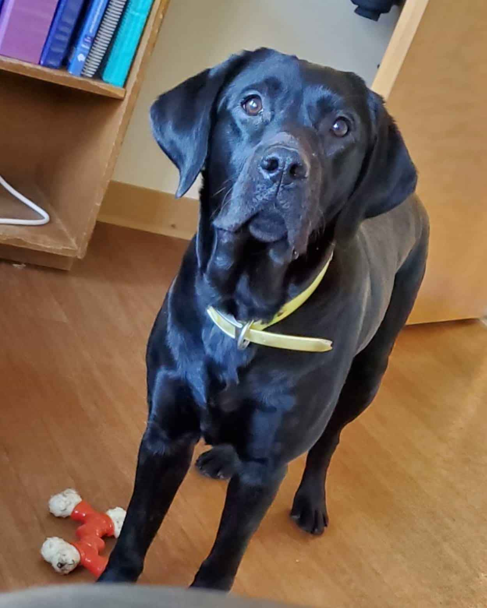
Questions?

Slide 31
Extra/alternative slides

Slide 32
Some References for CT Scans for detecting Elbow Dysplasia
Hazewinkel, H.A.W. and Lau, S. F. Pathogenesis of fragmentation of coronoid process. Proceedings of the 34th IEWG Meeting, Nice, 2022.
Lau S.F., Wolschrijn, C.F., Hazewinkel, H.A.W., Siebelt M., Voorhout G. The early development of medial coronoid disease in growing Labrador retrievers: radiographic, computed tomographic, necropsy and micro-computed tomographic findings. Vet J. 2013;197:724–30. https://doi.org/10.1016/j.tvjl.2013.04.002
Villamonte-Chevalier, A., van Bree, H., Broeckx, B., Dingermanse, W., Soler, M., Van Ryssen, B., and Gielen, I. Assessment of medial coronoid disease in 180 canine lame elbow joints: a sensitivity and specificity comparison of radiographic, computed tomographic and arthroscopic findings. BMC Vet Res 11, 243 (2015). https://doi.org/10.1186/s12917-015-0556-9

Slide 33
Summary of Health Measures Needed
https://www.iwdr.org/master-knowledge-base/what-data-should-i-collect/
Health Trait | Need
 | Which Dogs | Age | Best Method
Elbow | All | ≥12 mos Ideally 15-16 mos Repeat 36 mos | 4 radiographic views read by certifying organization or CAT scan https://www.iwdr.org/elbow-dysplasia-screening/ http://www.fci.be/medias/SCI-ART-DYS-COU-MDU-en-1744.ppt
Skin | All | All diagnoses, lifetime or at least 5 years | Use definitions to assign diagnoses. Owner survey for dogs not in organization’s direct care.
Mast Cell | All | All diagnoses, lifetime or at least to 7-9 years old | Owner survey as dogs age – need data through advanced ages.

Slide 34
Data Used in Addition to Health Data
Sex of the dog (males vs. females; fixed effect)
Age in days when phenotype was measured (covariate)
Inbreeding level- determined by which male is chosen to be the father (covariate)
Blue Color- You influence these data

Slide 35
Heritability of Health Traits
 | GEB | IWDR
Trait | LR | LR | GS | GR
Skin | 0.395 | 0.353 | 0.279 | 0.459
Elbow | 0.594 | 0.312 | 0.268 | 0.204
MCT | 0.298 | NA | NA | NA

Slide 36
Challenges of Each Condition
Skin:
  Average age of onset can be later – need health survey to get longevity data
  Interpreting owner responses can be intensive if the survey is not coded
Elbow:
  Need multiple radiographic views read by a certifying agency to properly identify several relevant diagnoses. May miss incidences otherwise.
Mast Cell:
  Average age of onset is at an advanced age – need health survey as with skin, but to an even later age.
Overall: Change in observable trait lags a few years behind change in EBVs.

Slide 37
Principles to Keep in Mind
Look at the whole dog & whole picture.
  If it matters for long term longevity, it must have measures in place
  Focus on the priorities
  Consequence of not doing this = making improvements one trait while something else is inadvertently worsened
It takes a long time to “turn around the airship.”
  EBV trend changes before phenotype changes, especially with lower heritability
  Usually ~3 generation lag
Occasionally choose mates that BOTH have strong EBVs to avoid accidentally losing exceptionally good genetic merit

Slide 38
*Data still accumulating – distribution likely to change

