Slide 1
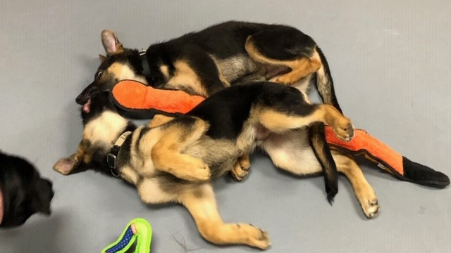
Improving Behavior With Estimated Breeding Values
Breeders Workshop, Vancouver Canada
May 1-3, 2023
Jane Russenberger,
International Working Dog Registry

Slide 2


Our Thanks To
What data are required
Best age to measure
Leading the way
Allowing use of their data and results
Estimates of heritability
Challenges
Response to selection
Users of IWDR for
Learning to use these
Tools and collaborating in IWDR

Slide 3
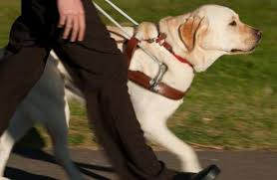

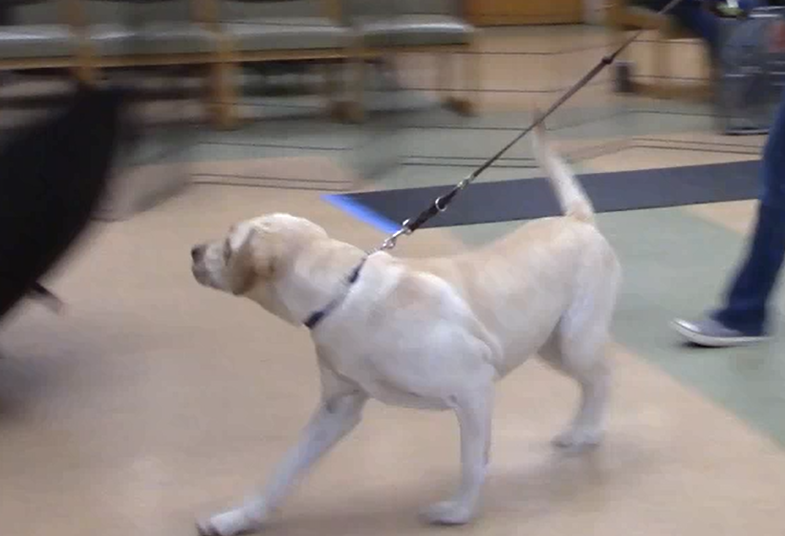
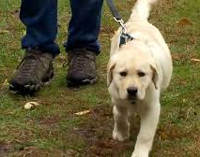
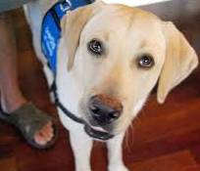
Multiple Measures- Same Scoring System
Graduated
Working Dog
Early Development
Age 3-8 weeks
Training
16-25 mo
2 months old
GDBart Pup Test
+ observations from early socializations
N>3000
  On all or most dogs- (even those rejected)
Trainer’s observation
In kennel, field work, social situations
Half-way in training
End of training
Also if withdrawn N>7,300
Puppy Raising
2-15 months
4,8,13 Mo W&T
Observe puppy walker –semi-standard assessment Group puppy class observations
Raiser surveys
N>9,000
Pre-train assessment
Ave age -16 months
Start of training
GDBart Adult Test
N>3400
Notes:
Define protocol to collect data- Assessment & Ages
Multiple measures- more reliable
Higher consistency
Shorter intervals between assessments
Same test
Ref: Personality Consistency In Dogs: A Meta-Analysis
Fratkin et al, Plos One,2013

Slide 4
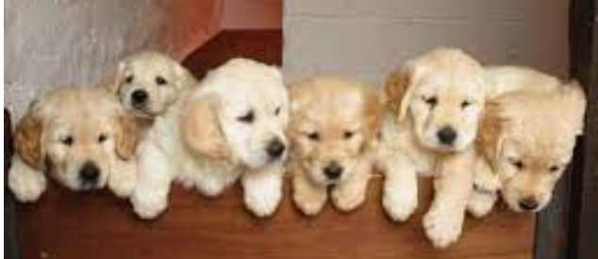

What Causes Observed Variation?
Genetic makeup fixed at conception
Sex and color won’t change due to the environment
Variation in aspects of behavior
very impacted by environment
Environmental influence
Genetic potential

Slide 7
What Influences Heritability?
 | Org Contemp Grp | Additive Genetic | Permanent Environment | Unexplained | Total
Variance | 0.13349 | 0.097725 | 0.029278 | 0.53056 | 0.79093
% Var/Total | 16.88% | 12.36% | 3.70% | 67.08% | 100.00%
Estimate of Heritability | Genetic Var/ Total Var: 0.097725/0.53056 = 0.12
Dogs evaluated in the same 3 mo period at an organization
Testing method per protocol, consistently done
Scoring accuracy
Data only on breeders (best phenotypes)
Distribution of genes across dogs measured in the population
Additive gene effects passed from parents to offspring
Family within a breed
Missing ancestors that tie pedigrees together
Learned Conditioned Emotional Response
  Sibling interactions (e.g. bullying)
  Fear of dam
Socialization quality & quantity at target ages
Raiser/trainer skills
Unaccounted for in the genetic model
Notes:
Permanent Environment can only be measured when the analysis is using repeated measures on an individual dog
Genetic Variance- Additive Genetic Variance that gets passed from parents to offspring
There are other genetic influences due to the unique combination of how the genes come together
Missing ancestors diminish the ability to parse out the portion of addititve genetic variances
5 generations is better - Possibly less important to have further generations for calculating additive genetic variances
That is why accuracy in the pedigree is so important – flow of germplasm across the generations is dependent on how the dog are related.
Inaccuracies in the pedigree distort those relationships.

Slide 9
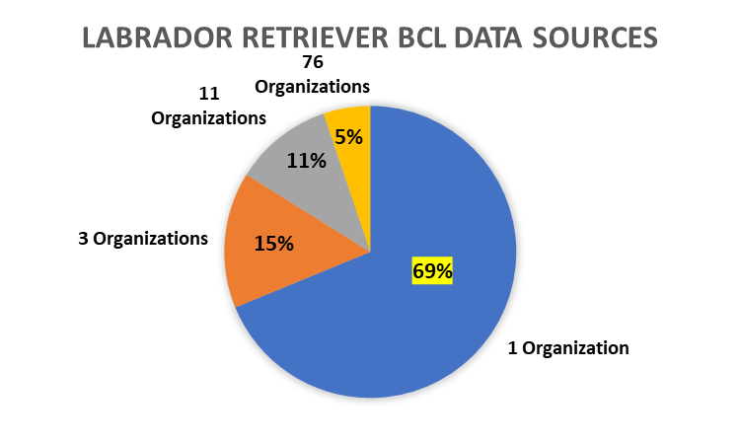
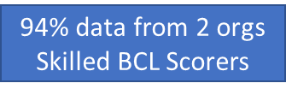
74% data from 5 orgs
Contemporary Grp Within Org | GR | LR | GS
Activated with Stress | 7.4% | 8.0% | 2.5%
Excitable | 2.8% | 5.7% | 7.0%
Resilience (return productive state) | 19.8% | 9.8% | 5.7%
ObjectFear | 17.0% | 18.6% | 4.2%
Noise Sensitivity | 11.6% | 16.3% | 6.3%
Lacks Initiative | 1.0% | 13.6% | 2.1%
Inhibited with Stress | 9.2% | 13.3% | 3.1%
HarnessSensitivity | 4.0% | 3.1% | 5.6%
Dog Distraction | 18.6% | 16.1% | 5.9%
ChaseAnimals | 10.1% | 11.1% | 0.7%
Body Sensitivity | 25.2% | 11.5% | 1.8%
31% data from 96 orgs
Variation Greater In
BCL Scoring Skills
Relatedness of Dogs
Completeness of data

Slide 10
Update N-Ped after 3/19

Slide 13
Choosing Where to Focus Genetic Selection Pressure
Need MZ to provide
Updated data from Monthly Inv
Requested 3/11- organize by trait

Slide 14
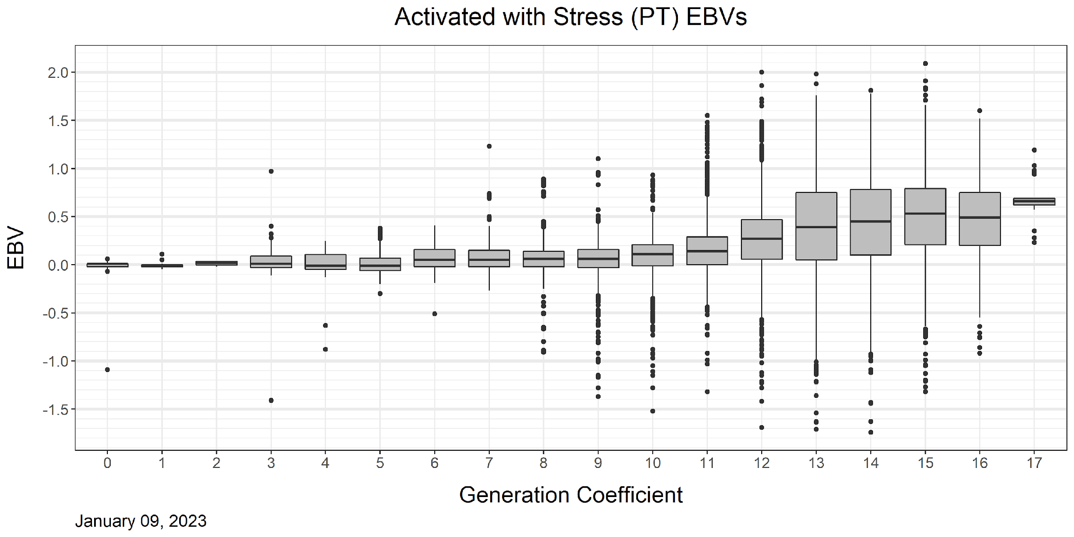
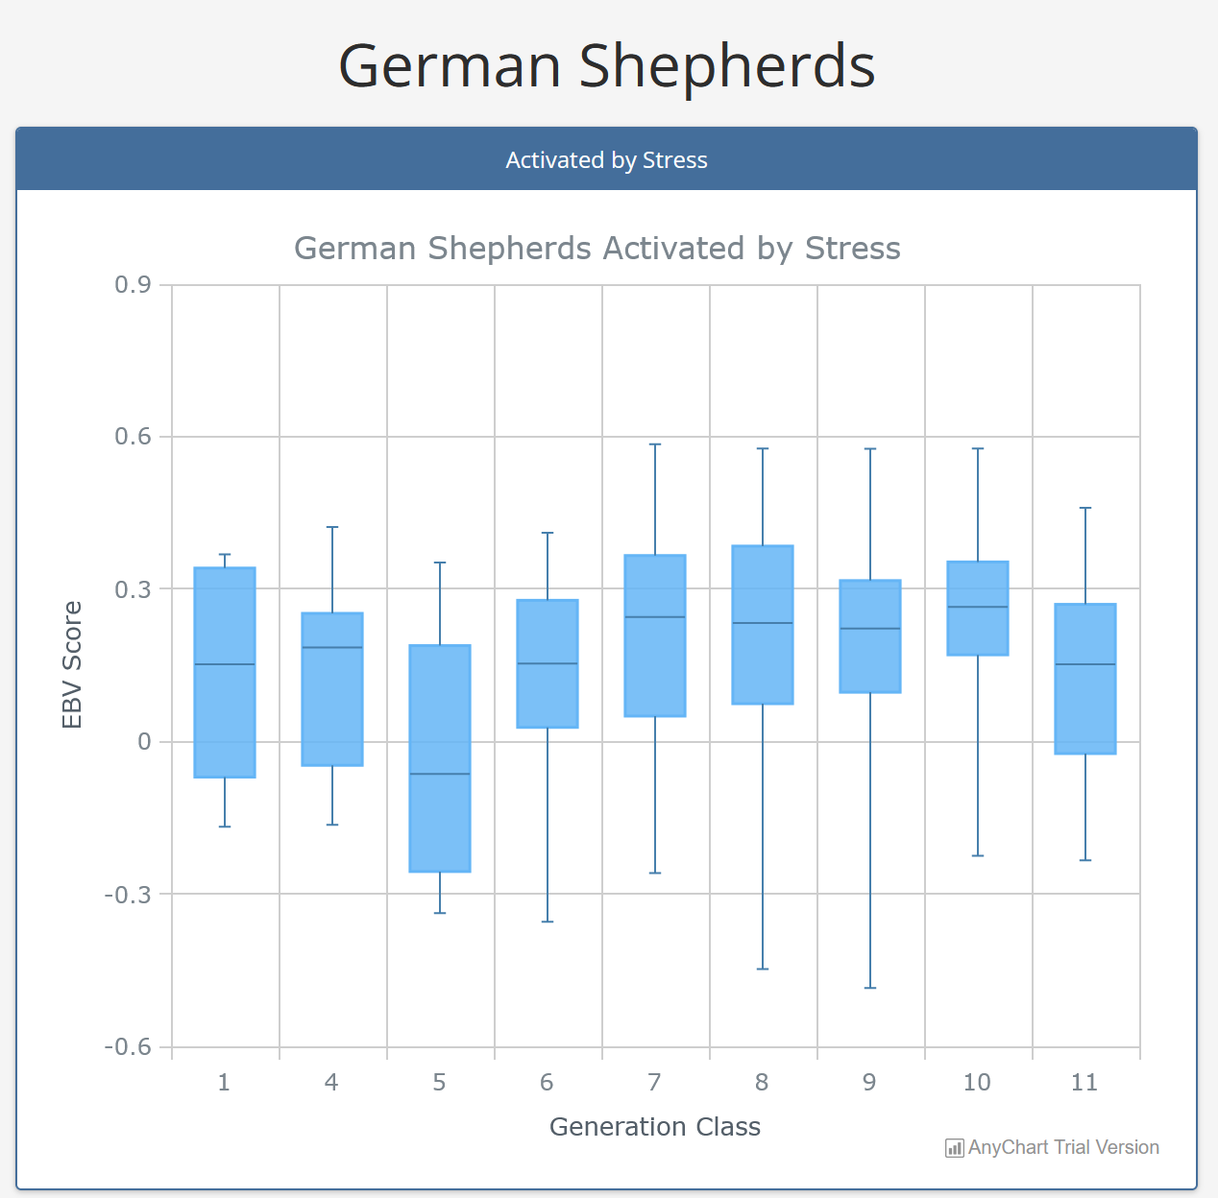
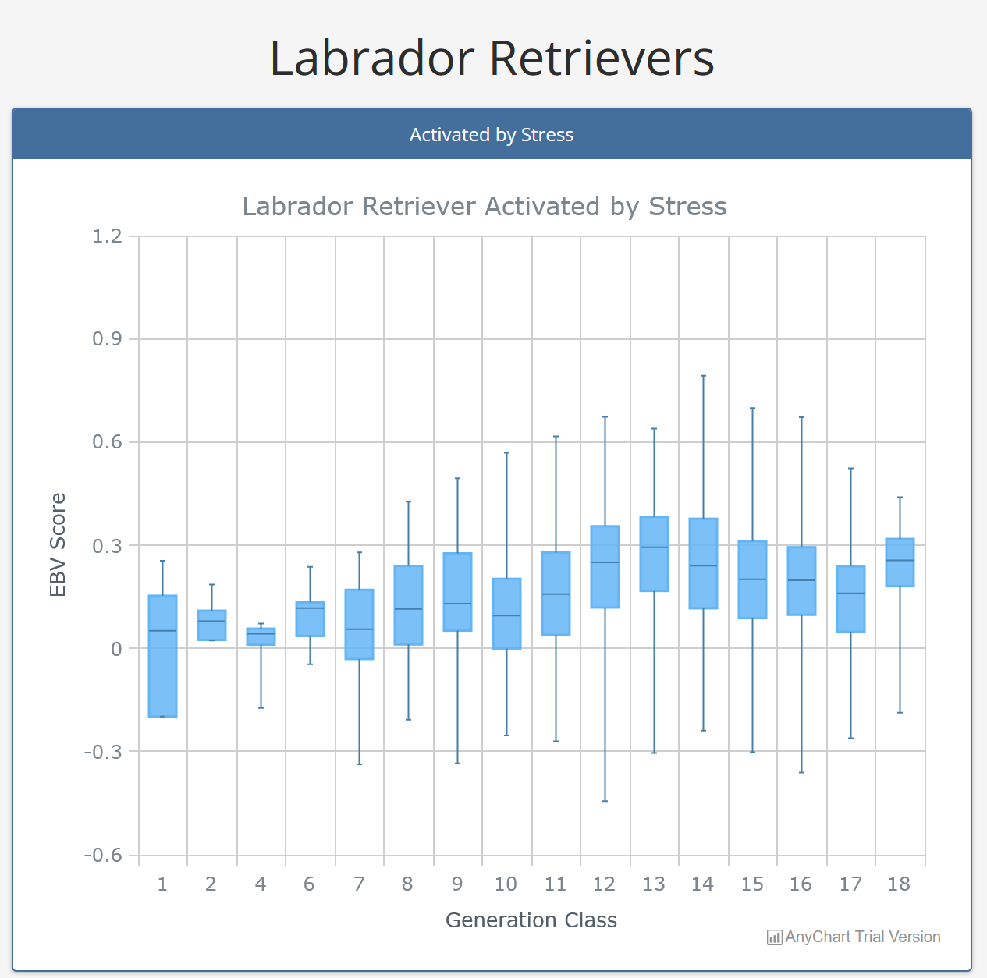
Activated by Stress
GEB LRs -different model- BCLs from Puppy Test
EBVs since xxxx LRs
Moderate selection pressure
No EBVs on GS until 2023
IWDR based on all IWDR data & all BCLs

Slide 15
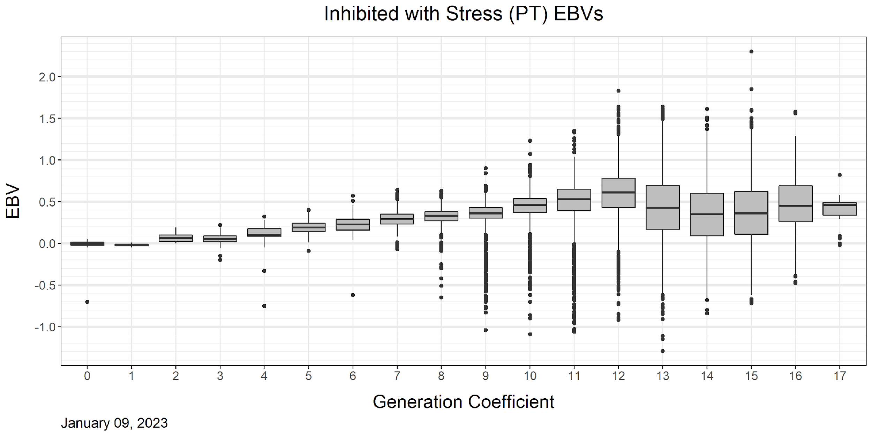
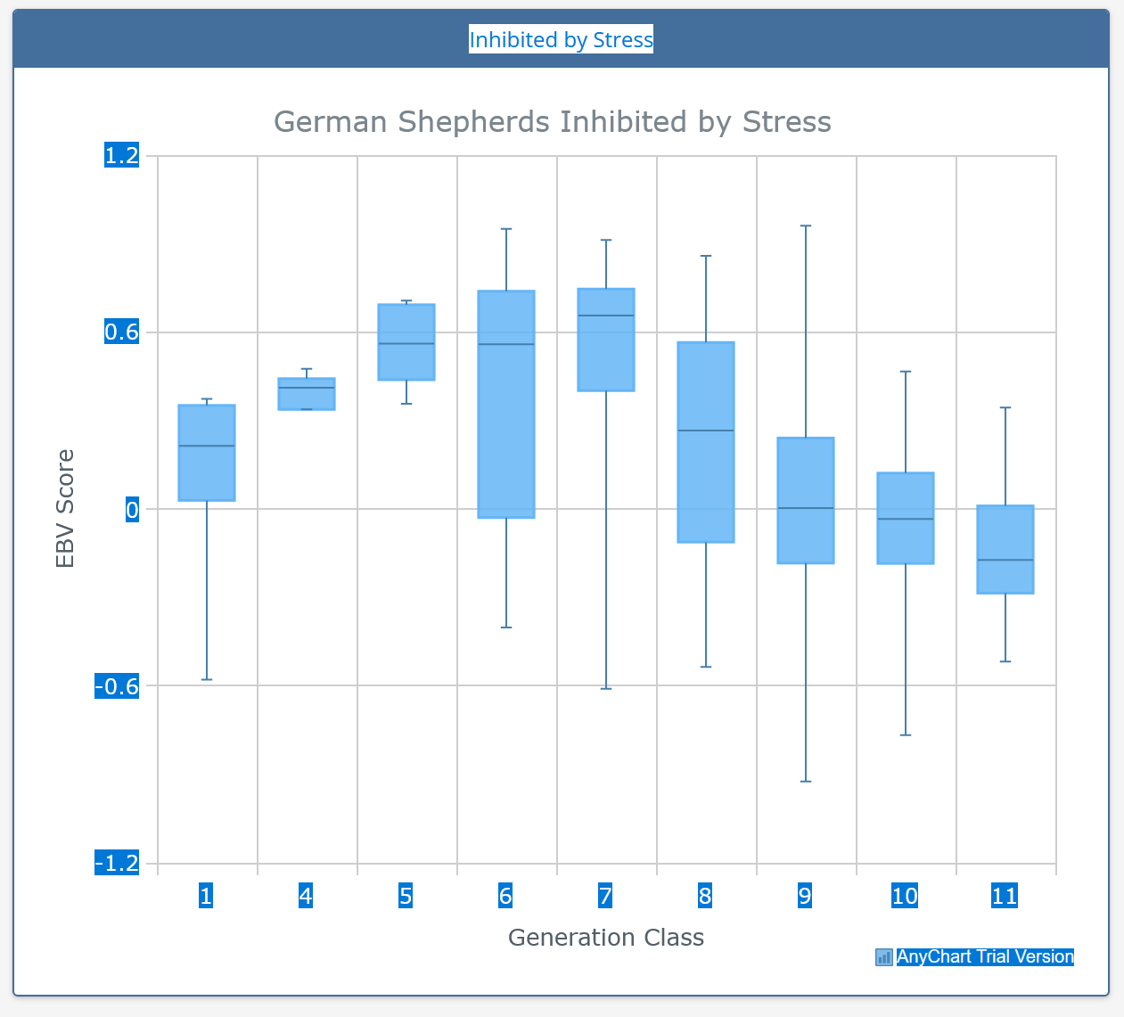
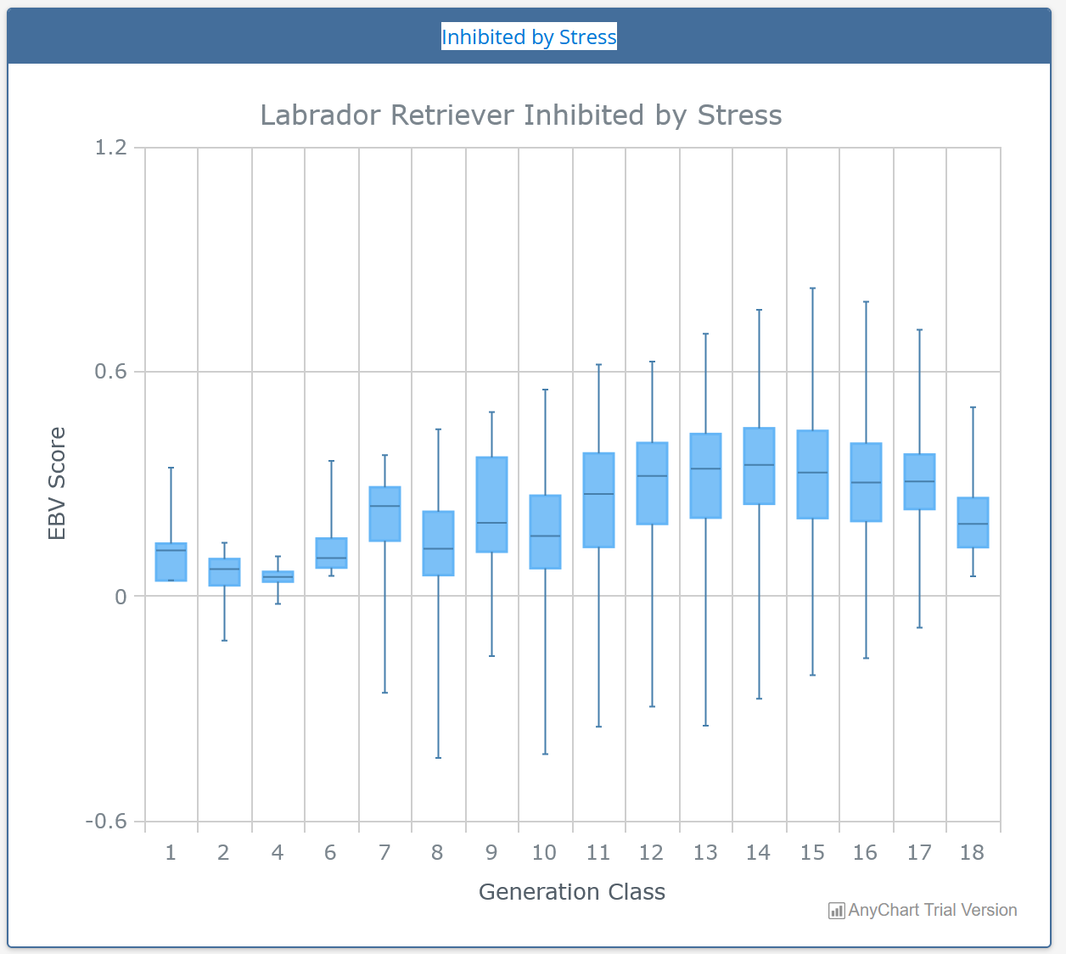
Inhibited by Stress
GEB LRs different model- BCLs from Puppy Test
EBVs since XXX in LRs
Small amount of selection pressure
No EBVs on GS until 2023
IWDR based on all IWDR data & all BCLs

Slide 16
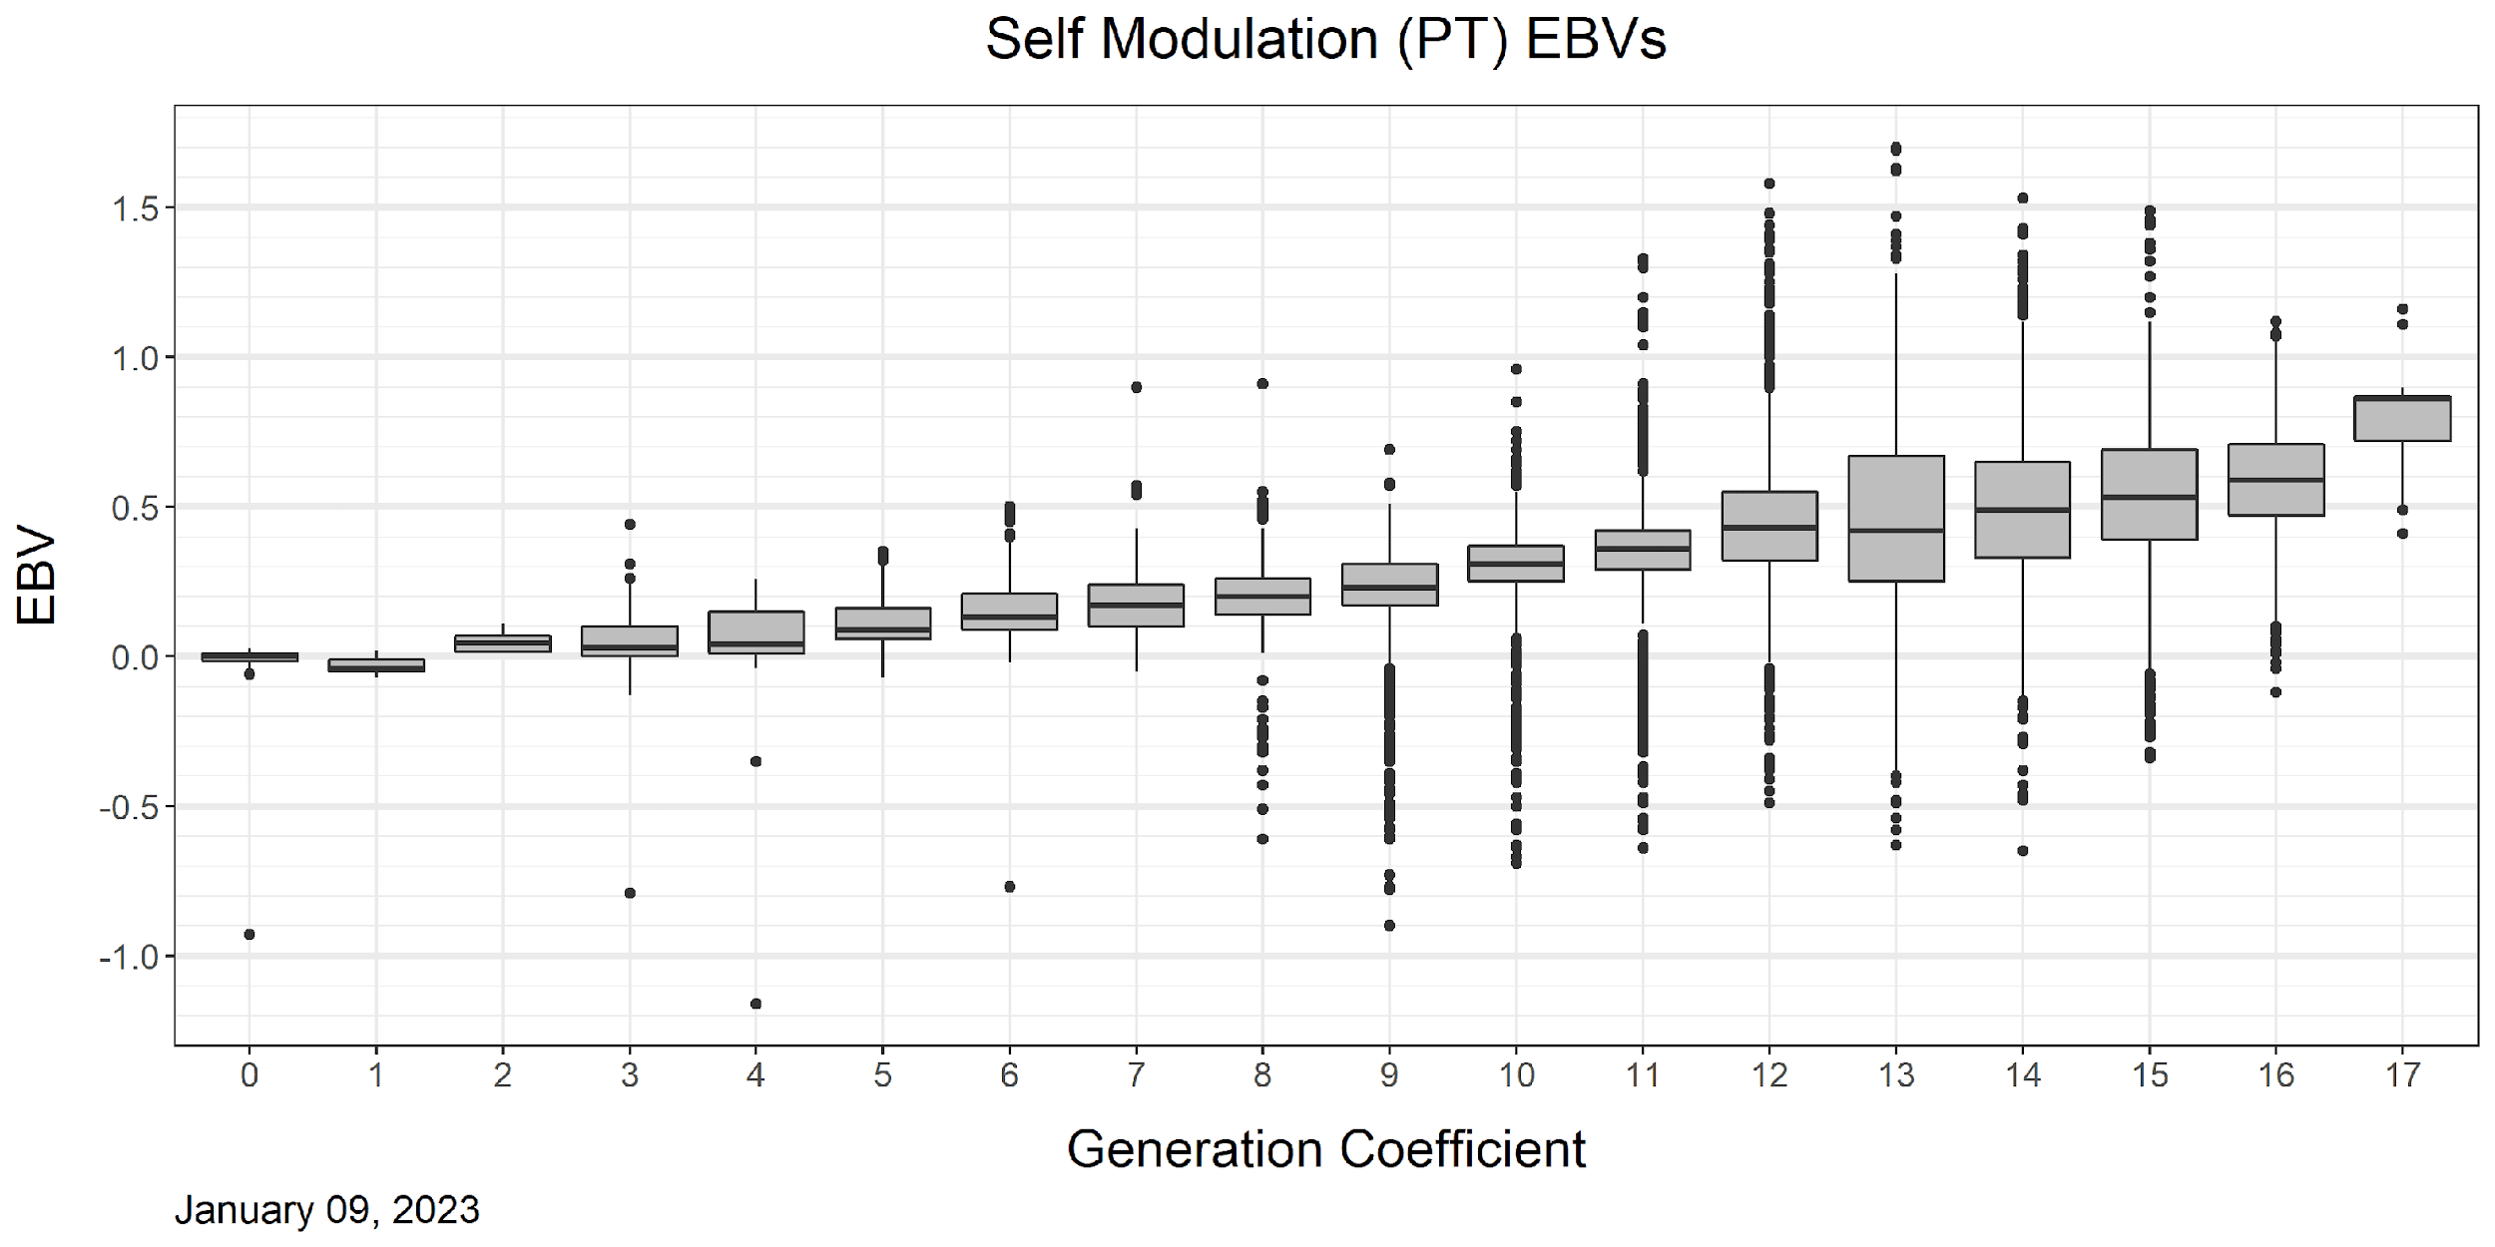
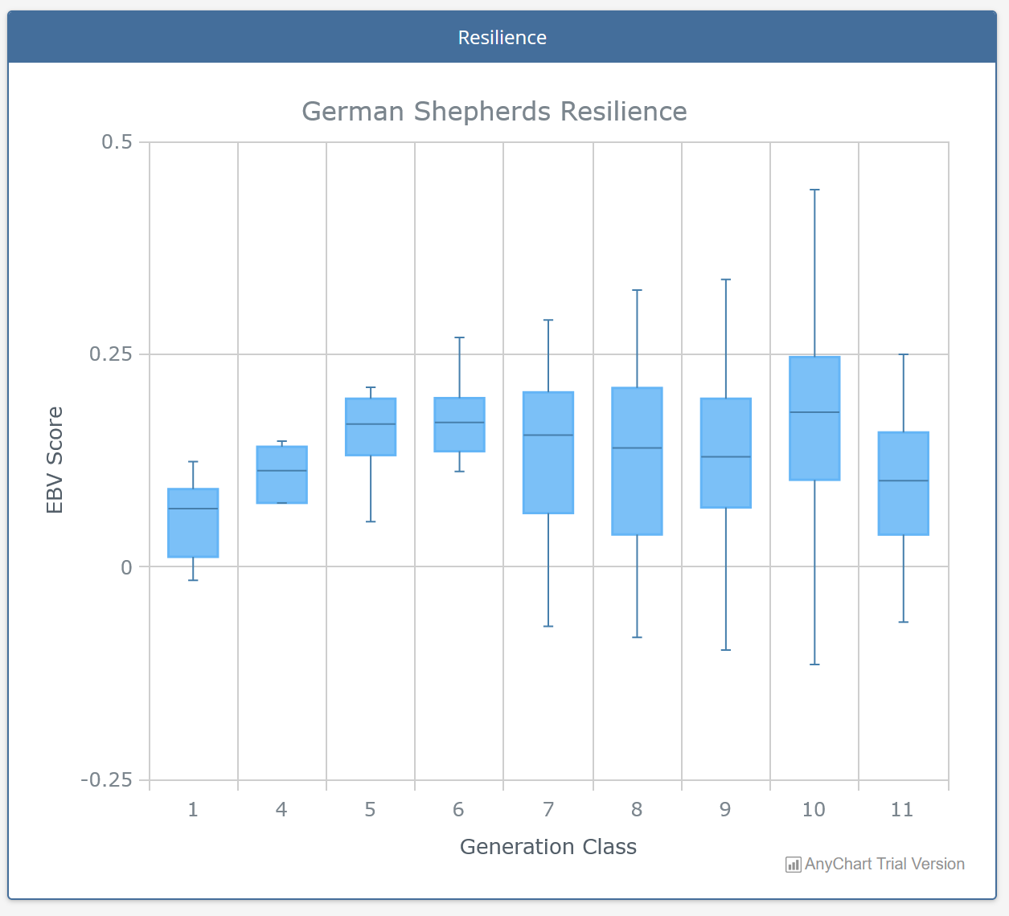
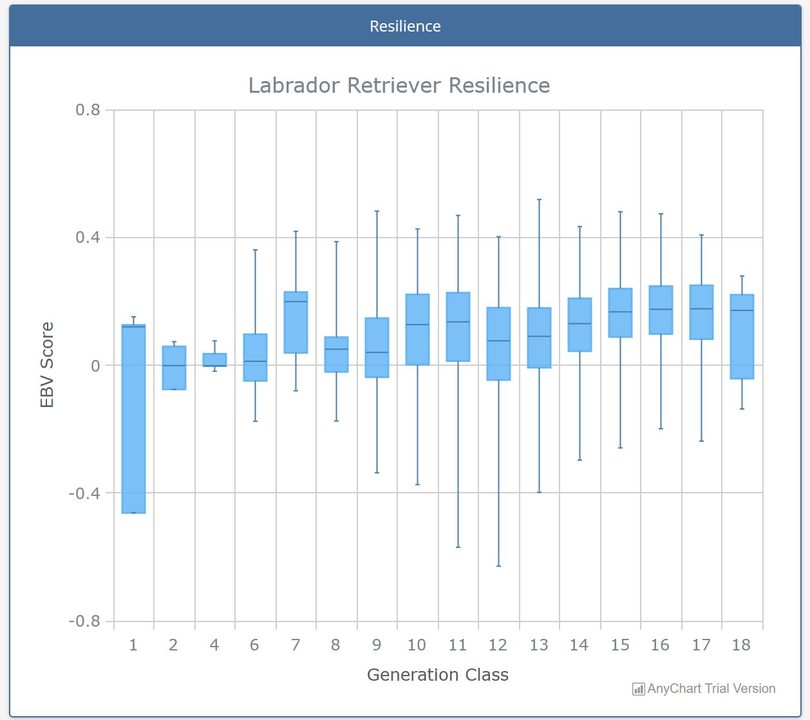
Reslience
GEB LRs different model- BCLs from Puppy Test
EBVs only calculated in IWDR
Selection
No EBVs on GS until 2023
IWDR based on all IWDR data & all BCLs

Slide 17
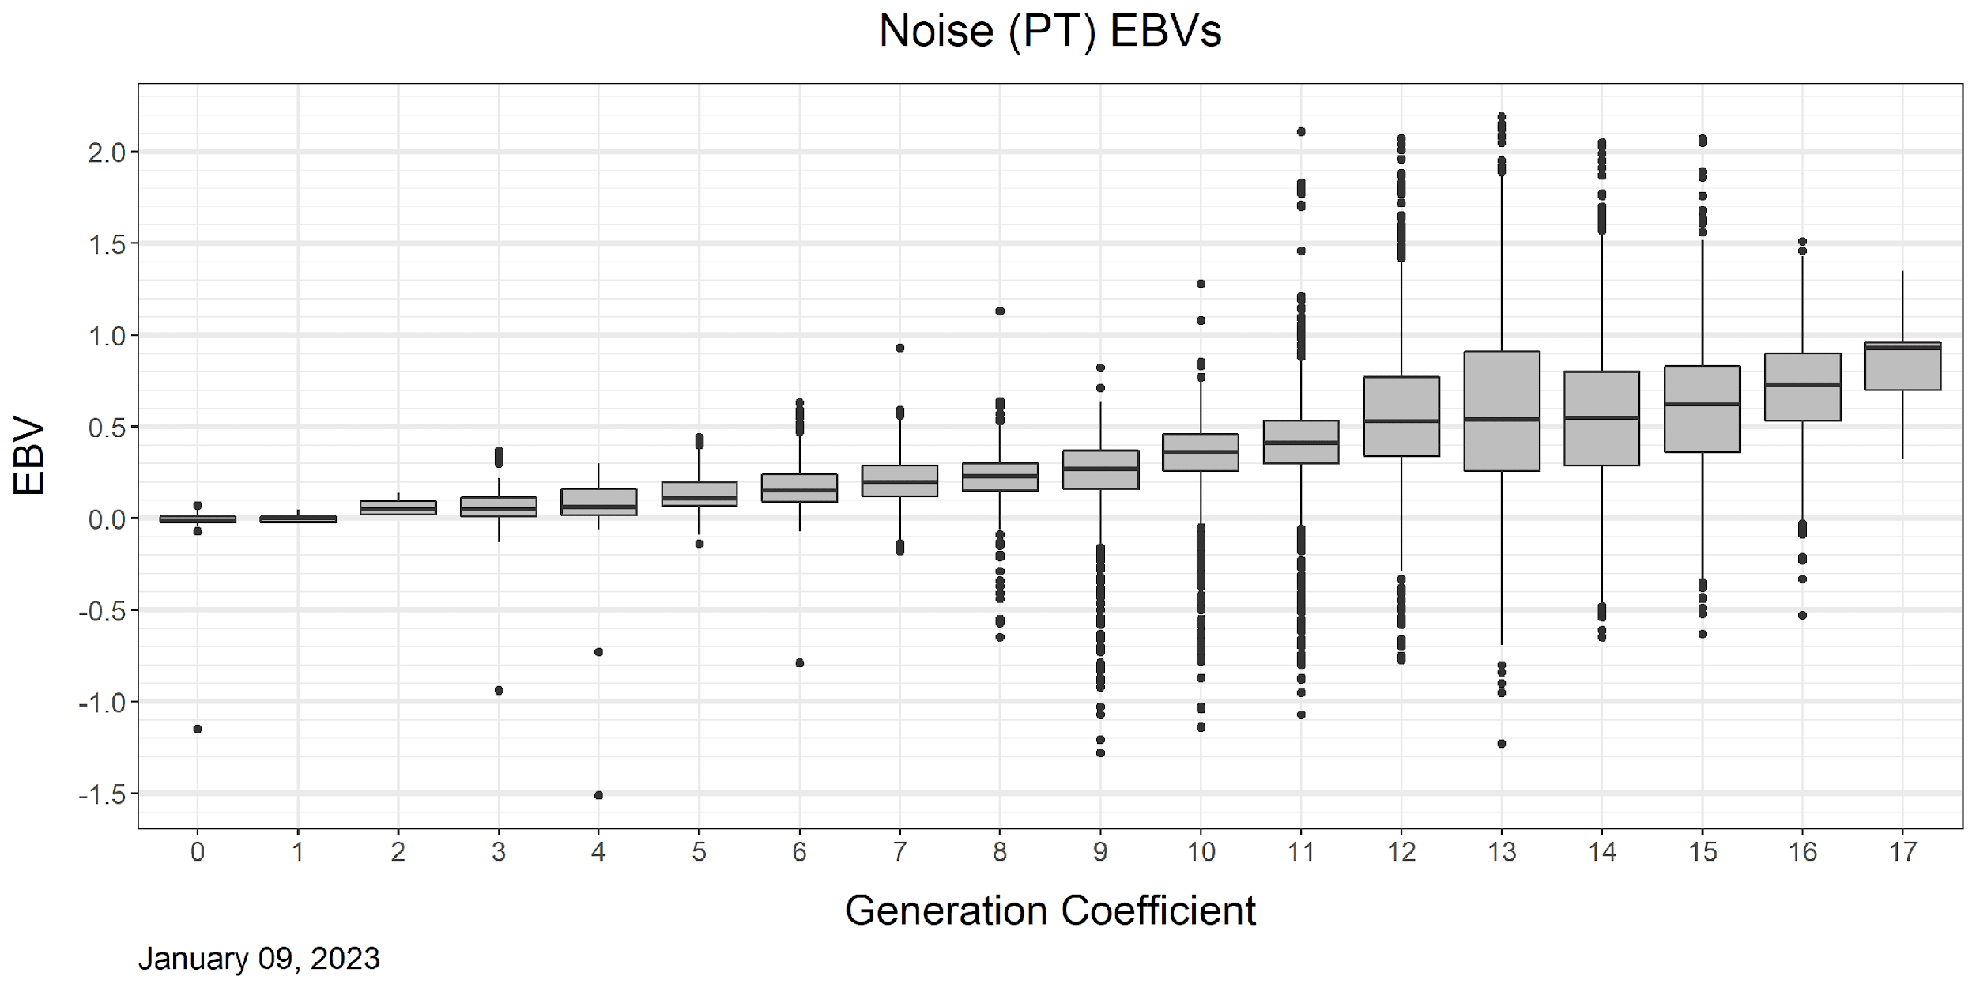
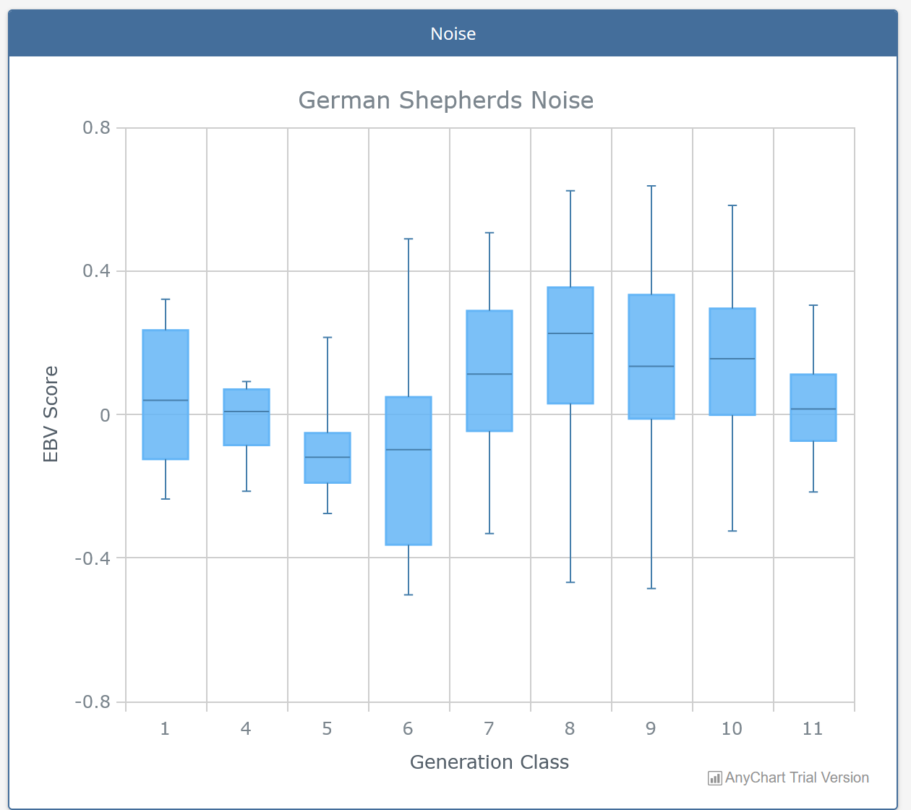
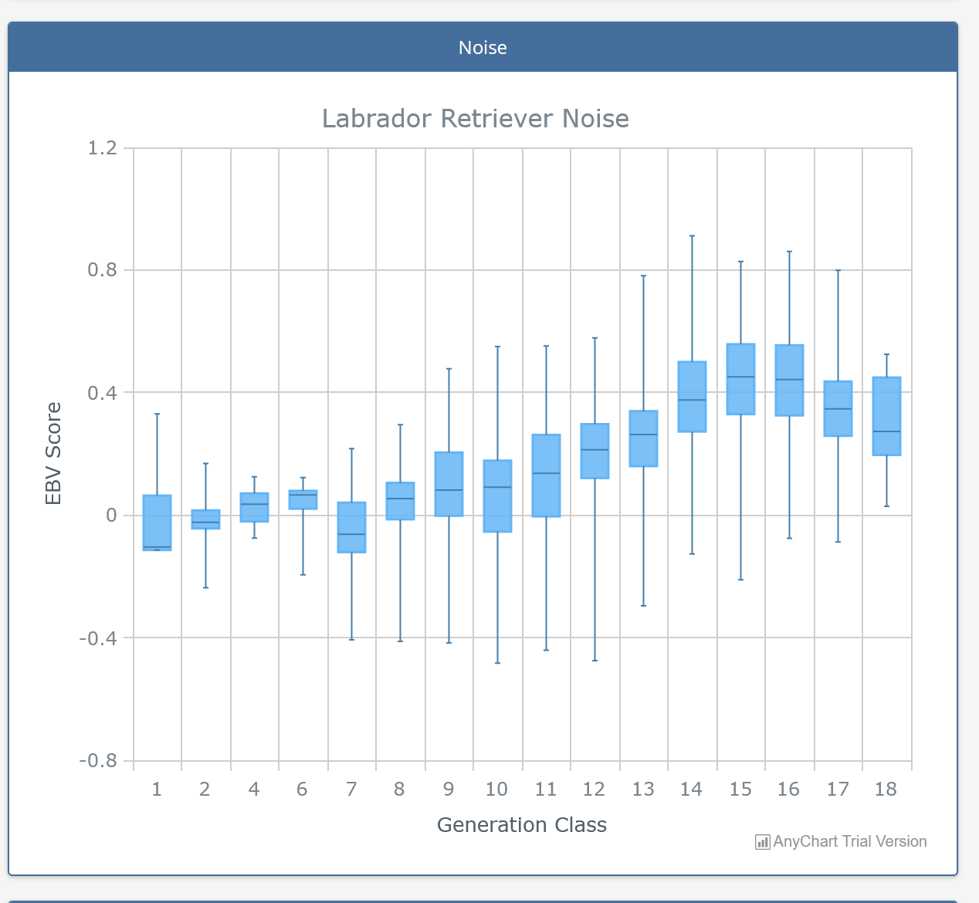
Noise Fear
GEB LRs different model- BCLs from Puppy Test
EBVs since XXX in LRs
Small amount of selection pressure
No EBVs on GS until 2023
IWDR based on all IWDR data & all BCLs

Slide 18
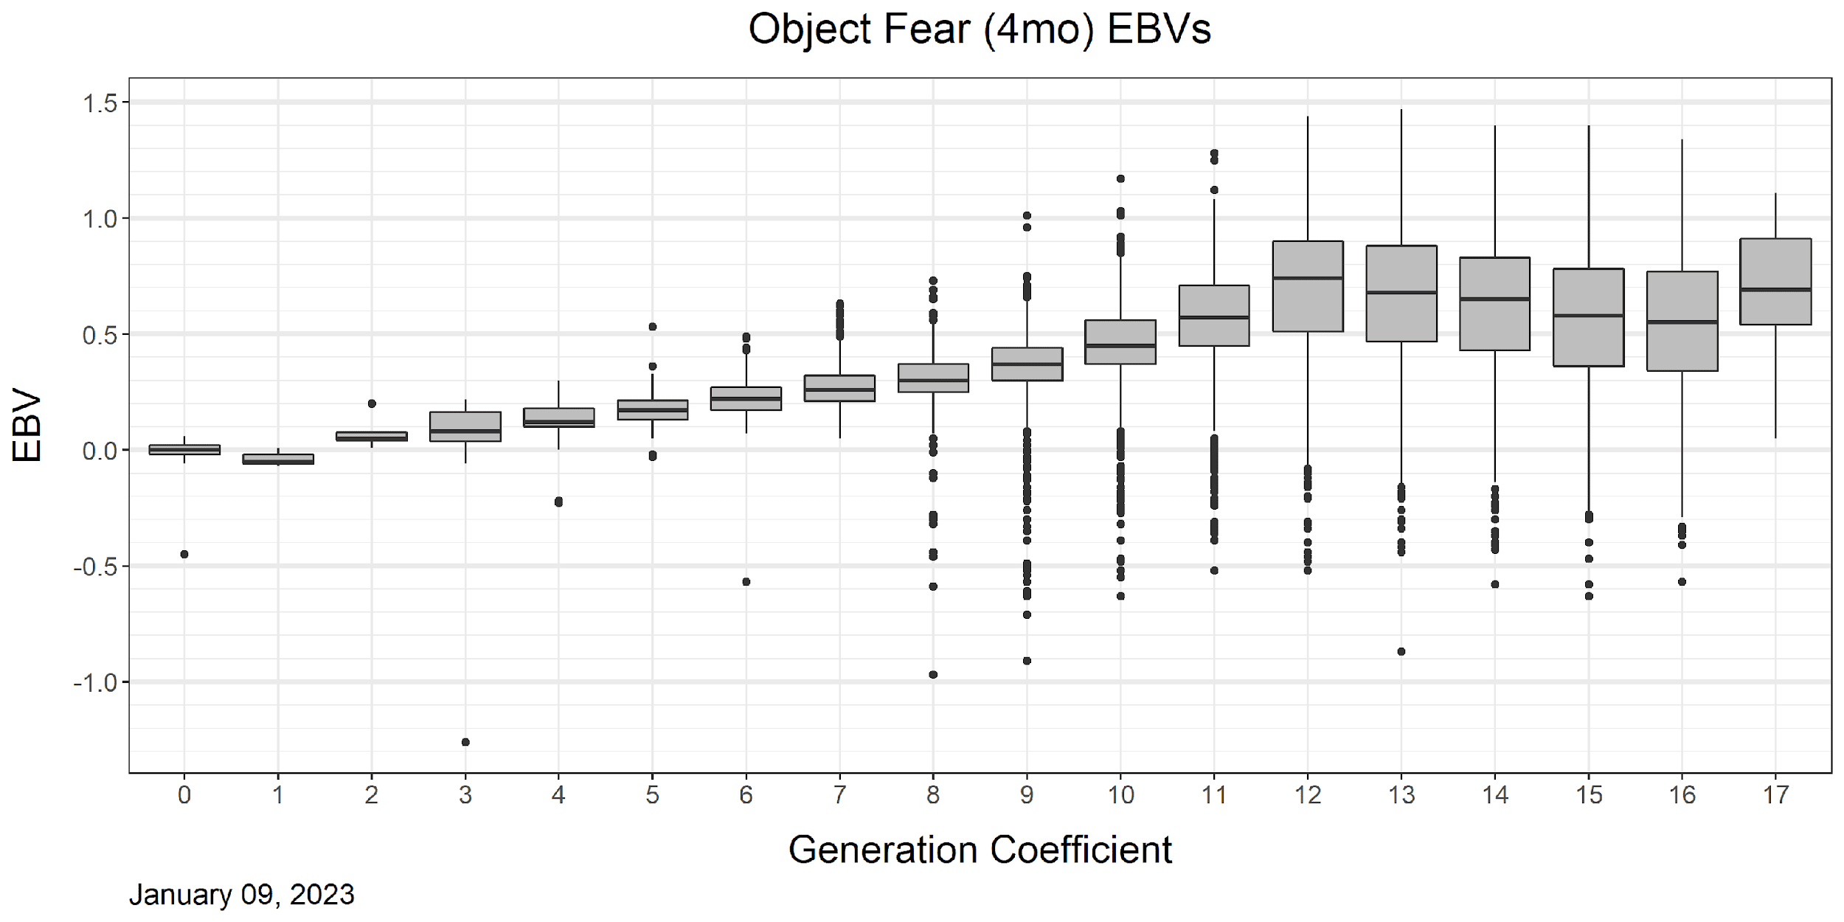
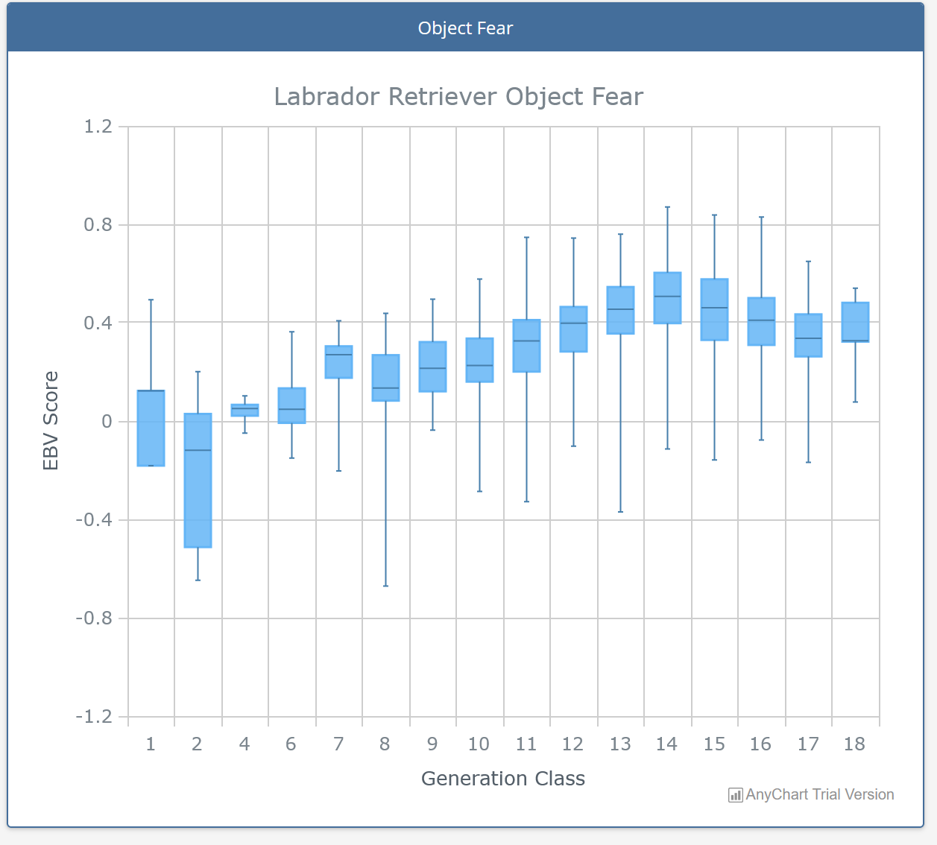
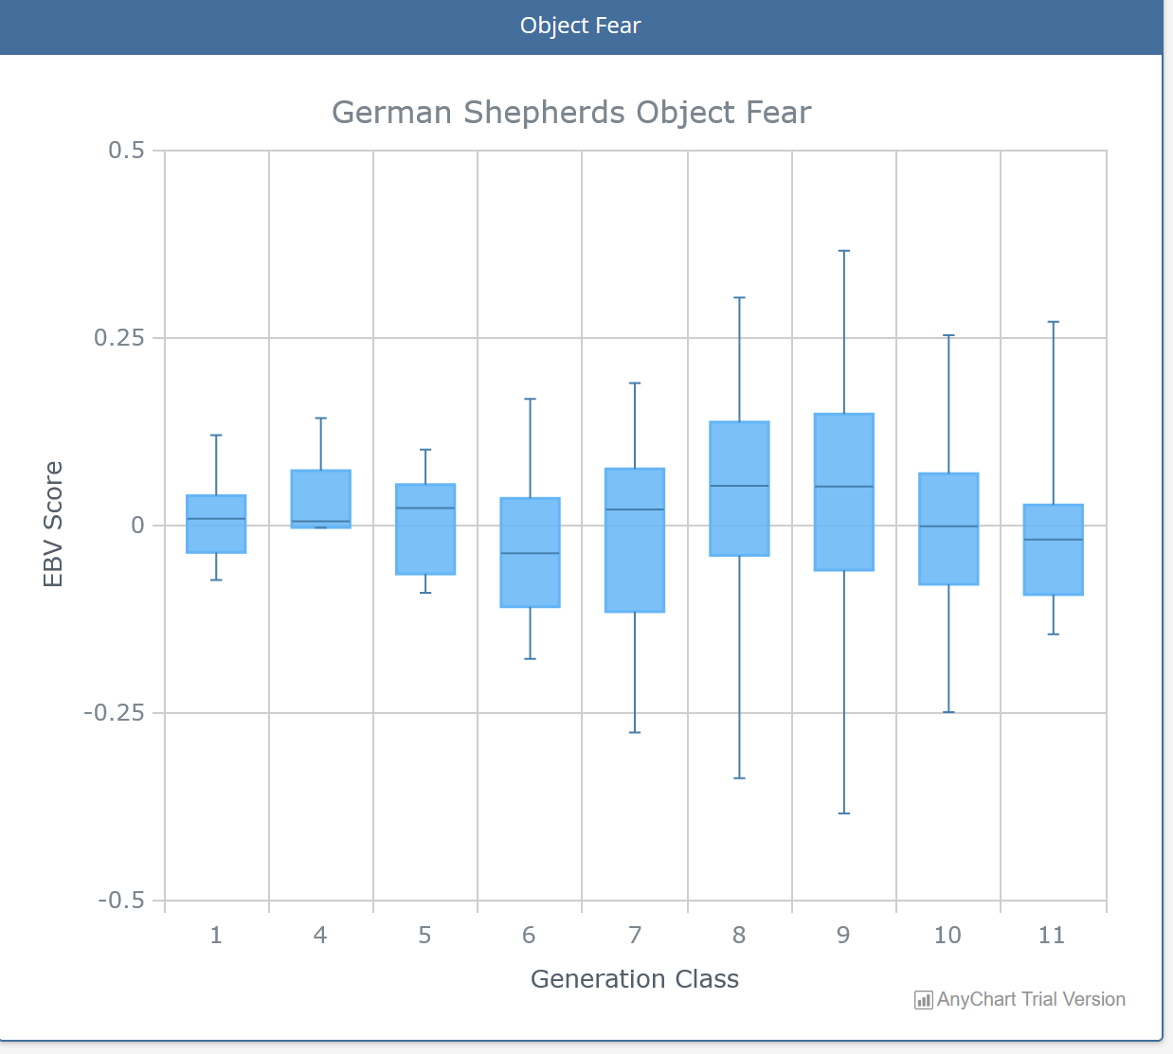
Object Fear
GEB LRs different model- BCLs from 4 Mo W&T
EBVs since xxxx in LRs
Low selection pressure to improve
IWDR based on all IWDR data & all BCLs
No EBVs GS Until 2023

Slide 19
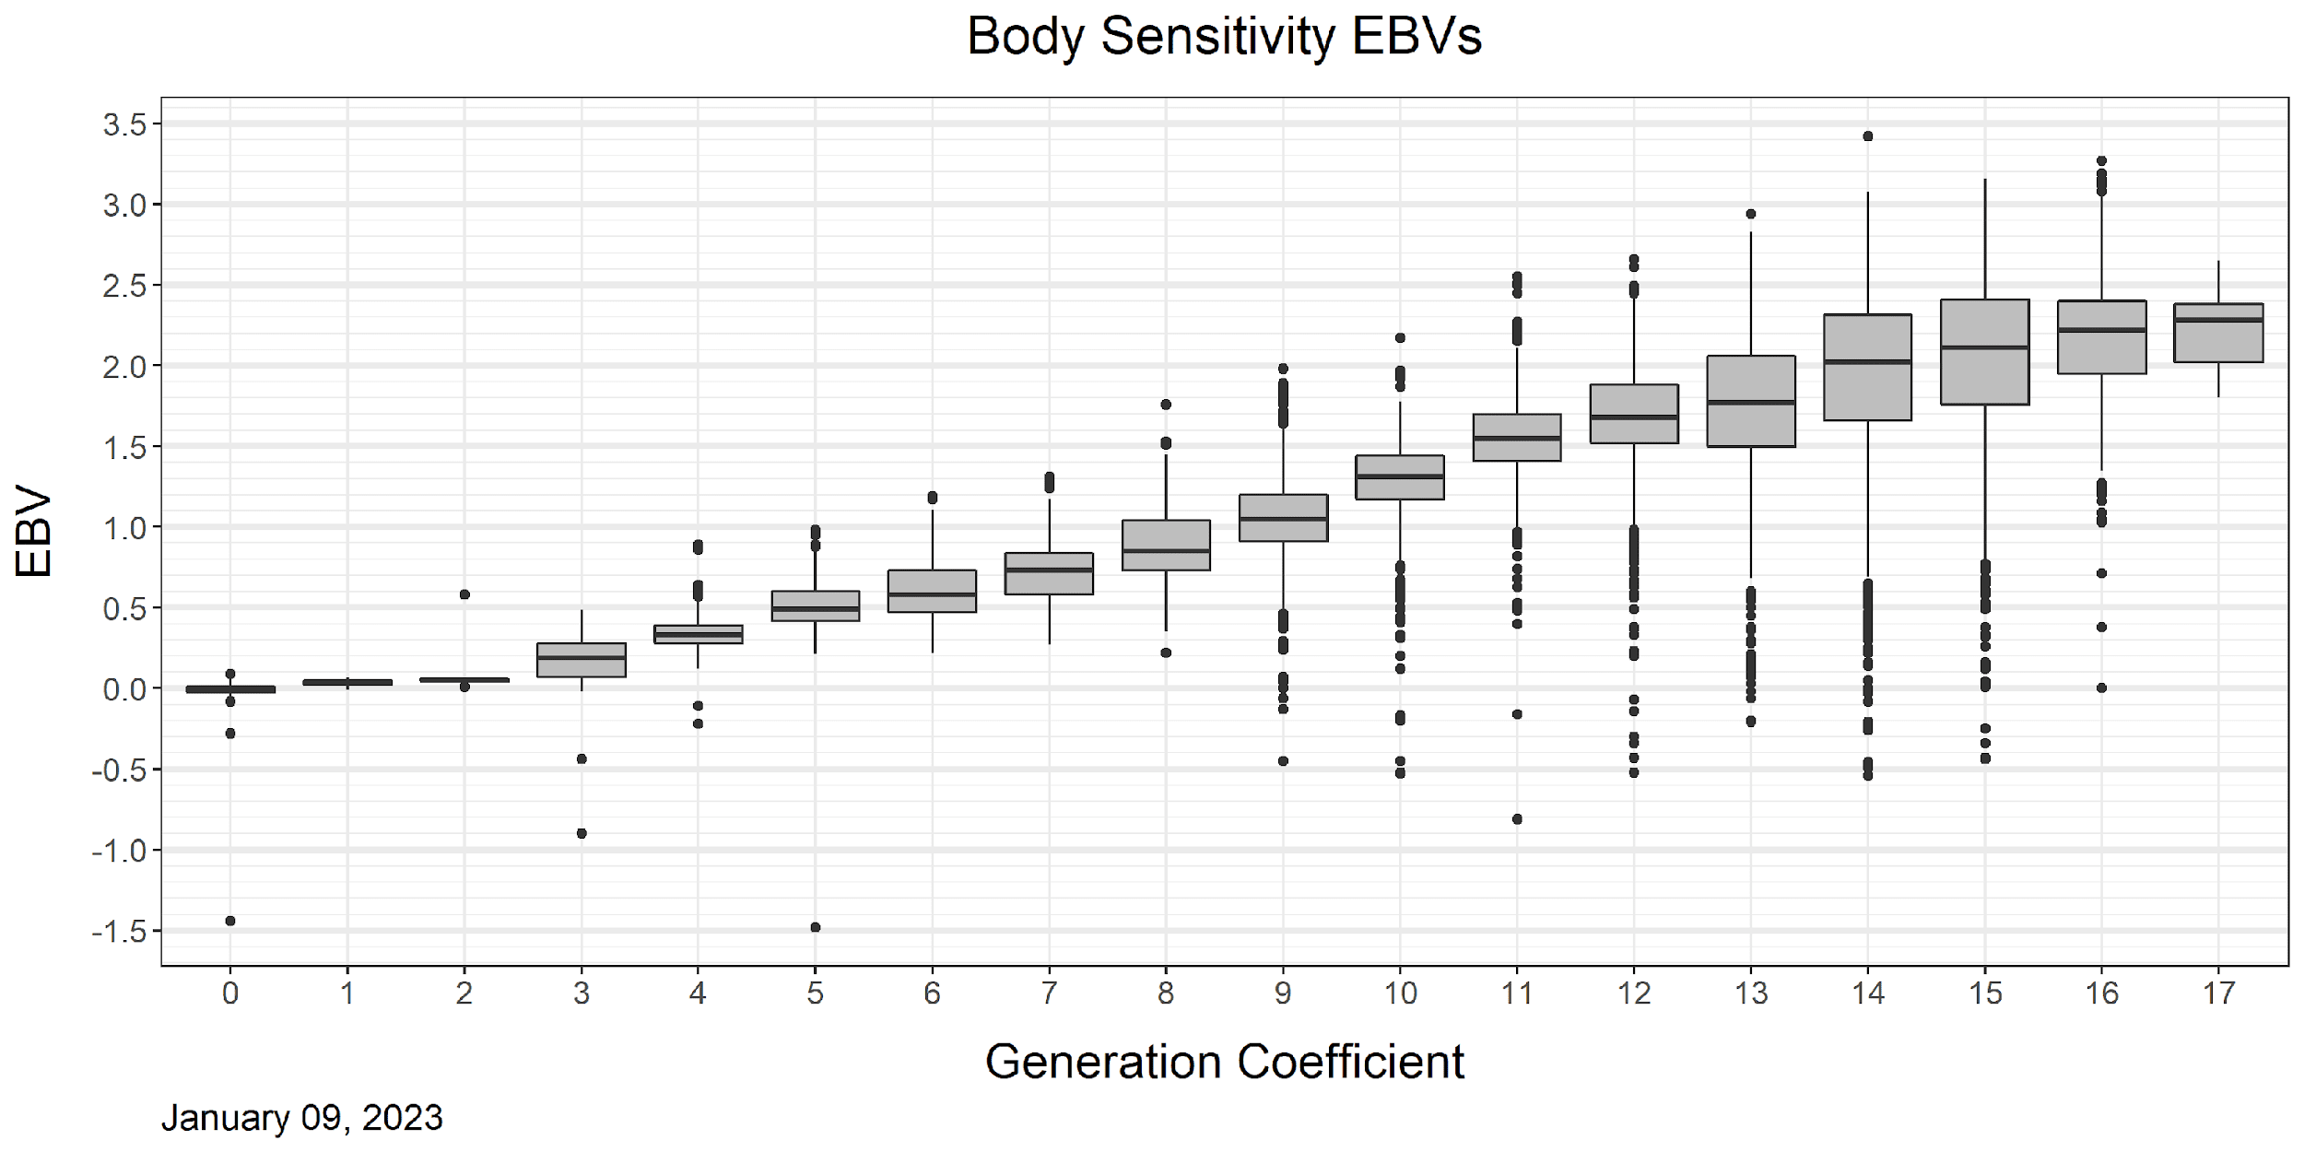
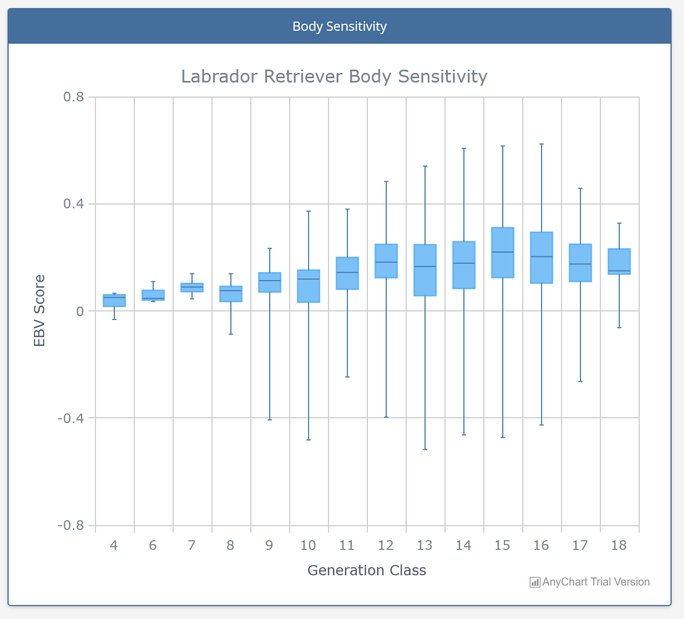
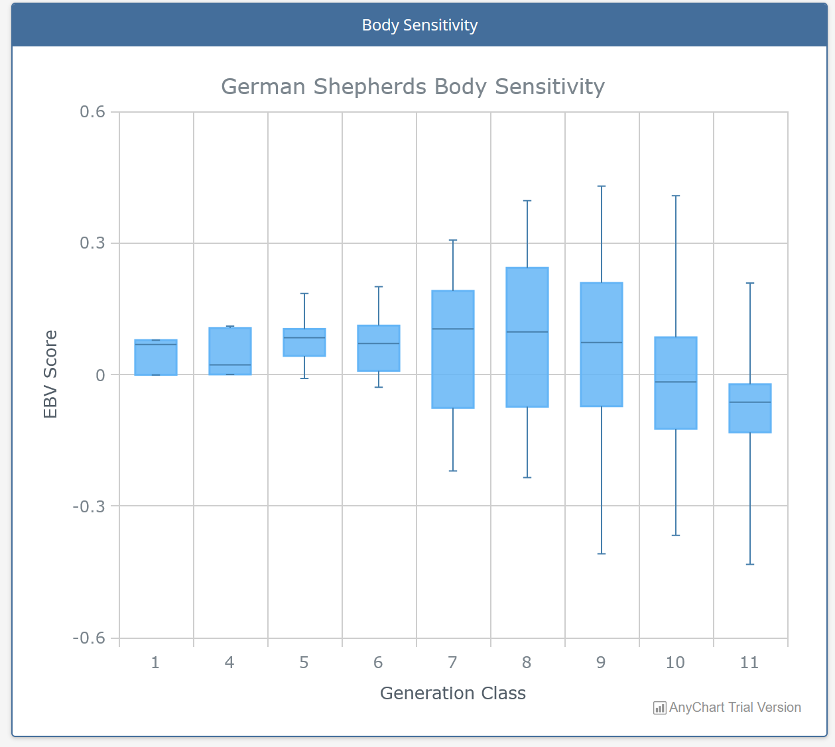
Body Sensitivity
GEB LRs different model- BCLs from 10 mo W&T, GDBart and Training
EBVs since 2012 in LRs
Moderate selection pressure to improve
IWDR based on all IWDR data & all BCLs
No EBVs GS Until 2023

Slide 20
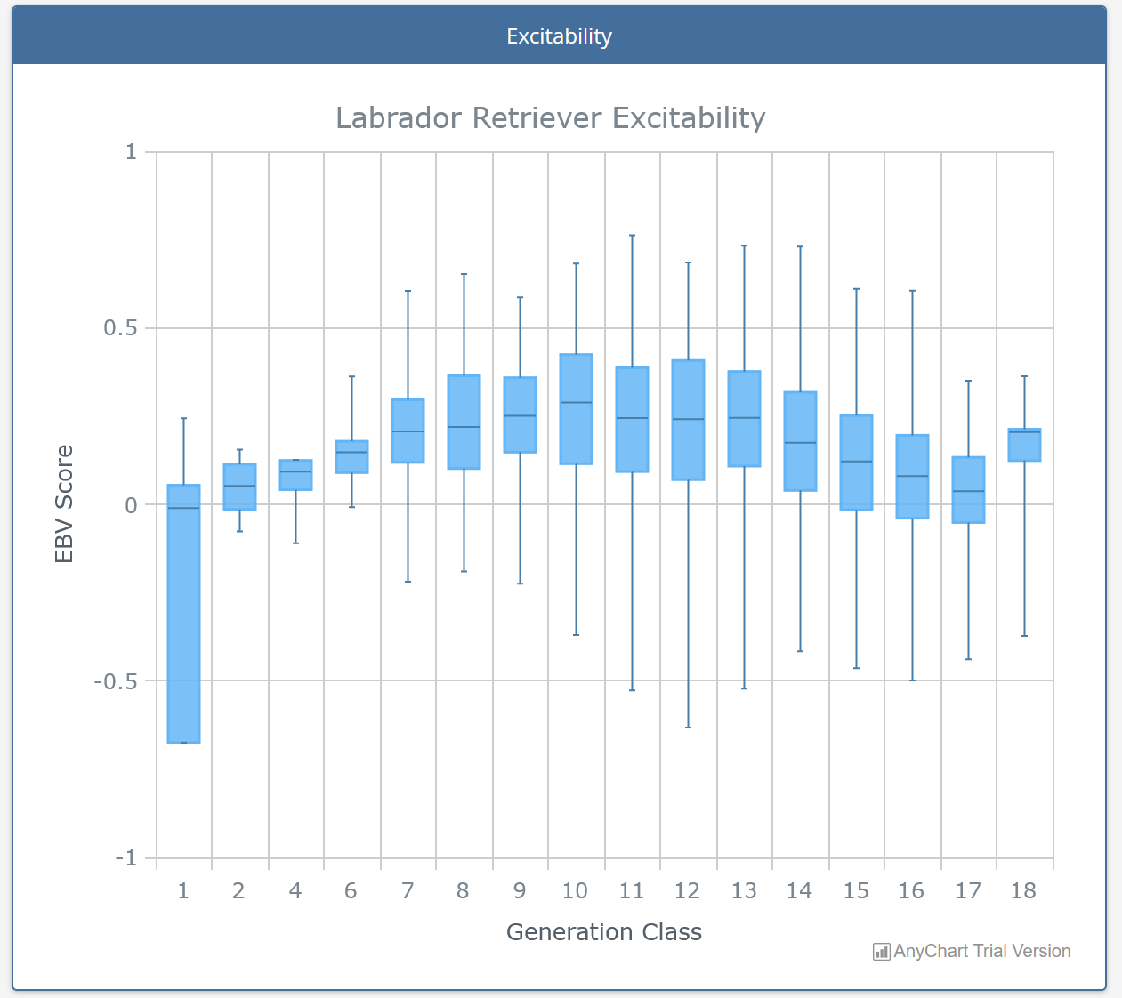
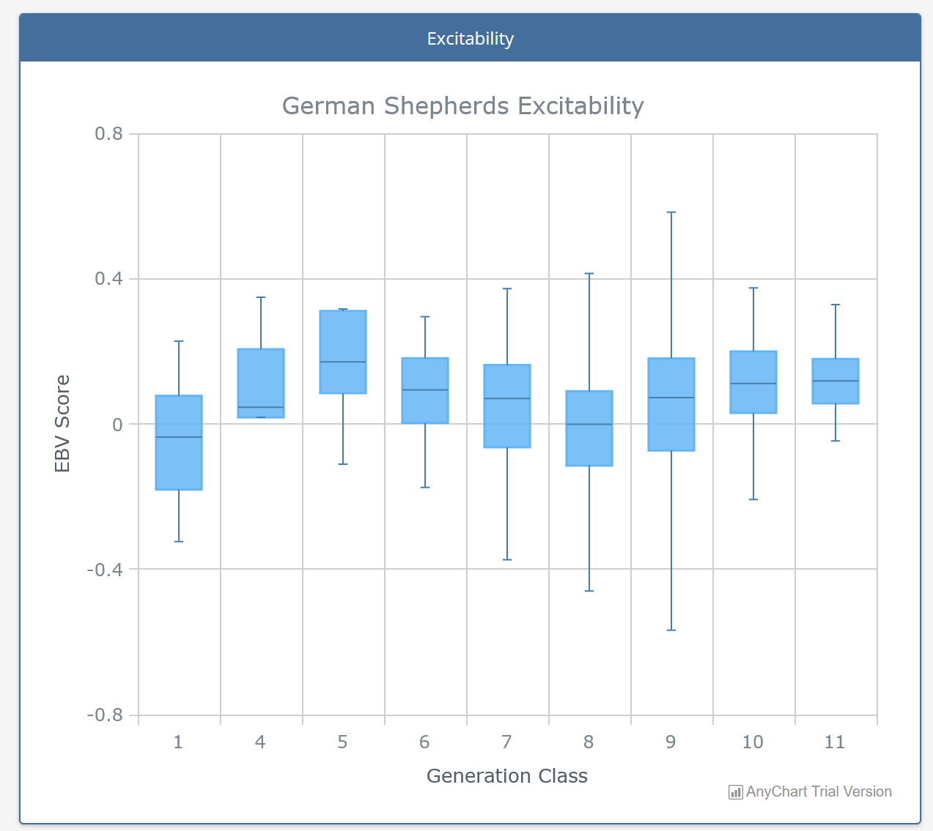
Excitable
EBVs only calculated in IWDR
No selection pressure to improve
In Labrador Retrievers and German Shepherds
IWDR based on all IWDR data & all BCLs
No EBVs on GS until 2023

Slide 21
Questions?

Slide 22
BCL Items Loading to Arousal Factor
BCL Items | Phenotypic PCA Fratkin 2021 | Genetic PCA Tsuruta 2021 | Estimates of Heritability Tsuruta 2021
Chase | 0.726 | 0.79 | 0.29
Movement excites | 0.713 | 0.87 | 0.21
Excitable | 0.655 | 0.95 | 0.29
Dog Distraction | 0.61 | 0.90 | 0.20
Activated by stress | 0.582 | 0.90 | 0.24
Lacks Focus | 0.552 | 0.87 | 0.23
Fidgety | 0.54 | 0.95 | 0.19
High energy | 0.527 | 0.90 | 0.28
Poor return to productive state | 0.482 | 0.90 | 0.35
Scavenges | 0.477 | 0.78 | 0.17
Olfactory distraction | 0.475 | 0.74 | 0.19
Sep anxiety | 0.018 | 0.81 | 0.17
Barks Persistently | 0.141 | 0.77 | 0.25
Inconsistent |  | 0.64 | 0.17
Poor House Manners |  | 0.63 | 0.32
OverallScore |  | 0.60 | 0.19
Estimates of heritability use the puppy test, Walk and Talk, IFT and Training BCLs

Slide 23
BCL Items Loading to Environmental Soundness Factor
BCL Item | Phenotypic PCA Fratkin 2021 | Genetic PCA Tsuruta 2021 | Estimates of Heritability Tsuruta 2021
Noise Fear | 0.696 | 0.85 | 0.25
Anxious New Situations | 0.628 | 0.74 | 0.22
Traffic Fear | 0.617 | 0.53 | 0.22
Object Fear | 0.528 | 0.72 | 0.24
Dog Fear | 0.476 | 0.24 | 0.23
Underfooting Fear | 0.418 | 0.82 | 0.20
Stair Fear | 0.33 | 0.73 | 0.28
Blowing Fan Fear | 0.696 | 0.85 | 0.17
Estimates of heritability use the puppy test, Walk and Talk, IFT and Training BCLs

Slide 24
Adaptability
BCL Item | Phenotypic PCA Fratkin 2021 | Genetic PCA Tsuruta 2021 | Estimates of Heritability Tsuruta 2021
Separation anxiety | 0.738 | -0.11 | 0.17*
Barks Persistenty | 0.666 | -0.13 | 0.25
Kennels Poorly | 0.553 | 0.84 | 0.58
HandlerAttachment | 0.509 | -0.07 | 0.30
Poor Social Manners | 0.429 | 0.10 | 0.27
Estimates of heritability use the puppy test, Walk and Talk, IFT and Training BCLs
* NOTE-Separation anxiety Estimate of heritability without puppy test data = 0.28

Slide 25
Relationship- Initiative
BCL Item | Phenotypic PCA Fratkin 2021 | Genetic PCA Tsuruta 2021 | Estimates of Heritability Tsuruta 2021
Lacks Initiative | 0.772 | 0.70 | 0.34
Unwilling | 0.675 | 0.74 | 0.22
Inhibited By Stressful Situations | 0.644 | 0.40 | 0.32
Dog & handler work as a team | 0.459 | 0.40 | 0.29
Estimates of heritability use the puppy test, Walk and Talk, IFT and Training BCLs

Slide 26
Body Sensitivity
BCL Item | Phenotypic PCA Fratkin 2021 | Genetic PCA Tsuruta 2021 | Estimates of Heritability Tsuruta 2021
Body Sensitivity | 0.811 | 0.67 | 0.21
Harness Sensitivity | 0.725 | 0.59 | 0.39 /0.50*
Retreats When Reached For by Familiar Person | 0.681 | 0.41 | 0.16
Body Handling Problems | 0.542 | 0.56 | 0.22
Estimates of heritability use the puppy test, Walk and Talk, IFT and Training BCLs
* Estimate of Heritability Harness Sensitivity without puppy test data = 0.50

Slide 27
Which Traits Explain Differences Among Dogs?
Principle Components Analysis Simplifies the 52 BCL items into underlying factors | Phenotypic Correlations Training BCLs Fratkin 2018 Variance Explained 42.8% | Genetic Correlations All BCLs but puppy test Tsruta 2021 Variance Explained = 35.7%
Emotional Composure | 18.82 | 14.84
2 Environmental Soundness | 9.43 | 8.05
3 Adaptability | 5.77 | 2.92
Relationship (Willingness, Team, Inhibited) | 4.95 | 2.30
5 Body Sensitivity | 3.80 | 2.00
6 Stranger Fear or Aggression | * | 1.97
7 Dog Fear or Aggression | * | 1.77
8 Resource Guarding Toward People or Dogs | * | 1.74
28.25
23.34
66%
65%
* BCL Items eliminated from dataset which was BCLs from training. There is a very low incidence of BCL items loading in Factors 6-7 for dogs in training. The genetic PCA uses all BCL data- repeated measures analysis

