Slide 1
IWBDA Breeders Workshop
2 May 2023

Slide 2
Pregnancy, Whelping and Lactation
In the Bitch
Small Animal Reproduction
Greg Burns DVM
Diplomate, American College of Theriogenologists

Slide 3
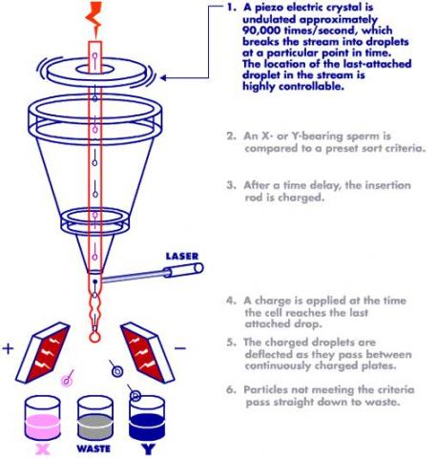
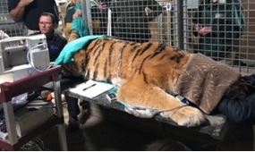
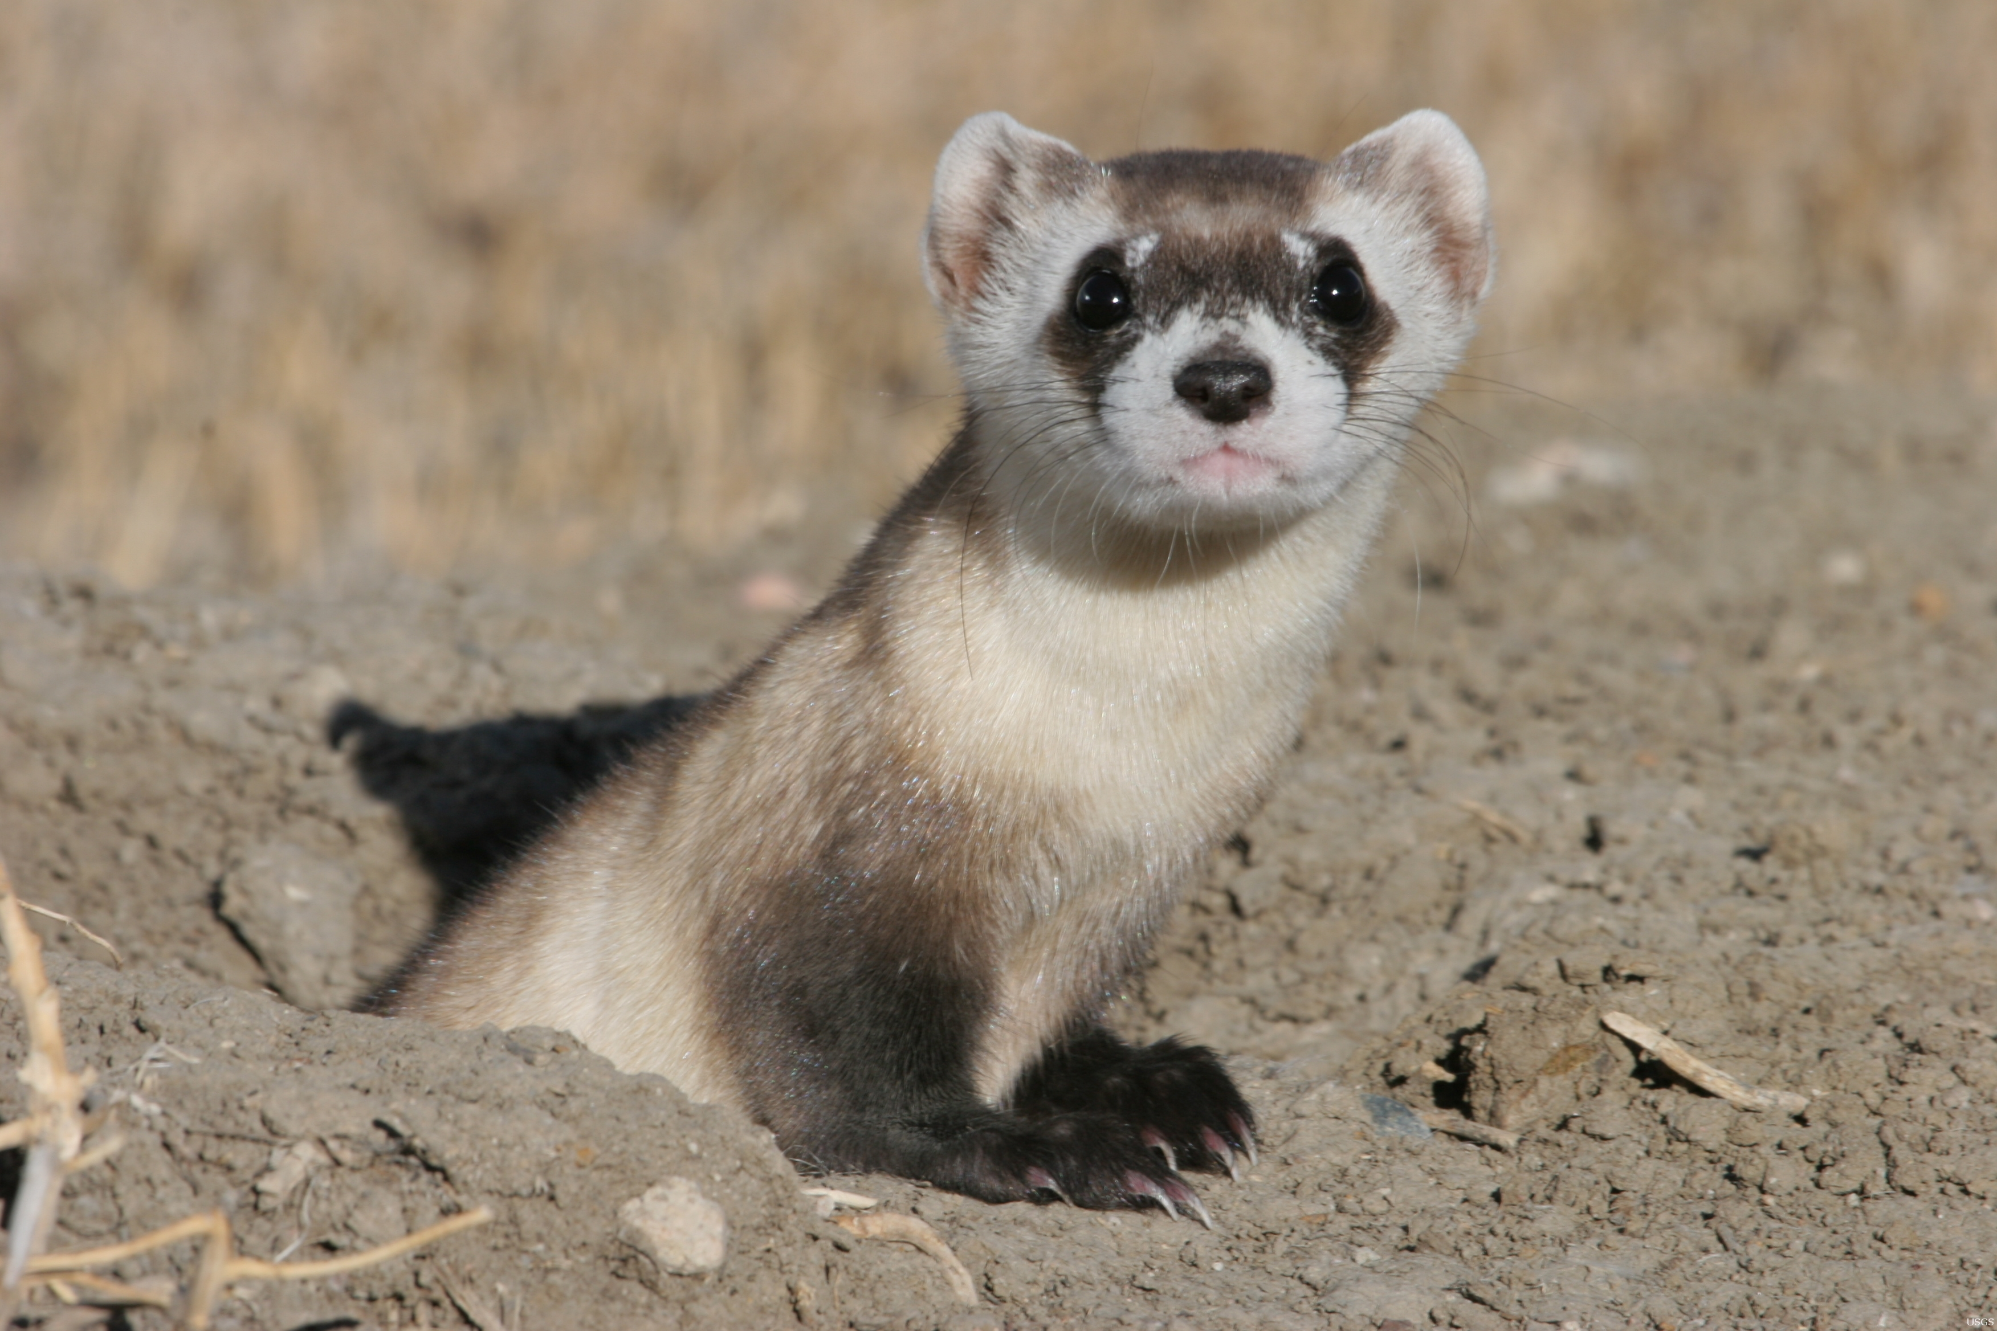
Who am I ?
Started in a veterinary canine reproduction practice in the 1990’s
International Canine Genetics Synbiotics Pfizer Zoetis
Mentorship residency program in 2000’s and American College of Theriogenology Board Certification
Colorado State University
Veterinary Reproductive Specialist
Private practice for 24 years
Exclusively small animal reproduction
International semen freeze/storage facility
TCI, Sex Sorted Semen
Faculty at Colorado State University
Small Animal and Wildlife Reproduction

Slide 4
Goals
Discuss pre-breeding considerations in the bitch
Normal canine pregnancy and parturition – gestation length, pregnancy diagnosis, normal delivery
Dystocia (abnormal delivery)
Lactation and agalactia review
Mastitis review

Slide 5
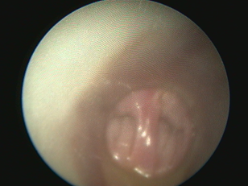
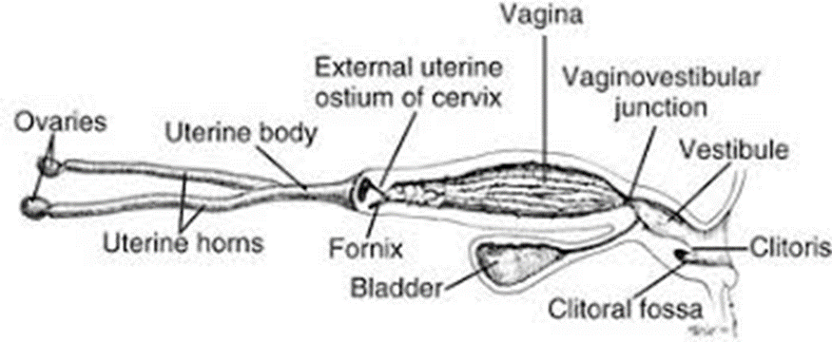
Pre-Breeding Considerations
General Physical Examination
Nose to tail physical examination
Body condition score
Reproductive System Examination
Vulvar conformation
Vestibulo-vaginal junction
Persistent Hymen
Stricture
Septum

Slide 6
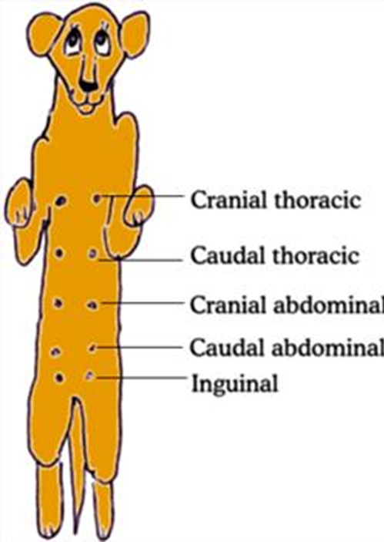
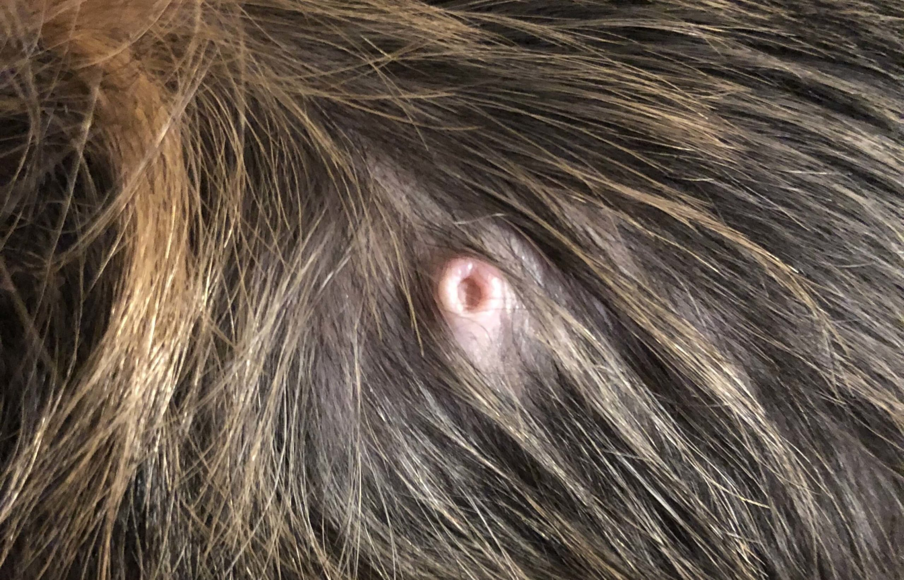
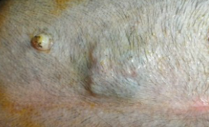
Pre-Breeding Considerations
Mammary Glands
Normal Anatomy
Masses

Slide 7
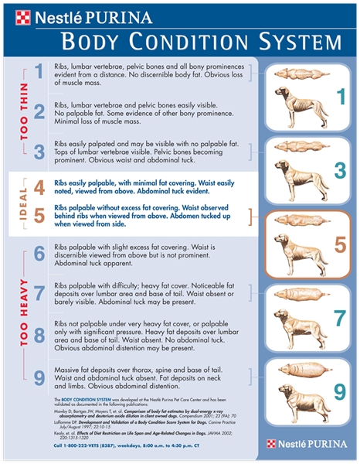
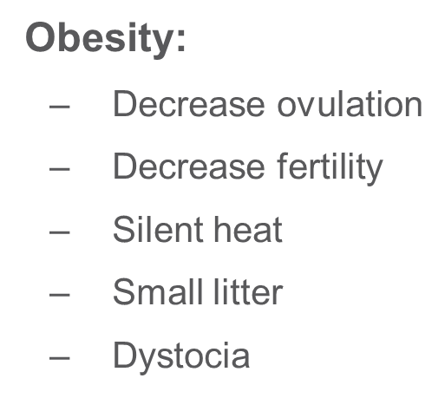
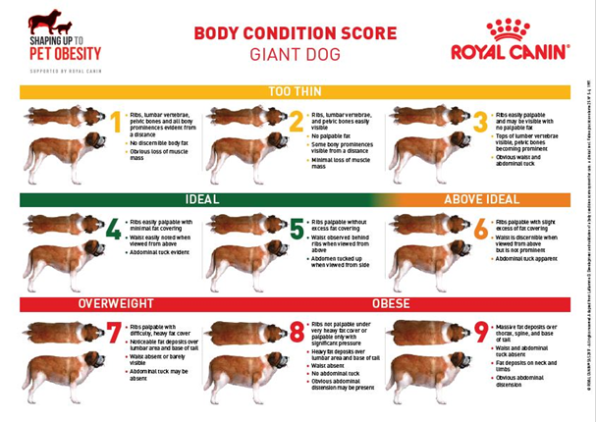
Pre-Breeding Considerations
Effects of inappropriate nutrition
Underfeeding:
Small litter
Decreased fertility
Low birth weight
Increased neonatal morbidity and mortality
Decreased milk yield

Slide 8
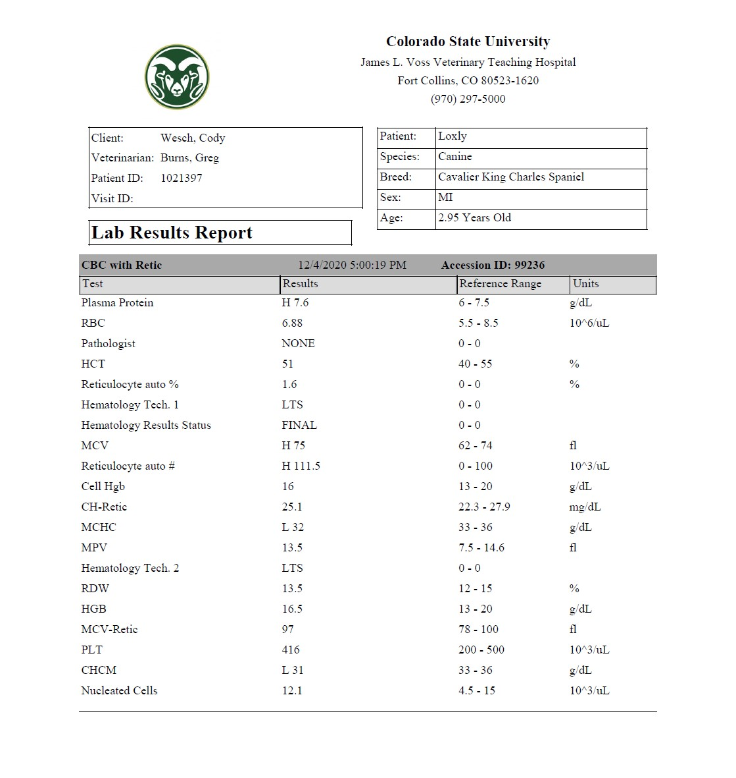
Pre-Breeding Considerations
Blood Profile
General Health Profile and Urinalysis
Heartworm Disease
Regional Diseases
Lyme
Coccidioidomycosis
Thyroid
Brucellosis Test
Fecal Examination

Slide 9
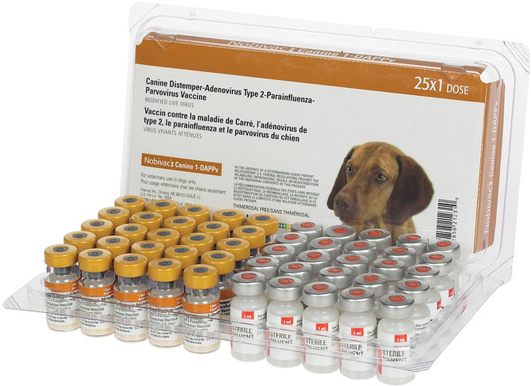
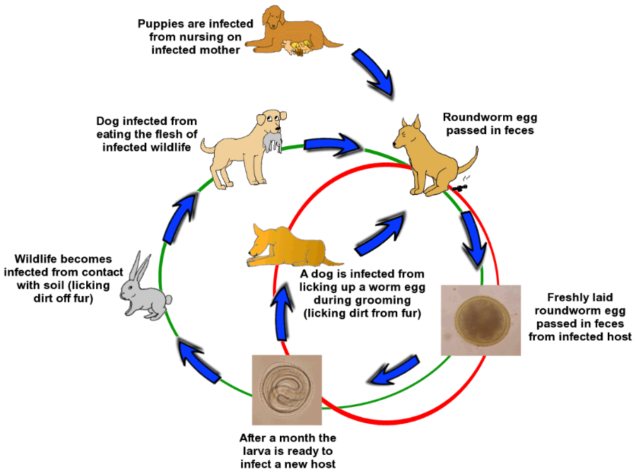
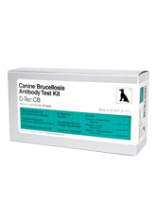
Pre-Breeding Considerations
General Health Considerations
Vaccination status/titers
Parasite control protocol
Current medication/supplements
Brucellosis status

Slide 10
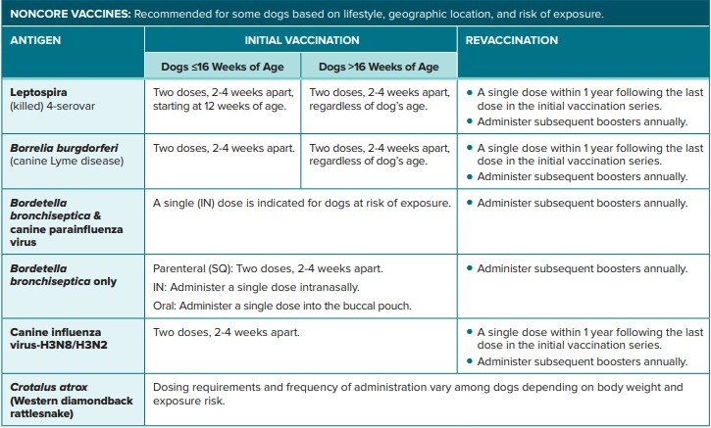
Pre-Breeding Considerations
General Health Considerations
Vaccination status
Core Vaccines
Parvo, Distemper, Parainfluenza, Adenovirus
Noncore Vaccines
As needed on risk/benefit basis

Slide 11
Pre-Breeding Considerations
General Health Considerations
Vaccinating the pregnant bitch
Vaccinate the prior to pregnancy!
Attenuated (live weakened) vaccines are not considered safe during pregnancy
Risk/benefit basis
Provide exceptionally clean environment
Reduce exposure
Inactivated (Killed) vaccines
Elicit immune response without replicating in body
Still not recommended during pregnancy but safer than attenuated vaccines
Might be required by law - Rabies

Slide 12
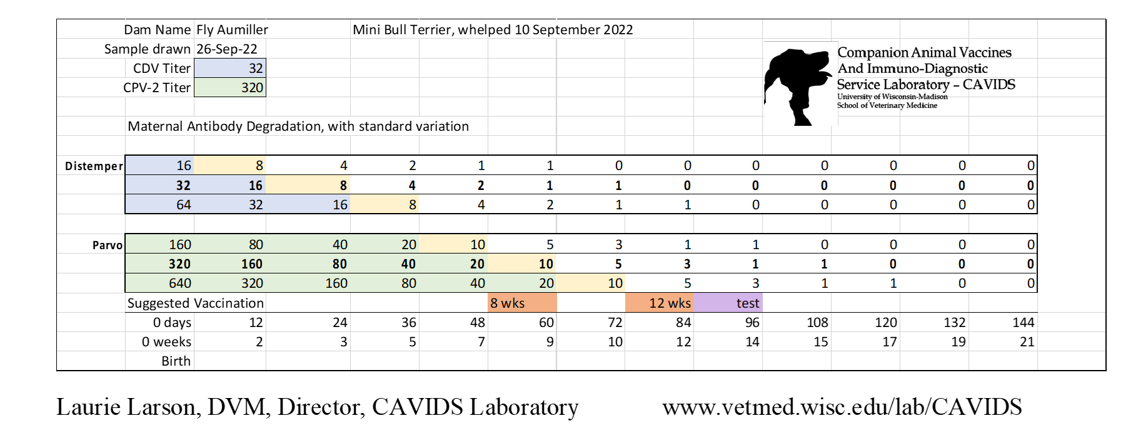
Pre-Breeding Considerations
General Health Considerations
Titers
Some breeders perform vaccination based on titers
Important to remember that these titers are measuring the protection that the bitch has from disease, not necessarily how that protection is passed to nursing offspring
Use nomograph if relying on titers, as this will help determine when to vaccinate offspring

Slide 13
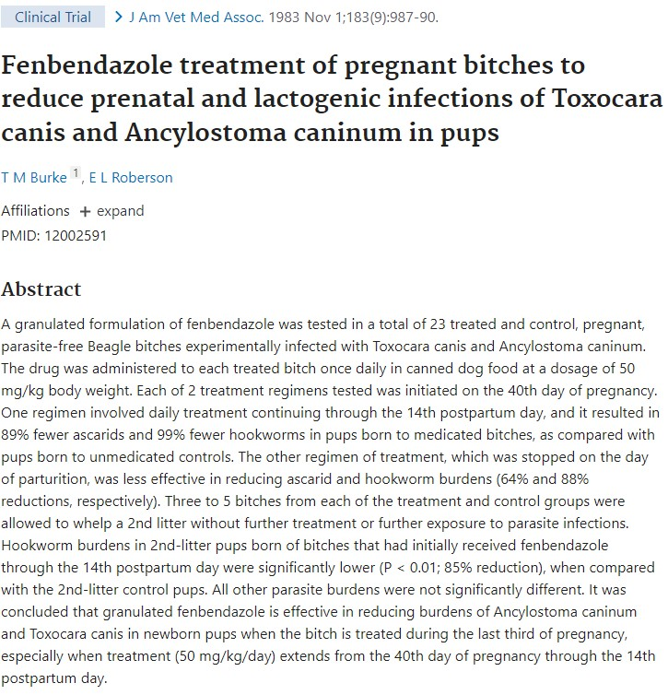
Pre-Breeding Considerations
General Health Considerations
Deworming
“The ability of Toxocara canis to be transmitted from the dam to the fetal offspring, together with the hardy nature of larvated eggs in a contaminated environment, contribute to the high prevalence of infection even among pets that are well cared for and routinely treated for intestinal parasites.”
Dam should be on appropriate deworming protocol prior to breeding!
Deworming during pregnancy
Fenbendazole has been demonstrated to be safe during pregnancy
Protocol 1 – “high risk”
Deworm once daily starting 3 weeks prior to delivery date and continue 2 weeks after delivery
Protocol 2
Deworm 2 weeks prior to delivery date, 2 days after delivery and 16 days after delivery
Each deworming course consists of once daily for 3 days in a row

Slide 14
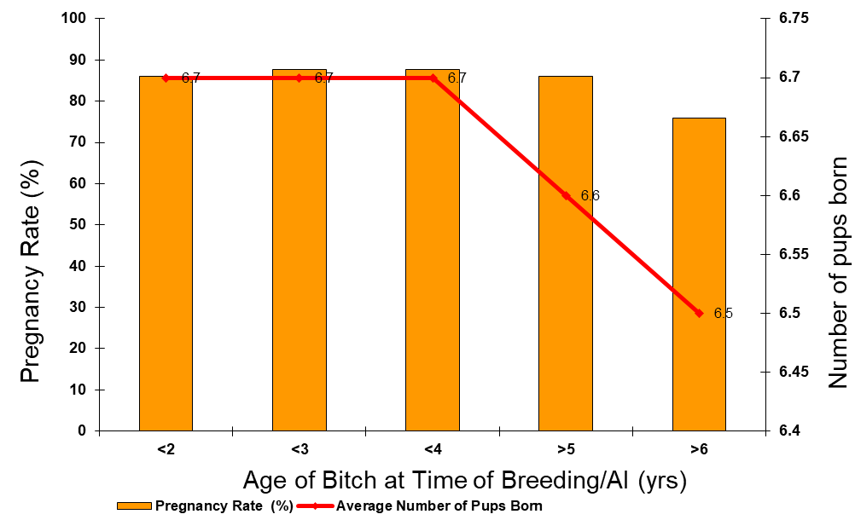
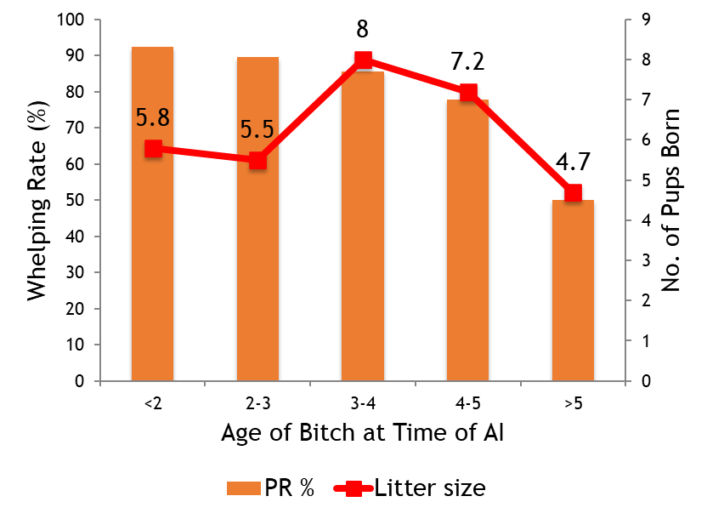
Pre-Breeding Considerations
Age Consideration
Litter sizes and pregnancy rates are optimal 2-4 years of age
Conception rates and litter sizes decline significantly after 4 years of age
Complication rates increase at age 5 and greater
Dystocia
Periparturient Disorders
Managing Expectations

Slide 15
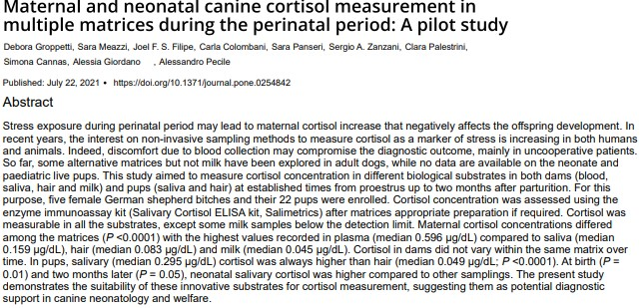
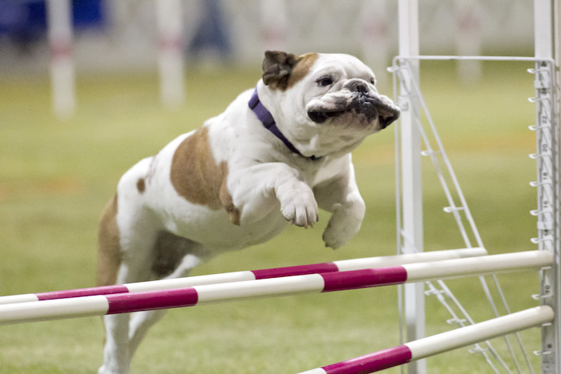
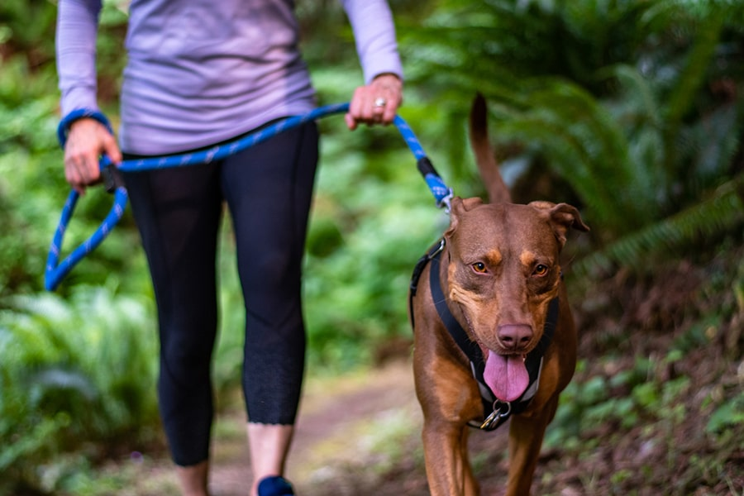
Pre-Breeding Considerations
Stress During Pregnancy:
Increase in perinatal cortisol may produce negative affects – premature labor, lower birth weights, etc.
What increases cortisol?
Intense exercise
Heat/Cold
Illness
Photo Courtesy AKC
Photo Courtesy ASPCA

Slide 16
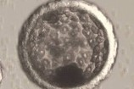
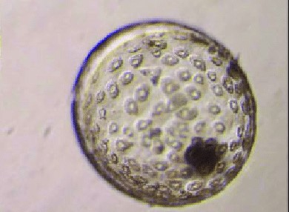
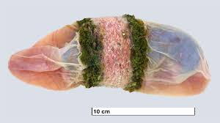
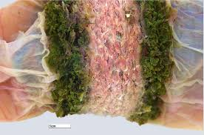
Pregnancy in the Canine
Ovulation
Ovulation occurs ~48h after LH peak (Day 0) and is complete in about 12 hours
Oocytes are immature and require 48 hours to mature (complete meiosis) in uterine tubes
Implantation
Blastocysts enter uterus around day 12 (or so) and implantation occurs day 18 (or so)
Placentation
Endothelial-chorial, zonary, circumferential
Maintenance of Pregnancy
The Corpus Luteum is the only known source of progesterone in the canine
LH and Prolactin are luteotropic hormones (relaxin too?)

Slide 17
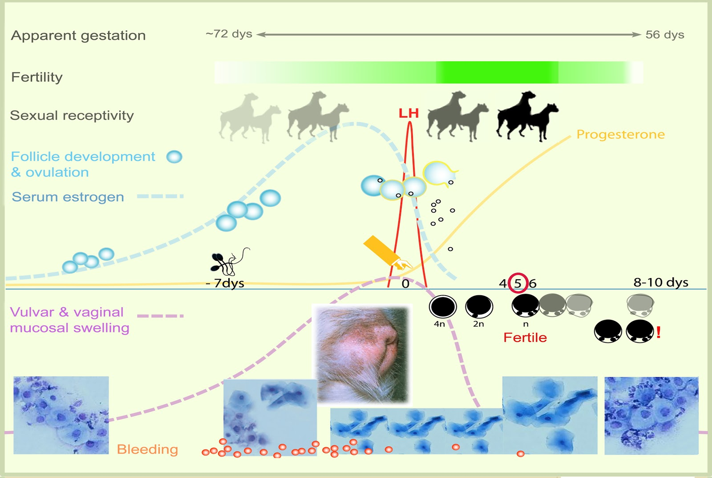
Pregnancy in the Canine
Gestation length
Normal gestation is 63 days from ovulation (62-64 days)
65 days from LH peak (64-66 days)
58 days from first day of onset of cytologic diestrus
Bitches may stand to be bred 6-7 days prior to LH peak, semen can last up to 9-11 days in the female reproductive tract
Results in an “apparent” gestation length of 57-72 days
LORI (Library Of Reproduction Illustrations)

Slide 18
Determining Prolonged Gestation in the Canine
>66 days post LH peak
>64 days post ovulation (ovulation typically consistent with 5.0 ng/ml progesterone)
>60 days after onset of cytologic diestrus

Slide 19
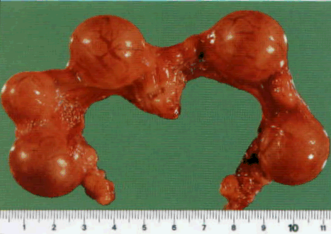
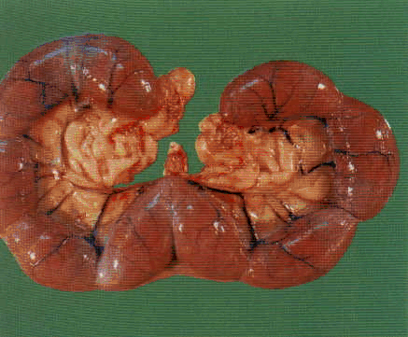
Pregnancy Diagnosis - Canine
There is NO pregnancy specific gonadotropin (ie. hCG, eCG) for pregnancy diagnosis in the canine
Palpation
Discrete uterine enlargements – best between days 22-35
Depends on body condition
Ultrasound
Best after day 22 (or so)
Radiograph
Fetal skeletons evident around day 46
Relaxin
Secreted by fetoplacental unit
Accurate day 30 or greater
In-house test available
Courtesy LSU, Dr. Bruce Eilts

Slide 20
Events leading to normal parturition
Fetal Stress
Fetal ACTH
Fetal Cortisol
PGF2α
3βHSD
StAR
(apoptosis)
P450C17
Progesterone (P4)
Estradiol (E2)
Luteolysis
Myometrial activity
Cervical dilation and softening
Placental attachments disrupted

Slide 21
Normal Parturition
Stage I (canine)
Synchronous uterine contractions leading to complete cervical dilation
Anorexia, restlessness, panting, shivering, ”nesting”
Averages 6-12 hours
Nervous, primiparous bitches can experience up to 36 hours of stage I
Stage II (canine)
Puppies moving through birth canal
Usually delivered every 30-60 minutes
Up to 2 hours between can be normal
Stage II usually complete in 6 hours, can extend up to 24 hours

Slide 22
Normal Parturition
Stage III (canine)
Expulsion of fetal membranes
Often occurs during stage II
Pass with puppies or within 15 minutes
Retained fetal membranes are rare in the canine

Slide 23
Dystocia (canine)
Defined as “Abnormal Parturition”
Common in the canine
Overall incidence has been reported as 5%⃰, 16%⃰⃰⃰ ⃰⃰⃰ and 28%⃰ ⃰⃰⃰ ⃰
As much as 100% in some breeds!
Factors Leading to Dystocia
Fetal
Maternal
*Linde-Forsberg and Eneroth In Ettinger, 2000
**Bergstrom et al., 2006 Incidence and breed predilection for dystocia and risk factors for C-section in a Swedish
population of insured dogs Vet Surg 35:786-791
*** Hollinshead and Hanlon 2017 Factors affecting the reproductive performance of bitches: A prospective cohort study
involving 1203 inseminations with fresh and frozen semen Theriogenology 101; 62-72

Slide 24
Maternal Factors
Primary Uterine Inertia
Secondary Uterine Inertia
Breed
Conformation
Uterus
Torsion, Rupture, Adhesion
Pain
Fear

Slide 25
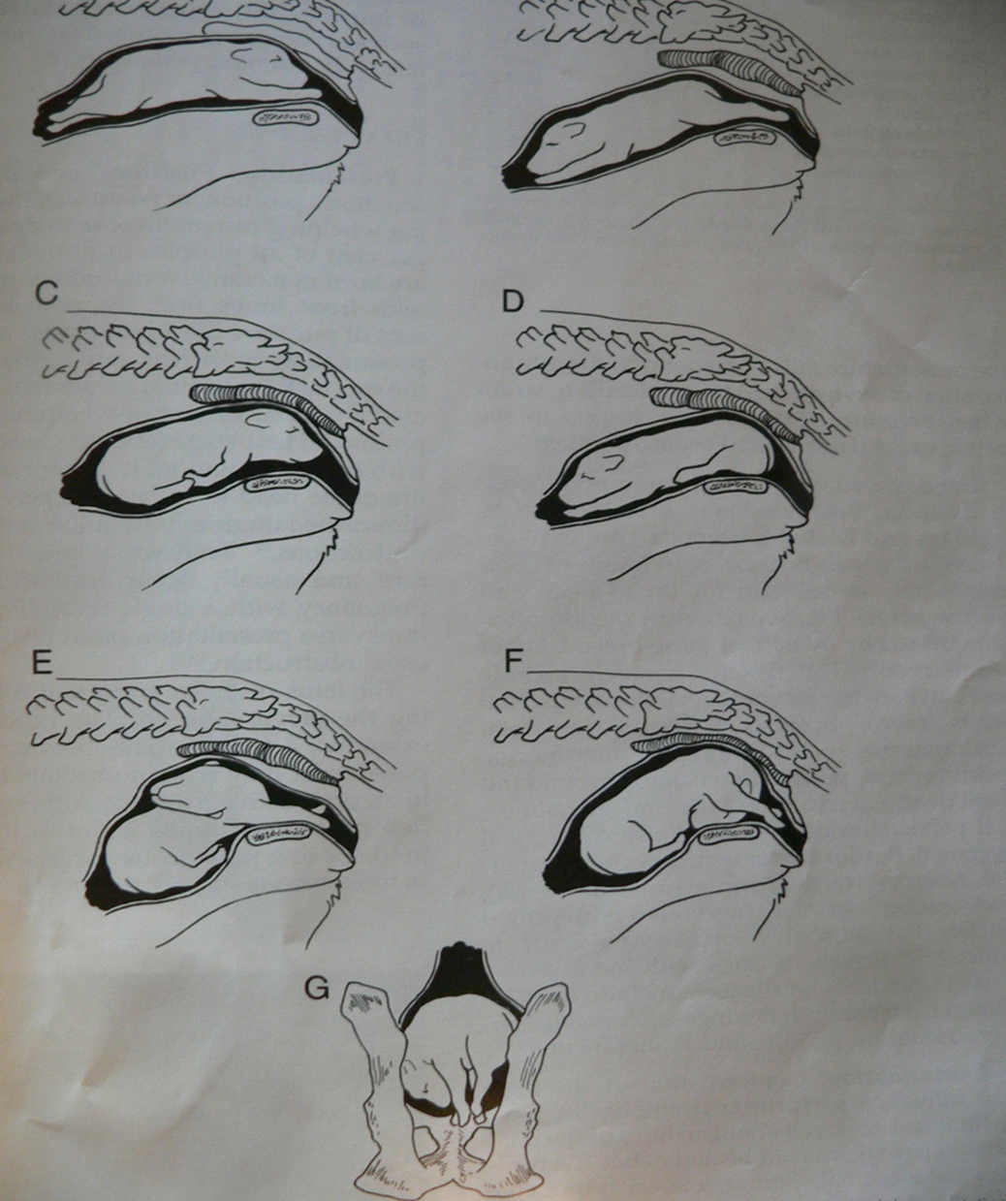
Fetal Factors
Presentation
Position
Posture
Abnormal Fetal Development
» 40% born caudal longitudinal !!!
Image from: Johnston, Root-Kustritz, Olson, Canine and Feline Theriogenologhy, WB Saunders Company, Philadelphia, PA, 2001

Slide 26
Indications to go to the Veterinarian when whelping
More than 3 (2) hours between normal delivery of pups
Delivery of a dead pup
Evidence of systemic illness – weakness, collapse, excessive bleeding, etc
Stage II (hard) abdominal contractions for 20 minutes with no pup born
Vulvar discharge (green, black, bloody) not associated with birth of a pup
More than 12 hours of Stage I labor (panting, pacing, restlessness, nesting behavior)
Partial birth – evident fetus or fetal membranes from vulva with failure of delivery to progress
Fetal distress – as determined by fetal heart rates

Slide 27
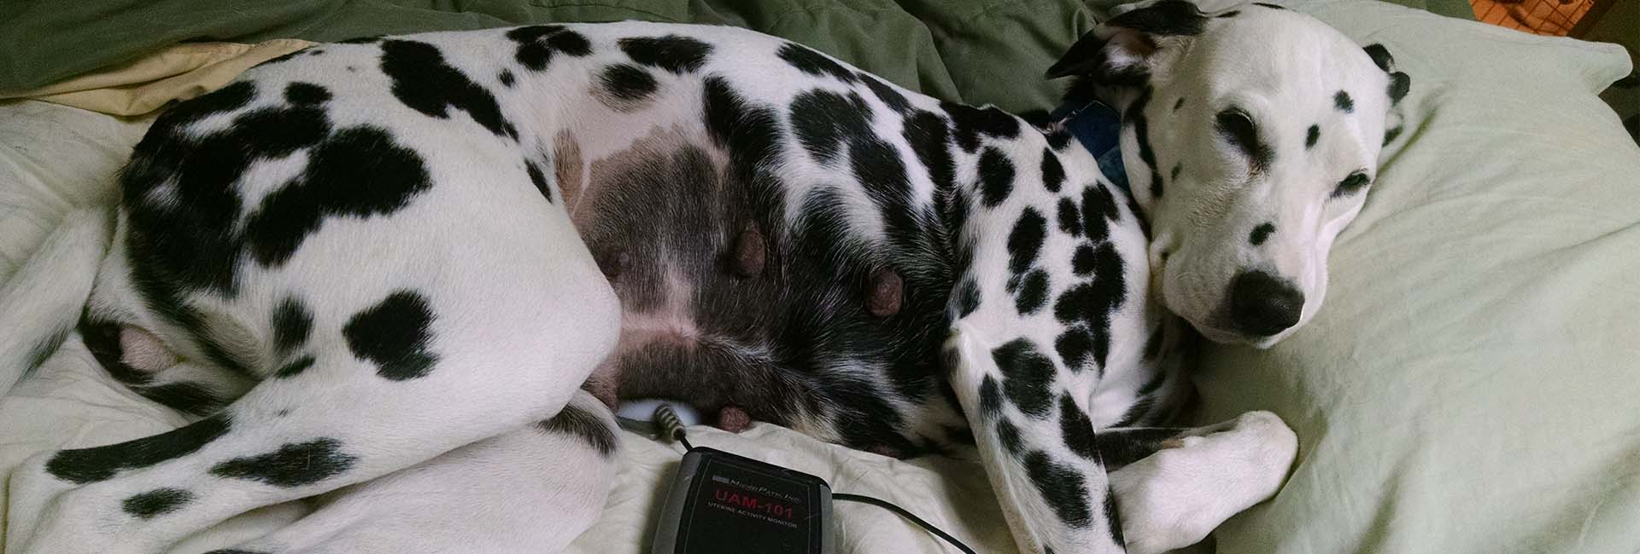
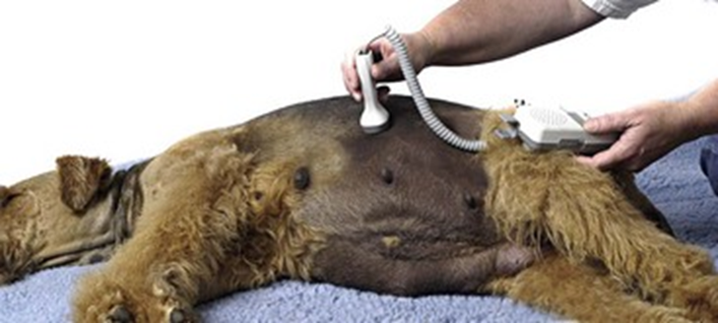
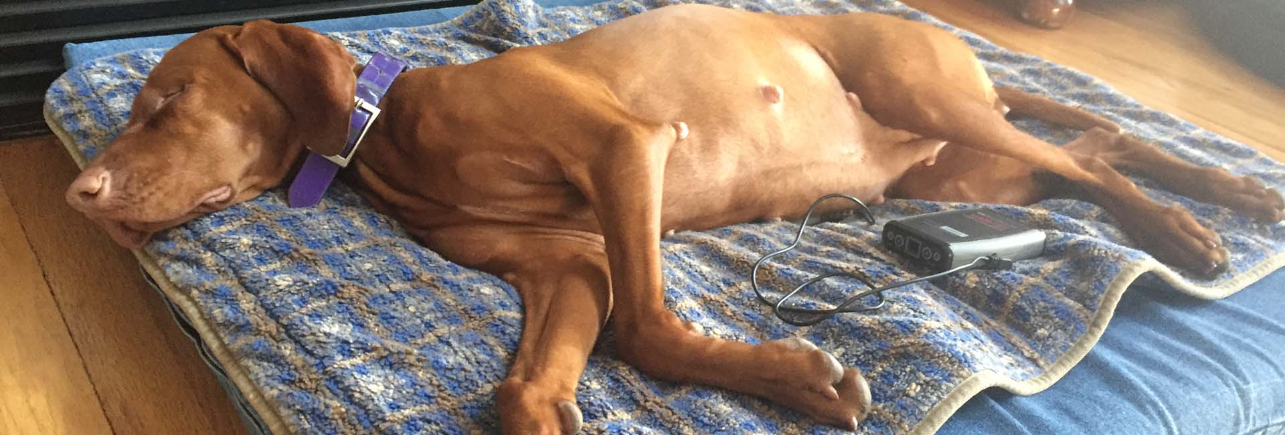
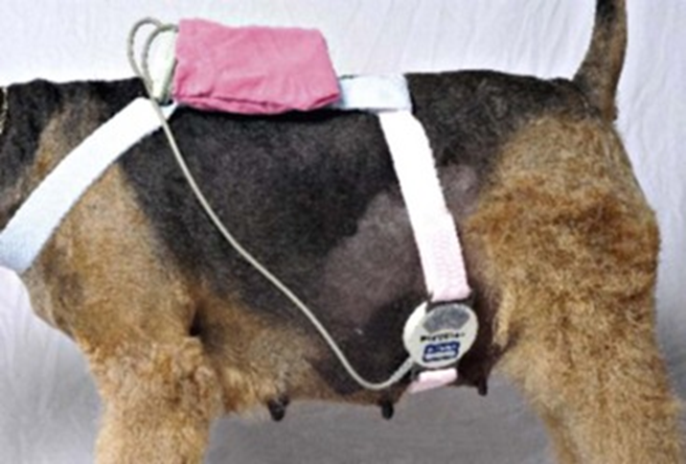
Determining Fetal Distress
Generally accepted that normal fetal heart rate is 180-220 bpm
Heart rate of 150-180 is consistent with fetal distress
Heart rate <150 is considered an emergency
Heart rate <100 is a very poor/grave prognosis
Images Courtesy of WhelpWise, Wheatridge, CO

Slide 28
Dystocia Treatment
Classify Patient as “Mild” Dystocia or “Severe” Dystocia
Mild Dystocia
Healthy bitch with normal conformation
Pups normal size and appropriate position
No evidence of obstruction
No evidence of fetal distress or compromise
4 or less pups remaining
Weak or infrequent contractions
Severe Dystocia
Obvious oversized fetus(es)
Evidence of fetal compromise
Green/black discharge with no pup born in 20-30 minutes
Progesterone level <2ng/ml for 24 hours
Obstructive dystocia (any cause)
Dystocia for any reason with 5 or more pups remaining

Slide 29
Dystocia Treatment
Treatment Options for “Mild” Dystocia
Manipulative Intervention
Medical Therapy
C-Section

Slide 30
Dystocia Treatment
Treatment Options for “Severe” Dystocia
Surgical Intervention
Advise Cesarean Section if the bitch is suffering from severe dystocia

Slide 31
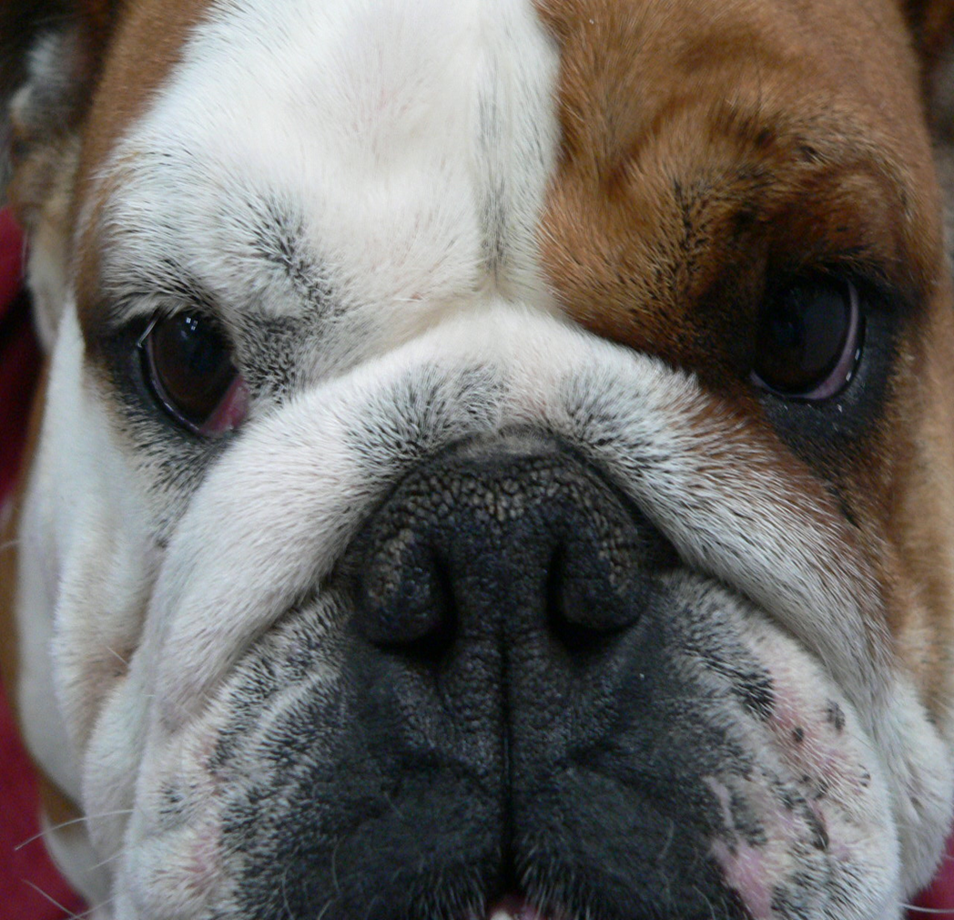
Reducing incidence of dystocia
Be mindful of the breed
Maintain appropriate health and body condition
Breed at appropriate age (not >4-5 years)
Be mindful of dam – if she experienced dystocia due to primary uterine inertia, she will likely again, as will her offspring

Slide 32
When to breed again
Maternal behavior
Complications – including surgical complication, short and long term recovery, etc.
Indication for C-section - might not want to keep breeding if primary inertia
Body condition and general health status
Age
Appropriate interestrus interval
If all is above is acceptable, most experts agree to breed on the next cycle

Slide 33
Lactation
Nutritional demands are very high – about 3x normal caloric intake
High demand for water during lactation
High quality, easily digestible, high-energy diet

Slide 34
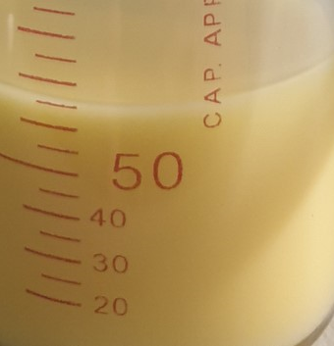
Neonate Care
Colostrum
What is Colostrum?
“First Milk” – yellowish and more viscous than milk – high in antibodies and nutrients (slight laxative effect)
Canine neonates rely almost exclusively on passive immunity from colostrum, not transplacentally
Survival depends on this passive immunity and weight gain during first 48 hours of life

Slide 35
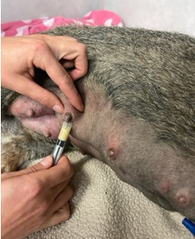
Neonate Care
Immune System
Neonates MUST receive colostrum the first 12-24 hours of life
Susceptible to systemic sepsis (infection) that can lead to death if no colostrum
Cross foster, Oral serum administration (15ml/100g bw), Colostrum bank

Slide 36
Periparturient Disorders
Agalactia
Inadequate milk production
Somewhat uncommon in canine and feline
Signalment/Presentation
Nursing bitch
Poorly developed mammary glands late gestation/early after parturition (true agalactia)

Slide 37
Periparturient Disorders
Agalactia
History/Clinical Signs
No milk obviously present in glands
Pups not gaining weight, not nursing for long
Sometimes post C-section (prematurity?)
Nervous bitch?
Progesterone supplementation during pregnancy?

Slide 38
Periparturient Disorders
Agalactia
Etiopathogenesis
Genetic
Stress – epinephrine inhibiting oxytocin (milk letdown)
Systemic Illness
Dehydration
Risk Factors
Premature
Progesterone supplementation during gestation

Slide 39
Periparturient Disorders
Agalactia
Diagnosis
History/PE
No milk with hand stripping
Are neonates gaining and content?
Pituitary-Ovarian-Mammary gland axis
Evaluate for systemic illness
Assess: Body condition, pain, hydration, vulvar discharge
CBC
Chemistry
+/- u/s of uterus

Slide 40
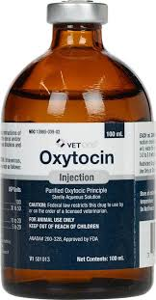
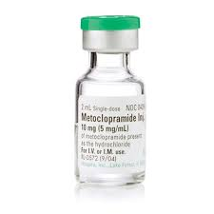
Periparturient Disorders
Agalactia
Treatment
Recognize and treat quickly if possible
Correct dehydration if present
Reduce stress if present
Get pups suckling ASAP
Oxytocin
Helps milk “letdown”
0.5-2U SC
Metoclopramide
Might help prolactin release
0.1-0.2 mg/kg SC q 8-12h

Slide 41
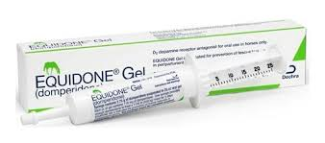
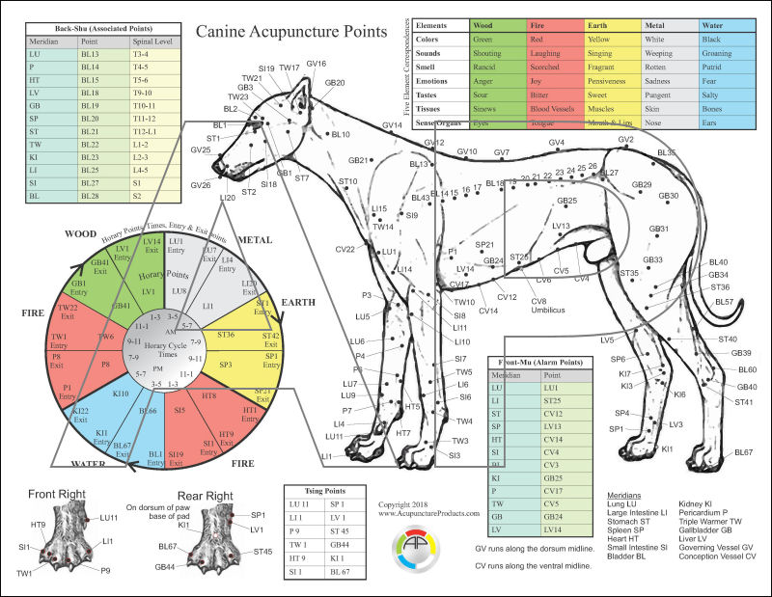
Periparturient Disorders
Agalactia
Treatment
Domperidone
Dopamine receptor antagonist
Results in increase in prolactin
2.2 mg/kg po BID
Acupuncture

Slide 42
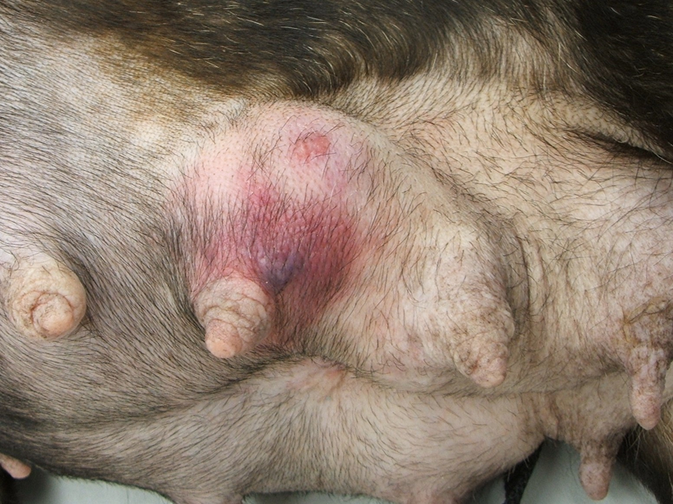
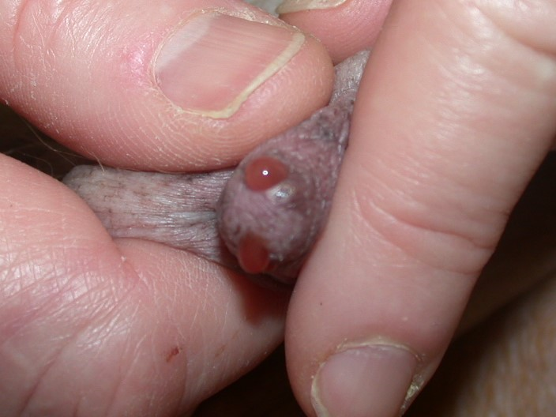
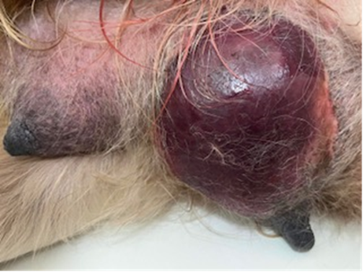
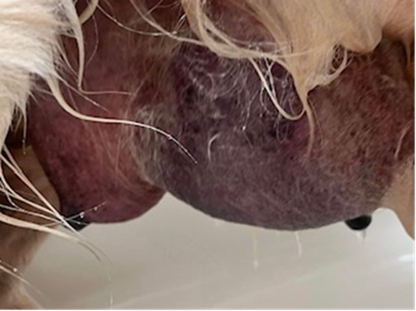
Periparturient Disorders
Mastitis
Inflammation of the mammary gland caused by infectious agent (bacteria)
Signalment/Presentation
Nursing bitch (rarely pseudocyesis)
Small litters
Large litters
Firm, reddened, painful mammary gland
Can be one or multiple glands
Abnormal milk
Courtesy: Margaret V. (Peggy) Root Kustritz, DVM, PhD

Slide 43
Periparturient Disorders
Mastitis
History/Clinical Signs
Hot, painful gland(s)
Fever, lethargy, anorexia
Neglecting neonates
Pups not gaining weight

Slide 44
Periparturient Disorders
Mastitis
Etiopathogenesis
Ascending infection (hematogenous spread possible)
Milk congestion (galactostasis)
Infrequent milk expression leads to gland congestion
Ascending bacterial infection
E.coli, Strep, Staph
Risk Factors
Infrequent nursing – galactostasis
Poor sanitary conditions
Trauma

Slide 45
Periparturient Disorders
Mastitis
Diagnosis
Usually based on history and physical exam
CBC
Leukocytosis in severe cases
Chemistry
Usually within normal limits
Cytology
Milk/discharge often reveals inflammatory cells
Culture
Always culture milk/discharge (even if it appears normal)
FNA v. Expression

Slide 46
Periparturient Disorders
Mastitis
Treatment
Supportive
Patients can present severely ill (dehydration, shock) – IV fluid therapy, IV antibiotics
Pain/Inflammation Control
Patients are significantly painful
Base therapy knowing all meds will be passed to nursing offspring
Hot packing – encourage drainage
Cabbage leaves –
Alternating warm/cool
Enzyme action? Glucosinolates reduce inflammation….

Slide 47
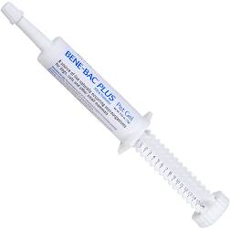
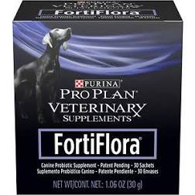
Periparturient Disorders
Mastitis
Treatment
Antimicrobial Therapy
All antibiotics will be passed in milk
Start with broad spectrum and base final decision on culture
Probiotics – dam and offspring
Keep glands expressed
Hand stripping
Keep pups nursing
Controversial

Slide 48
Periparturient Disorders
Mastitis
Treatment
Surgery
Abscess drainage might be necessary in severe cases
Mastectomy

