Slide 1
IWBDA Breeders Workshop
Reproduction Practical Focus Day
Wednesday, 3 May
2023

Slide 2
The Breeding Female
Small Animal Reproduction
Greg Burns DVM
Diplomate, American College of Theriogenologists

Slide 3
Overview
Estrous Cycle Review
Ovulation Timing
OVT Abnormalities
Normal Vaginal Flora
Cystic Endometrial Hyperplasia CEH
Pyometra
Mucometra
Endometritis

Slide 4
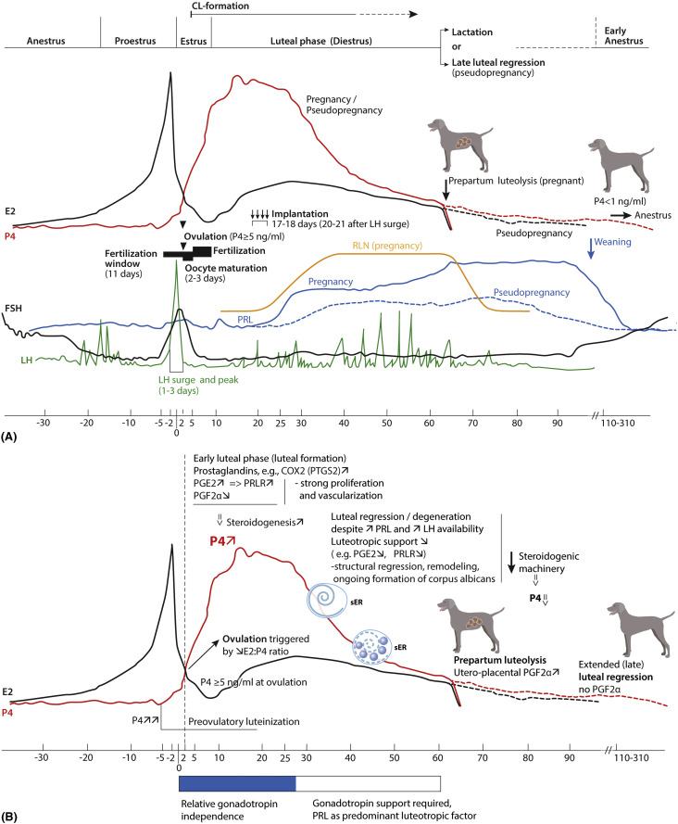
Canine Estrous Cycle
Proestrus
Estrus
Diestrus
Anestrus
Mariusz P. Kowalewski, in Encyclopedia of Reproduction (Second Edition), 2018

Slide 5
Canine Estrous Cycle
True four stage cycle – Proestrus, Estrus, Diestrus, Anestrus
Proestrus
Reproductive tract getting ready for possibility of breeding/pregnancy
Length – 1 day to 17 days (average of 9 days)
Physical Changes
Vulva enlarges and becomes firm
Discharge – serous to serosanguinous
Attract male dogs but do not allow breeding
Hormonal Changes
Estrogen rising and peaks
LH and Progesterone are low

Slide 6
Canine Estrous Cycle
Estrus
Period of receptivity when ovulation occurs
Begins first day female will accept male to be bred and ends first day she will no longer accept male
Length – 3 to 21 days (averages 9 days)
Physical Changes
Vulva somewhat less firm
Discharge – straw colored to serosanguinous
Stands to be bred and “flags” – moves tail dorsolaterally
Hormonal Changes
Estrogen declining
Progesterone begins to rise (pre-ovulatory)
LH surge (narrow peak, 12-24h)

Slide 7
Canine Estrous Cycle
Diestrus
Period following estrus when receptivity ends
Two outcomes for dogs
1) Successful breeding and subsequent fertilization of oocytes – pregnancy (gestation)
2) No or unsuccessful breeding – pseudopregnancy
Both outcomes result in the same hormonal state, under the control of progesterone, solely from the corpora lutea (ovaries), for same period of time
The corpora lutea will continue to secrete progesterone during pregnancy or non-pregnancy (dogs do not experience maternal recognition of pregnancy to end diestrus) – this is unique to the canine

Slide 8
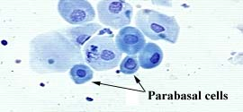
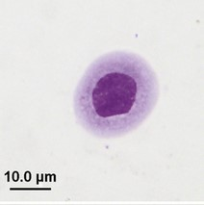
Canine Estrous Cycle
Anestrus
“Quiet” reproductive period following diestrus
Length – 4.5 – 5 months (average interestrous interval ~7 months, which includes ~2.5 months of other stages of cycle)
Physical Changes
Typically, no physical changes
Hormonal Changes
No significant hormonal changes during this period
Vaginal Cytology
Predominate cell type is Parabasal

Slide 9
Why is timing important?
Improper timing (poor breeding management) is the most common causes of infertility in the bitch
Artificial insemination methods most often use attenuated semen samples
Fresh Semen is thought to last up to 9 (5-7) days in the female reproductive tract
Fresh-Chilled Semen is thought to last about 3-4 days
Frozen Semen is thought to last 12-24 hours

Slide 10
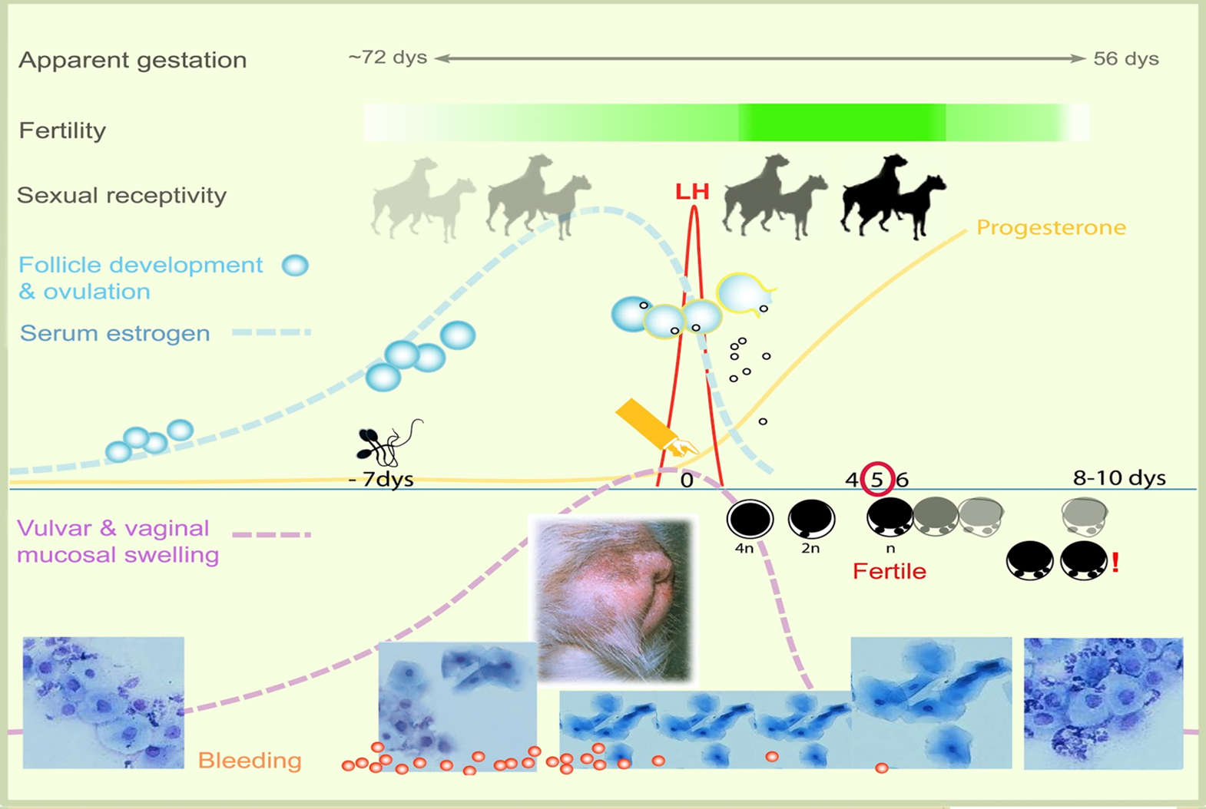
The bitch is in “heat” for approximately 3 weeks BUT there are only 3 days when oocytes capable of fertilization are present in the oviduct.
Ovulation
Fertility Period
So…how do we determine when this 3 day fertile period is occurring?
2
Notes:
Simplified graph of the ‘’fertilization period’ which illustrates Unique Features of the bitch during this critical time in regards to breeding:
Like in all species: Estrogen produced from growing follicles (granulosa cells) at start of heat/proestrus-> build up dominant follicles->an E2 surge- positive feedback at hypothalamic level- trigger LH release/surge from pituitary.
LH0: bitch unique in that progesterone rises before the LH surge…it is this rise in P4 that is associated with pre-ovulatory follicular lutenisation (metaplasia of the granulosa cells into large and small luteal cells) is one way that allows us to detect the LH surge which we will discuss more. LH surge takes apx 24-72 h
Apx 2 days (36-50 h) after LH 0 ovulation occurs
Ovulation: not highly synchronous but generally agreed to occur over 24-36 h ( 2 days) (French work with ovarian ultrasound showed ovulation occurred over only 24h….which differ to other reports of 36 -60h) later but of immature oocytes at the GV stage
Maturation of oocytes: from M1-M2 occurs over another 2 d. French group- Reproduction paper 2005- flushed oviducts after ovulation established that fertilization occurred 90 h post ovulation in M2 oocytes i.e LH 5-6 = most fertile days
Fertile Period i.e presence of mature fertilisabile oocytes in the oviduct: lies over a 3 days from some start as early as LH 4 but majority of fertilization occurs over LH 5 to LH 6

Slide 11
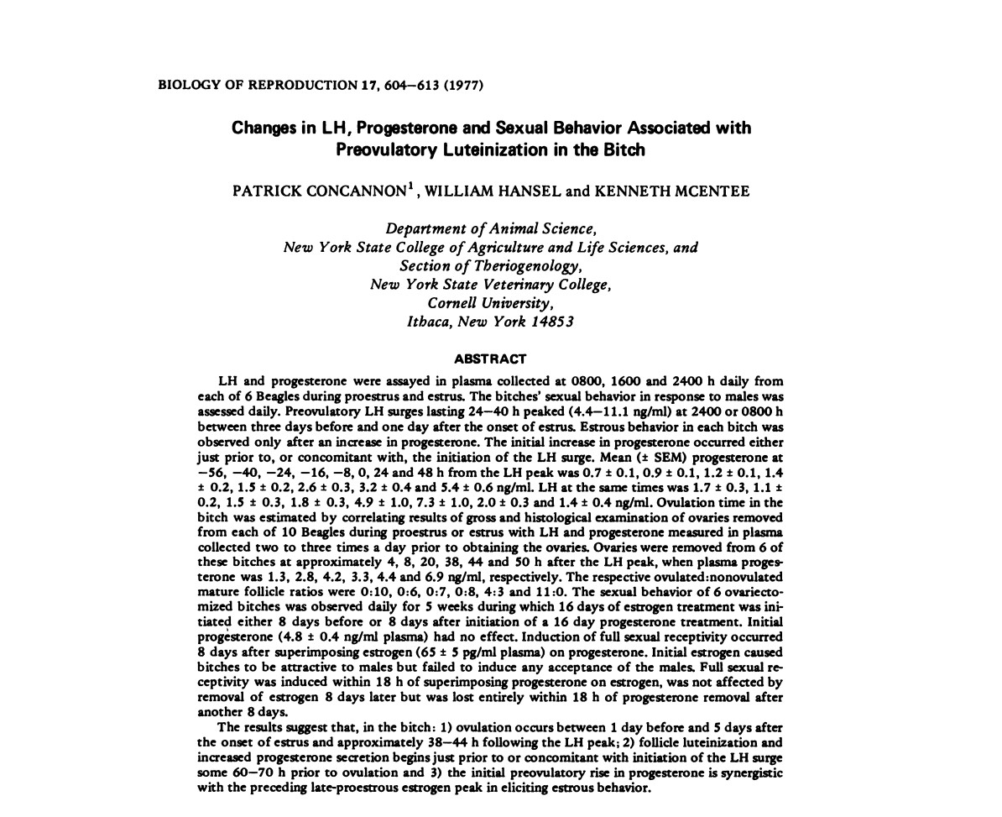
Ovulation Timing
“The early preovulatory increases in progesterone continuous with those observed after the
time of ovulation and the dramatic preovulatory changes in follicle histology (Fig. 5-10)
leave little doubt that in the bitch luteinization
of follicles begins prior to ovulation. “

Slide 12
Ovulation Timing
Key Aspects of Ovulation Timing
Timing of Insemination
Site of semen deposition
Number of effective sperm inseminated

Slide 13
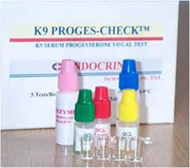
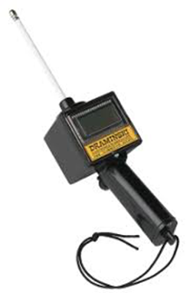
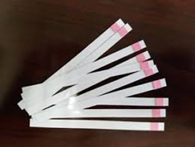
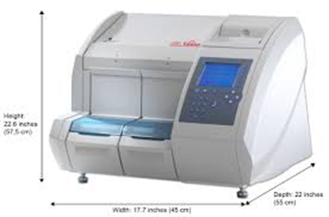
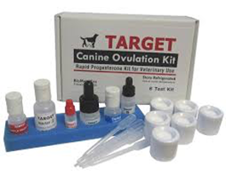
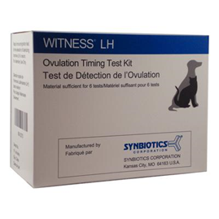
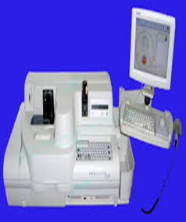
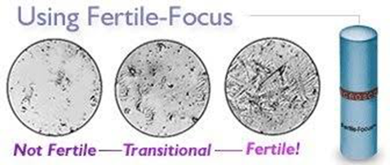
Ovulation Timing

Slide 14
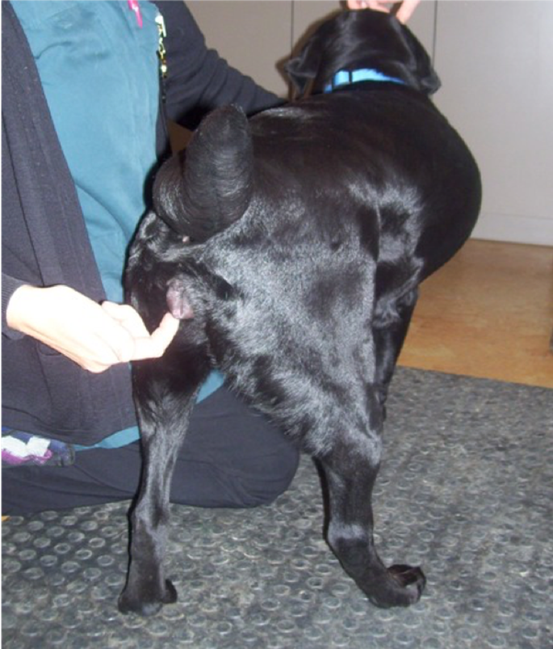
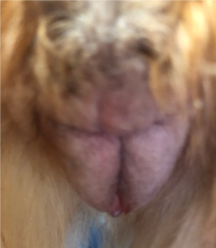
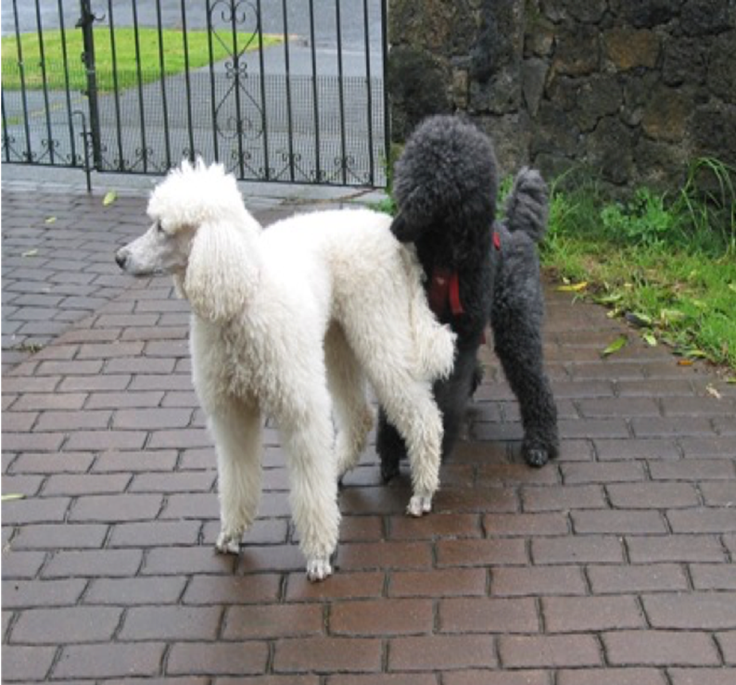
Methods of Ovulation Timing
Reproductive Behavior (estrus detection)
Reproductive Anatomical Changes (estrus detection)
Vaginal Cytology
Vaginoscopy
Endocrinology
Luteinizing Hormone (LH)
Progesterone Hormone (P4)

Slide 15
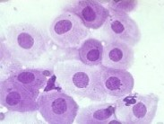
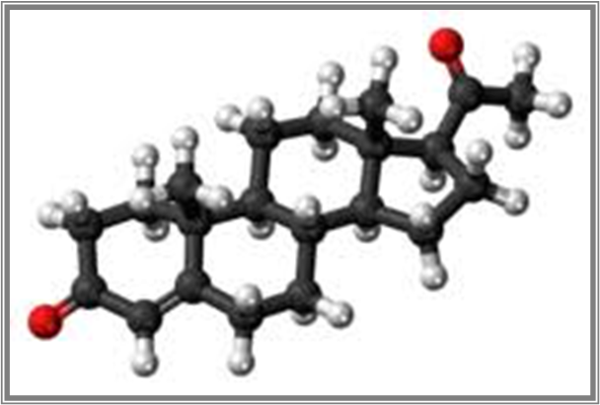
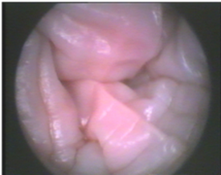
Methods of Ovulation Timing
Vaginal Cytology
Vaginoscopy
Endocrinology
Luteinizing Hormone (LH)
Progesterone Hormone (P4)

Slide 16
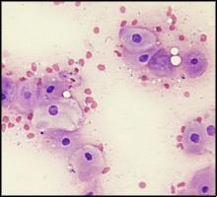
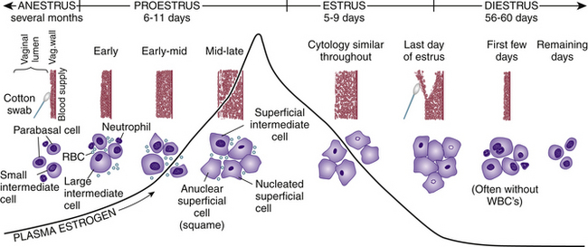
Canine Estrous Cycle
Proestrus
Vaginal Cytology – “endocrine bioassay”
RBC’s present, WBC’s mostly absent
Predominant cell type is intermediate and moving to superficial epithelial
(From Feldman EC, Nelson RW: Ovarian Cycle and Vaginal Cytology. In: Feldman EC, Nelson RW, editors: Canine and feline endocrinology and reproduction, ed 3, Philadelphia, PA, 2004, Saunders, p. 755.

Slide 17
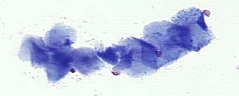
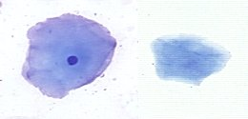
Canine Estrous Cycle
Estrus
Vaginal Cytology
RBC’s declining and sometimes absent, WBC’s absent
Predominant cell type is cornified epithelial cell (>50% anuclear)

Slide 18
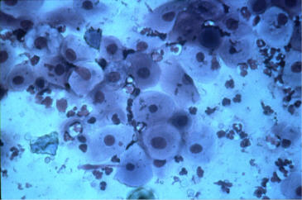
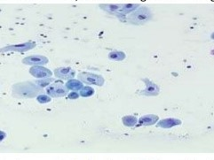
Canine Estrous Cycle
Diestrus
Vaginal Cytology
Predominant cell types are intermediate and parabasal (abrupt shift from cornified cells in 24-48h)
WBC’s present (sometimes abrupt “influx” of WBC’s)

Slide 19
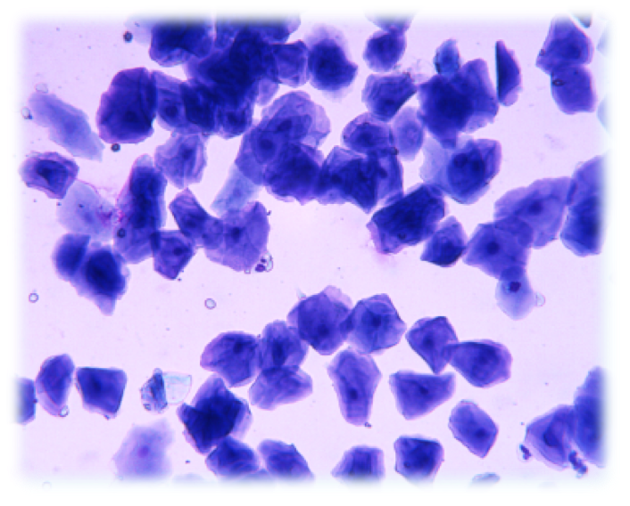
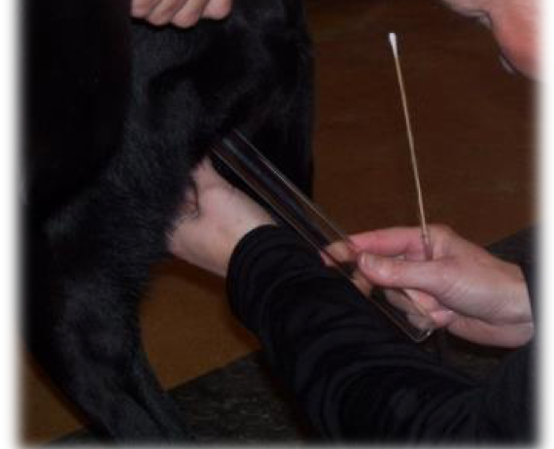
Vaginal Cytology
Vaginal cytology is an indirect measurement of ESTROGEN – “Endocrine Bioassay”
Reflected by the % of superficial keratinized (cornflake) vaginal epithelial cells
Predictive value: It will not tell you when ovulation has occurred BUT will identify the “fertilization period”

Slide 20
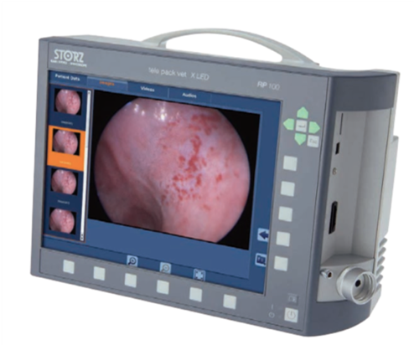
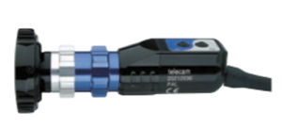
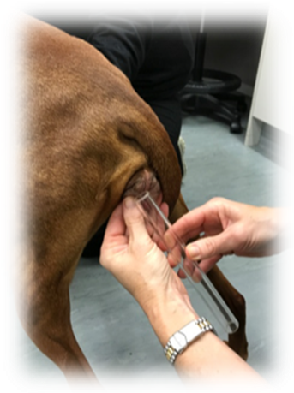
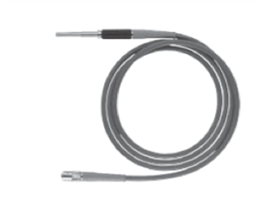
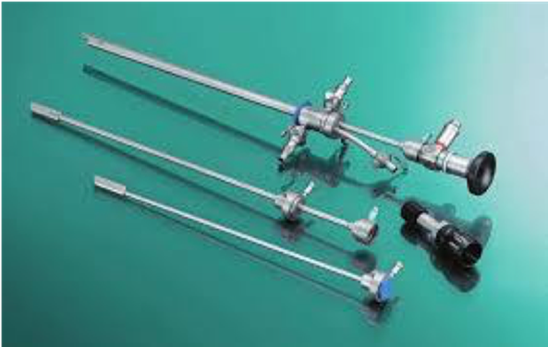
Equipment: Basic Requirements for Vaginoscopy
Rigid endoscope (minimum working length 29cm)
Air insufflation- rectal insufflation bulb +/- shunt system
Cold light source: xenon or LED
Camera
Cable
Monitor
Speculum and light source

Slide 21
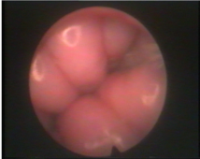
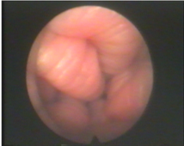
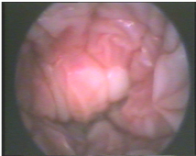
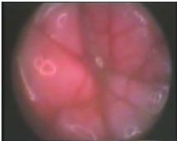
Vaginoscopy
Proestrus: pink, moist, large edematous folds, little or no vaginal lumen
Estrus: becomes paler, drier and edema recedes – progresses through shrinking rounded to shrunken angular phase, large vaginal lumen
Late estrus: most fertile period! Dry, pale, shrunken angular, crenulated mucosa, large luminal space
D1: Loss of E₂: SCI falls by > 20%
Diestrus: pink, flat moist folds often with brown mucky material
KEY: Assess level of crenulation, lumen size and mucosa color
BREED NOW!

Slide 22
Hormone Assessment

Slide 23
Endocrinology
Luteinizing Hormone (LH)
Hormone produced by pituitary gland and peaks to cause ovulation
Challenges for OVT
Very narrow peak in the canine. Usually peaks and returns to baseline within 24 hours
This makes daily testing necessary to obtain a true peak
Fertilization period is thought to begin 96 hours after LH peak

Slide 24
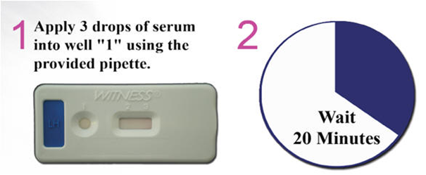
Ovulation Timing - Canine
Luteinizing Hormone (LH)

Slide 25
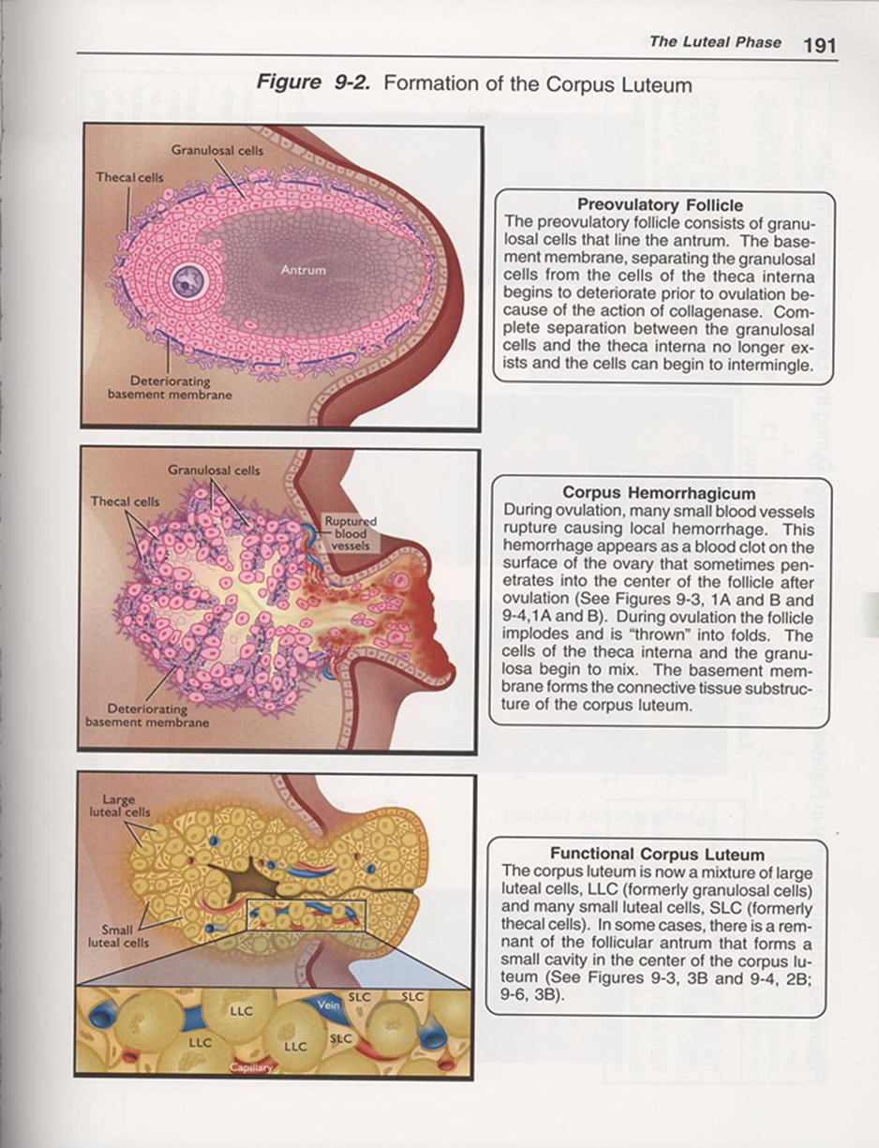
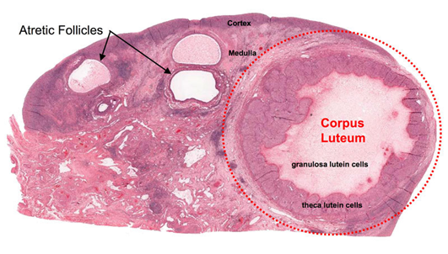
Endocrinology
Progesterone (P4)
Steroid hormone produced by the corpus luteum (CL) for pregnancy maintenance in the canine
Pre-ovulatory rise can be used for ovulation timing

Slide 26
Progesterone
Qualitative Testing – Testing that approximates or characterizes but does not measure the attributes, characteristics, properties, or abundance of a substance in a sample.
Quantitative Testing – Testing that measures absolute or relative abundance (expressed as concentration) of a substance in a sample.
We are interested in quantitative progesterone testing for accurate ovulation timing in the canine.

Slide 27
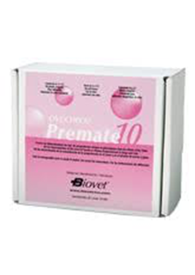
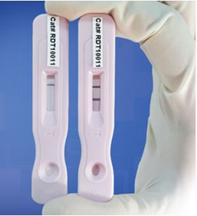
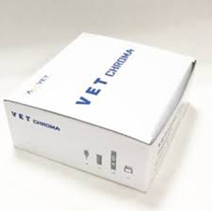
Qualitative Testing

Slide 28
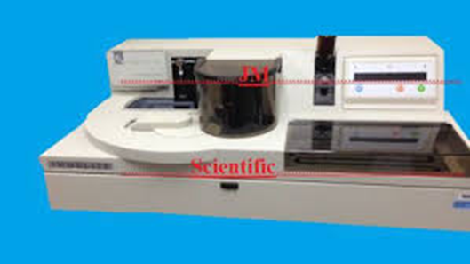
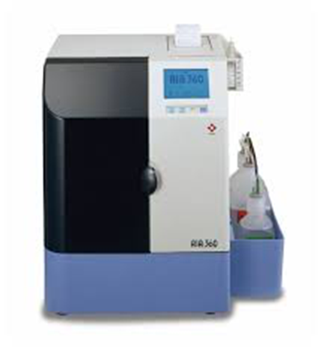
Quantitative Testing

Slide 29
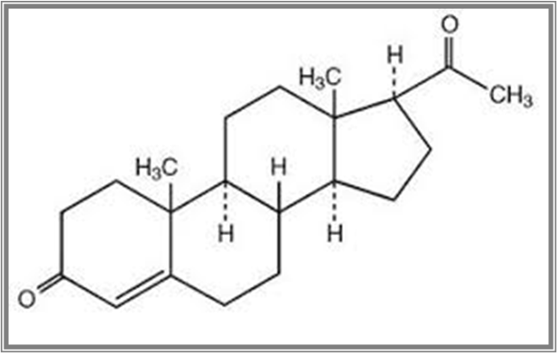
Progesterone Testing
Progesterone structure is the same for all species
However, the same quantitative result is not always obtained from machine to machine or between species
Hormone folding
Protein binding
Cross reacting molecules
Assay interference – lipid molecules
Use a machine that is validated for the canine

Slide 30
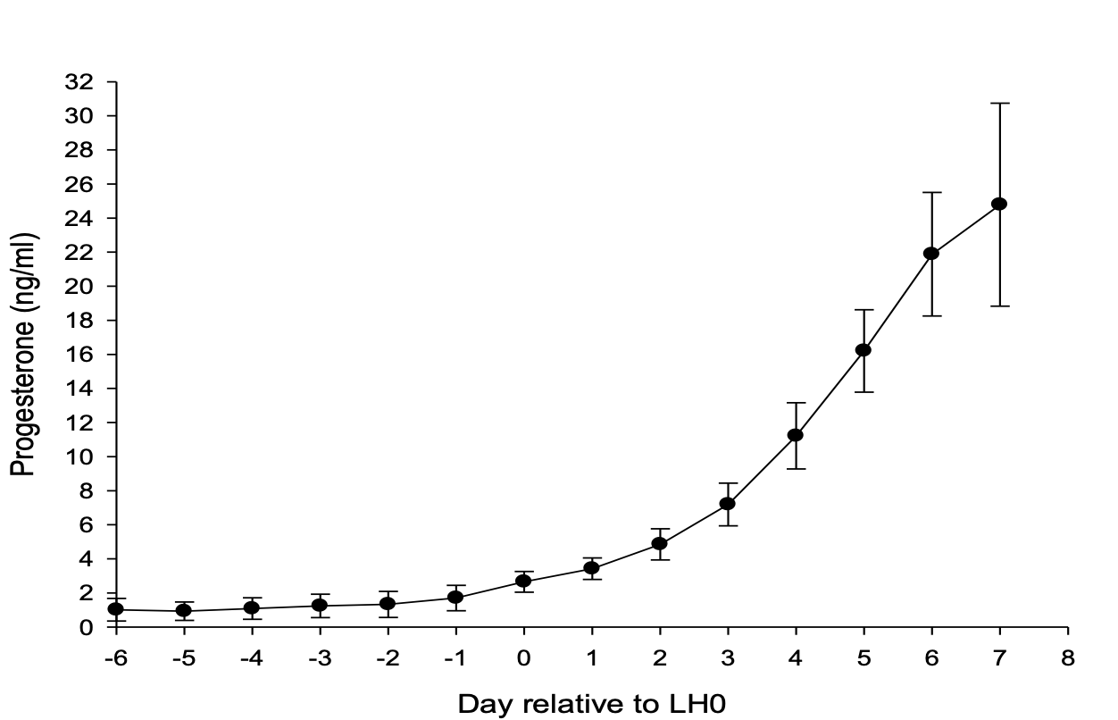
Progesterone Curve: Profile
Profile of mean (± SD) serum progesterone concentrations (4213) during estrus from 1300 individual bitches monitored for 1420 artificial inseminations. The progesterone profile was normalized to LH 0.
Hollinshead F.K. and Hanlon D.W. (2018) Normal progesterone profiles during estrus in the bitch: A prospective analysis of 1420 estrous cycles. Theriogenology 125, 37-42

Slide 31
Progesterone Testing
Fertility Period
Begins 96 hours after the LH peak
Begins 48 hours after ovulation
Fertility period lasts 72-96 hours

Slide 32
Summary
Due to the predictability of the normal progesterone curve in the bitch serial progesterone measurements to confirm when LH0 is estimated to occur coupled with confirmation of a continual rise in progesterone concentrations until the day of AI will facilitate greater reproductive performance especially when using frozen semen
Start testing at day 5-7 of proestrus and then every 2-4 days depending on progression, cytology and vaginoscopy findings
Continuing monitoring every 2 d after determination of LH0 and ovulation until day of AI
PROGESTERONE MONITORING
Ref: Hollinshead and Hanlon Therio 125, 37-42. 2019

Slide 33
Summary
Estimation of both LH0 and ovulation by detection of a rise in progesterone >2 ng/ml and >5 ng/ml respectively
Confirmation of the fertile period by a continual rise in progesterone concentration >10-20 ng/ml within 4-6 d after the estimated LH0 or 2-4 d after when ovulation is estimated to occur
Often the determination of when the LH0 and ovulation was estimated to occur is done retrospectively
‘Slow’ progesterone rises can be associated with smaller LS: clinically important when genetically valuable frozen semen is to be used
PROGESTERONE MONITORING
Notes:
Due to the predictability of the normal progesterone curve in the bitch
Retrospective: esp when a bitch ‘sits’ around 2 ng/ml. Often easier to detect ovulation than LH0 initially

Slide 34
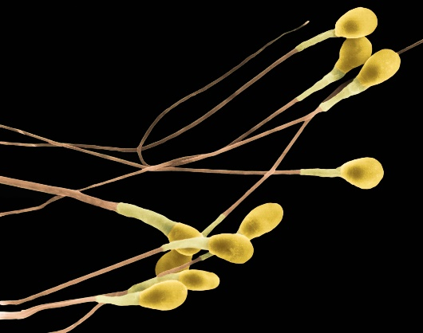
Ovulation Timing - Conclusion
The intensity of estrus monitoring will depend on the type of semen planned
for AI or mating
Natural mating/ fresh ejaculated semen:
Viable up to 7 days after NM/AI
Fresh chilled (shipped 24 h) semen:
Viable from 2-5 days after AI
Frozen-thawed semen
Lifespan 6- 24 (48) hours after thawing and AI
Lifespan of all types of semen is variable depending on the dog’s age, semen quality, fertility, extenders, handling , processing and storage conditions

Slide 35
When things don’t seem quite right….
Persistent estrus
“Slow rise”
Ovulation failure

Slide 36
Persistent Estrus (Prolonged Estrus)
Defined as estrus that persists more than 21 days (does not include Proestrus)
Clinical Signs
Consistent with Estrogen stimulation (“Heat”)
Vulvar swelling/serosanguinous discharge
Vaginal epithelial cornification
Behavioral estrus – standing to be bred, flagging
Progesterone Level
Typically remains ≤ 2ng/ml (dependent on cause)

Slide 37
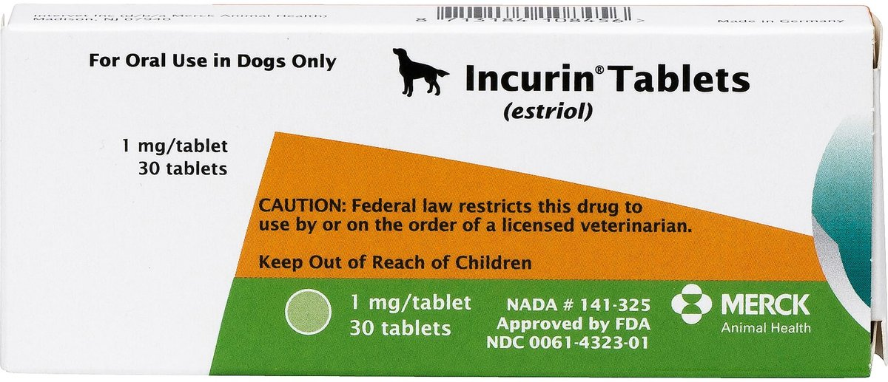
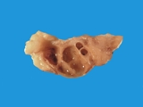
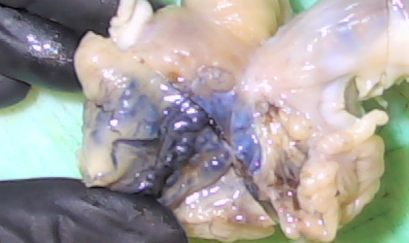
Persistent Estrus (Prolonged Estrus)
Causes
Exogenous estrogen exposure – HRT creams/ointments, oral estrogen for urinary incontinence (Incurin®)
Endogenous estrogen production
Ovarian abnormalities
Follicular cysts
Granulosa cell tumors
Hypophysis or hypothalamus tumor

Slide 38
Persistent Estrus (Prolonged Estrus)
Advanced Diagnostic Testing
Ultrasound
Assess endometrium
Generally accepted that a “cyst” is ≥ 8mm
GCT
Sometimes normal
Inhibin level?
Surgery – Open or Laparoscopic
Treatment
OE (Ovariectomy) or OHE (Spay)
Induce diestrus (or anestrus) using GnRH or hCG – results in luteinization, not ovulation (don’t breed)
Potential Risks (prolonged estrogen exposure)
Increased risk of pyometra
Bone marrow suppression

Slide 39
“Slow Rise”
Those that rise to 2.0ng/ml – 4.0ng/ml for more than 3 days followed by rapid (ovulatory) rise
Possible causes
Delayed ovarian response to LH surge?
Inappropriate ovarian estrogen surge to cause ovulation?
Inappropriate pituitary delivery of LH?
Inappropriate receptor response to LH?
Result is smaller litter sizes

Slide 40
“Slow Rise”
Type 1 example:
1/1 – 1.5ng/ml
1/2 – 2.2ng/ml
1/4 – 2.4ng/ml
1/5 – 3.5ng/ml
1/6 – 5.3ng/ml
1/7 – 10.8ng/ml
1/8 – Fertility period begins this day
LH Peak
Ovulation

Slide 41
Progesterone profiles: speed
Abnormal progesterone curves: slow and ovulation failure
The litter sizes of bitches inseminated with frozen semen with slow progesterone curves were significantly smaller compared to bitches with fast progesterone curves (3.9 ± 1.8 vs 5.6 ± 3.1 pups per litter respectively; P<0.001).
Care: in using a single and absolute P4 concentration of 15ng/ml to time AI
Schematic graph illustrating different progesterone curves
Notes:
Slow curves: reproductively ‘sub clinical’ negative impact on litter size
Clinical implications : Need to consider using frozen semen in bitches with slow prog curves: double whammy (EEL) = v small LS
And Need the whole picture- can’t AI of 15
2. We didn’t include very slow curves/ ov failure curves: (clinical reproductive failure ) in our study so b/c anecdotally/experience @ with reduced PR- when valuable frozen semen to be used most clients will elect not to AI

Slide 42
Ovulation Failure (Luteinization)
Progesterone level
1/1 – 1.5ng/ml
1/2 – 2.2ng/ml
1/4 – 3.0ng/ml
1/5 – 3.5ng/ml
1/6 – 3.9ng/ml
1/7 – 5.1ng/ml
1/8 – 5.9ng/ml
1/10 – 6.7ng/ml
1/12 – 7.1ng/ml
1/14 – 7.2ng/ml
1/16 – 8.7ng/ml

Slide 43
Normal vaginal flora
Most common bacteria found in vaginal vault of healthy bitches
E. coli
Streptococcus spp.
Staphylococcus spp.
Pasteurella spp.
A mixed population of commensal bacteria is normally present within the vagina and plays an important role in homeostasis
We typically do not culture normal bitches as part of a prebreeding work up (Infertility? Subfertility? Vulvar discharge?)
Culture of a swab from this region is significant if there is a pure, heavy growth of a single bacteria, together with appropriate history and clinical signs (vulvar discharge, excessive neutrophils)

Slide 44
Vaginal Cultures
“Because reproductive tract infection is caused by overgrowth of normal flora, the laboratory performing the culture always should be asked to provide a quantitative result, with culture of any single organism with moderate to heavy growth, or 3+ to 4+ growth on a four-point scale, considered relevant.
“Mycoplasma and ureaplasma organisms are part of the normal flora of the canine genitourinary tract.”

Slide 45
Cystic Endometrial Hyperplasia (CEH)
Etiopathogenesis - not completely understood
Cystic Endometrial Hyperplasia (CEH ) - Hormone driven process from repeated exposure
Estrogen influence
Promotes growth, vascularity of endometrium
Opens/dilates cervix
Increases number of progesterone receptors on endometrium
Progesterone influence
Promotes secretion and proliferation of endometrial glands
Decreases local immunity
Closes cervix
“Quiets” endometrium – decreases contractibility
Cystic endometrial hyperplasia, pseudo-placentational endometrial hyperplasia, and other cystic conditions of the canine and feline uterus
D.H.SchlaferA.T.Gifford

Slide 46
CEH in the Canine
Etiopathogenesis – not completely understood
CEH develops because of an abnormal uterine response to ovarian hormones (estrogen and progesterone)
Fluid (sterile) accumulates in endometrial glands and uterine lumen as an exaggerated response during the luteal phase (repeated, chronic influence of progesterone)
CEH mucometra/hydrometra is not always associated with inflammation and not typically a clinical disease (other than infertility)
Many patients with CEH are not symptomatic
Current evidence suggests that Cystic Endometrial Hyperplasia (CEH) and Pyometra are separate entities
CEH can also be induced (triggered) by trauma (biopsy), suture, irritants (cryoprotectants), etc.
If bacteria are the trigger, Pyometra is the result

Slide 47
CEH
Cystic distention, fluid accumulation, fibrosis, etc.,
+
bacteria
Endometritis
Hydrometra or mucometra depending on fluid viscosity
Pyometra
Infertility/Subfertility

Slide 48
Pyometra in the Canine
Etiopathogenesis - not completely understood
Pyometra – Endometritis
Pyometra can occur in the absence of CEH reinforcing the evidence that CEH and pyometra are separate entities
Complex etiology
Bacteria
Immune dysfunction
Hormone
Inflammation of endometrium always present
These patients are clinically ill
Bacteria include:
E. coli
Strep, Staph, Klebsiella, Proteus, Pasteurella

Slide 49
Pyometra in the Canine
Signalment
75% are nulliparous
Mean age is 6 years
Clinical Presentation – can vary greatly with patency of cervix – “open” v. “closed”
Most commonly present 5 weeks post estrus
Fever, lethargy, anorexia
Vulvar discharge – mucopurulent – associated with cervical patency - “open”
PU/PD, GI – vomiting/diarrhea
Abdominal distention – typically associated with closed cervix
Dehydration, hypothermia, sepsis – associated with severe cases
These patients usually (almost always) present in diestrus (luteal phase).

Slide 50
Pyometra in the Canine
Diagnosis
History and Clinical Signs
Diestrus – signs of heat within the last 5 weeks
Mucopurulent vulvar discharge (if cervix open)
Blood Profile Changes
Marked leukocytosis with left shift (often >30,000)
Serum progesterone is typically >2ng/ml
Pre-renal azotemia
ALP, ALT increase (response to toxemia, diminished hepatic circulation?)
Uterine Enlargement
Palpation
Radiography
Ultrasound

Slide 51
Pyometra in the Canine
Treatment
Ovariohysterectomy (OHE) – curative and preventative
Stabilize first with IV fluid therapy, antibiotic therapy
Medical Therapy – no approved medication in the U.S. for this use
Only if:
Significant contribution to genetic pool
4y or less
Patent cervix
No or minimal biochemical changes (normal BUN, Cr, ALP, ALT)
Prostaglandin – PGF2α
10-20ug/kg TID SQ
Can have significant side effects
Vomiting, Diarrhea, Hypersalivation, Abdominal Cramping
Requires several days (5-7 or so) of therapy and should be done in hospital
73%-93% effective for complete resolution, 75%-87% fertility following therapy

Slide 52
Pyometra in the Canine
Treatment
Medical Therapy – continued
Dopamine Agonist (prolactin inhibitor)
Will cause decrease on Prolactin (luteotrophic hormone)
Cabergoline (Dostinex)
Minimal side effects
Given once daily
5ug/kg PO SID
Progesterone Receptor Antagonist
Remove progesterone block to open cervix and allow uterus to evacuate (contractions?)
Eventual luteolysis
Aglepristone (antiprogestin) – RU534 – Not available/approved for us in the U.S. (special permit)
Minimal side effects
Two injections, given 24 hours apart
10mg/kg SQ
84%-93% for complete resolution, ~75% fertility following therapy (probably higher)

Slide 53
Pyometra in the Canine
Treatment
Medical Therapy – continued
Antimicrobial Therapy
Start with broad spectrum and base on culture
Treat for 10-14 days post resolution of pyometra
Prevention
Not routine and controversial
Estrus suppression (2-3 months) to allow additional time for endometrial regeneration
Only drug approved for this use is a progestin – not appropriate in this situation
Mibolerone – androgen – not approved for this use in U.S, or in “breeding dogs”
Has been shown to be effective

Slide 54
Mucometra in the Canine
Clinical Signs
Often no clinical signs – other than infertility
May see mucous vulvar discharge when cervix is open
Diagnosis
Usually, no clinical signs but fluid in uterus – NOT lethargic, no fever, normal attitude/appetite
Normal CBC, Chemistry profile
If vulvar discharge – mucous and not purulent
Treatment
None/Monitor?
Hasten evacuation of uterus
Prostaglandin – PGF2α
Dopamine Agonist – cabergoline
Progesterone Receptor Antagonist - aglepristone

Slide 55
Endometritis in the Canine
Etiopathogenesis - Unclear
Clinical Signs
Often no clinical signs – other than infertility
Diagnosis
Usually NOT lethargic, no fever, normal attitude/appetite
Normal CBC, Chemistry profile
Definitive diagnosis via transcervical catherization by vaginal endoscopy – cytology, culture (most are bacterial)
Treatment
Choose a different breeding bitch (especially if not young and highly valuable)
Anti-inflammatory therapy (NSAIDS)? Antibiotic therapy?

