Slide 1
How to make breeding decisions on traits without EBVs
Madeline Zimmermann, M.S.
2023 Breeders Workshop

Slide 2
Outline
Background
A general process for assessing genetic risk when EBVs are unavailable
Where could this go wrong? (Data considerations)
Considerations if risk is suggested
Examples:
CLD
Head tremors
TVD

Slide 3
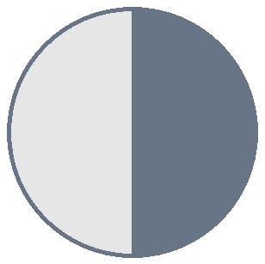
Many are familiar with autosomal recessive:
Caused by 1 gene
Need 2 copies of causative variant to show phenotype
Can do genetic tests, e.g. dog has it or they don’t and there’s a carrier state that is healthy
Rarely applies to traits of interest
 | A | a
a | Aa | aa
a | Aa | aa
Normal
Normal
Normal
Normal
Normal
AFFECTED
Notes:
Use example of hip dysplasia – can breed great hips and get worse

Slide 4
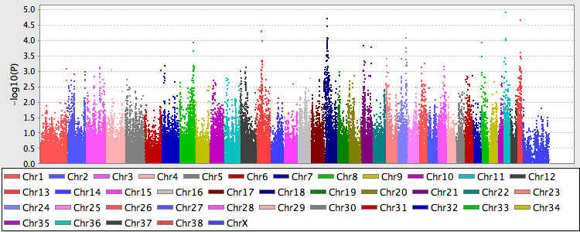
Traits of interest are often complicated
Polygenic = many genes of small effect add up to produce the observable phenotype
Difficult to find reliable genes for testing or understand how genes combine to affect phenotype
From a 2016 GWAS analysis of Mast Cell Tumor cases done by the Broad Institute and Guiding Eyes for the Blind. No significant associations identified.
Notes:
MCT image is typical – many genes with some role, hard to find those genes, understand how they interact together.

Slide 5
Making progress in polygenic traits
Use EBVs!
Quantify “how good the dogs’ genes are” based on relevant information available on the dog and all related dogs so you can identify who is higher or lower risk for producing more of the issue.
Do not need to know specific genes involved or what they do
Notes:
Example: threshold trait – can have some risk genes but if you accumulate too many, then affecteds will start to appear.

Slide 6
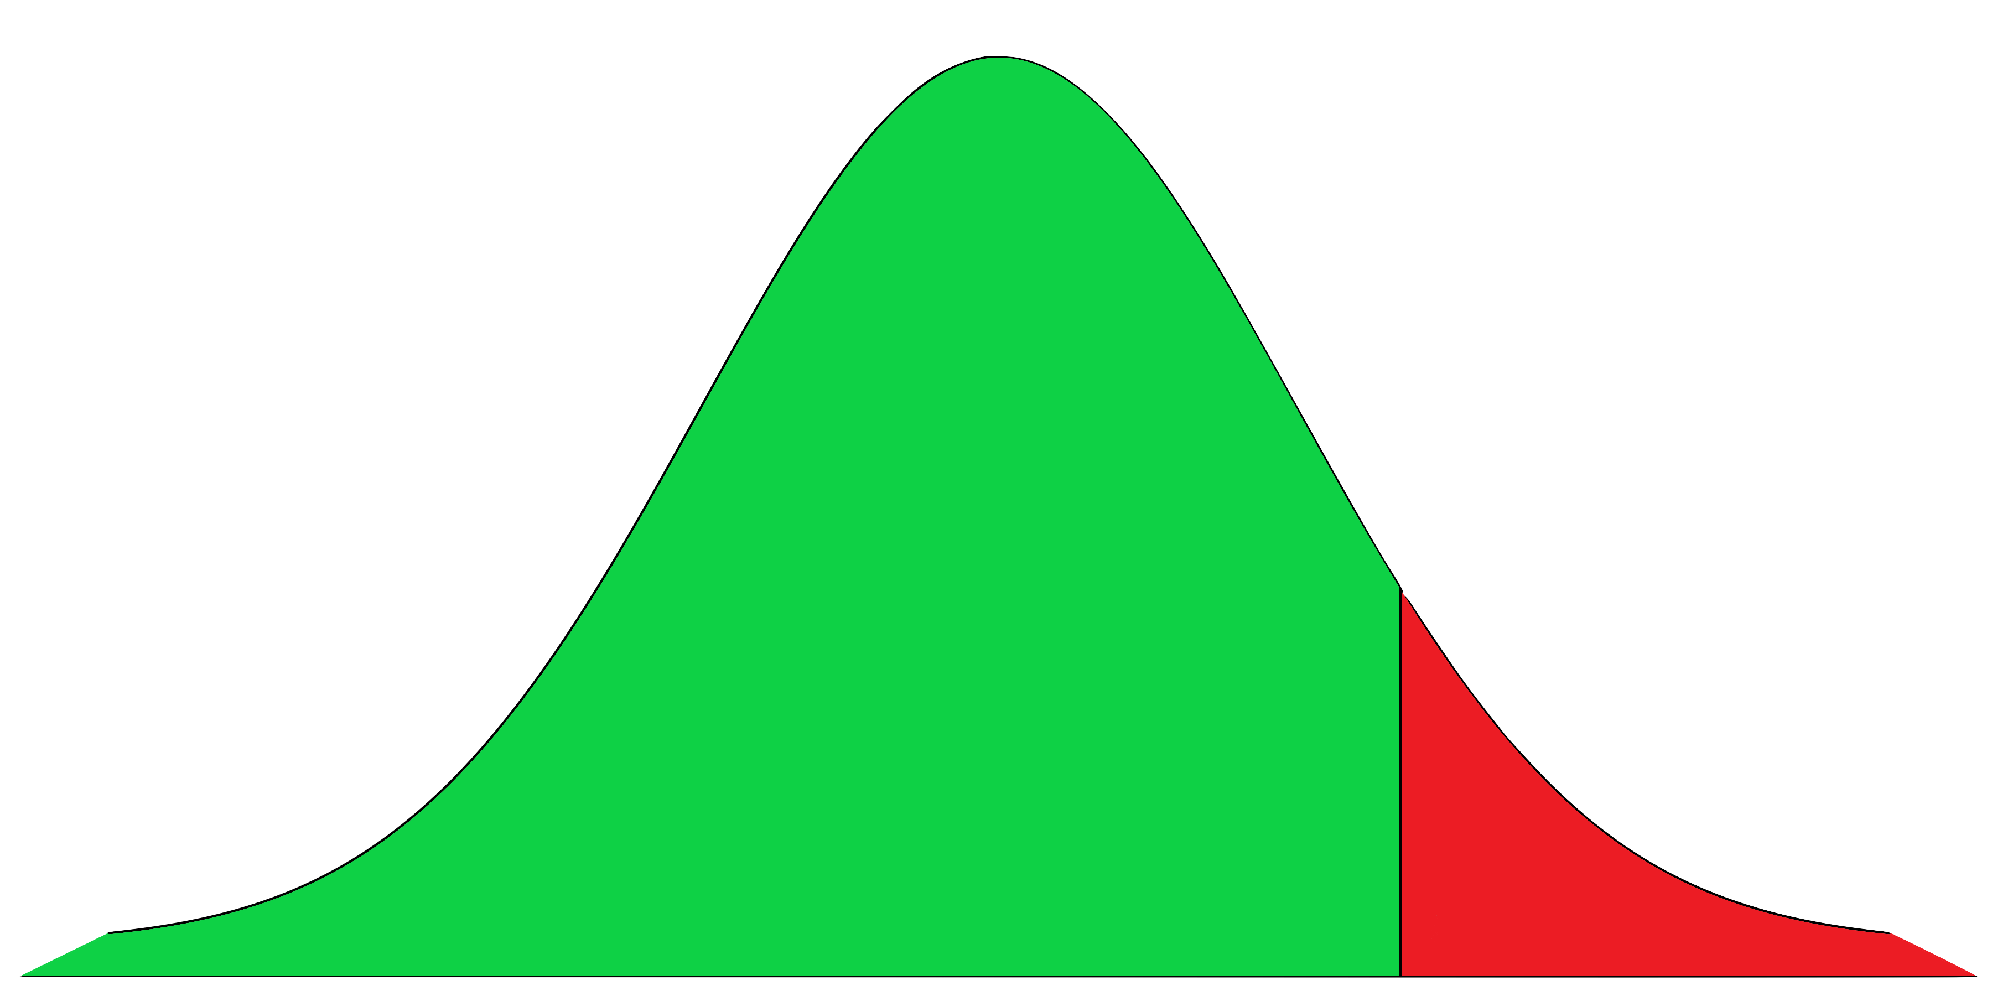
A General Process for Assessing Genetic Risk When EBVs are Unavailable
Is there an increased incidence when breeding higher risk dogs?
Identify affected dogs.
Classify other dogs:
“Carrier” = produced at least 1 affected puppy OR has at least 1 affected parent
“Not carrier” = has no affected puppies or parents
Calculate & evaluate % incidence with various parent combinations:
Affected x Affected (if applicable)
Affected x “Carrier” (if applicable)
"Carrier” x “Carrier”
"Carrier” x “Not carrier”
"Not carrier” x “Not carrier”
Threshold
Healthy
Affected
Genetic Risk
Notes:
Getting a feel for risk. Will not know if “carrier” and “not carrier” is accurate description of the genetic underpinnings.

Slide 7
Where could this go wrong?
Problem | Consequence | Solution
Poor quality measurements (inconsistent or inaccurate) | Evaluations and therefore decisions will be inaccurate (Garbage in = garbage out) | Ensure consistent, accurate measurements
Only have information on breeders | Can’t tell which breeders/families have produced more or less of the issue | Screen as many dogs as possible
Dogs’ health is not followed throughout their lifetimes | Don’t know which dogs are affected, especially for later-onset conditions | Continue collecting information about dogs’ health as they age, e.g., with an annual health survey, regular screenings, etc.
No record made when dog is examined and found to be normal | Can’t distinguish dogs confirmed to be healthy from dogs with health unknown | Routinely record “normals”

Slide 8
Considerations if risk is suggested
Replacement Breeder Selection
Mate Decisions
How many siblings are affected?
Look for 80% or more NORMAL in a litter, as a general rule of thumb.
Depends on incidence in colony
Are parents affected?
How much do you know about the disease?
Be sure you’re still saving enough dogs! (Save best available in the number needed from variety of pedigrees.)
Choose mates that reduce risk while following key principles:
Proposed litter has the lowest inbreeding of choices available
Avoid producing affected dogs where genetic tests are available
Avoid repeat matings
Use studs equally
Stud is good for traits where brood is not so good
Notes:
Risk increased for both sibs and parents affected.
Usually 3 litters gives enough data
Example breeder selection: Could verbally mention metatarsal fistulas pop up recently, sporadic cases in similar timeframe of singleton in litter with no common sire or dam except one litter with 5/6. Skipping stud if possible until we learn more.

Slide 9
What to do next?
Create (& document) guidelines based on incidence and how many issues being managed. Adjust criteria based on accumulated knowledge of disease.
Follow incidence:
If responding, consider pursuing EBVs.
If not responding, re-evaluate guidelines/criteria.

Slide 10
Evaluating Risk in Two Broods
Breeder | Bite Prob | Bite Prob Litter | Bite Prob Produced | % Bite Prob Produced | CLD Affected | CLD Produced | % CLD Produced | Sire CLD Affected | Dam CLD Affected
Brio | No | 1 | 2 | 0.11 | No | 0 | 0 | No | No
Capri | No | 0 | 0 | 0 | Yes | 1 | 0.08 | No | Yes
Breeder | Cleft Litter | Cleft Produced | % Cleft Produced | Curled Toes | Curled Toes Litter | Curled Toes Produced | % Curled Toes Produced | Entropion Affected | Entropion Produced | % Entropion Produced
Brio | 0 | 0 | 0 | 0 | 0 | 1 | 0.06 | 0 | 0 | 0
Capri | 0 | 0 | 0 | 0 | 0 | 0 | 0 | 0 | 1 | 0.03
Breeder | Head Tremor Affect | Head Tremor Litter | Head Tremor Prod | % Head Tremor Prod | Iris Cyst Score | Liver Shunt Sib | Liver Shunt Produced | % Liver Shunt Produced | Skin Produced | % Skin Produced
Brio | 0 | 0 | 1 | 0.06 | 5 | 0 | 0 | 0 | 0 | 0
Capri | 0 | 0 | 0 | 0 | 5 | 0 | 0 | 0 | 2 | 0.11
Notes:
IWDR is building out summaries for individual dogs about whether they have a bite problem/CLD/other health traits. Then, by breeder, counting total number of progeny w/score, affected progeny based on score 1 or 2, and % normal based on diagnoses with score 5-3/total with score. Some is done already, will be adding more to BRDStock and Test Mating.
Point = how do we interpret this? (Priorities?) Want to show criteria need to be adjusted.
This is 2 broods with a bunch of data, there will be risks. If dealing with 4 or 5 problems, can’t be highly picky that won’t take any. Can’t eliminate all offspring because of one thing.
Brio – skipped the litter w/HT but screening some of her puppies from the next litter next week.
Capri – recently retired but did save 2 puppies as replacement breeders.

Slide 11
Notes:
Later onset – hardly ever see on Puppy Program. NEED LONGITUDINAL DATA, BE SURE BREEDERS ARE BEING SCREENED THROUGHOUT LIFETIME.
The 2 yrs and less are the only ones you see while they are in your care.

Slide 12
Guidelines Developed: CLD
Breeders examined regularly by a board-certified ophthalmologist:
Potential breeders: before deciding whether to keep – only keep normal
Active breeders: annually
Newly affected: Retire as soon as possible – not necessarily immediately
Retired breeders: every 1 or 2 years until at least age 8
When possible, avoid mating dogs who both have affected parent(s)
Collect longitudinal health data on as many dogs as possible.

Slide 13
Issue identified.
Surveys & analysis were underway.

Slide 14
Guidelines Developed: Head Tremors
Avoid breeding littermates of affected dogs. Rare exception: if they are otherwise genetically exceptional, save only 1 brood or limited semen from a male. Do this very sparingly.
Avoid mating two dogs with close relatives affected or that have produced many cases.
Head tremors cases receive follow up contact to confirm details.
Notes:
Currently have 2 breeders with HT sibs out of slightly over 100 LR breeders.

Slide 15
EBV introduced.
Echocardiograms on prospective breeders.
Incidence rising slightly based on persistent murmurs and occasional echocardiograms.
Breeders not routinely getting echocardiograms.
Low incidence based on persistent murmur auscultated.
Notes:
YELLOW - 2009 communication:
Review the data of produced about every 6 months.
Echos on any dogs with murmurs and to echo breeders if they are sibs of affected or due to production are suspicious of being affected.
Remove dog if affected or producing with a higher frequency than the rest of the population.

Slide 16
Guidelines Developed: TVD
Ensure breeders are normal by echocardiogram – this measure has high heritability.
Use one (the same) high-quality cardiologist for all screenings for consistency. Different cardiologists may differ in interpreting what is trivial vs significant.
Have a cardiologist follow up with dogs in field who have a persistent murmur where possible.
Stop breeding dogs producing TVD at high rates.
Notes:
2009 communication:
Review the data of produced about every 6 months.
Echos on any dogs with murmurs and to echo breeders if they are sibs of affected or due to production are suspicious of being affected.
Remove dog if affected or producing with a higher frequency than the rest of the population.

Slide 17
Summary
EBVs are best practice to improve complex traits, but if they are not available, classify dogs according to rough risk assessment (affected, “carrier”, “not a carrier”) and evaluate incidence at different levels of risk in parents. Then develop guidelines for selecting new breeders. Follow up by making mating decisions to lower risk while following genetic principles.
Monitor trend and revise approach as information evolves.
Must take best of what’s available in number needed from a variety of pedigrees – there is no perfect dog/family. Risk will be reduced & outcome improved over several generations of selection.

Slide 18
Questions?

Slide 19
Extra Slides

Slide 20
Literature showed TVD to be highly heritable
Famula et al. (2002) reported 71%
GEB EBV (2011) 14%
GEB EBV (2019; different program) 67%
Famula, T. R., Siemens, L. M., Davidson, A. P., & Packard, M. (2002). Evaluation of the genetic basis of tricuspid valve dysplasia in Labrador Retrievers. American journal of veterinary research, 63(6), 816–820. https://doi.org/10.2460/ajvr.2002.63.816

Slide 21
2. Choose Mates Where:
1. Proposed litter has the lowest inbreeding of choices available
2. Avoid producing affected dogs where genetic tests are available
3. Avoid repeat matings
4. Use studs equally
5. Stud is good for traits brood is not so good
Brood | Mature Pups |  | Skin | Hip | Elbow | EIC
Addison | 15 |  | 92.5 | 82 | 95.9 | C
Stud | # Matings | Litter Inbreeding Coefficient | Skin | Hip | Elbow | EIC
Archer | 3 | .062 | 39 | 79.3 | 41.8 | NP
Carbon | 1 | .049 | 76.9 | 95.6 | 90.3 | NP
Declan | 7 | .088 | 49.9 | 49.4 | 64.8 | NP
Gibson | 3 | .035 | 81.8 | 99.9 | 95.8 | NP
Hero | 2 | .062 | 92.7 | 94.3 | 79.9 | C
Maestro | 6 | .109 | 97.6 | 92.5 | 94.8 | C

Slide 22
Issue identified.
Surveys & analysis were underway.

Slide 24
Many are familiar with autosomal recessive:
Caused by 1 gene
Need 2 copies of causative variant to show phenotype
Can do genetic tests, e.g. dog has it or they don’t and there’s a carrier state that is not healthy.
Rarely applies to traits of interest
Above data are simulated. Real-life example: https://www.ncbi.nlm.nih.gov/pmc/articles/PMC3664012/
 | A | a
a | Aa | aa
a | Aa | aa
Normal
Normal
Normal
Normal
Normal
AFFECTED
Notes:
Use example of hip dysplasia – can breed great hips and get worse

Slide 25
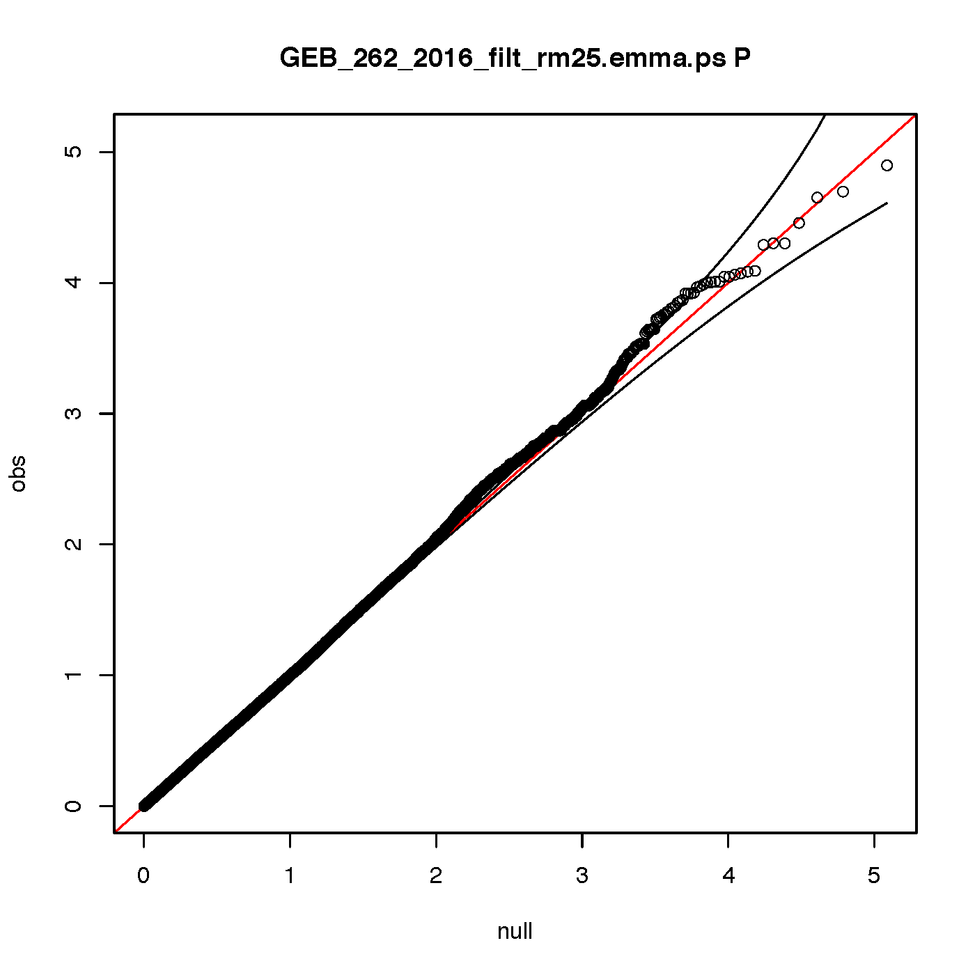
GEB GWAS analysis based on mast cell tumour cases and controls
No significant association identified
261 individuals 141 cases 120 controls (recently updated phenotypes) after removing individuals related more than 25% there are 101 cases and 64 controls. Analysis performed using the emmax software. No deviations from the expected p-values in the qq-plot are seen.
QQ plot to the left shows expected versus observed p-values, a deviation from the expected normal indicates significance. 95% confidence interval is indicated by thin black line.
Manhattan plot to the right shows dots for each SNP in the analysis. Location of each SNP is on the x-axis and on the y-axis the -10log p-value is noted.

Slide 26
An Autosomal Recessive Trait
Assume a condition is caused by 1 gene with 2 variants (“A” or “a”):
A = normal
a = causative
Genotype: | AA | Aa | aa
Phenotype: | Normal | Normal | AFFECTED
Based on the parents’ genotypes, the expected percent of normal vs affected offspring can be easily quantified.

Slide 27
What % incidence should be expected?
Genotype: | AA | Aa | aa
Phenotype: | Normal | Normal | AFFECTED
 | Clear | Carrier | Affected
Parent 1 Genotype
Parent 2 Genotype
Possible puppy genotypes
(Each square = 25%)

Slide 28
Example: Carrier x Affected
Genotype: | AA | Aa | aa
Phenotype: | Normal | Normal | AFFECTED
 | Clear | Carrier | Affected
 | A | a
Parent 1 Genotype
Parent 2 Genotype
Possible puppy genotypes
(Each square = 25%)

Slide 29
Example: Carrier x Affected
Genotype: | AA | Aa | aa
Phenotype: | Normal | Normal | AFFECTED
 | Clear | Carrier | Affected
 | A | a
 | A | a
 | A | a
Parent 1 Genotype
Parent 2 Genotype
Possible puppy genotypes
(Each square = 25%)

Slide 30
Example: Carrier x Affected
Genotype: | AA | Aa | aa
Phenotype: | Normal | Normal | AFFECTED
 | Clear | Carrier | Affected
 | A | a
a | A | a
a | A | a
Parent 1 Genotype
Parent 2 Genotype
Possible puppy genotypes
(Each square = 25%)

Slide 31
Example: Carrier x Affected
Genotype: | AA | Aa | aa
Phenotype: | Normal | Normal | AFFECTED
 | Clear | Carrier | Affected
 | A | a
a | Aa | aa
a | Aa | aa
Parent 1 Genotype
Parent 2 Genotype
Possible puppy genotypes
(Each square = 25%)

Slide 32
Example: Carrier x Affected
Genotype: | AA | Aa | aa
Phenotype: | Normal | Normal | AFFECTED
 | Clear | Carrier | Affected
 | A | a
a | Aa | aa
a | Aa | aa
Parent 1 Genotype
Parent 2 Genotype
Possible puppy genotypes
(Each square = 25%)
Aa = 25% + 25% = 50% Normal
aa = 25% + 25% = 50% Affected

Slide 33
What % incidence should be expected?
Parent Combination |  | Expected % Affected Progeny
Affected x Affected | aa x aa | 100%
Affected x Carrier | aa x Aa | 50%
Affected x Clear | aa x AA | 0%
Carrier x Carrier | Aa x Aa | 25%
Carrier x Clear | Aa x AA | 0%
Clear x Clear | AA x AA | 0%
Traits of interest are usually more complicated and therefore rarely follow this exactly.
If parents are grouped into roughly Affected, presumed “Carrier,” and presumed “Not a carrier,” there may be observed increases in incidence among litters with presumed higher risk parents.

