Slide 1

GD Bart Puppy Test
Helen West
Canine Behavior Specialist - Guiding Eyes for the Blind - hwest@guidingeyes.org
BCL Consultant - International Working Dog Registry - helen.west@iwdr.org

Slide 2


Thank you
Yorktown Heights, NY
Our Agenda
About the GD Bart Puppy Test
Scoring, using results and predictions of success
Using physiological data for scoring puppy test?

Slide 3
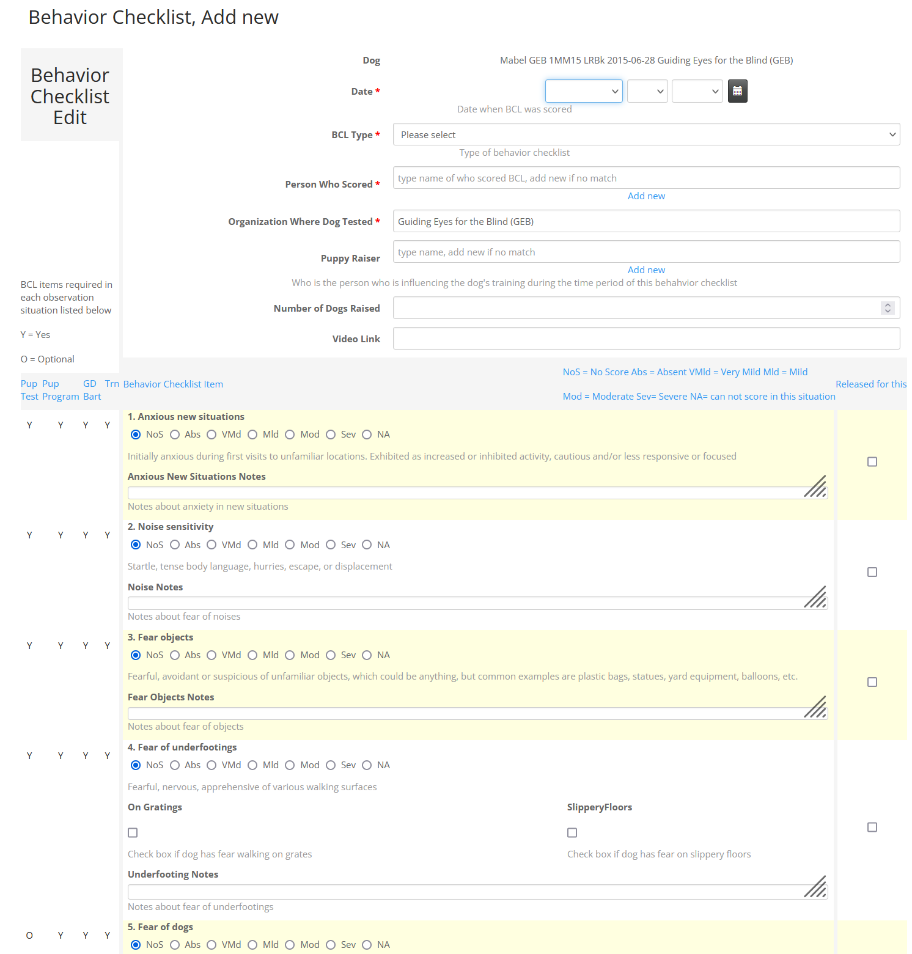
GDBart Puppy Test
Behavior Checklist
Behavioral scoring system that standardizes behavior scoring across multiple organizations.
Standardized test
Freely available
21 test components
12-15 minutes per pup
8 weeks of age
3 People needed:
  Scorer
  Handler
  Helper/Videographer
Equipment easy to create and purchase
Indoor test- approx 24 x 24 ft (7.3m x 7.3m) Smaller ok

Slide 4
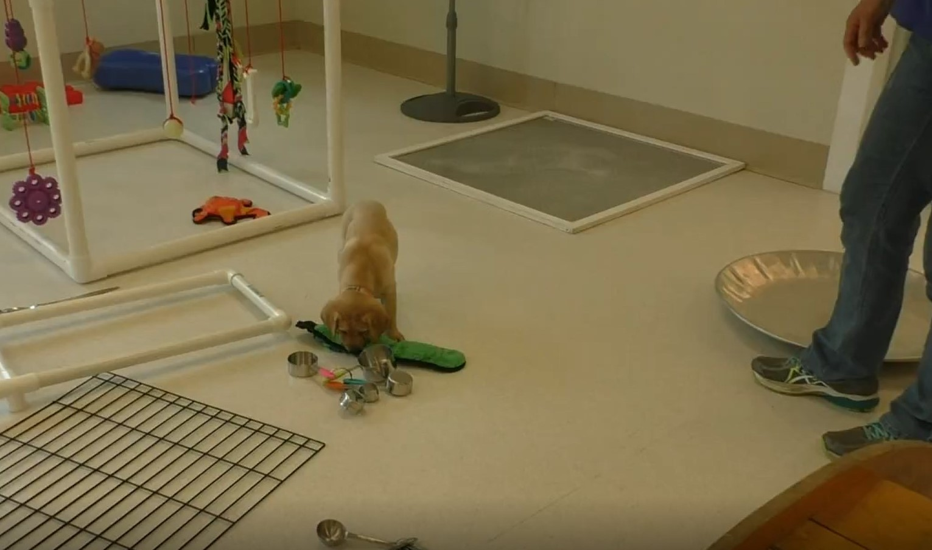
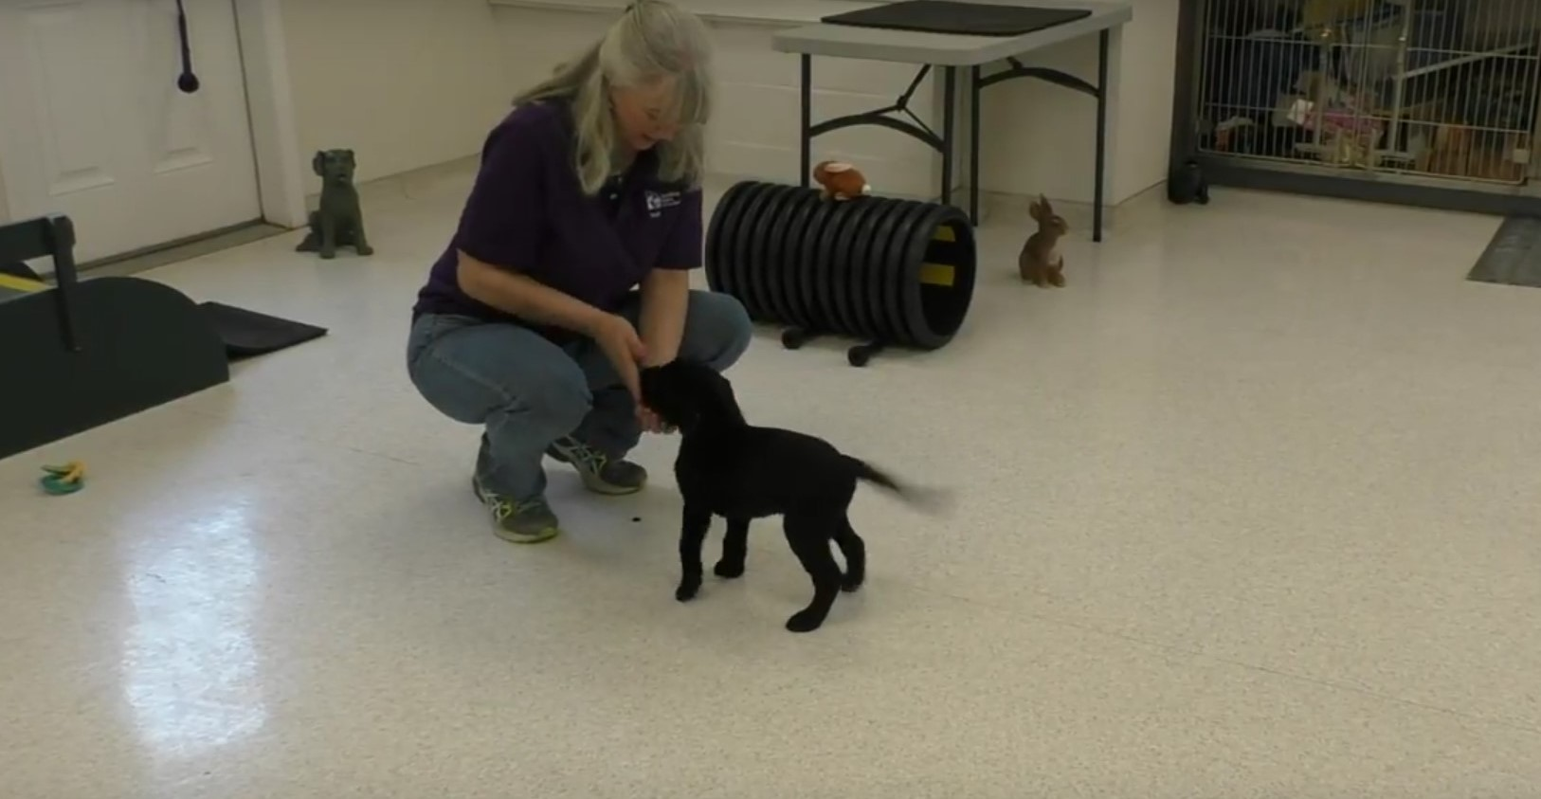
Need Multiple Observations- include early soc observations
Amount of early socialization impacts test reliability
Puppies are only about 50% through their most influential critical period
Most aspects of behavior are heavily impacted by environmental influences
Use 3 to 6 early socialization observations PLUS GD Bart Puppy Test to score the Puppy Test Behavior Checklist

Slide 5
BCL Scores- General Concept
5 | Absent | Relaxed with no or rare stress signals
4 | Very Mild | Very mild stress signals Slightly less able to respond without support good with minimal support Improves when repeat, recover very quickly
3 | Mild | Mild stress signals Mild loss of responsiveness, better with support and reassurance Improves when repeat recover reasonably quickly
2 | Moderate | Moderate stress signals Moderate loss of responsiveness even with support Still stressed with repeat
1 | Severe | Severe stress signals Very slow to recover or can’t recover even with support Usually worse with repeat

Slide 6
What to Look for When Scoring
Incorporated Into Behavior Checklist Definitions
How the dog is moving (slow, fast)
Body language (compression, scoots, scratching etc)
Coping strategies (displacement sniffing, scavenging)
Ability to response to handler
How often does it happen?
What causes it?
How extreme is it?
How long does it continue?
What is needed for the dog to return to a productive state?

Slide 7
If the Puppy fails to return to a productive emotional state despite having support, reassurance, and time to resolve any emotional stress or conflict. This may be seen as shutting down or high arousal.
Stop The Test

Slide 8

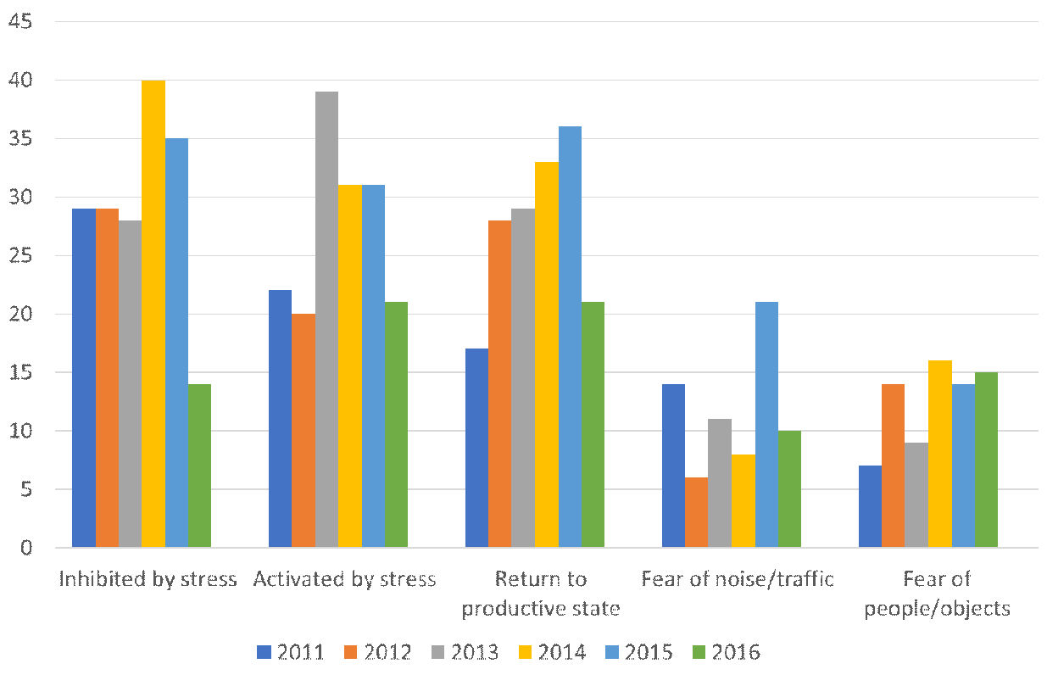

Why Do Puppy Tests?
Match pup with raiser
Give you an overview of trends over time e.g. what’s improving or getting worse
Evaluate effectiveness of program changes e.g. changes in socialization protocols
See what traits are produced by your broods and studs when bred multiple times
Use some of data in EBV calculations if heritable (trait controlled enough by genes)
Identify dogs that need behavioral or emotional help and can intervene and provide support before it potentially gets worse

Slide 9

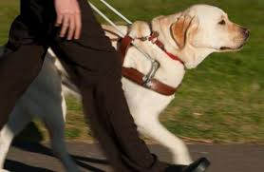
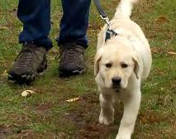
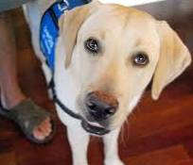
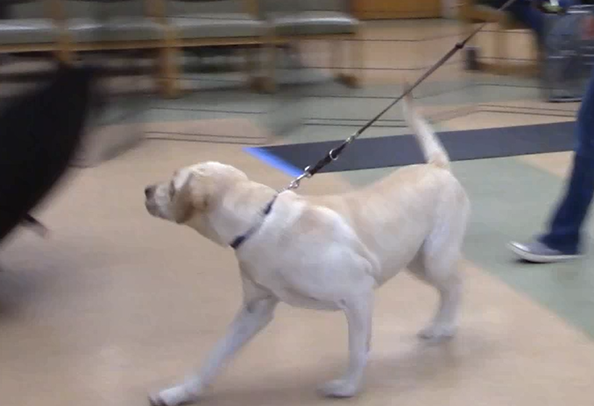
Puppy Test Is Part Of Longitudinal Data when using the Behavior Checklist
Select Replacement Breeders
  Score all or most dogs- (even those rejected)
Matings
2 months old
GDBart Pup Test + early socialization
Analyze data
Success Outcome
Raise & Train
Successful
4 + 8 + 13 Mo W&Ts
Observe puppy walker
Novel place
Rejected
Half way in training & again end of training
Or Rejected, Trainer’s observation
Start of training
GDBart Adult Test
As of March 2018

Slide 10
Accuracy of Predicting Outcome
Increases with Age
Environmental influence modifies genetic potential
Age | Prediction of success
2 month | 34.4%
4 month | 57.4%
8 month | 56.0%
13 month | 61.4%
In for training | 66.5%
Prelim blindfold | 73.3%
Final blindfold | 85.1%
Courtesy of Jamie Fratkin, U. Texas 2014, based on Guiding Eyes data

Slide 11
Should You Career Change Puppies Based On Puppy Test?
Accuracy of predicting outcome with age
Early Ages better at predicting failure,
Older Ages-better at predicting success
Courtesy of Jamie Fratkin, U. Texas 2014, based on Guiding Eyes data

Slide 12
Summary
What We Have Learned In Past 35 Years
Need multiple observations- include early soc observations (5wks to 8wks) with puppy test for first Behavior Checklist scoring
Quantity and quality of socialization impacts scores
Need skilled observers/scorers
Technique of the handler and type of equipment used matters
Confidence typically improves especially through 16 weeks old when socialized effectively
Prediction- More accurate predicting failure of extreme puppies

Slide 13


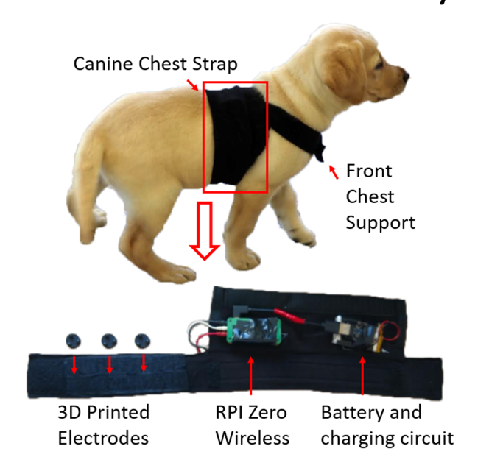
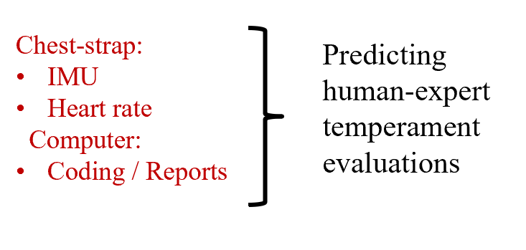

Is the BCL measuring what we think it is?
Machine Learning
Cloud storage

Slide 14
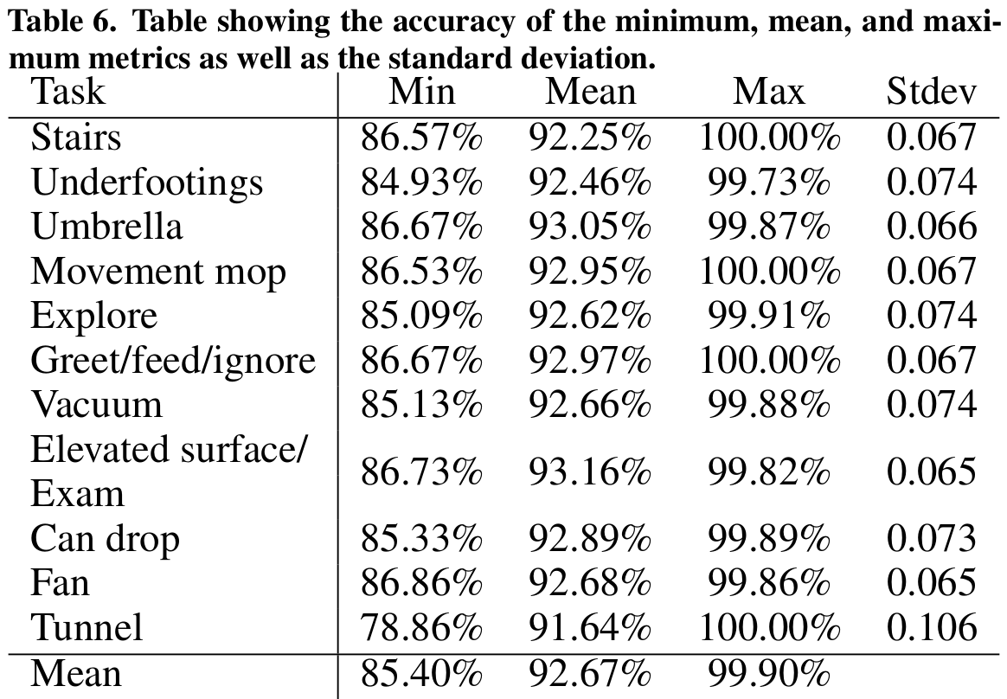
Conclusion
Results indicate that temperament can evaluated using physiological data
Problem: Temperament evaluation of guide dog puppies has historically been subjective
Solution: Use objective data (Raw ECG) to predict expert BCL scores
Outcomes: Approximately 93% accuracy rate of expert BCL prediction.

Slide 15
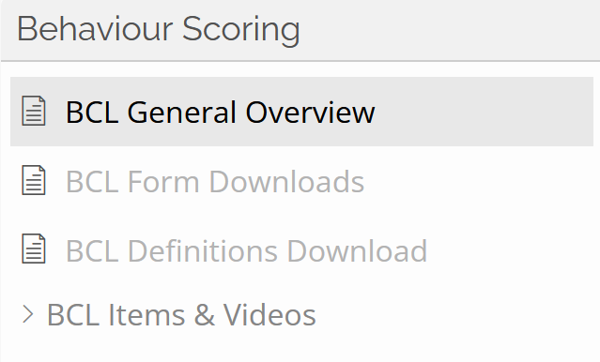
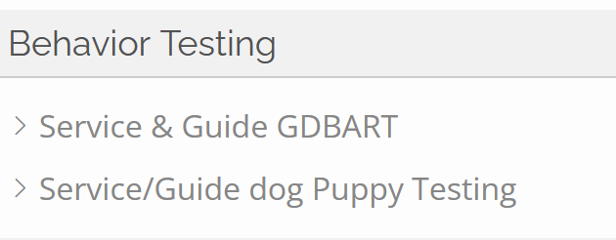
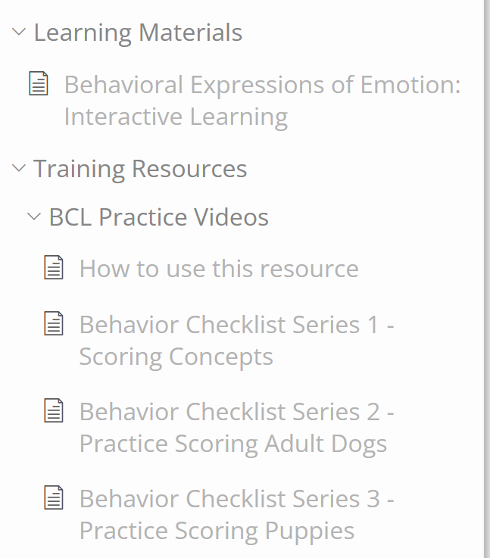
Learning to Score the BCL & Assess Dogs
Open access https://www.iwdr.org/master-knowledge-base/bcl-general-overview/
Requires login to www.IWDR.org
Free to ADI, IGDF members & IWDR Users
Create a free account
https://www.iwdr.org/register/bcl-access/

