Slide 1


Slide 2

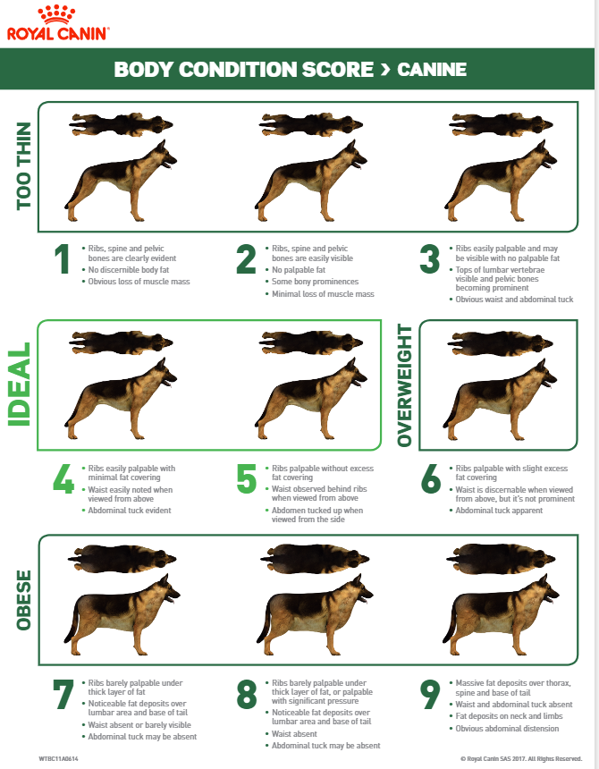

Slide 3
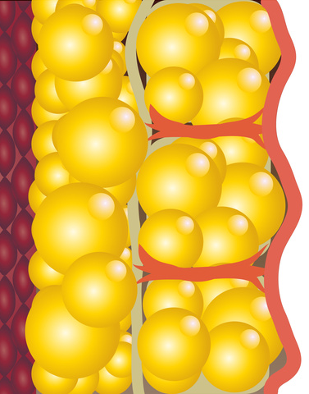

Fat

Slide 4
Fat
Hormones

Slide 5
Fat
HPA
Hormones

Slide 6
Fat
HPA
Hormones



Slide 7
#1
BCS

Slide 8


Last seasons :
Apr 2015
Sept 2015
May 2016
???

Slide 9

Last seasons :
Jan 2015
May 2015
Sept 2015
???

Slide 10

Last seasons :
Feb 2014
Aug 2014
Nov 2014
Fev 2015
???

Slide 11
#2
CYCLICITY

Slide 12
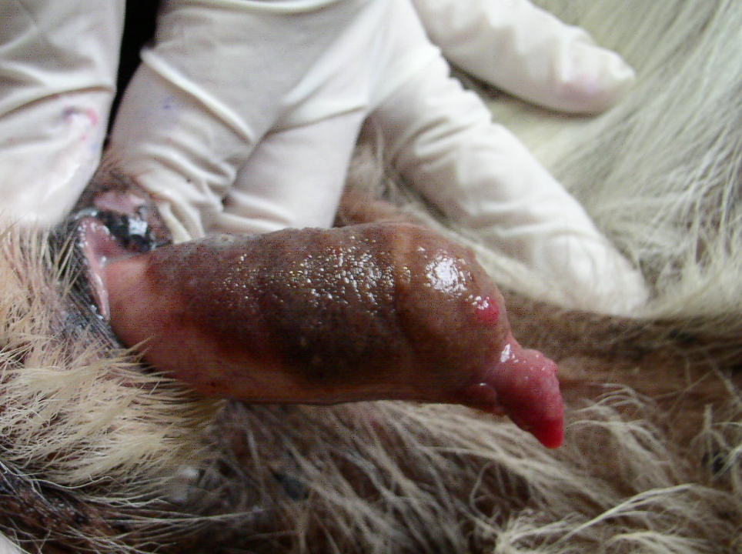
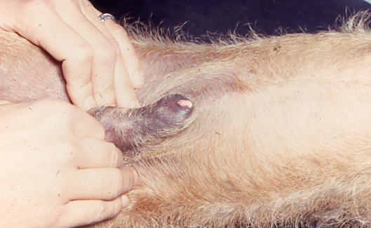
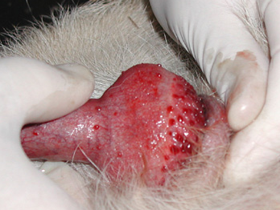
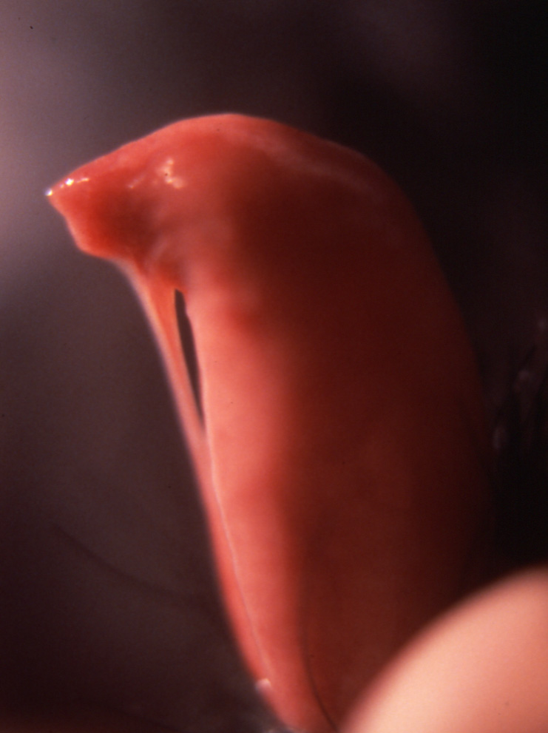

Slide 13
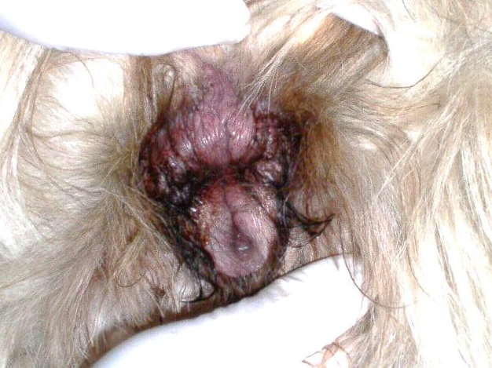
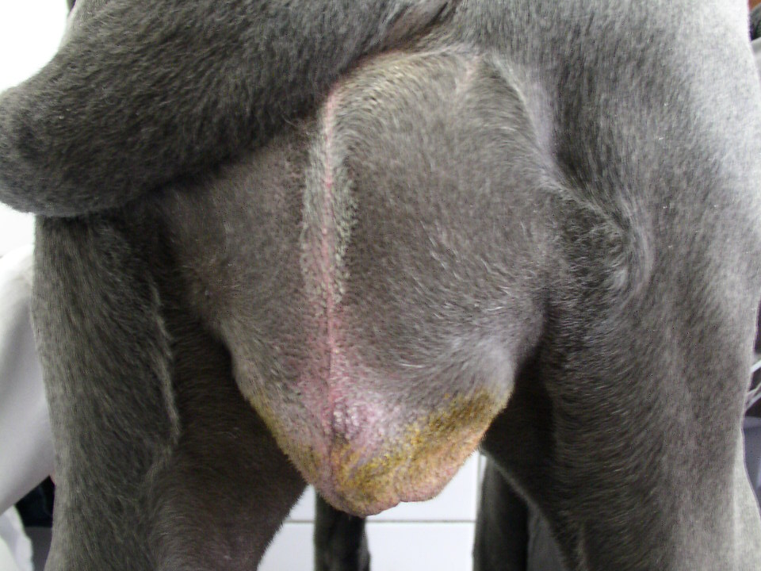
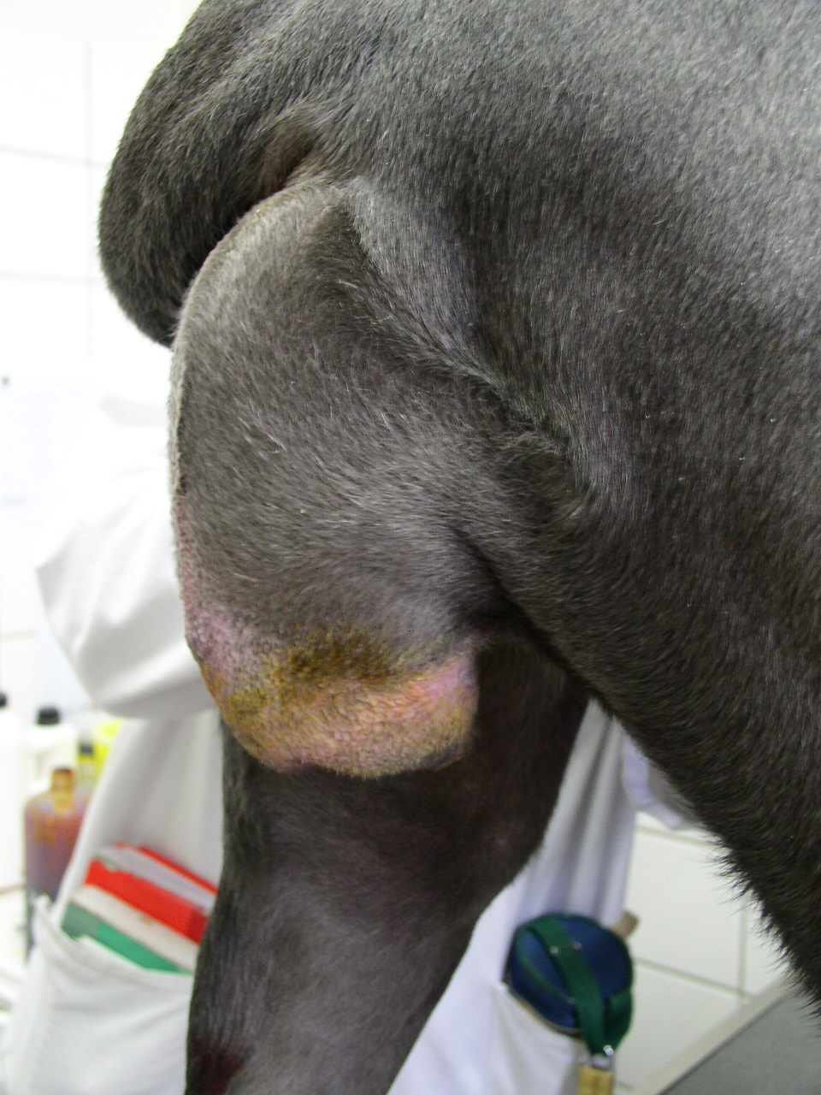
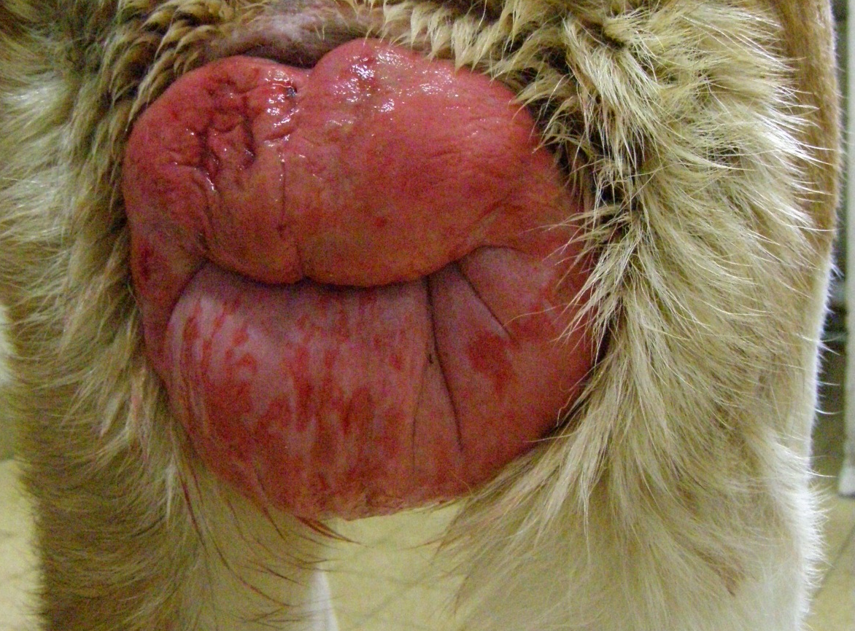

Slide 14
#3
ANATOMY

Slide 15

TEAM WORK :
At least 150 millions needed

Slide 16



Slide 17
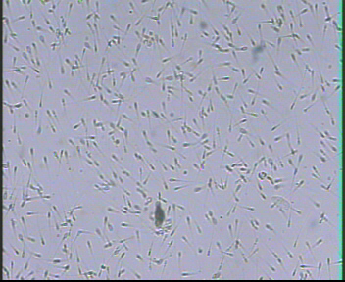


Slide 18
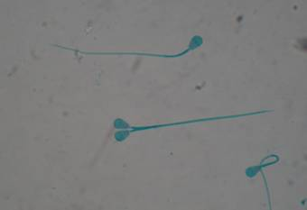
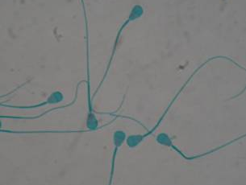
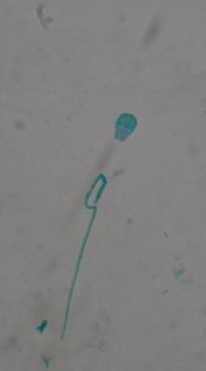
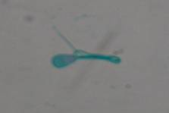
>30% : NO FREEZING
>50% : RISK OF INFERTILITY

Slide 19
#4
SEMEN QUALITY

Slide 20
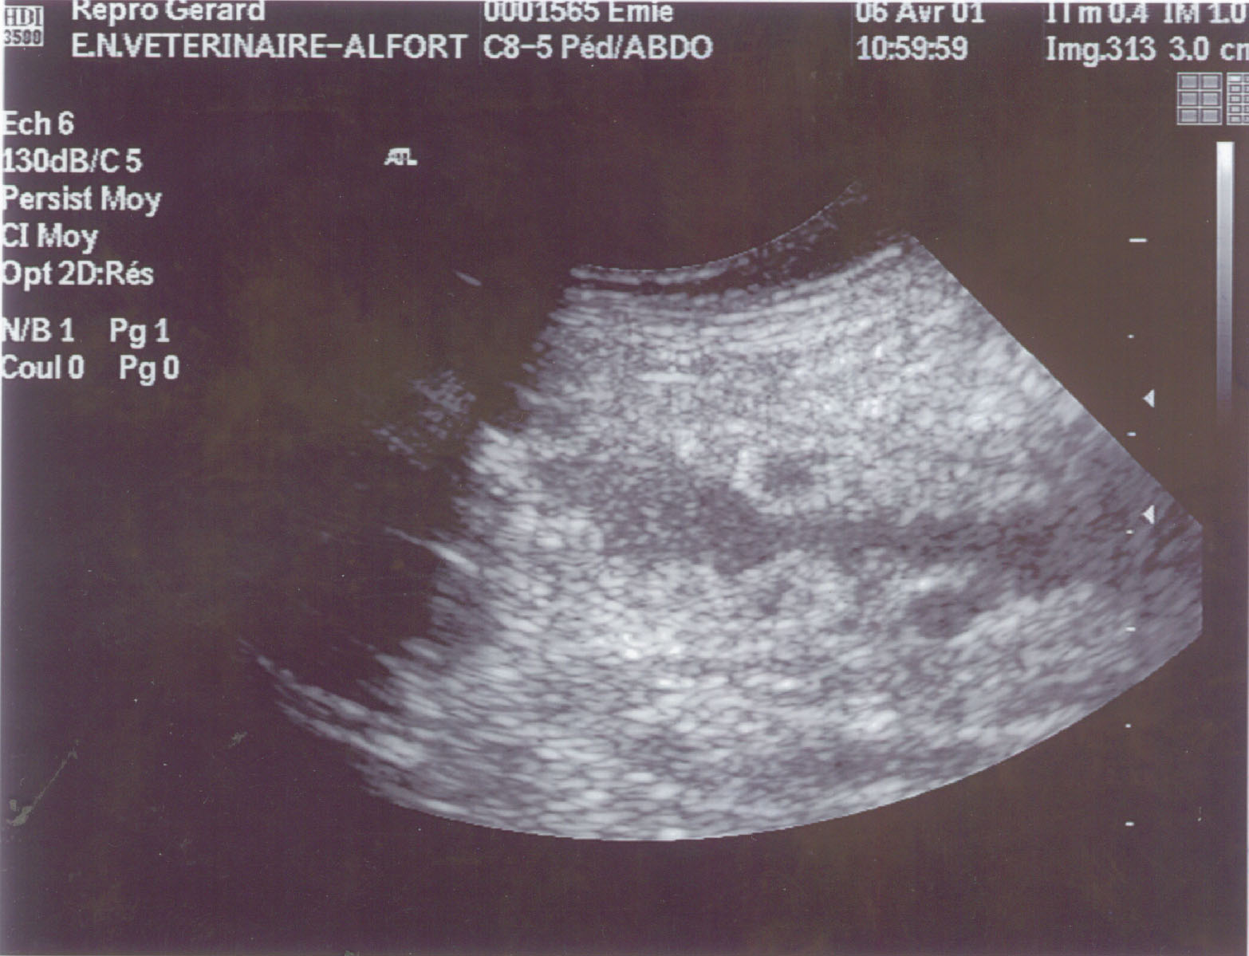
C
ystic
E
ndometrial
H
yperplasia

Slide 21
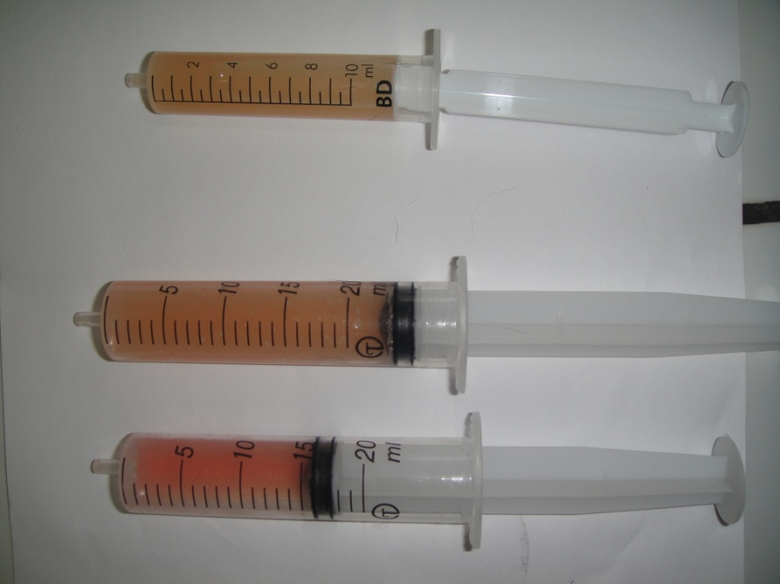
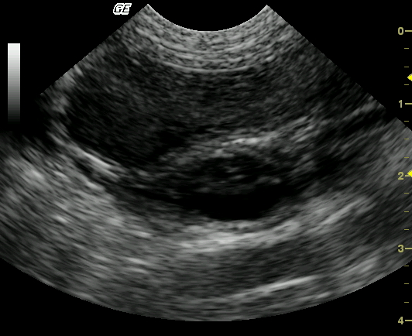
MUCOMETRA
= mucus in the uterus

Slide 22
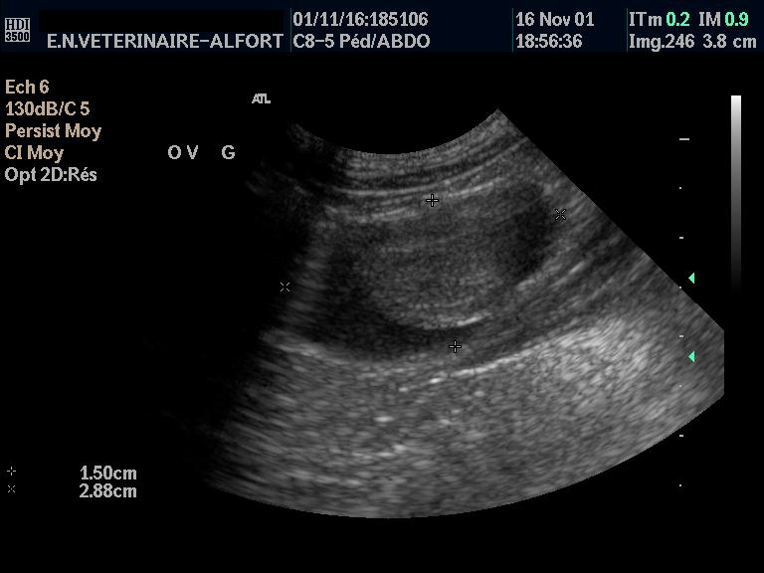
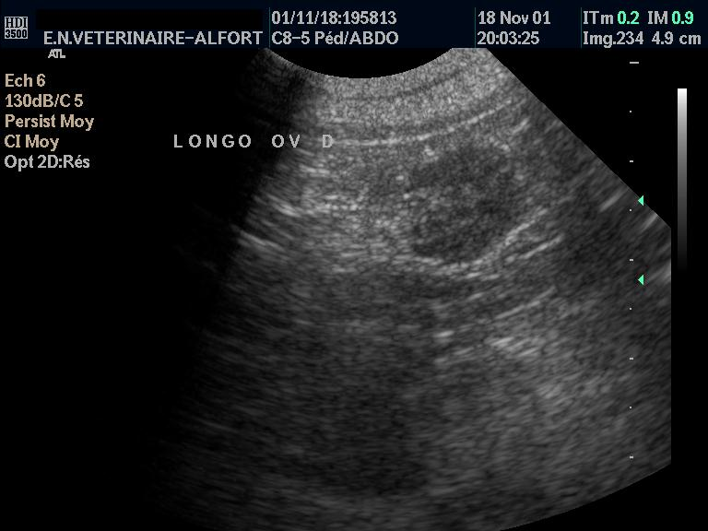
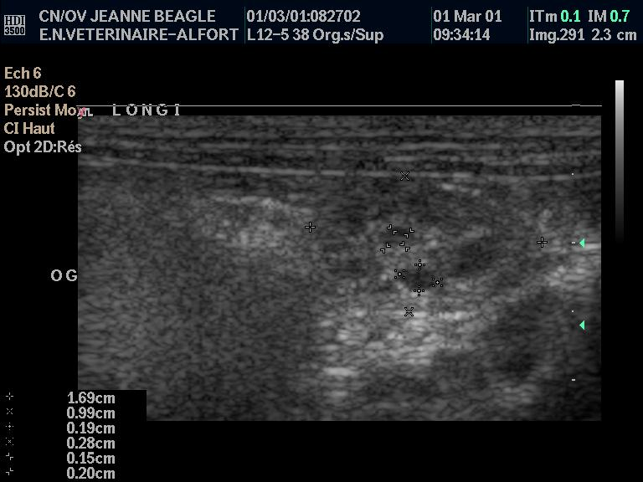
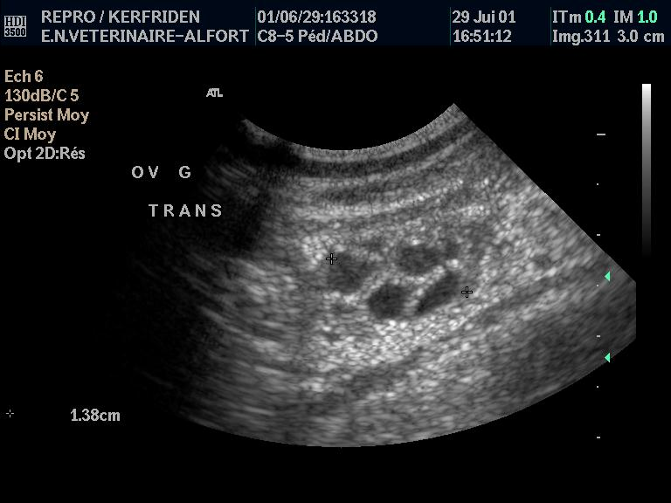
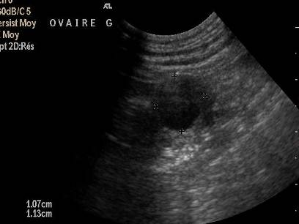
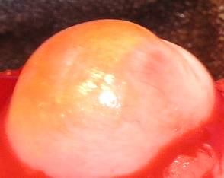
Genital ultrasounds
©ENVA
Notes:
Add video

Slide 23
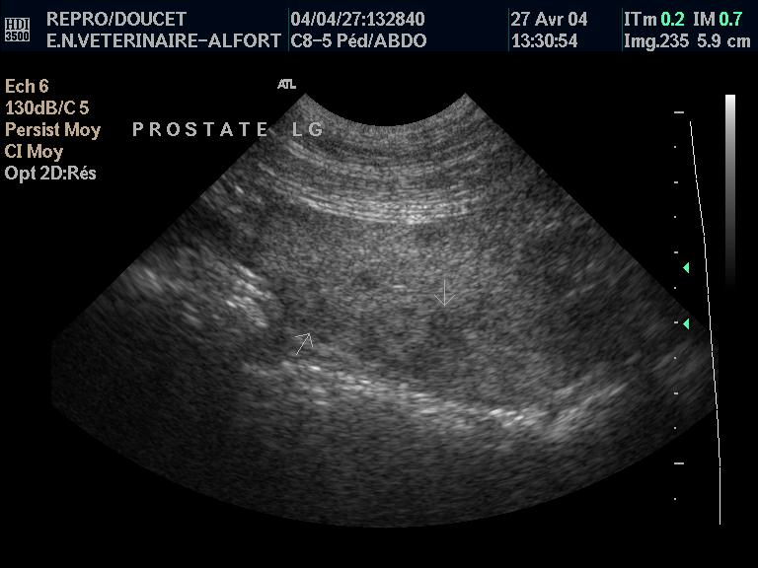
BIG
ABNORMAL

Slide 24
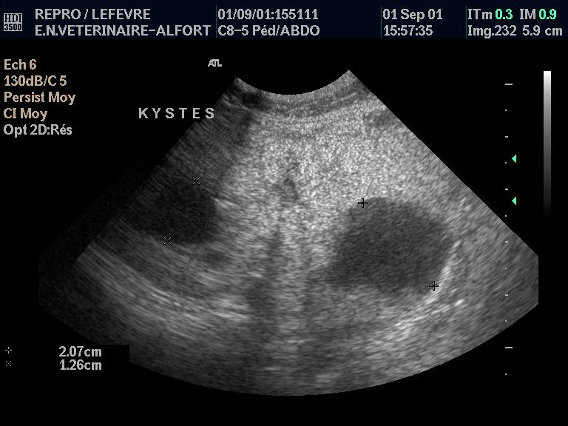
??????

Slide 25
#4
GENITAL U/S

Slide 26
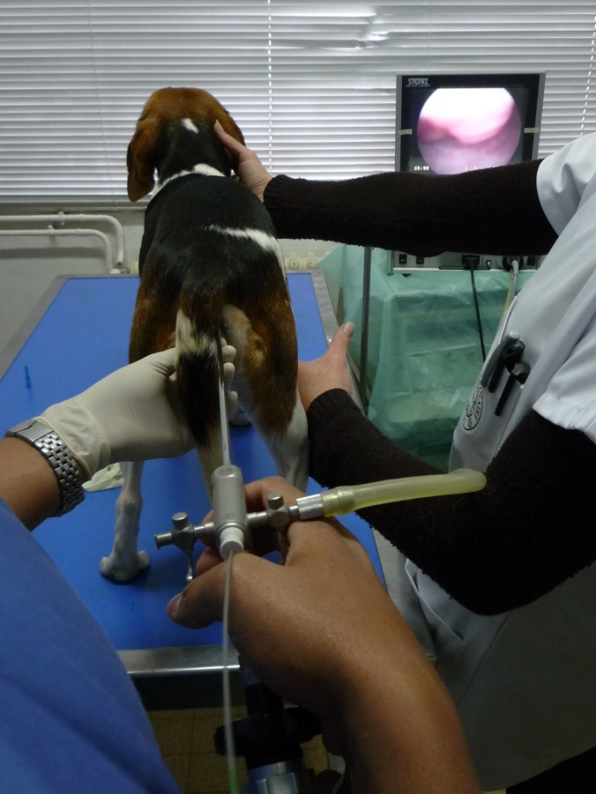

Slide 27
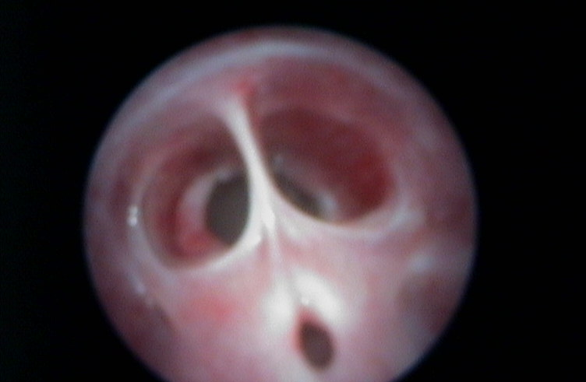

Slide 28
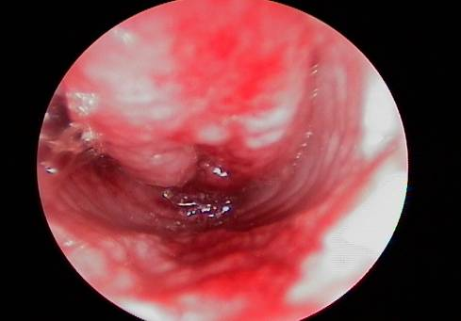

Slide 29
#5
ENDOSCOPY

Slide 30


