Slide 1

Entropion EBVs at GDB-Update 2023
Presented by:
Jenna Bullis
Breeding Manager
Notes:
Hello everyone, My name is Jenna Bullis and I am the breeding manager at Guide Dogs for the Blind in the US. At the breeding conference in Sydney 2018 I was asked to talk about a project we were working on at GDB on Entropion and specifically using EBVs to reduce the incidence rate of them in our population.

Slide 2
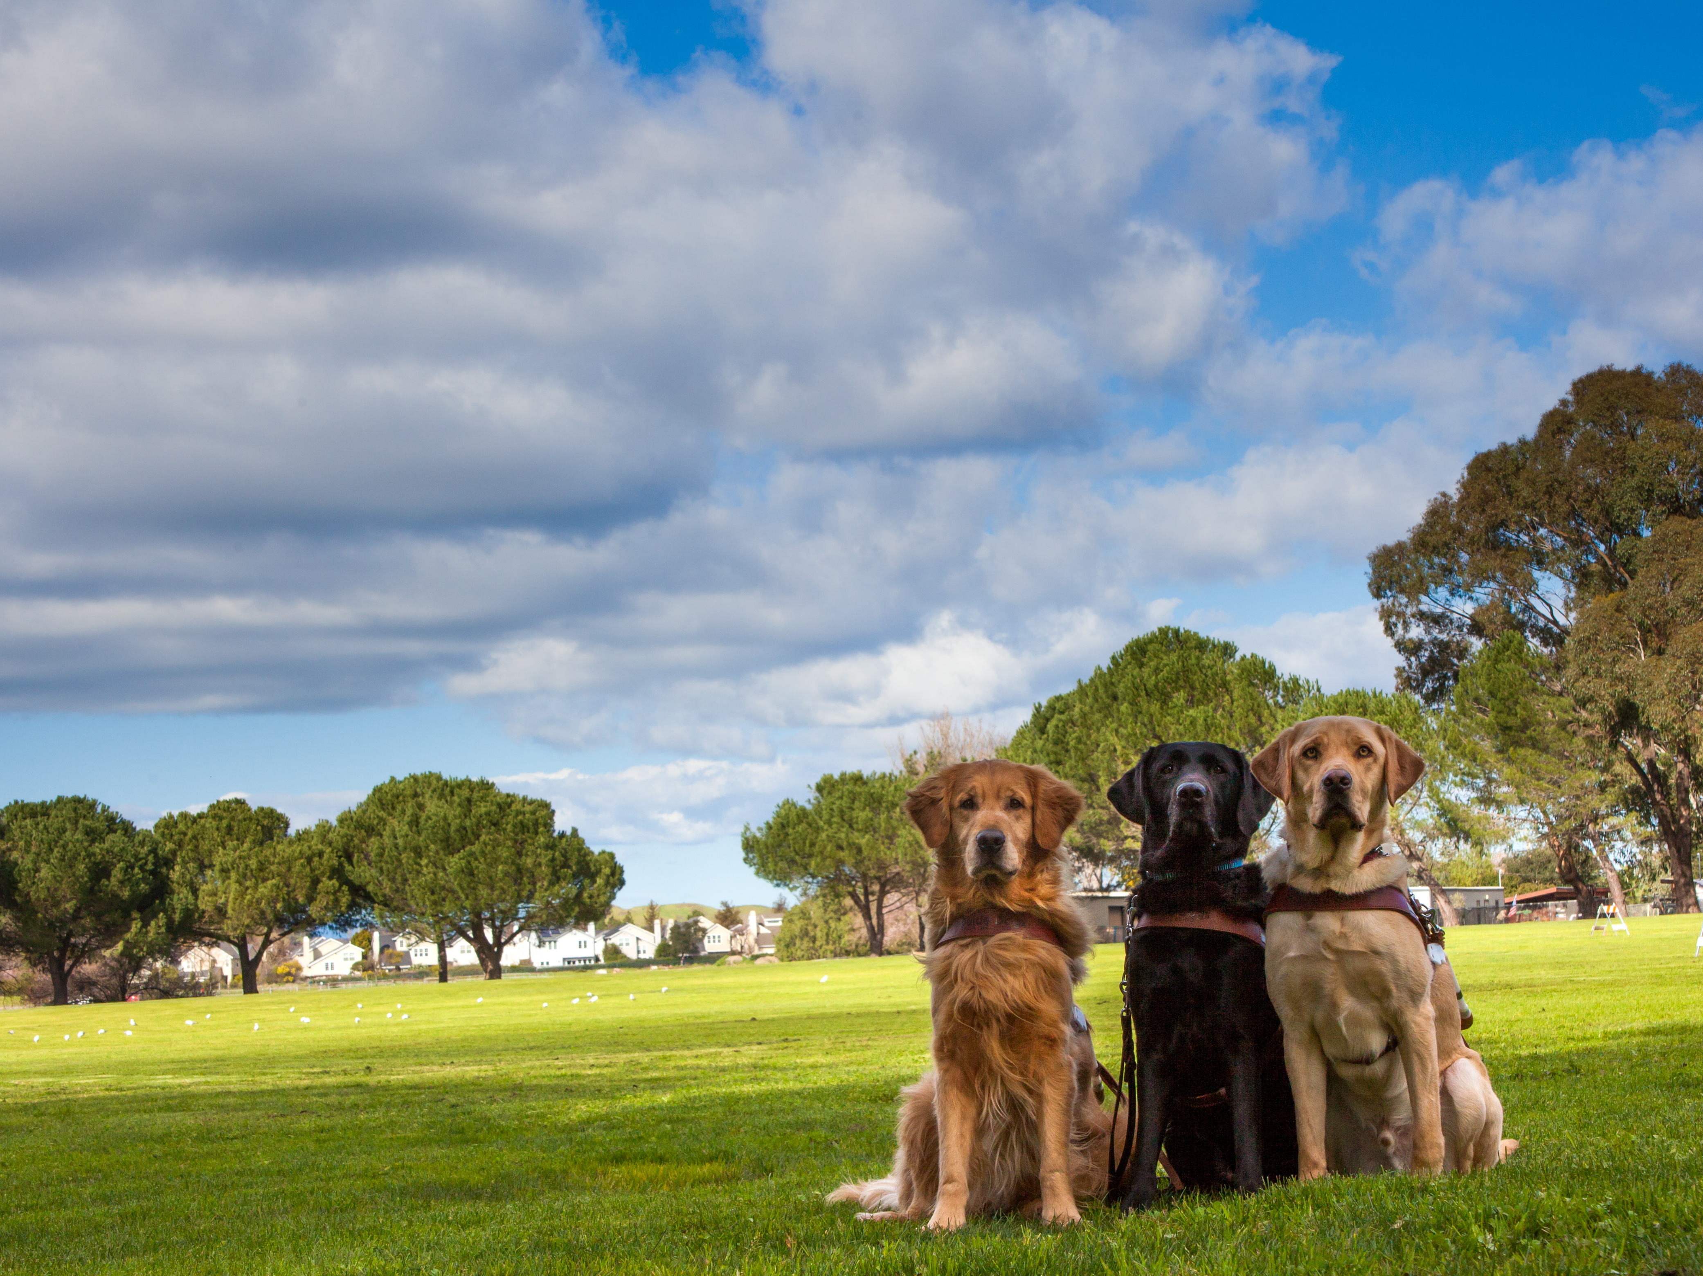
Notes:
We as breeding managers of guide dogs schools all have the same goal – breeding the best dogs possible for the clients we serve. It’s important that we remember that “best” is a relative term. The kind of dog that is “best” for one client may not be the best for another and the “best” dogs for one school’s program may not be the best for another. This means that each of us must make selection decisions that are influenced by our individual program needs and what dogs and resources we each have to work with.

Slide 3
Selection Principals
You Can’t Select For Everything!
Choose your selection traits
Prioritize your traits
Choose your selection method
Determine selection intensity
Calculate Estimated Breeding Values
Notes:
So although we all have different populations, resources, and pressures the Basic selection principals outlined here apply to us all and it is beneficial for us all to be systematic when we are trying to make progress in our programs.

Slide 4
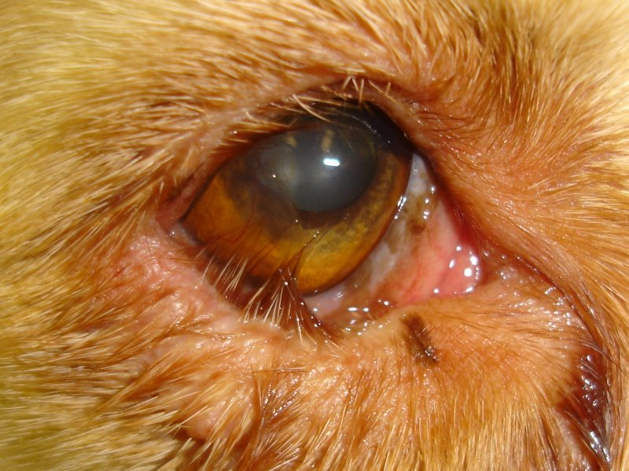
Notes:
So here we go… Entropion… What is it? You probably all have seen this before, it’s a condition in which a portion of the eyelid is inverted or folded inward. This can cause an eyelash or hair to irritate and scratch the surface of the eye leading to corneal ulceration or perforation. In the photo here you can see both upper and lower eyelids rolling in and the hair actually rubbing the surface of the eye. This is not one of our program dogs as in our colony it is always the lower eyelid and one or both eyes can be affected.
Entropion is fairly common in dogs and seen in a wide variety of breeds and almost always diagnosed by the time a puppy reaches it’s first birthday.
As I mentioned we see it in the lower eyelid only routinely at GDB and usually diagnose it around 4 weeks of age (occasionally younger) but it can occur at anytime within the first year
The cases we have at GDB almost always require surgical repair and over the years we have chosen to do these surgeries in house. Because our puppies are raised in 10 different states across the western US we deal with a wide variety of Local vets, some of whom may not have much experience in these types of surgeries and refer these cases to optholomologist. There is a cost savings aspect when we do the surgeries in house and because our puppies have a mild form compared to breeds like a Sharpei there is the risk of the surgery overcorrecting the condition and creating Ectropion, the sagging outward rolling of the eyelid.

Slide 5
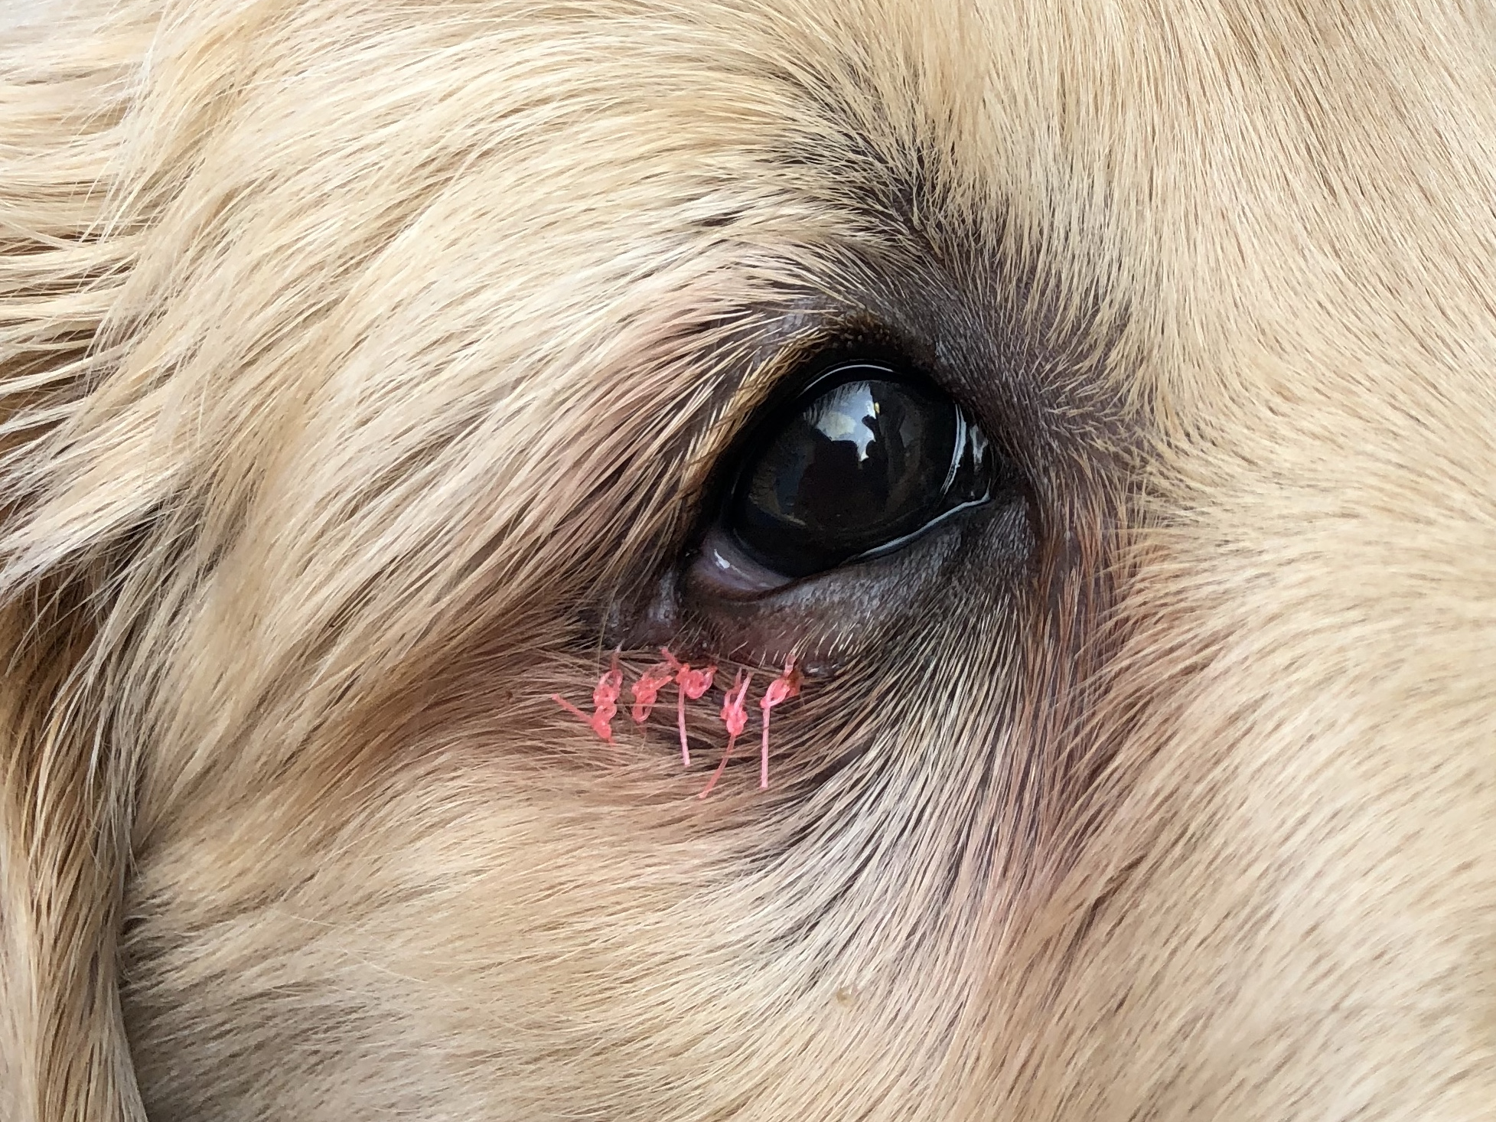
Notes:
So our vets repair them on campus before the puppy is placed and they do an excellent job….
Now a little at the end of 2016 our vets started noticing what they thought was a general increase in the number of puppies what needed surgery and they also started to notice occasional litters where more than one puppy was affected.
So they came to me and asked if the condition was on the rise and what the heritability was….

Slide 6
2001-2017
Notes:
As I shared in 2018 I pulled data on the # of Entropion Dx and confirmed the upwards trend…
In FY2017 GDB vets performed 49 entropion repair procedures (just above 7% of the puppies born that FY year)

Slide 7
Selection Principals
Choose your selection traits
  Is the trait inherited?
  To what degree?
    Range is from 0 to 1
GDB Entropion heritability is 0.66
Notes:
Back to our principals of selections…. Choose your selection traits….
One of the first things to find out when you are considering a trait is how heritable is the trait so that we can know if it will even respond to a method of genetic selection. If the trait is more influenced by environmental factors you would be spinning your wheels…
In a given population, different individuals vary in their predisposition to develop a certain disease. The proportion of this variation between individuals that can be attributed to genetic factors, as opposed to environmental ones, is called “heritability.” Heritability is a statistical concept that describes the extent to which genetic factors explain these risk variations between individuals in a specific population.
Heritability does not indicate what proportion of a trait is determined by genes and what proportion is determined by environment. So, a heritability of 0.7 does not mean that a trait is 70% caused by genetic factors; it means that 70% of the variability in the trait in a population is due to genetic differences among people. eritability estimates are single numbers ranging from 0.0 to 1.0. An estimate close to 0.0 indicates very little contribution from genetics, while a heritability estimate close to 1.0 suggests that nearly all the variability in risk can be attributed to genetics, with little contribution from environmental factors.
As for heritability, there are no strict rules, but most people talk about .05 to .15 as “low”, .25 to .30 as “moderate” and anything over 0.4 as “high”. Now, that’s based in livestock stuff, where there is always lots of environmental variation. Nothing ever gets over 0.5 there. But for your stuff, you could probably up it to .55 to .6 for high.

Slide 8
Traits at GDB
Trait | Heritability
Cataracts | 0.19
Medical | 0.22
TVD | 0.28
Success | 0.34
Distraction | 0.35
Control Factor | 0.37
Fear | 0.44
Temperament | 0.45
Entropion Dx | 0.66
Entropion Dx + repair under 12 wks | 0.68
Entropion Repair | 0.74
Notes:
In addition to having our wonderful database we also have our friend Dr Tom Famula as I mentioned earlier. Dr Famula calculates EBVs for us on a bi-monthly basis on various traits that we have been tracking for many years. You can see them on the slide here along with their heritability.
We asked Dr Famula to take a look at entropion in our colony and sent him a data set. We looked the trait in 3 ways. Dogs who received a Dx (includes puppies, older LDVM), dogs who had a surgical repair (both on and off campus) and dogs who got a Dx and repair under 12 weeks. These are puppies we are seeing on our campus so we have the most confidence in the Dx.
As you can see on the slide the heritability of all 3 entropion categories are quite high which means selection pressure on the phenotype should produce genetic gain…
Heritability Estimates and Confidence Limits
Trait Heritability Low 95 High 95
Entrop 0.66 0.58 0.72
EntRepair 0.74 0.66 0.83
Ent3Category 0.68 0.59 0.75
As for heritability, there are no strict rules, but most people talk about .05 to .15 as “low”, .25 to .30 as “moderate” and anything over 0.4 as “high”. Now, that’s based in livestock stuff, where there is always lots of environmental variation. Nothing ever gets over 0.5 there. But for your stuff, you could probably up it to .55 to .6 for high.

Slide 9
Considerations
Does not disqualify a dog from the program
Discomfort
Resources
  Vet
  Other staff
Post surgery care
Isolation
  Decreased socialization
Delay in placement
Notes:
Entropion in our colony does not disqualify a dog from the program….. However there are other considerations

Slide 10
Selection Principals
Choose your selection traits
Prioritize your traits
Choose your selection method
Determine selection intensity
Calculate Estimated Breeding Values
Notes:
Back to our principals of selections…. Prioritizing traits….
So now we know that Entropion is increasing in our colony and the trait is highly heritable, what do we need to consider next?
We know that for selection to be effective it must be consistently practiced for 3 or 4 traits over multiple generations. This suggests we have to focus our efforts on the most important traits. Usually these are traits that are the most common reasons for rejection as a guide dog, things like hip dysplasia or fearful behavior…. So how do we prioritize a trait like entropion?

Slide 11
Selection Principals
Choose your selection traits
Prioritize your traits
Choose your selection method
Determine selection intensity
Calculate Estimated Breeding Values
Notes:
So back again to our principals of selection….
Now that we have decided to put some selection pressure on entropion how do we proceed?
We could just cull from our colony any active breeder who is entropion, or make a cutoff level and remove any individual producing at above the cutoff…. However, it turns out that right now some our MOST successful breeders are producing high rates of entropion… and remember, entropion doesn't prevent a dog from becoming a guide…. So we aren’t doing that!
We decided on a more conservative approach, understanding that our rate of genetic change will be slower

Slide 12
Selection Principals
Choose your selection traits
Prioritize your traits
Choose your selection method
Determine selection intensity
Calculate Estimated Breeding Values

Slide 13
Selection Intensity at GDB
Affected Active Breeding Stock
  Offspring
Affected puppies
Littermates of Affected Puppies
Litters with Multiple Affected Puppies
Notes:
What kind of selection intensity are we placing on entropion?
Affected puppies are not eligible for breeding - Any puppy with a Dx of entropion is designated to be altered.
Affected active breeders are under evaluation - We did take a look at all our active breeders and there are only a few dogs who are affected. We have chosen to allow these dogs to remain in the colony as long as their success rates are high. In general their offspring are not eligible for breeding consideration
Unaffected littermates of affected puppies may be considered for breeding if they have other valuable merits – If there are multiple puppies in a litter affected then the whole litter is altered.

Slide 14
Selection Principals
Choose your selection traits
Prioritize your traits
Choose your selection method
Determine selection intensity
Calculate Estimated Breeding Values
Notes:
Thanks for our good friend Dr Famula we are now using EBV for entropion both in breeder selection and in mate selection.

Slide 15
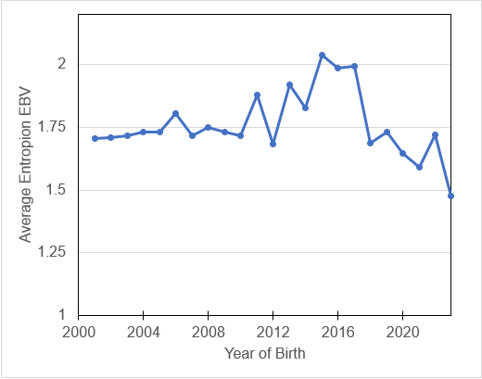
Average Entropion EBV
Notes:
As for scoring, no disease was scored as zero and yes was scored as 1. - the bigger the EBV the riskier to use that dog as a breeder. That is, BIG is BAD. So the ideal plot will be going down over time.
You can see our downward trend for EBVs…

Slide 16
2001-2022
Notes:
And we see that downward trend represented in the actual numbers of surgical procedures a well!

Slide 17
FY | # of entropion procedures
2015 | 44
2016 | 32
2017 | 54
2018 | 54
2019 | 36
2020 | 17
2021 | 9
2022 | 11

Slide 18
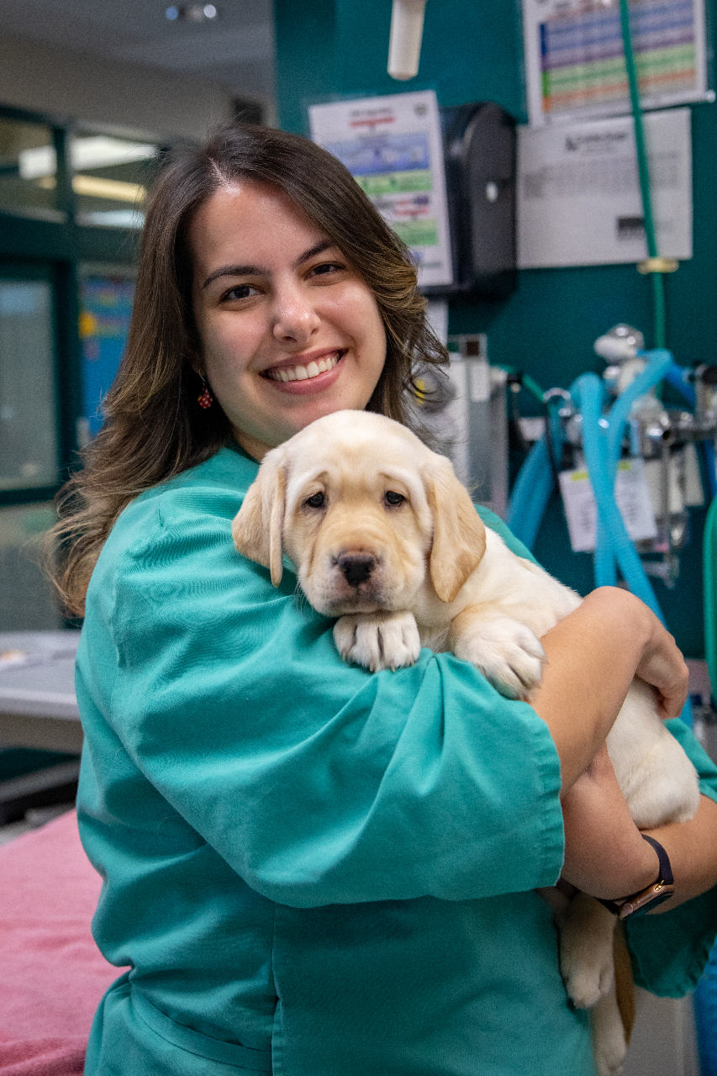
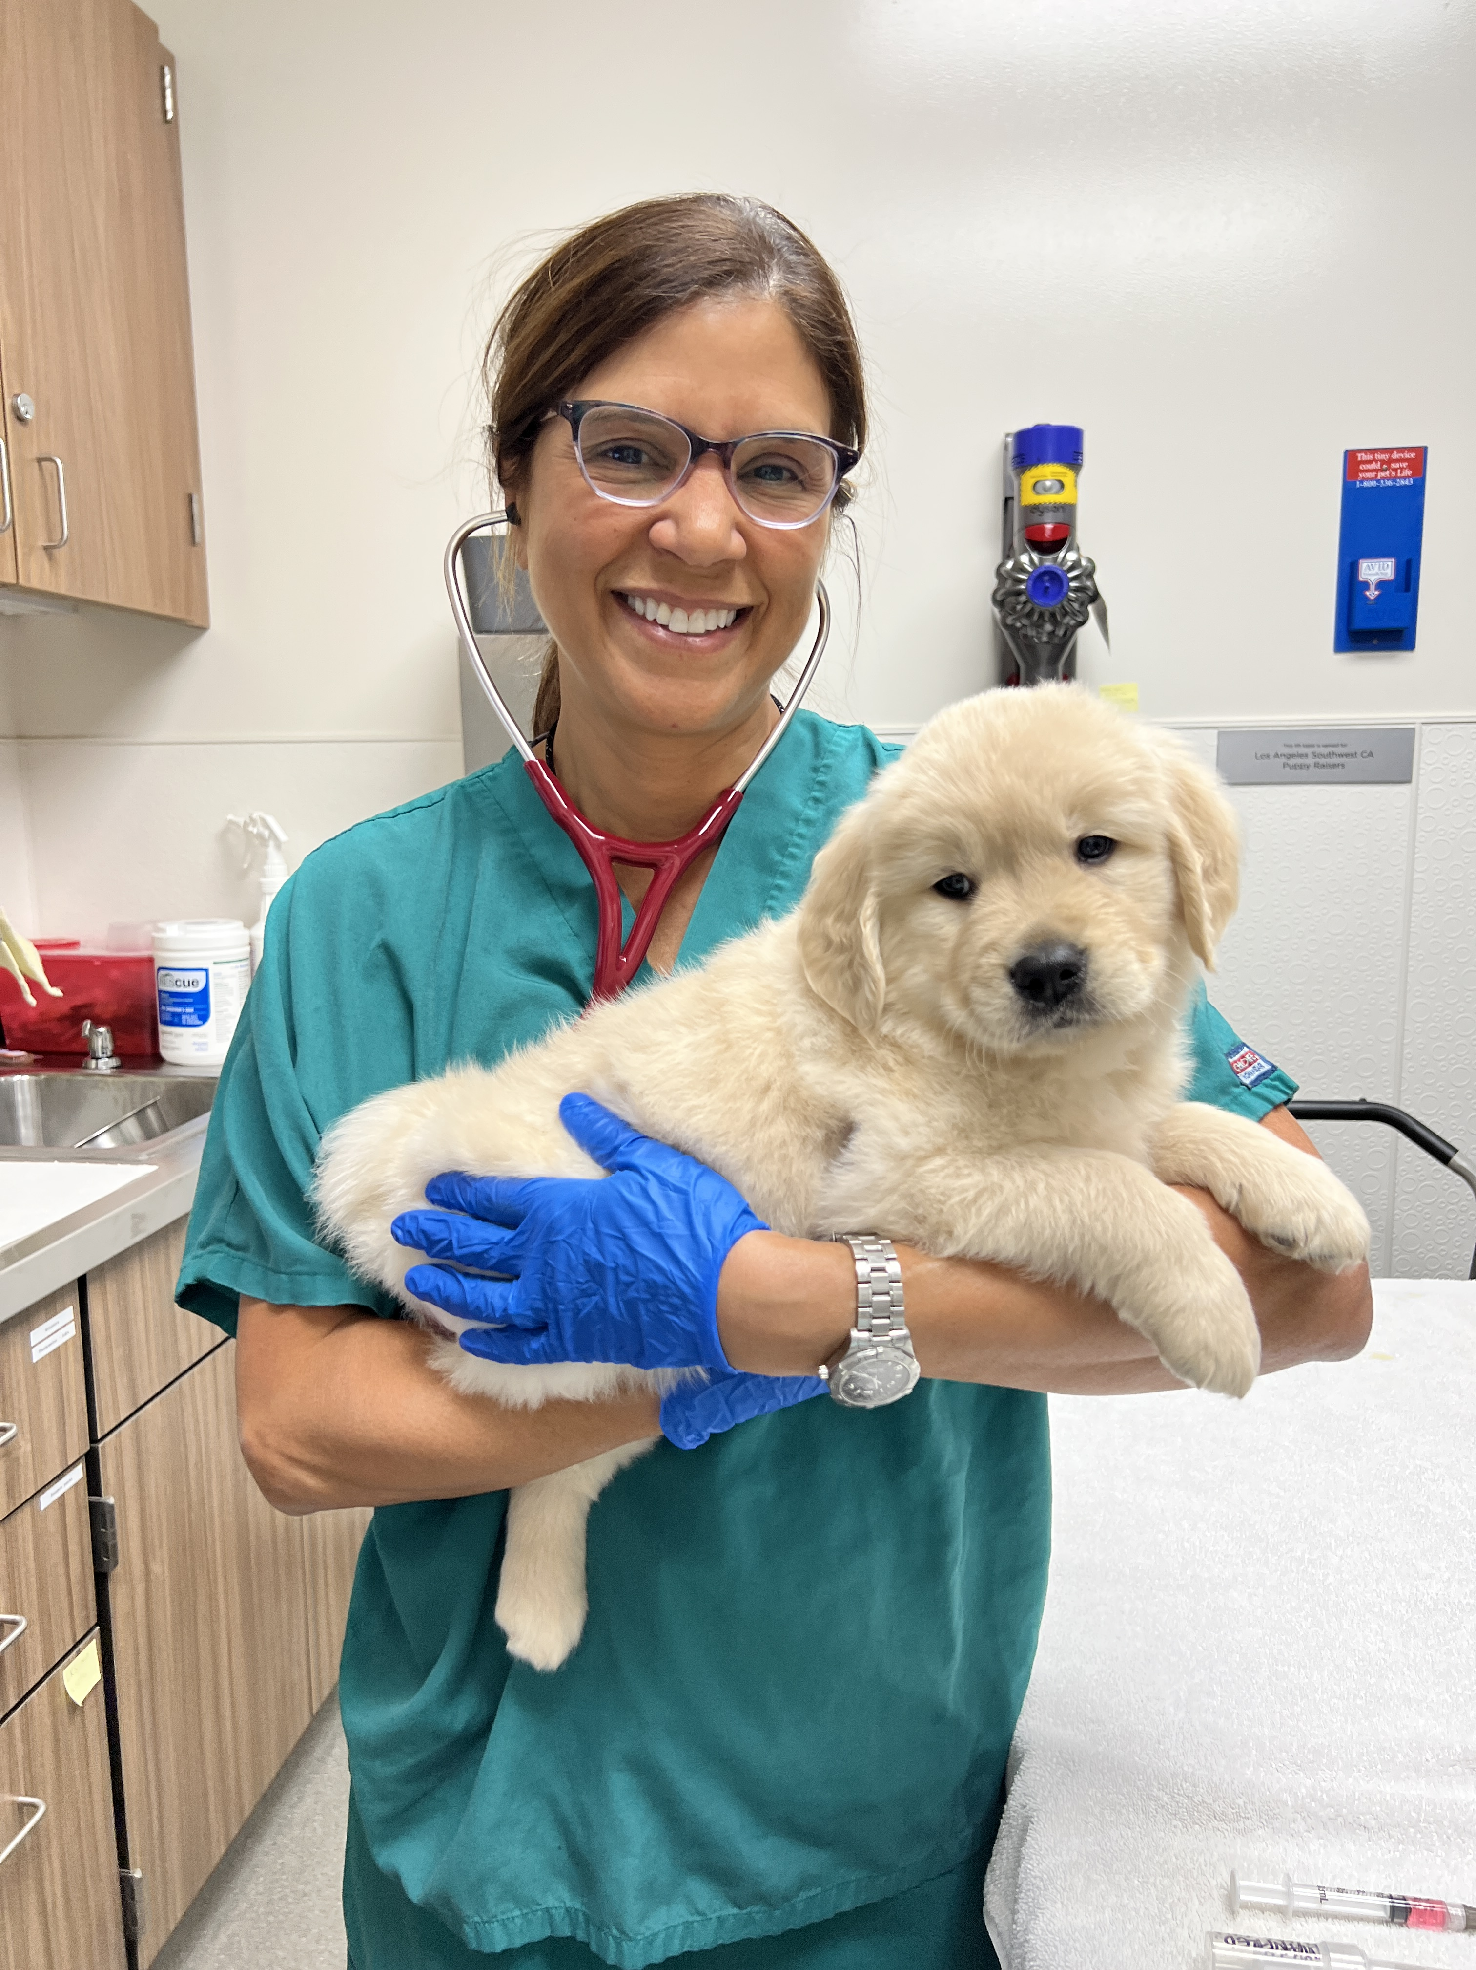
Notes:
Our conservative approach to reducing the incidence of entropion in our population while still balancing the need for producing successful guides has been successful and I am happy to report that we have healthier puppies and happier veterinarians :)

