Slide 1
Strategies for genetic diversity
Department of Veterinary and biosciences
  Laboratory of Animal genetics
Prof. dr. Bart Broeckx

Slide 2
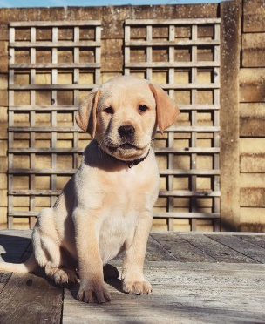
Situation in Belgium
Back in 2018:
  60% of the puppies that start the training are rejected
Bogaerts et al. (2019)

Slide 3
Situation in Belgium
Back in 2018:
  60% of the puppies that start the training are rejected
Bogaerts et al. (2019)

Slide 4
Situation in Belgium
Back in 2018:
  60% of the puppies that start the training are rejected
  Average cost of a rejected dog
  ≈ 10 000 euro
Major problem!

Slide 5
Why was the success rate that low?

Slide 6
Why was the success rate that low?
Causes:
  Orthopedic disorders
  Behavioural rejections
Characteristics with a genetic basis

Slide 7
Solution?

Slide 8
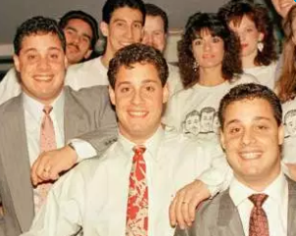
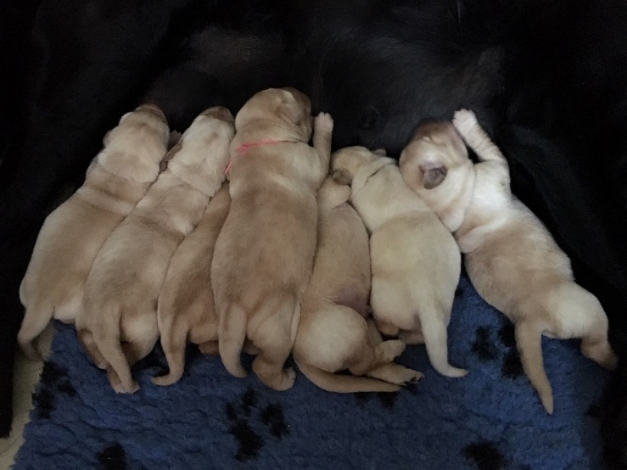
Solution?
Observation:
  All these characteristics (behaviour, joints) are heritable
  “you look like your family”

Slide 9
Solution?
Observation:
  All these characteristics (behaviour, joints) are heritable
  “you look like your family”
  Improve the parents

Slide 10
Solution?
Observation:
  All these characteristics (behaviour, joints) are heritable
  “you look like your family”
  Improve the parents Improved puppies
IT MAKES ONE THINK!

Slide 11
Purpose Dogs VZW

Slide 12
Purpose Dogs VZW
Non-profit organization
Founded in 2018
Breed our own dogs

Slide 13
Challenges
Reduction of the number of rejections
Avoid other disorders to pop up
Grow to meet the demand
Practically:
  Improved joints
  Better suited behaviourally
  Focus on genetic diversity

Slide 14
Challenges
Reduction of the number of rejections
Avoid other disorders to pop up
Grow to meet the demand
Practically:
  Improved joints
  Better suited behaviourally
  Focus on genetic diversity
Selection of part of the population
vs
Increase of the number of dogs in the program

Slide 15
Challenges
Reduction of the number of rejections
Avoid other disorders to pop up
Grow to meet the demand
Practically:
  Improved joints
  Better suited behaviourally
  Focus on genetic diversity

Slide 16
Why genetic diversity one of key features?
The cause of the high disease prevalence…

Slide 17
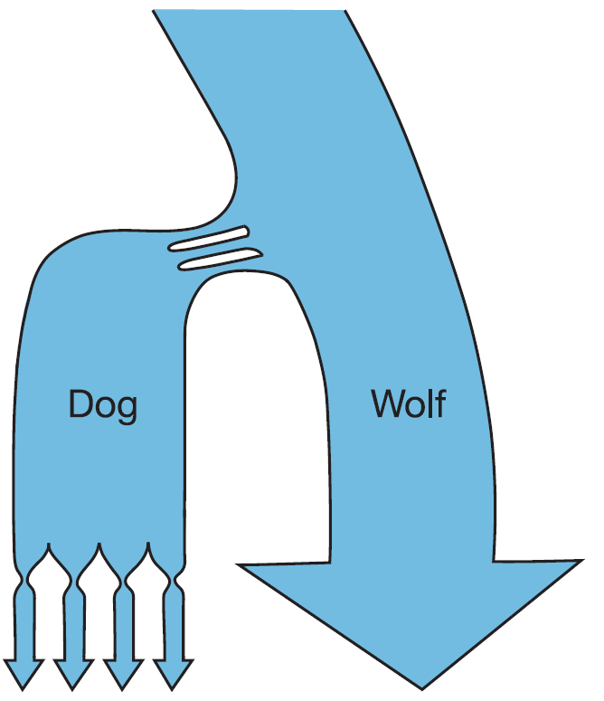
On the origin of the dog
Population “bottlenecks”
  Domestication
  Breed creation
1.
2.
Lindblad-Toh et al. (2005)
Notes:
The dog population went through two population bottlenecks. The first bottleneck was around 15,000–100,000 years ago when the dog was domesticated. A second population bottleneck was much more recent and involved the breed creation. A lot of breeds originated from a very limited number of animals.
Domesticatie: het tot huisdier maken

Slide 18
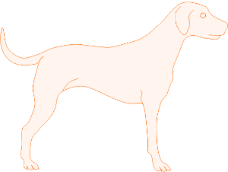
What are the consequences?
At the level of the dog

Slide 19
What are the consequences?
At the level of the dog

Slide 20
What are the consequences?
At the level of the dog
At the DNA level

Slide 21
What are the consequences?
At the DNA level

Slide 22



What are the consequences?
At the DNA level

Slide 23
What are the consequences?
At the DNA level
High diversity
So what?
Low diversity

Slide 24
Every dog/human carries genetic diseases
At the DNA level
Big part of the population carries the same mutation!
Population bottlenecks are responsible for the spreading of diseases

Slide 25
What has caused the high prevalence of these disorders?
Other examples with a similar effect:
  The “founder effect”
  The “popular sire effect”

Slide 26
Founder effect
E.g. a new breeding project: starts from a limited number of founding dogs

Slide 27
What has caused the high prevalence of these disorders?
Other examples with a similar effect:
  The “founder effect”
  The “popular sire effect”

Slide 28
Popular sire effect
The overuse of a certain breeder
This (male) animal contributes too much to the next generations
Spread of its disease-causing mutations

Slide 29
What has caused the high prevalence of these disorders?
Other examples with a similar effect:
  The “founder effect”
  The “popular sire effect”
  The spread of disease-causing mutations
But what about inbreeding?

Slide 30
Inbreeding
Definition:
“The mating of two genetically related individuals is called inbreeding”

Slide 31
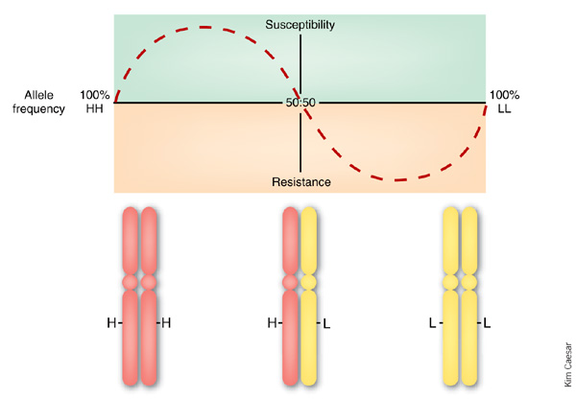
Inbreeding

Slide 32
Inbreeding
Definition:
“The mating of two genetically related individuals is called inbreeding”
Diseases become visible

Slide 33
What has caused the high prevalence of these disorders?
The combined effect of:
  Bottlenecks
  Founder effect
  Popular sire effect
  Inbreeding

Slide 34
What has caused the high prevalence of these disorders?
The combined effect of:
  Bottlenecks
  Founder effect
  Popular sire effect
  Inbreeding
Genetic diversity should ALWAYS be taken into account!
We have to learn from the past!

Slide 35
But how?

Slide 36
Practically
Size matters
Genetic diversity:
Focus on N_{e} = effective population size
Based on how you manage your population, how many animals are there genetically present in your breeding program?
≠ the number of animals you have

Slide 37
Effective population size N_{e}
What is a good N_{e}?
Cut-offs often reported:
  N_{e} = 100
  N_{e} = 50
  N_{e} = 25
Arbitrary, but the higher the better

Slide 38

Effective population size N_{e}
Various calculation methods:
Link with number of bitches and studs:
Practically: a population of 1000 dogs =>
1) one stud and 999 bitches Ne = 3.996
2) 500 studs and 500 bitches Ne = 1000
$$N_{e}= \frac{4n♂n♀}{n♂+n♀}$$

Slide 39
Effective population size N_{e}
Various calculation methods:
Link with number of bitches and studs:
Practically: a population of 1000 dogs =>
1) one stud and 999 bitches Ne = 3.996 ✗
2) 500 studs and 500 bitches Ne = 1000 ✓
$$N_{e}= \frac{4n♂n♀}{n♂+n♀}$$

Slide 40
Effective population size N_{e}
Various calculation methods:
Link with number of bitches and studs:
Advice 1: balance the number of bitches and studs
$$N_{e}= \frac{4n♂n♀}{n♂+n♀}$$

Slide 41
Effective population size N_{e}
Various calculation methods:
Link with number of bitches and studs:
Advice 1: balance the number of bitches and studs
$$N_{e}= \frac{4n♂n♀}{n♂+n♀}$$
Semen collection and continue training:
No loss of time invested by trainers
No loss of valuable genetic material

Slide 42
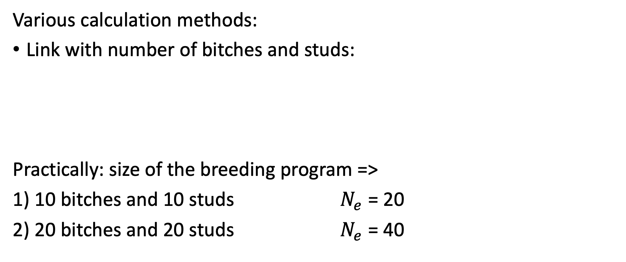
Effective population size N_{e}
Various calculation methods:
Link with number of bitches and studs:
Practically: size of the breeding program =>
1) 10 bitches and 10 studs $N_{e}$ = 20
2) 20 bitches and 20 studs $N_{e}$ = 40
$$N_{e}= \frac{4n♂n♀}{n♂+n♀}$$

Slide 43
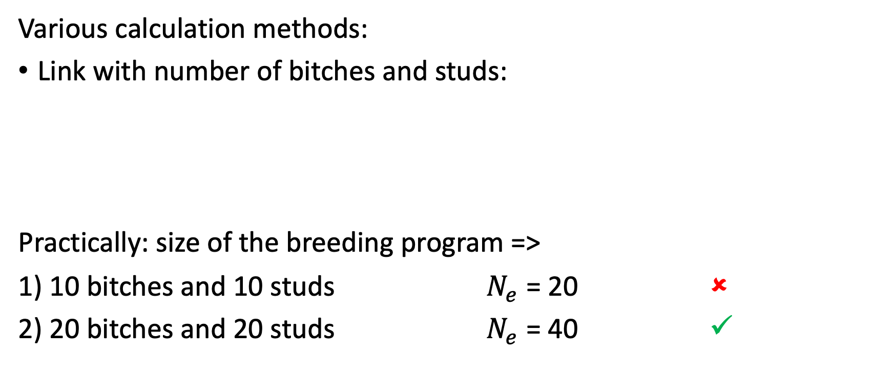
Effective population size N_{e}
Various calculation methods:
Link with number of bitches and studs:
Practically: size of the breeding program =>
1) 10 bitches and 10 studs $N_{e}$ = 20 ✗
2) 20 bitches and 20 studs $N_{e}$ = 40 ✓
$$N_{e}= \frac{4n♂n♀}{n♂+n♀}$$

Slide 44
Effective population size N_{e}
Various calculation methods:
Link with number of bitches and studs:
Advice 1: balance the number of bitches and studs
Advice 2: increase the size of the breeding program
$$N_{e}= \frac{4n♂n♀}{n♂+n♀}$$

Slide 45
Purpose Dogs
Breeding project for 1 association

Slide 46
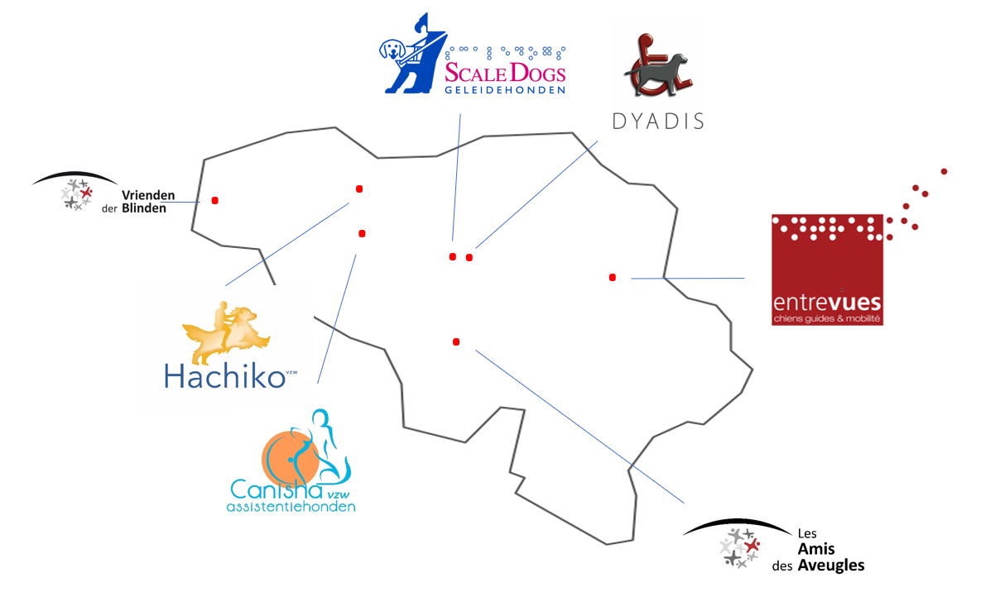
Purpose Dogs
Breeding project for 1 association => Breeding project on a national scale

Slide 47
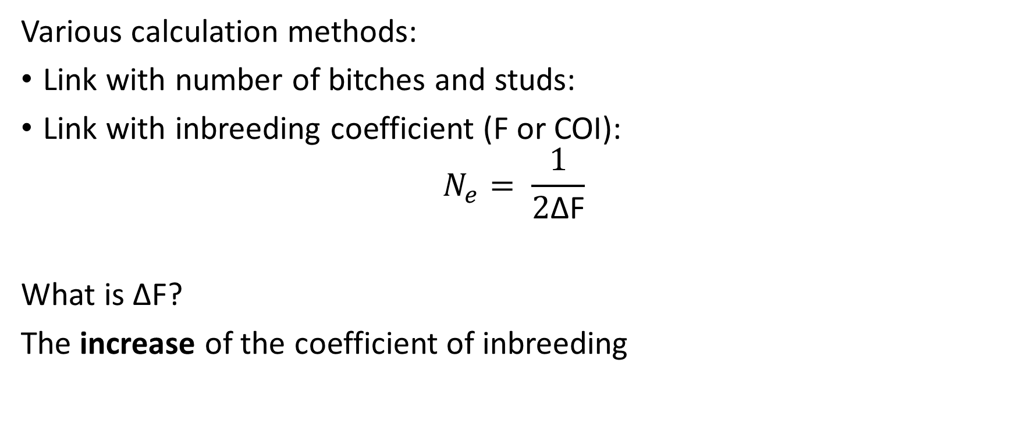
Effective population size N_{e}
Various calculation methods:
Link with number of bitches and studs:
Link with inbreeding coefficient (F or COI):
$$N_{e}= \frac{1}{2\text{Δ}\text{F}}$$
What is $\text{Δ}\text{F}$?
The increase of the coefficient of inbreeding

Slide 48
Calculation of coefficient of inbreeding
Search for common ancestor(s)
Practically:
# Ancestors = 2^{n} with n the number of generations
e.g. 2 parents => 4 grandparents => 8 great-grandparents => 16 … => 32 … => 10th generation: 1024 => 15th generation: > 30 000
Finding a common ancestor ≠ horrible
What is important: is the amount of inbreeding/magnitude of the inbreeding coefficient

Slide 49
coefficient of inbreeding
Pedigree completeness = key

Slide 50
 |  | Phil | Tennessee
 |  |  | Brandy
 | Dusty | O’Joint | Jolt
 |  |  | Elvira
 |  | Snuffy | Scotch
 |  |  | Caledonia
Hajk | Zero | Vecheyenne | Snickers
 |  |  | Quoia
Hagendas | Foxmulder | Dust | Dusty
 |  |  | Vecheyenne
 |  | Belle | Timon
 |  |  | Vecheyenne
 | Eden | Shadow | Timon
 |  |  | Ruby
 |  | Vecheyenne | Snickers
 |  |  | Quoia
COI = 0
X

Slide 51
 |  | Phil | Tennessee
 |  |  | Brandy
 | Dusty | O’Joint | Jolt
 |  |  | Elvira
 |  | Snuffy | Scotch
 |  |  | Caledonia
Hajk | Zero | Vecheyenne | Snickers
 |  |  | Quoia
Hagendas | Foxmulder | Dust | Dusty
 |  |  | Vecheyenne
 |  | Belle | Timon
 |  |  | Vecheyenne
 | Eden | Shadow | Timon
 |  |  | Ruby
 |  | Vecheyenne | Snickers
 |  |  | Quoia
COI = 0
X

Slide 52
 |  | Phil | Tennessee
 |  |  | Brandy
 | Dusty | O’Joint | Jolt
 |  |  | Elvira
 |  | Snuffy | Scotch
 |  |  | Caledonia
Hajk | Zero | Vecheyenne | Snickers
 |  |  | Quoia
Hagendas | Foxmulder | Dust | Dusty
 |  |  | Vecheyenne
 |  | Belle | Timon
 |  |  | Vecheyenne
 | Eden | Shadow | Timon
 |  |  | Ruby
 |  | Vecheyenne | Snickers
 |  |  | Quoia
COI = 0 => 0.03
X

Slide 53
 |  | Phil | Tennessee
 |  |  | Brandy
 | Dusty | O’Joint | Jolt
 |  |  | Elvira
 |  | Snuffy | Scotch
 |  |  | Caledonia
Hajk | Zero | Vecheyenne | Snickers
 |  |  | Quoia
Hagendas | Foxmulder | Dust | Dusty
 |  |  | Vecheyenne
 |  | Belle | Timon
 |  |  | Vecheyenne
 | Eden | Shadow | Timon
 |  |  | Ruby
 |  | Vecheyenne | Snickers
 |  |  | Quoia
COI = 0 => 0.03 => …
Snickers
X
…

Slide 54
 |  | Phil | Tennessee
 |  |  | Brandy
 | Dusty | O’Joint | Jolt
 |  |  | Elvira
 |  | Snuffy | Scotch
 |  |  | Caledonia
Hajk | Zero | Vecheyenne | Snickers
 |  |  | Quoia
Hagendas | Foxmulder | Dust | Dusty
 |  |  | Vecheyenne
 |  | Belle | Timon
 |  |  | Vecheyenne
 | Eden | Shadow | Timon
 |  |  | Ruby
 |  | Vecheyenne | Snickers
 |  |  | Quoia
COI = 0 => 0.03 => 0.1956
Snickers
X
…

Slide 55
coefficient of inbreeding
Pedigree completeness = key
Increase in number of ancestors known:
More correct estimates!
Calculation becomes more difficult
Use software

Slide 56
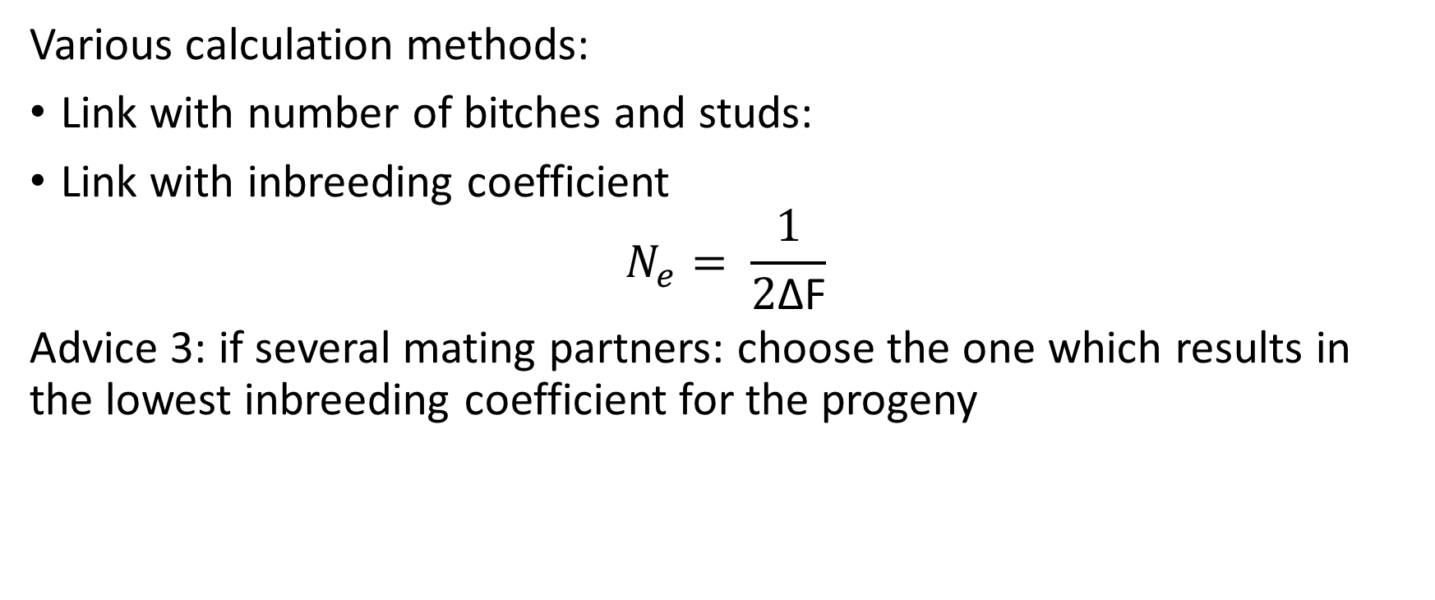
Effective population size N_{e}
Various calculation methods:
Link with number of bitches and studs:
Link with inbreeding coefficient
$$N_{e}= \frac{1}{2\text{Δ}\text{F}}$$
Advice 3: if several mating partners: choose the one which results in the lowest inbreeding coefficient for the progeny

Slide 57
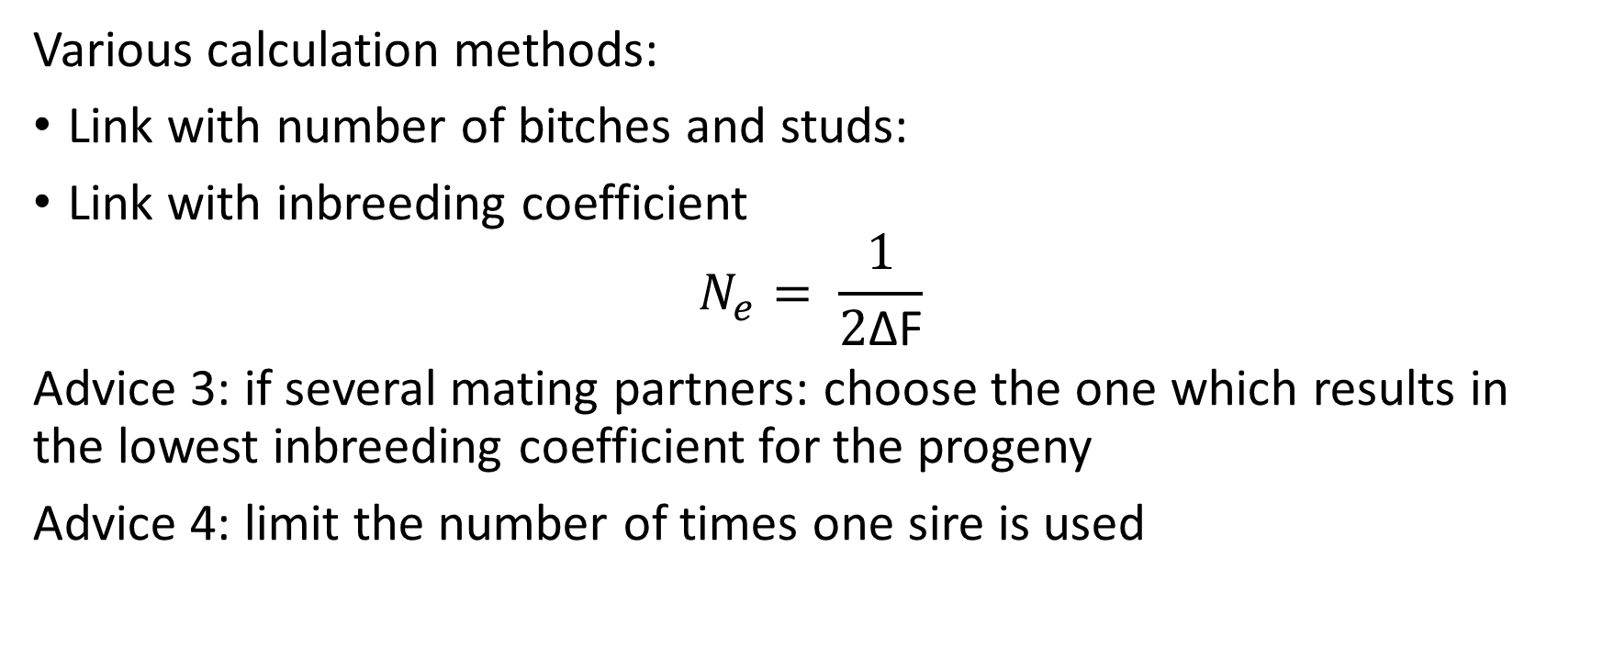
Effective population size N_{e}
Various calculation methods:
Link with number of bitches and studs:
Link with inbreeding coefficient
$$N_{e}= \frac{1}{2\text{Δ}\text{F}}$$
Advice 3: if several mating partners: choose the one which results in the lowest inbreeding coefficient for the progeny
Advice 4: limit the number of times one sire is used

Slide 58
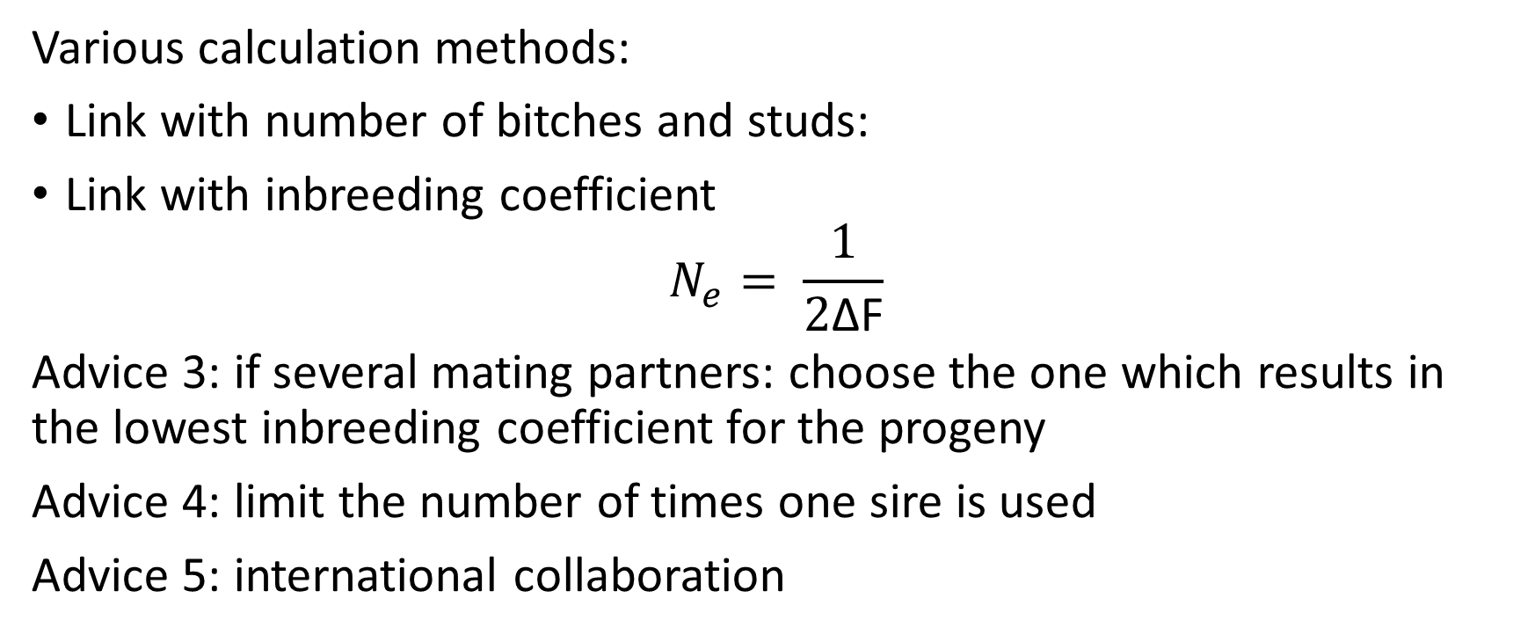
Effective population size N_{e}
Various calculation methods:
Link with number of bitches and studs:
Link with inbreeding coefficient
$$N_{e}= \frac{1}{2\text{Δ}\text{F}}$$
Advice 3: if several mating partners: choose the one which results in the lowest inbreeding coefficient for the progeny
Advice 4: limit the number of times one sire is used
Advice 5: international collaboration

Slide 59
International collaboration
Pro:
“new” genetic material => genetic diversity
Con:
Potentially unpredictable results
Check whether you have the same screening tools/standards/…
Balance input!

Slide 60
Results

Slide 61
Results
Diversity:
  4 bitches
  4 studs
N_{e} = 8

Slide 62

Results
Diversity:
  4 bitches => 11 bitches
  4 studs => 10 studs
  N_{e} (based on $\text{Δ}$F) =
Succes%:
    Not bred by Purpose Dogs: 38 – 50%
    Bred by Purpose Dogs: 63 – 71%
N_{e} = 8 => N_{e} ≈ 21
Overall: + 21%

Slide 63
Conclusion
The cause of widespread genetic diseases
Not necessarily easy to understand/nor calculate
Essential to take into account
Improved phenotypes AND high diversity => both possible!

Slide 64



Prof. dr. Bart Broeckx
Department of Veterinary and Biosciences laboratory of animal genetics
E bart.broeckx@ugent.be www.ugent.be/di/di07
Ghent University
@ugent
Ghent University

Slide 65


Slide 66
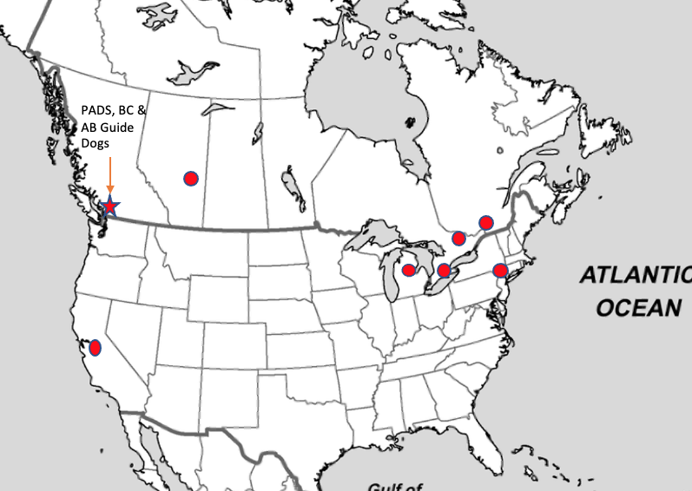
PADS
Breeding program since 2001
Challenges:
How to prioritize diversity?
Geographically isolated
Most assistance dog schools small, limited cooperation
Advantages:
Seeded with puppies & stud services by established schools
Formation of ABC
Trust of our Training department & management

Slide 67
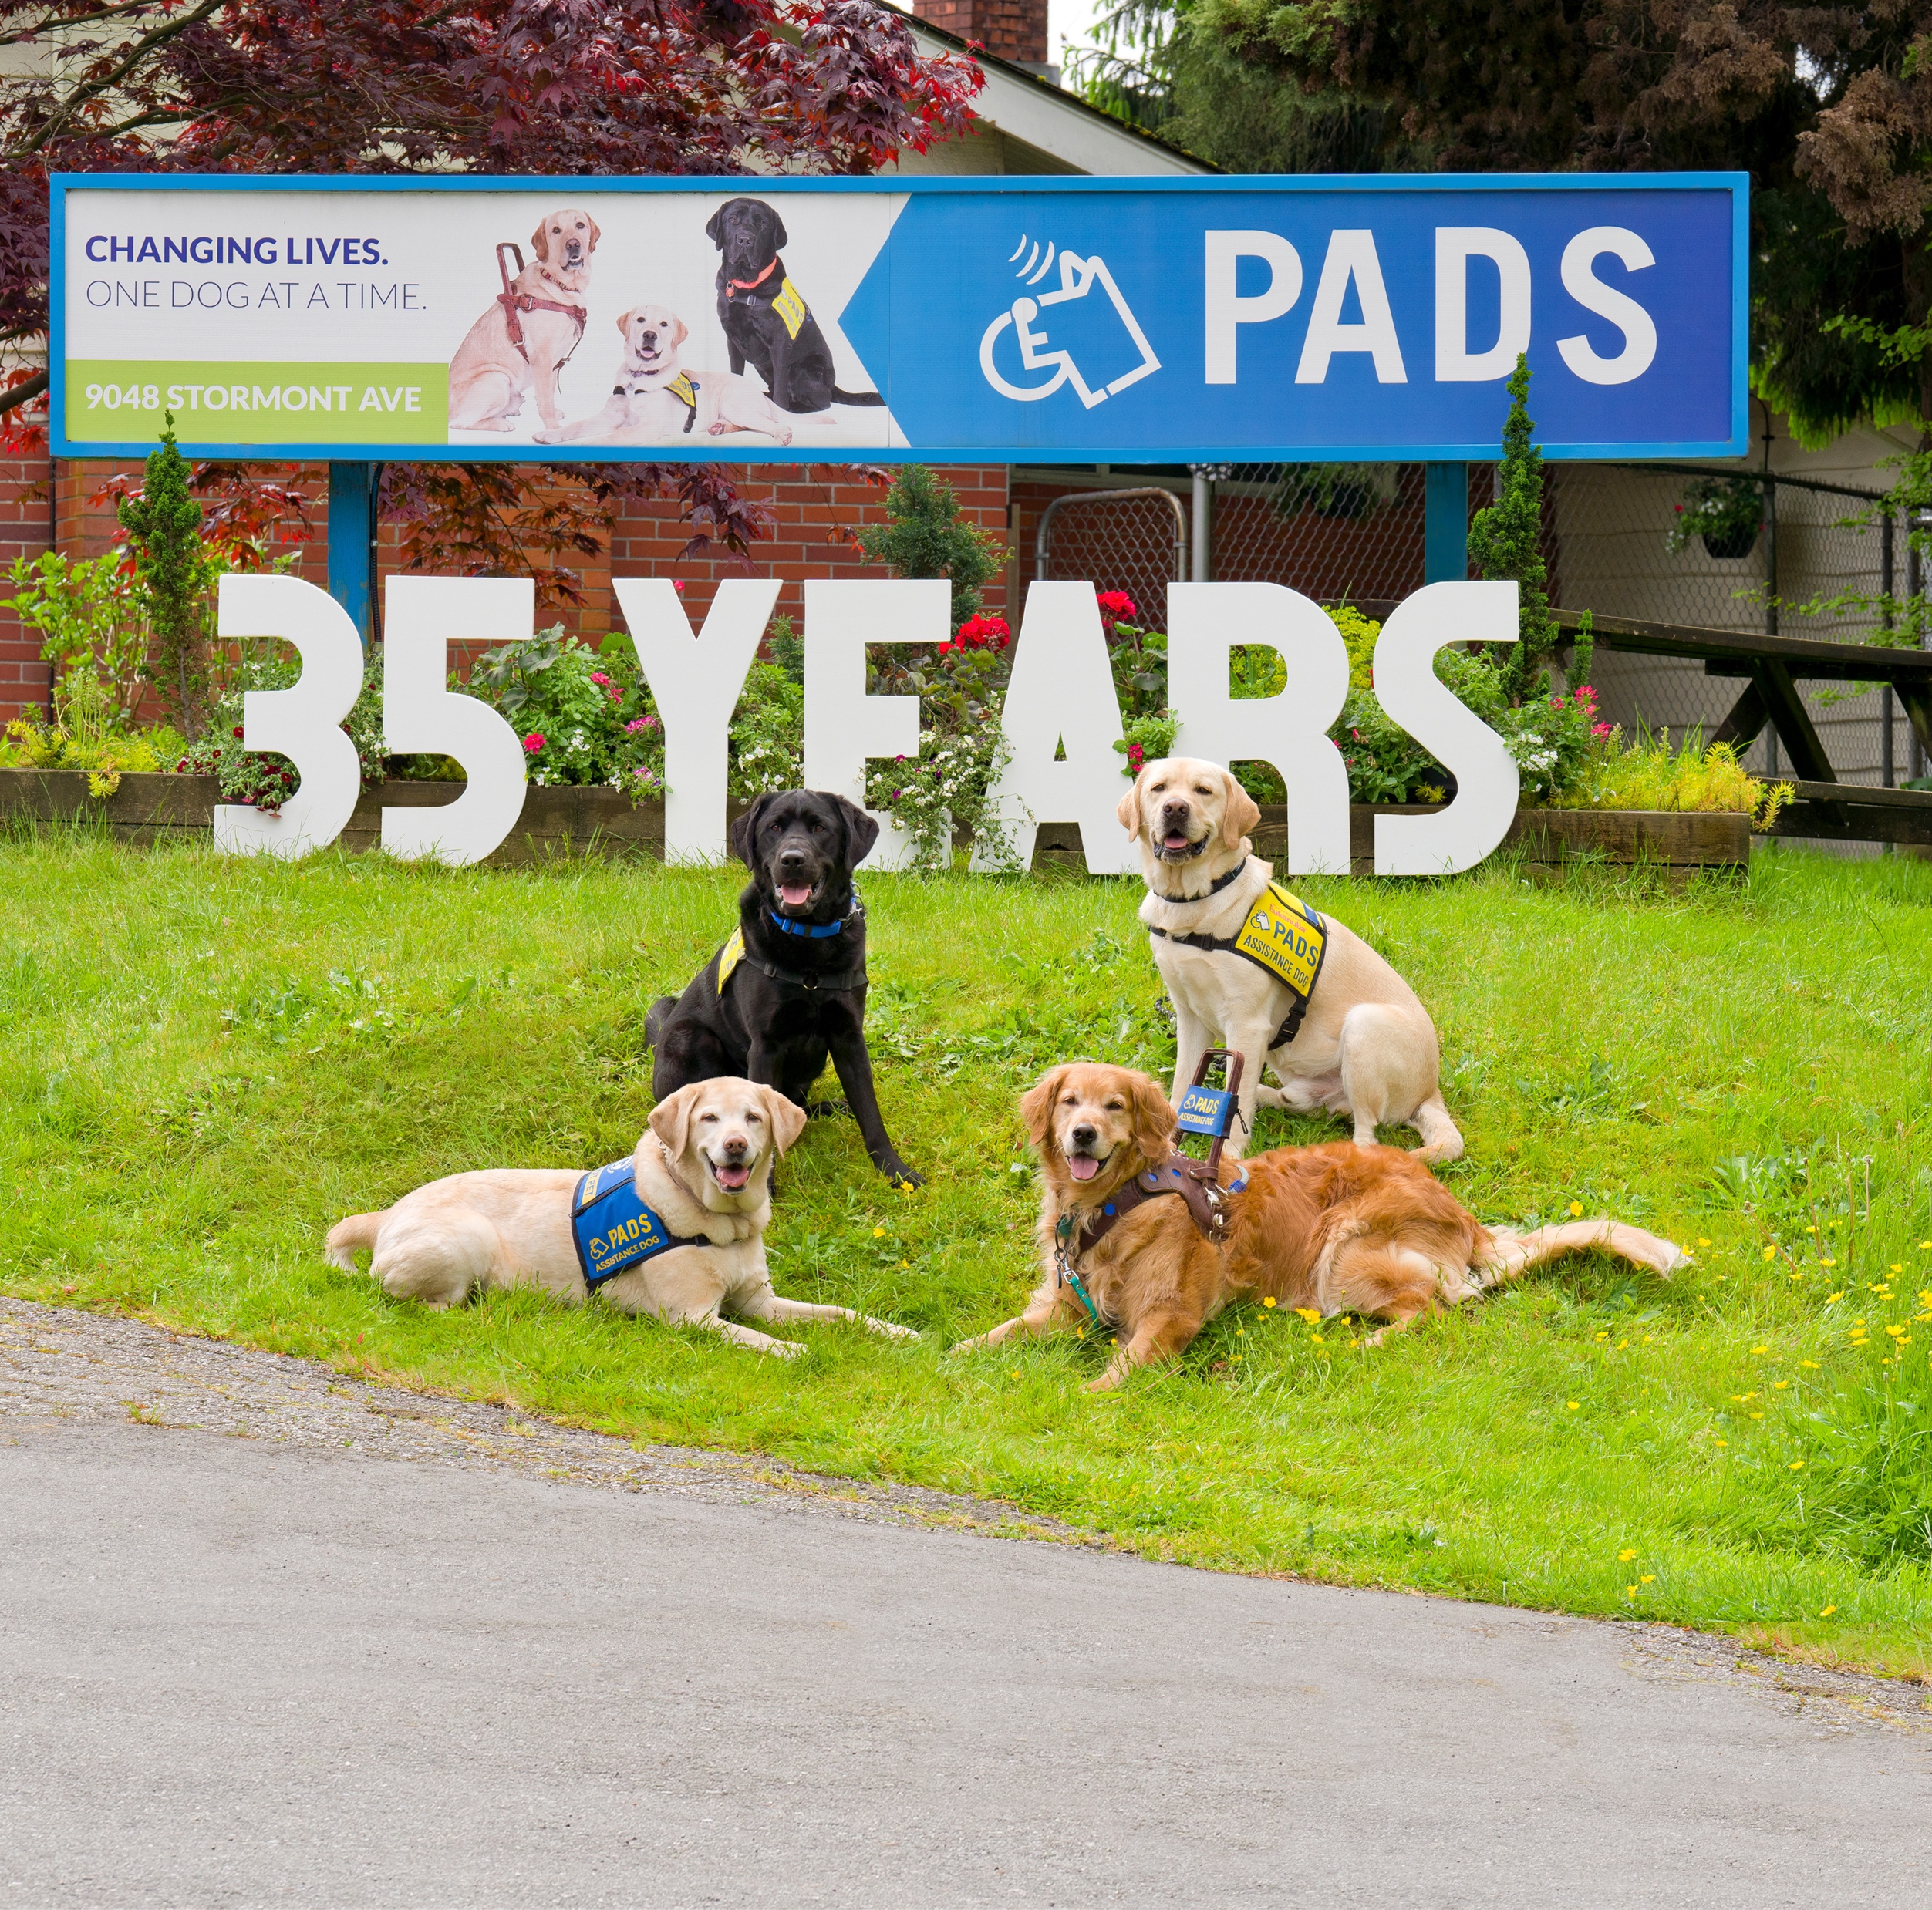
PADS
Current Composition:
Female breeders: 17
Male breeders: 5
Use of outside males/yr: avg 6
Breeder Selection Targets/Yr:
Females: 6
Males: 1-2

Slide 68
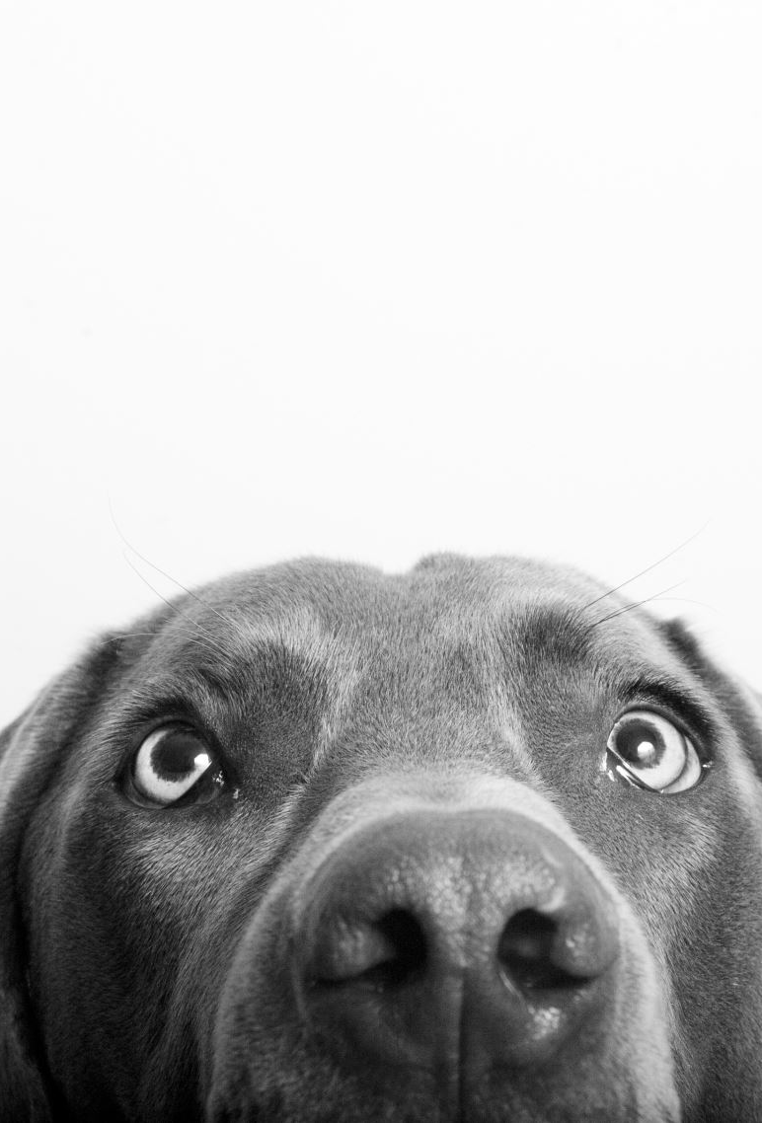
Approaches to Diversity – Stock Acquisition
Not assistance/guide dog bred
  Traits looking for?
  Consistency?
  More readily available
  Risk of less success
  Turning over generations quickly
  What you breed them to
Purpose assistance/guide dog bred
  Traits looking for
  Consistency
  Less readily available
  Odds of greater success
Diversity not just about #’s – need quality
Notes:
As Bart mentioned, the genetic health of your breeding program is about the number of quality dogs you have access to
Privately bred: More readily available – males & females (males puppy or stud service, females puppies, adult lease less available)
What you breed them to: We all have to start somewhere. Outside bred females bred to purpose bred males increase your guide/assistance dog genes by 50% each generation. Select better daughter, breed her to a purpose-bred male & progeny roughly 75% purpose bred.
Purpose bred dogs: Less readily available: adult males (stud service) > adult females; limit to number of breeding prospect puppies to go around from a couple big schools

Slide 69
Approaches to Diversity –
Access to More (Quality) Stock
Puppy acquisitions
Stud services (fresh, frozen)
Multisire litters
Partnerships with individual schools
Cooperatives
Commercial breeders of guide/assistance type pups
Notes:
Partnerships with other individual schools:
Pup exchanges
Split litters
Semen exchanges
Stud rotations
Combining breeding stock into 1 population
Partnerships offer some insurance against genetic loss – some of our lines that we were not able to continue with other schools were, and we’re able to weave them back in using descendants at other schools.
Cooperatives: Purpose Dogs, IBC, CESECAH
Commercial breeders: Career Dogs Australia

Slide 70

Cooperatives: International Breeding Cooperative (IBC)
68 member organizations across 3 regions/continents, 9 countries
Large breeding population housed across Host member schools
Increased access to quality diverse stock
Common measurements & data storage platform
Notes:
ABC – North America – 2013 (52 members: 7 General, 42 Host, 3 Foundation)
EBC – Europe – 2021 (12 members: 6 General, 6 Host)
OBC - Oceania – 2021 (4 members: 4 Host)
Diversity infused by bringing new populations of dogs in, ability to keep larger number of breeders, access to non-ABC studs
Relationships between a large network of schools – more breeding options outside of IBC as well
For small schools without a breeding program – access to quality working prospects
Has allowed many schools to start breeding programs with purpose-bred stock

Slide 71
Approaches to Diversity – What To Keep/Cut
Diversity aside, keeping dogs that meet minimum standards
The risk of cutting Carriers
Where can you make tradeoffs in favour of diversity?
Including diversity in your selection criteria
Notes:
Minimum standards: Make sure selection criteria under genetic influence

Slide 72
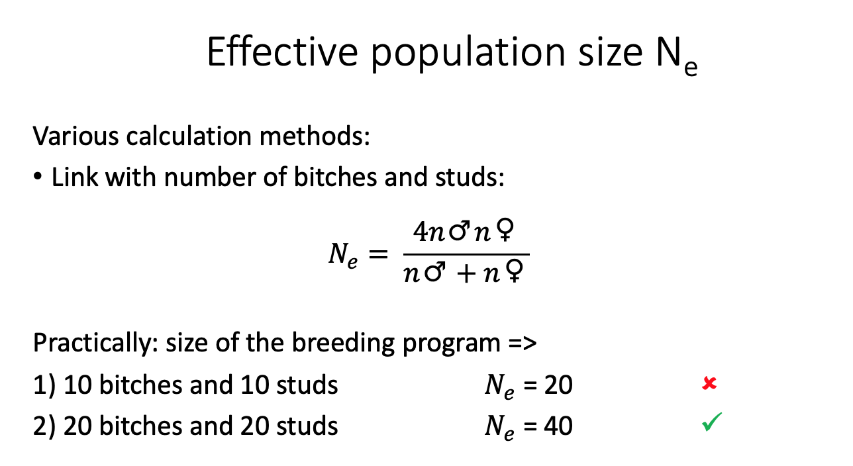
Produce & Keep More Breeders
Few litters = few replacement breeders.
Few breeders = less diversity
Notes:
This is where multisire litters can really help inject some diversity
Where cooperation and sharing puppies across litters can help

Slide 73
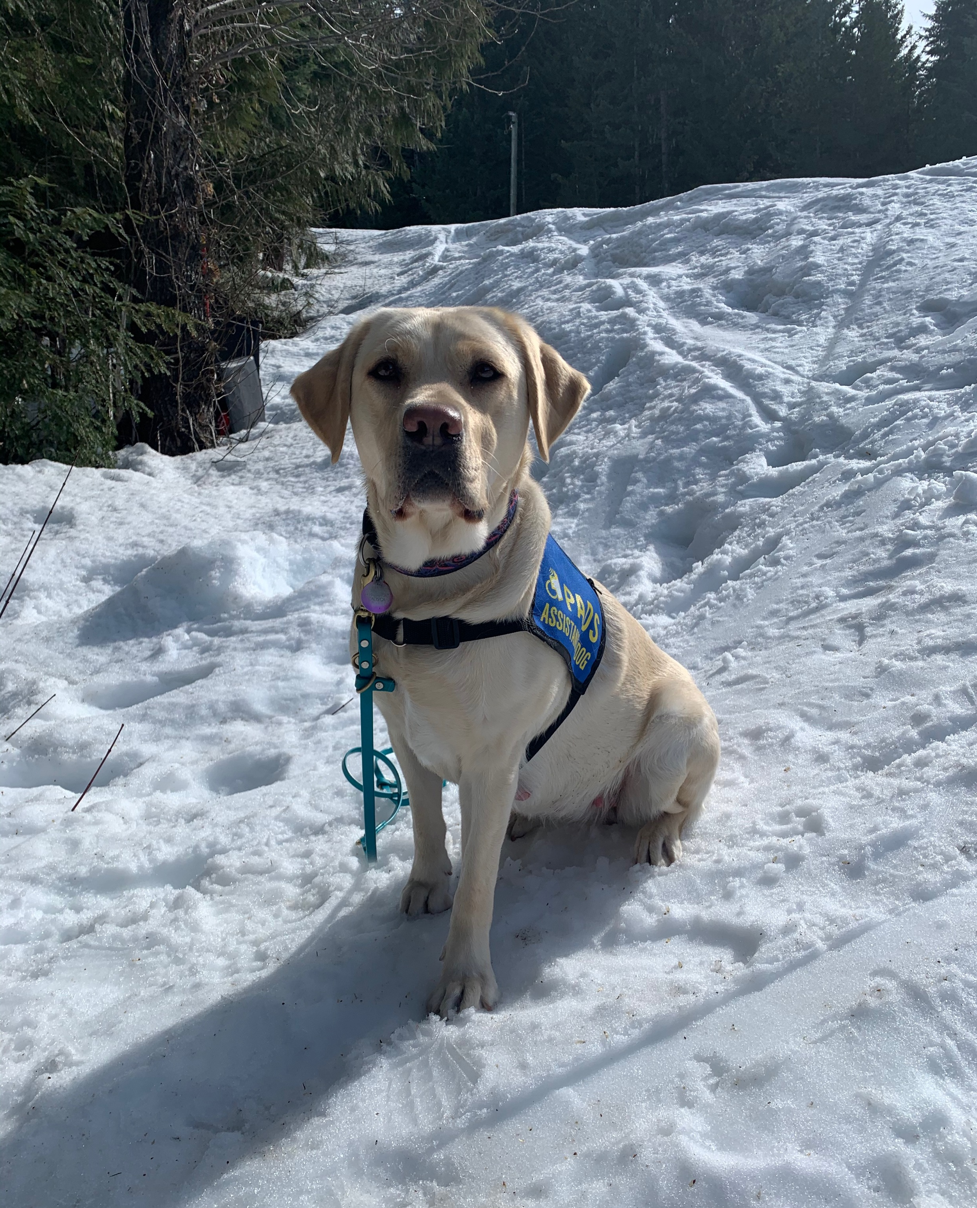
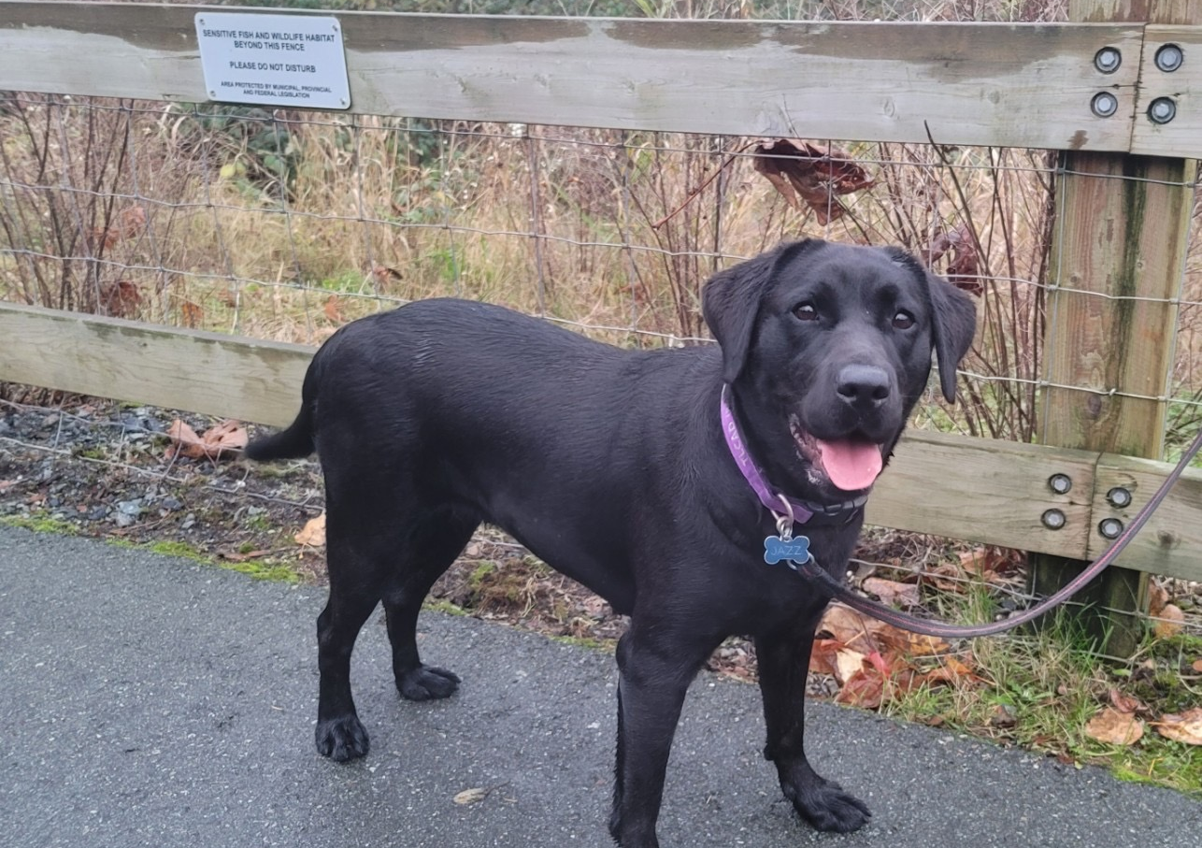
Options to Increase Diversity - Females
  Breed each female fewer times over normal career timespan
  Breed per normal schedule, distribute excess
  Turn over generations quickly & return to training
  Loan/Exchange with other organizations
Notes:
Scenario 1: More females in breeding – expense, loss to training
Potential negative effects on genetic progress (long time to turn over generations)
Ability to assess prior success before subsequent breedings
Scenario 2: Distribute via donations, trades, sale; puppies back?
Diversity – your own & in puppies back
Seeding other schools
More expensive, loss to training
Less genetic progress than scenario 3
Scenario 3:
More females in breeding - expense of clearances, but lower loss to training
More genetic selection pressure
Possible loss to production – dogs bred for diversity, but parents of good working prospects retired early

Slide 74
Options to Increase Diversity – Males
Career studs
Short term studs or
Freeze & neuter
Other schools’ studs
Stud Services to other schools
Notes:
Career Studs:
Our studs see the most use in the first year of their breeding career; effects of many studs negligible after this & cost to program (financial, volunteer housing). However if not able to freeze semen, may have no option but to hold back high value studs.
Use each stud equally
Attempt to select equal offspring from each stud
Potential loss of diversity if only keep 1 offspring for breeding
Limit impact of each breeder
For high success studs, consider ”production only” later breeding career
Short-term studs:
Ability to use a stud who doesn’t tick all the boxes as a career stud (eg. Carrier, lower genetic diversity)
Dual career – both offspring & working career
Freeze and neuter (before even through clearances – right into training without a delay)
Other schools’ studs:
Short term exchanges
Live cover or fresh-chilled semen – increases the size of your stud dog stable
Frozen semen on proven studs – able to bring in the traits you need
Offering stud services to other schools:
When we make studs available, they tend to bring back at least a litter’s worth of pups for us in stud fee pups; each one offers up to 50% new genes as a potential breeder

Slide 75
Semen Banking – Scenarios & Considerations
Training needs good dogs
Advantages of banking semen and returning to training:
Balances diversity & placement needs
  Top males can be used for both breeding & placed with a client
  More studs from one litter can be used without impacting Training’s production – increases diversity (# genes for each parent represented)
  Limits your use of stud
Diversity “insurance” to fall back on
Impacts on placement success/behaviour?
Notes:
Impacts: Purpose Dogs, PADS, SEGD & GEB data

Slide 76
Semen Banking – Other Impacts on Diversity
Ability to freeze semen for later use on short-term exchange studs
Ability to assess production & use stud further
Acquiring semen from proven studs with EBVs from other schools
Options for hard-to-pair females (low genetic diversity, Carrier statuses or EBVs, shipping disruptions) – dip into the tank
Bring back lost diversity

Slide 77
Barriers to Diversity
Borders
  Regulations
  Quarantines
  Physical barriers
Shipping
  Shipping companies
  Customs
  Holidays
Disruptions
  COVID
  Civil conflict / War
  Weather
Further reasons to have frozen semen, partnerships with other local schools

Slide 78
Tradeoffs to Diversity
Bringing in new stock, potential for less consistency in early generations – different selection criteria & preferences between organizations
Potential to introduce new “problem” genes, but at lower frequency
Notes:
New stock – effects of consistency less when bringing in puppies & assessing them at adulthood as potential breeders
IWDR will help minimize this or predict what genes getting if colony getting dogs from collects all phenotypes- Can assess possible outside germplasm mates on same criteria to have a better idea of how likely that dog will produce the desired traits

Slide 79

Thank you!
Jackie Clark
Breeding and Puppy-Raising Manager
Pacific Assistance Dogs Society (PADS)
E-mail: jackie@pads.ca

