Slide 1
Cardiac Diseases
Kevin Conrad, DVM, CCRP

Slide 2
Cardiac Diseases
Heart disease… #1 disease for humans in the United States
Due to life style, poor diets, lack of exercise, high blood pressure
Heart disease makes up 11% in canines…most acquired
Congenital diseases make up only 5% of this population.
By selecting dogs that do not exhibit these problems as breeders, You impact this population more than anyone else!

Slide 3
Anatomy

Slide 4
Common Cardiac Diseases
#1 Atrioventricular Valve disease (Mitral valve dysplasia) small breeds: Cavalier King Charles, Toy Poodles, Schnauzers, Lhasa Apso, Yorkshire Terriers, etc.
#2 Dilated Cardiomyopathy larger breeds: German Shepherds, Dobermans, Boxers, Great Danes Causes include: Hypothyroidism, infectious endocarditis, age
#3 Congestive Heart Failure lots of causes…congenital diseases include SAS, PDA, VSD, or Tetralogy of Fallot

Slide 5
Symptoms
Coughing
Fatigue and weakness
Dyspnea (difficult breathing)
Syncope (fainting)
Rapid or Irregular heart rhythm
Distended abdomen

Slide 6
Diagnosis
Physical exam and clinical signs
Cardiac auscultation
ECG
Echocardiogram, gold standard
Genetic testing, NT-proBNP (Embark)

Slide 7
Treatment
Diet
Diet adjustment, low salt, low fat diets
Exercise
Limit exercise and try to prevent strenuous work
Diuretics
Decrease Preload… furosemide (Lasix) or spironolactone
Vasodilator
Decrease Afterload… ACE inhibitors (enalapril, benazepril), Norvasc (amlodipine), hydralazine
Positive Inotropes
Increase force… pimobenden, digitalis

Slide 8
Heritable Cardiac Conditions
Patent Ductus Arteriosus
Pulmonic Stenosis
Subaortic Stenosis
Tricuspid Valve Dysplasia

Slide 9
Patent Ductus Arteriosus
Most common Congenital disease
German shepherds (Maltese, Poodles, Pomeranians, Keeshound, Bichon Friese, Chihuahua)
Large passage between the Aorta and Pulmonary Artery didn’t close properly
More common in females, 50% mortality by 1 year of age
Treatment is Surgical ligation or Transvenous catheterizations

Slide 10
Patent Ductus Arteriosus
Anatomy
Transvenous catheter

Slide 11
Pulmonic Stenosis
Second most common Congenital Disease
Labrador Retriever (Boxer, Newfoundland, West Highland Terriers, Chihuas, Beagles, English Bulldogs)
A defect of the pulmonic valve in the right ventricle increasing resistance of blood flow to the lungs
Leads to right sided congestive heart Failure and poor oxygenation of the blood.
Echocardiogram is the gold standard
Treatment: Meds for CHF, Severe cases benefit from Balloon Valvoplasty

Slide 12
Pulmonary Stenosis
Anatomy
Echocardiogram of stenosis

Slide 13
Subaortic Stenosis
Golden Retrievers and German Shepherds
(Newfoundland, Boxer, Rottweiler, E. Bulldog, Great Dane, German Shorthair Pointer)
Buildup of tissue below the aortic valve, obstructs flow out to the rest of the body… congestive heart failure
Diagnosis: Echocardiogram; murmurs may develop later New genetic test from N.C. State studying Newfoundlands
Prognosis is normal to sudden death. Tends to progress rapidly early in disease
Manage disease with antibiotics, limited exercise, and Beta blockers (atenolol, acebutylol, carvediol)

Slide 14
Subaortic Stenosis

Slide 15
Tricuspid Valve Dysplasia
Uncommon Congenital disease (7%) but Labrador Retrievers make up 25% (also German Shepherds, Irish Setters, Great Danes)
Malformation of the valves of the right side of the heart causing dilation of the heart, poor circulation, and a distended abdomen.
Diagnosis: may be able to auscult a murmur, echocardiogram is the gold standard
Treatment is meds for congestive heart failure. Many are normal, but if severe, progression happens in first couple years.

Slide 16
Tricuspid Valve Dysplasia

Slide 17
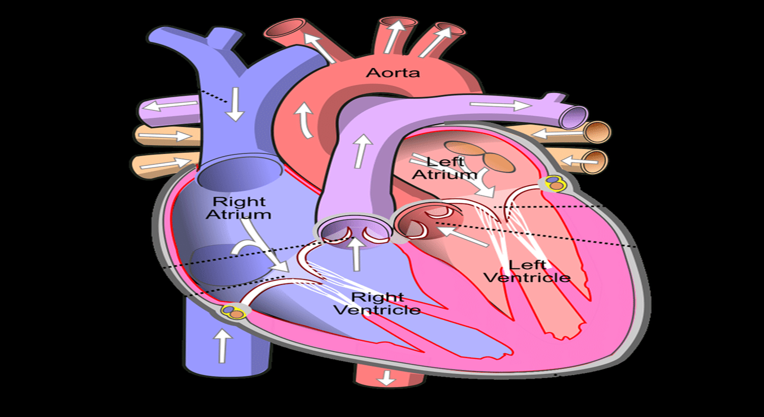
Cardiac Diseases
Golden Retriever: Subaortic Stenosis
Labrador Retriever: Pulmonic Stenosis
Tricuspid Valve Dysplasia
German Shepherd: PDA
Pulmonic Stenosis
Subaortic Stenosis
Tricuspid Valve Dysplasia

Slide 18
Cardiac Diseases
Any Questions?

