Slide 1
Behavioral Scoring in
Puppy Raising
Walk & Talks
Helen West
Canine Behavior Specialist - Guiding Eyes for the Blind
BCL Consultant - International Working Dog Registry
hwest@guidingeyes.org, helen.west@iwdr.org

Slide 2
Agenda
What is a walk and talk and what do they look like?
Who does them and why are they helpful?
When and where should you conduct them?

Slide 3
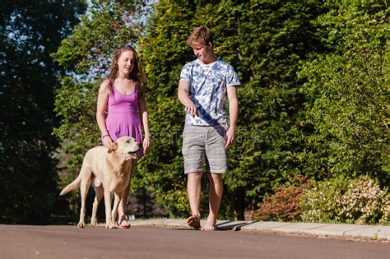
What is a
Walk & Talk and what do they look like?
One on one meeting in a real life situation.
Not a standardized test
Observe the dog and the raiser in real life situation
More flexible because of variety of where puppy raisers live
Held at key points during the puppy’s development
Lasts about 30 minutes to an hour
It should incorporate experiences to enable the supervisor to score a Behavior Checklist

Slide 4
Who does Walk and Talks and Why are they helpful?
Puppy Supervisor
Experienced BCL scorer

Slide 5
Why conduct Walk and Talks
Benefits for Raiser
One on one time with puppy supervisor
Ability to ask questions, or for help with challenges
Learning opportunity outside classroom setting to improve skills
Ability to see puppy supervisor work with their pup
Benefits for Puppy Supervisor
See dog and raiser outside of the classroom
One on one time with raiser
Help raiser understand dog body language
Study influence of raiser on dog

Slide 6
Why conduct Walk and Talks
Benefits for The Dog
Ability to work with a more experienced handler, get clear communication and support.
Opportunity for dog to work through any behaviors they struggle with
Benefits for The Organization
Regular Behavior Checklists showing dog’s progress.
Provide more data for EBVs or general overview of the Program
Opportunities to improve the skills of the raiser, and potentially increase the dog’s chance of success
Opportunity to review the teaching styles and skills of the puppy supervisor

Slide 7
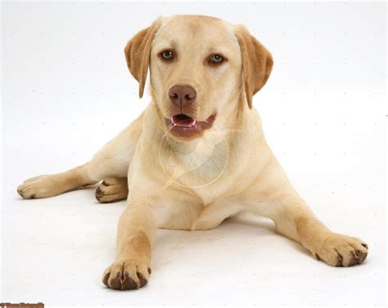
When and where should you conduct walk and talks?
4, 8, 13 months ideally or 2 weeks either side of those ages
4 months gives early picture of effect of raising since foundational BCL at 8 weeks
8 months prior to or in the beginning of adolescence
13 months many times after a heat, more mature, post adolescence, final look before training

Slide 8
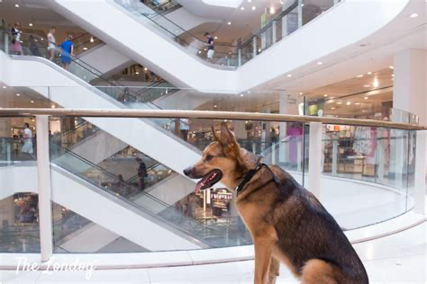
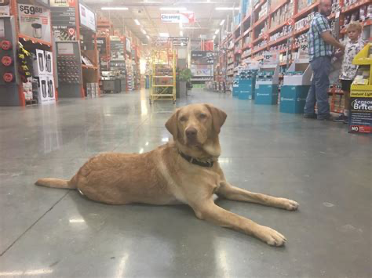
Where can they be done?
Somewhere appropriate for the age of the pup that gives opportunities to score a behavior checklist
Mall, town center, strip mall, Large store or shops, hardware store
Somewhere appropriate for what the pup can handle
You may have to pare down the session due to the capabilities of the pup
Indoors or outdoors
Either can be used but both is ideal

Slide 9
Other considerations
Before the Walk and talk, ask raiser to fill out a Raiser Survey
raiser can list challenges or questions they are having
raiser can give feedback on their experience as a raiser with your organization
collects any other information you would like prior to the W&T
During the W&T ask raiser specific questions in relation to the BCL items
After the W&T provide written feedback to the raiser about what they are doing well and 2 to 3 areas to work on

Slide 10
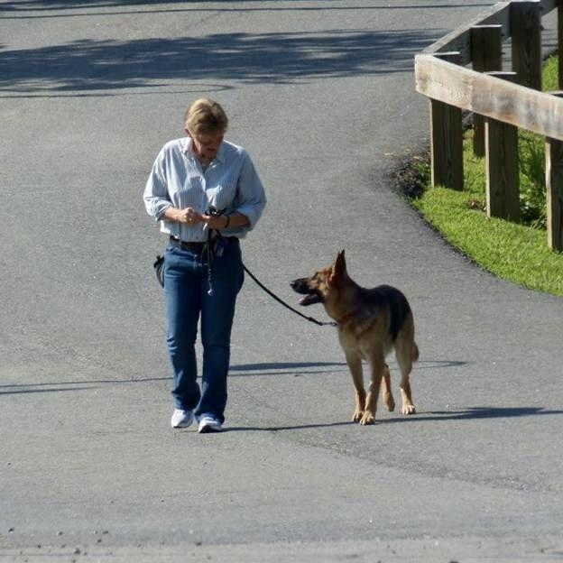
What we have learned over the years?
Relationship matters, especially;
Clear communication, use of verbal praise and touch for connection
Importance of repeated positive experiences with time to process things, to build confidence and time to resolve stress after events
Stress can impact both physical and psychological development so health and behavior, especially when it is chronic.
Teaching raisers to recognize stress and giving them the tools to help the dogs to manage this.
Can provide a lot more data and insight to your program
Focus on breeding and genetics for highly heritable traits like Body and Harness sensitivity.
Focus on the environmental impact on the puppy during the raising period for less heritable traits like
Distraction
House manners
Environmental soundness, noise, novel objects etc

Slide 11
Any Questions?

